Slide 1
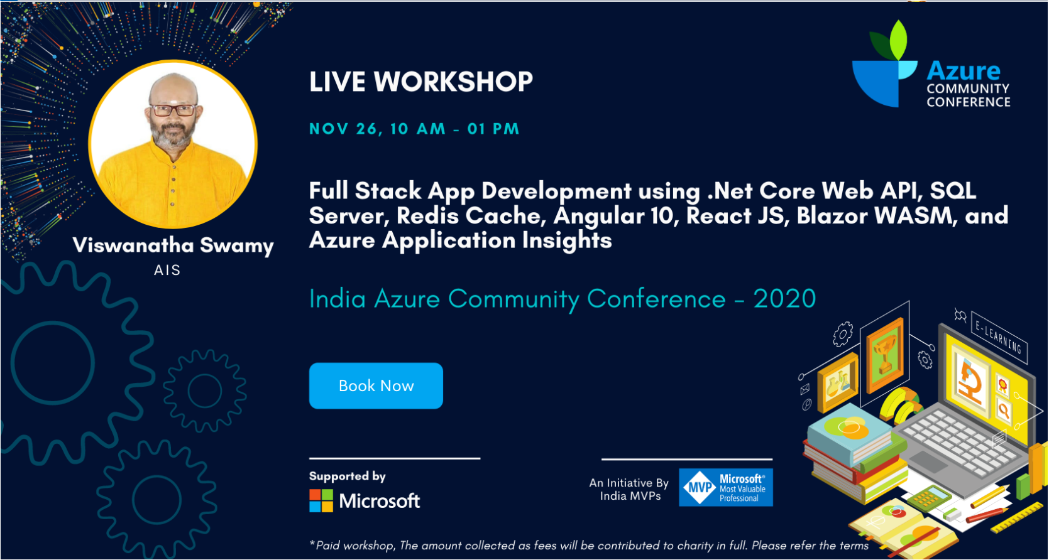
Hands-on Full Stack AzConf.dev
Viswanatha Swamy
LinkedIn: https://www.linkedin.com/in/viswanatha-swamy-b57326128/
Twitter: https://twitter.com/vishipayyallore
AzConf.dev

Slide 2
Information
All the sessions will be hands on.
Will have parking lots for queries and other topics.
Some of the concepts we will introduced and revisited in next sessions.
There are multiple ways to do, we will use one of the way.
The focus was more on concepts and demos are kept simple.
I am still a learner. What!!! … wait … Yes, I am still a learner.
AzConf.dev

Slide 3
Please fasten
your
seat belt !!!
AzConf.dev

Slide 4
Q & A
AzConf.dev

Slide 5
Thank You
Viswanatha Swamy
LinkedIn: https://www.linkedin.com/in/viswanatha-swamy-b57326128/
Twitter: https://twitter.com/vishipayyallore
AzConf.dev

