Slide 1
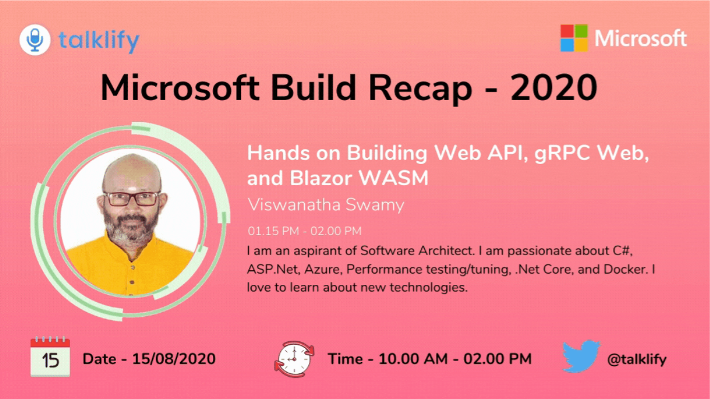
Viswanatha Swamy
LinkedIn: https://www.linkedin.com/in/viswanatha-swamy-b57326128/
Twitter: https://twitter.com/vishipayyallore
talklify

Slide 2
Information
All the sessions will be hands on.
Sessions will be weekly.
Will have parking lots for queries and other topics.
Some of the concepts we will introduced and revisited in next sessions.
There are multiple ways to do, we will use one of the way.
The focus was more on concepts and demos are kept simple.
I am still a learner. What!!! … wait … Yes, I am still a learner.
talklify

Slide 3

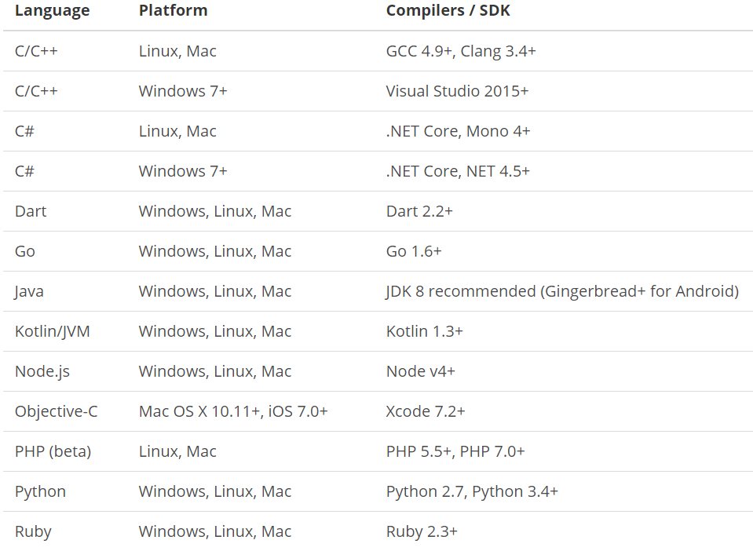
What is gRPC ?
is a modern open source high performance RPC framework that can run in any environment. It can efficiently connect services in and across data centers with pluggable support for load balancing, tracing, health checking and authentication. It is also applicable in last mile of distributed computing to connect devices, mobile applications and browsers to backend services.
https://docs.microsoft.com/en-us/aspnet/core/tutorials/grpc/grpc-start?view=aspnetcore-3.1&tabs=visual-studio
https://grpc.io/docs/guides/
https://grpc.io/docs/guides/concepts/
Motivation:
High Performance
IDL / Contract Based
Streaming (Unary, Client, Server, Bi-directional)
Security (https://developers.google.com/web/fundamentals/performance/http2)
Available across ecosystems
Supported Languages:
URL: https://grpc.io/about/#officially-supported-languages-and-platforms
talklify

Slide 4
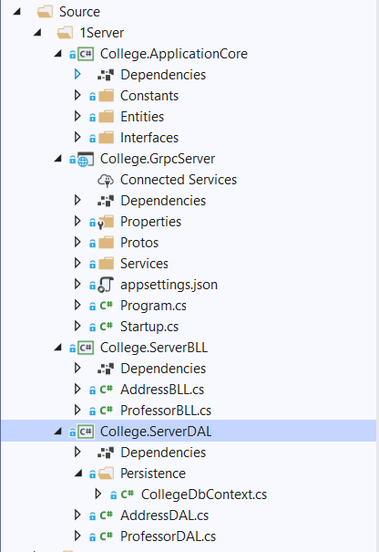
Improvising the gRPC Service into Layers
College.ApplicationCore:
Constants
Entities
Interfaces
College.GrpcServer:
.Proto files
gRPC Server implementations
Application Configuration
Start up and DI
College.ServerBLL:
Any Business Logic
College.ServerDAL:
Db Context
Data Access Layer which consumes Db Context
talklify

Slide 5
Improvising the gRPC Service into Layers
Demo
Improvising the gRPC Service
into Layers
talklify

Slide 6
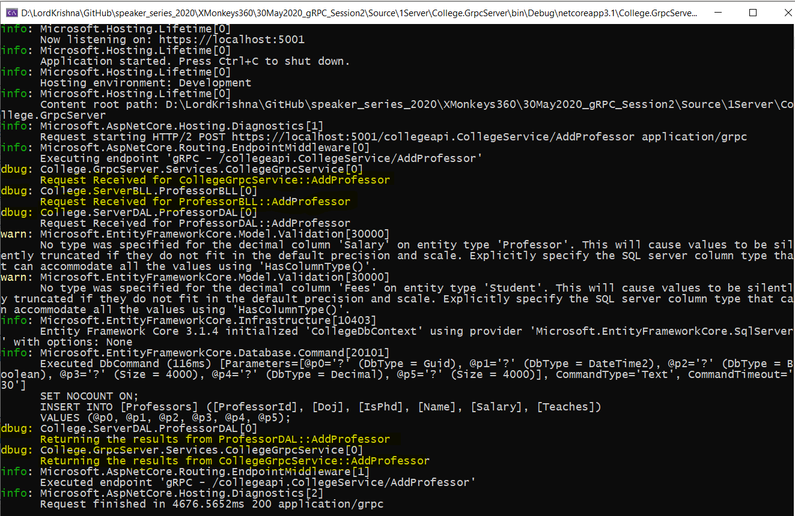
Adding Console Logging into gRPC Server and Client
talklify

Slide 7
Adding Console Logging into gRPC Server and Client
Demo
Adding Console Logging into
gRPC Server and Client
talklify

Slide 8
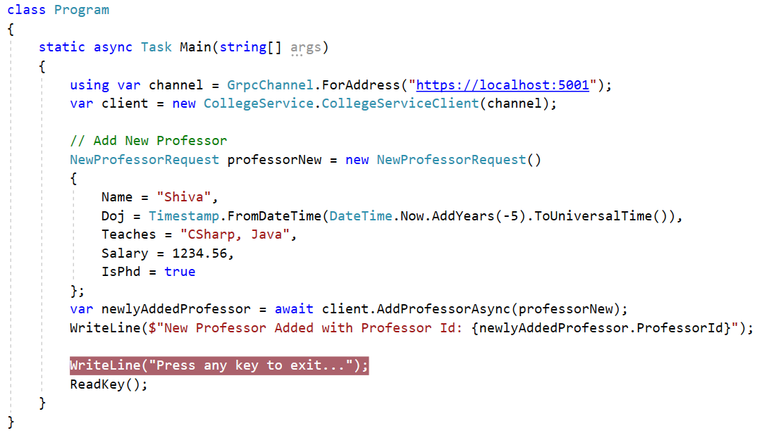
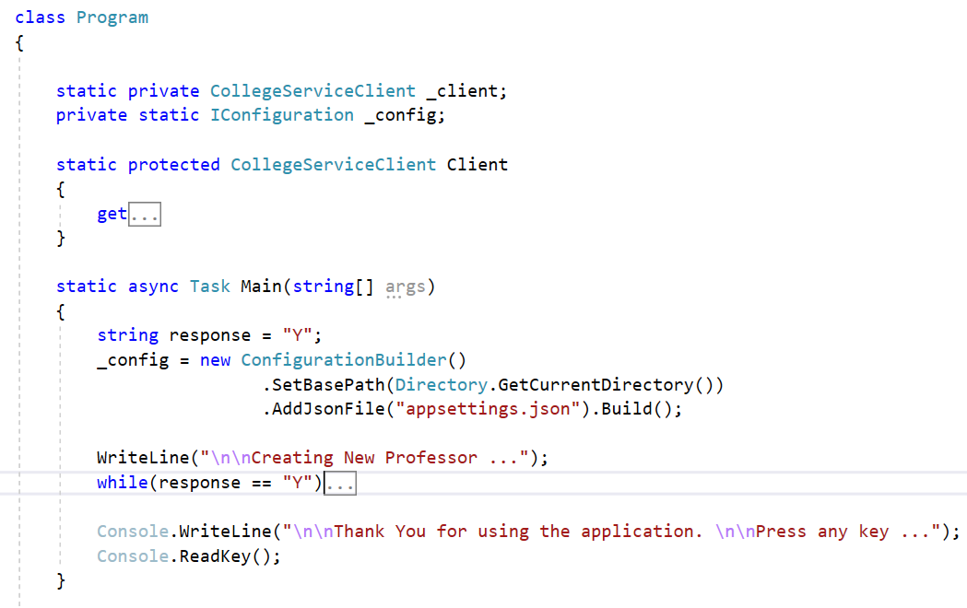
Improvising the gRPC Client
talklify

Slide 9
Improvising the gRPC Client
Demo
Improvising the gRPC Client
talklify

Slide 10
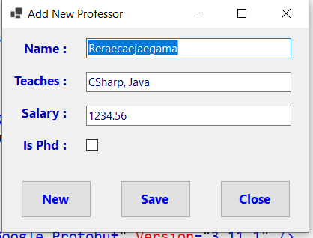
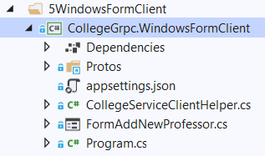
Windows Forms as gRPC Client
talklify

Slide 11
Windows Forms as gRPC Client
Demo
Windows Forms as gRPC Client
talklify

Slide 12
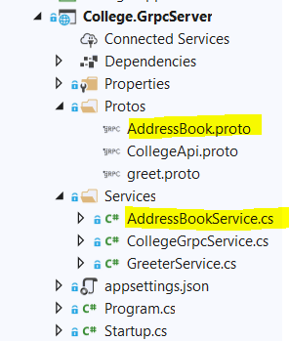
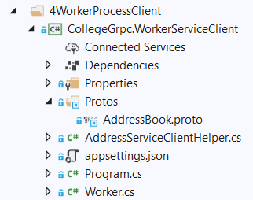
.NET Core Worker Process as gRPC Client
talklify

Slide 13
.NET Core Worker Process as gRPC Client
Demo
.NET Core Worker Process
as gRPC Client
talklify

Slide 14
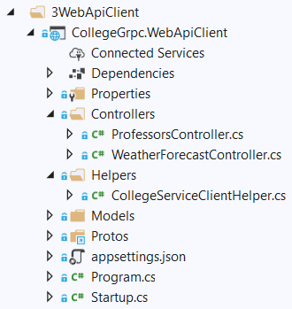
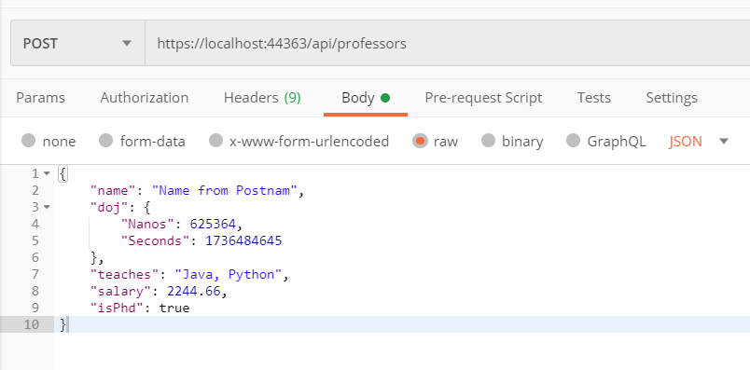
.NET Core Web API as gRPC Client
talklify

Slide 15
.NET Core Web API as gRPC Client
Demo
.NET Core Web API
as gRPC Client
talklify

Slide 16
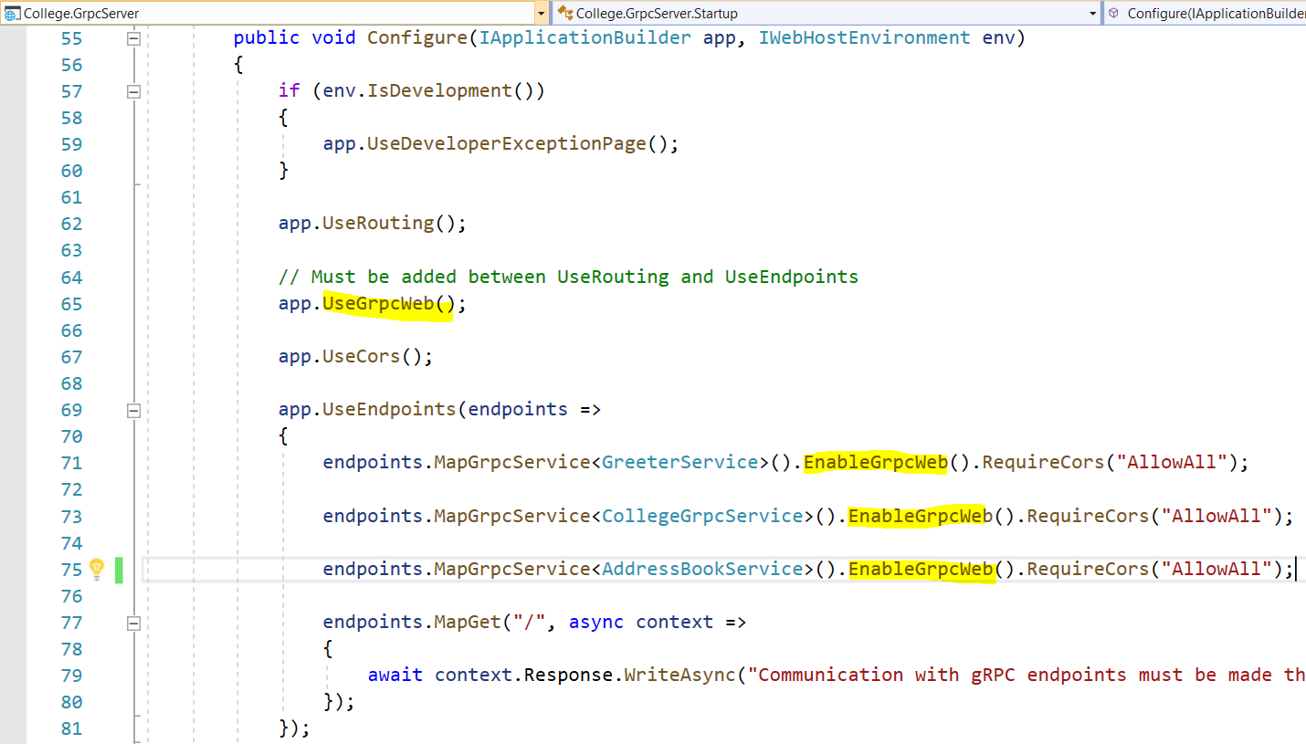
Adding gRPC Web Capability to existing gRPC Service
https://devblogs.microsoft.com/aspnet/grpc-web-for-net-now-available/
talklify

Slide 17
Adding gRPC Web Capability to existing gRPC Service
Demo
Adding gRPC Web
Capability to existing
gRPC Service
talklify

Slide 18
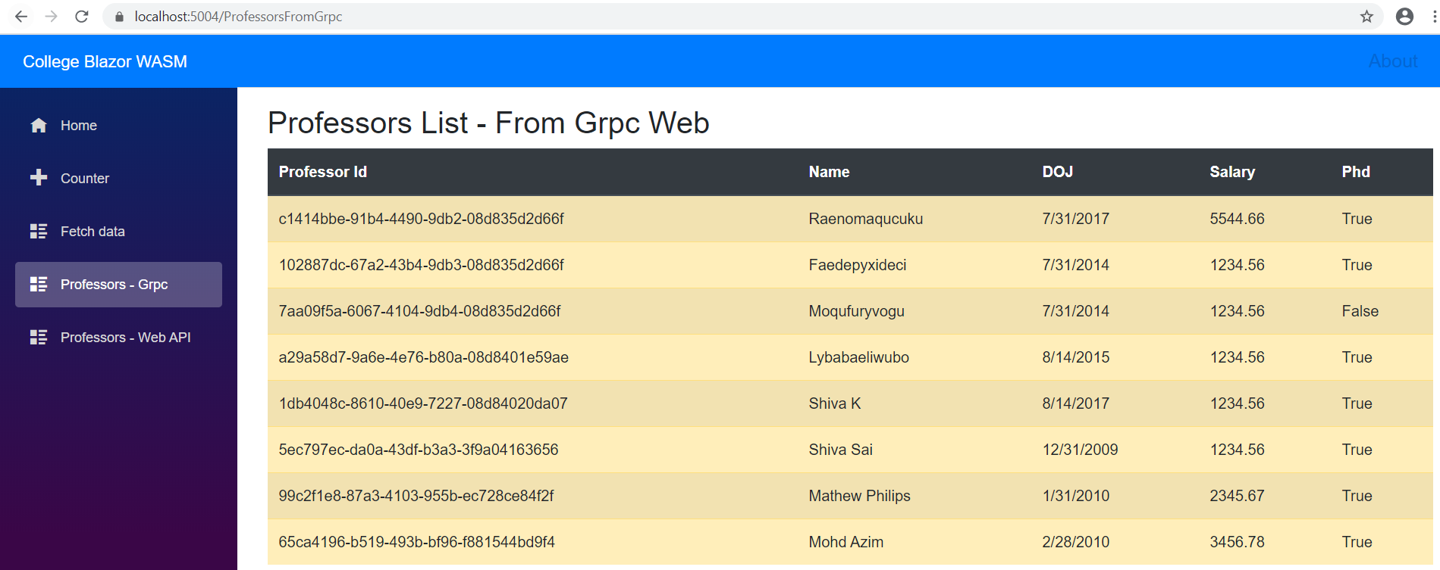
Blazor WASM communicating with gRPC Service
https://devblogs.microsoft.com/aspnet/blazor-webassembly-3-2-0-now-available/
talklify

Slide 19
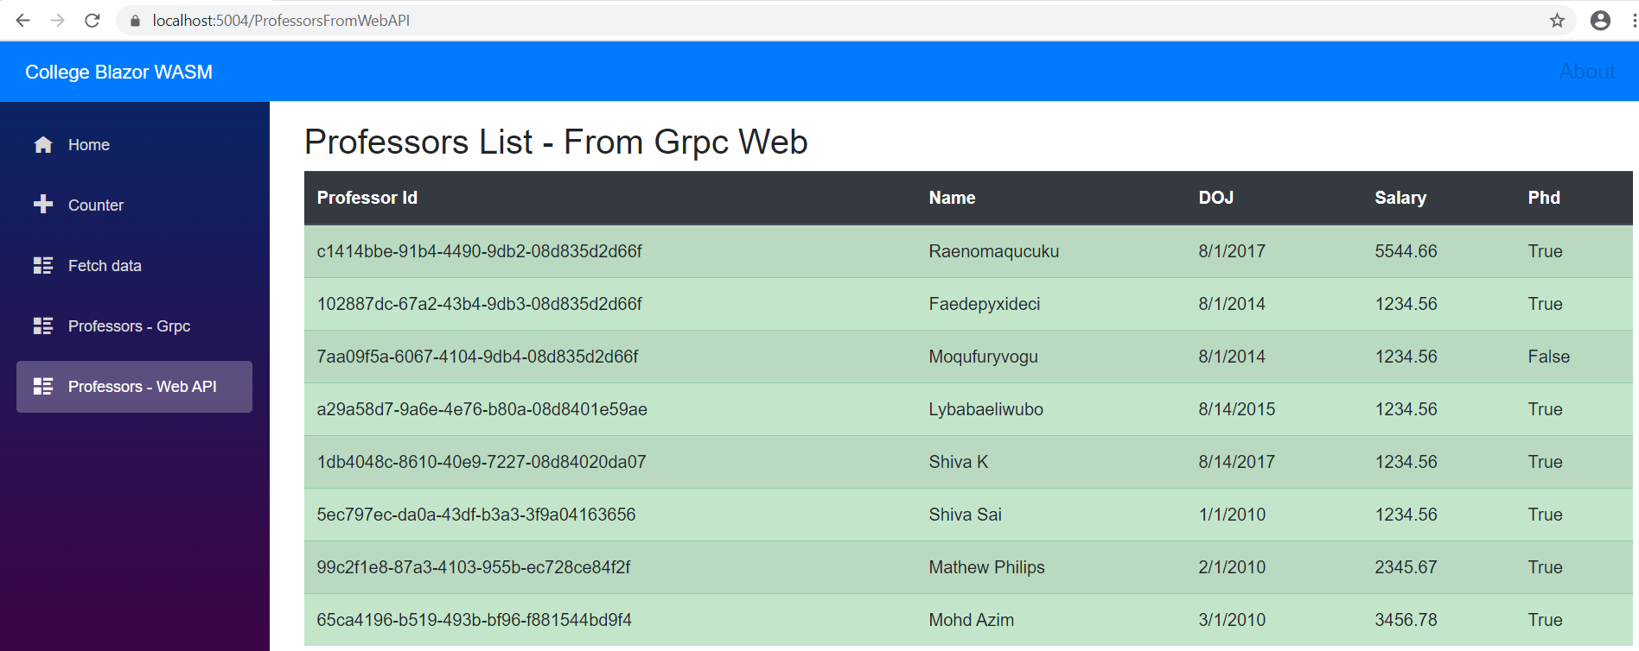
Blazor WASM communicating with REST Web API
talklify

Slide 20
Blazor WASM communicating with gRPC Service and REST Web API
Demo
Blazor WASM communicating
With gRPC Service
and REST Web API
talklify

Slide 21

Q & A
talklify

Slide 22
Thank You
Viswanatha Swamy
LinkedIn: https://www.linkedin.com/in/viswanatha-swamy-b57326128/
Twitter: https://twitter.com/vishipayyallore
talklify

