Slide 1
C# Corner Global Monthly Virtual Meet – April 2020
Hands On: Building Backend For Frontend
using Azure API Management
Viswanatha Swamy
LinkedIn: https://www.linkedin.com/in/viswanatha-swamy-b57326128/
Twitter: https://twitter.com/vishipayyallore
C# Corner: https://www.c-sharpcorner.com/members/vishipayyallore
C# Corner

Slide 2
C# Corner Global Monthly Virtual Meet – April 2020
What we will discuss and work today ….
Hosting a couple of Middle tier services as web API into Azure.
Creating Azure API Management and adding the two Middle Tier Services.
Adding Policies to Global, Product, Services and Operation Level.
Invoking API Gateway/BFF from Angular UI.
C# Corner

Slide 3
Orders
C1
Data Store
API Mgt
GW
Products
CN
Payment
DMZ
IP Restrictions

Slide 4
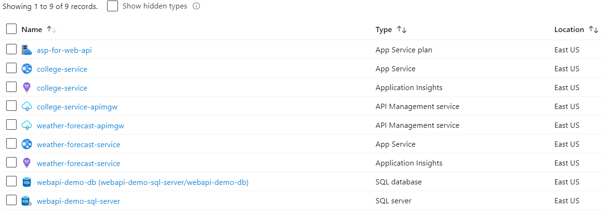
A Quick walk through of Resource in Azure
C# Corner

Slide 5
Hosting a couple of Middle tier services as web API into Azure
Hosting Middle Tier to Azure
We have created two App Service [Windows OS].
We have one App Service Plan. [D1 Shared].
We are deploying it using Visual Studio 2019. [Publish].
We have published College Service. We will verify using Postman.
We will publish Weather Forecast Service.
C# Corner

Slide 6
Hosting a couple of Middle tier services as web API into Azure
Demo 1
Hosting a couple of Middle tier
services as web API into Azure.
C# Corner

Slide 7
Creating Azure API Management and adding the two Middle Tier Services
Hosting Middle Tier to Azure
We have created two API Management.
college-service-apimgw
weather-forecast-apimgw
college-service-apimgw has been published. We will test using Postman.
We will configure weather-forecast-apimgw now.
Verify the Weather Forecasting APIM using Postman.
C# Corner

Slide 8
Creating Azure API Management and adding the two Middle Tier Services
Demo 2
Creating Azure API Management
and adding
One Middle Tier Services
C# Corner

Slide 9
Adding Policies to Global, Product, Services and Operation Level
Configuring Policies using Azure Portal
Verify the Policy created for college-service-apimgw. Rate Limit.
We will test using Postman.
We will configure for weather-forecast-apimgw now.
Verify the Weather Forecasting APIM using Postman.
C# Corner

Slide 10
Adding Policies to Global, Product, Services and Operation Level
Demo 3
Adding Policies to Global,
Product, Services
and Operation Level
C# Corner

Slide 11
Invoking API Gateway/BFF from Angular UI
Working with Angular UI with Hosted Middle Tier, and Api Gateway
Retrieve the data using Hosted Web Api.
Retrieve the data using APIM Gateway.
Adding CORS
Passing Headers to APIM Gateway.
C# Corner

Slide 12
Adding Policies to Global, Product, Services and Operation Level
Demo 4
Invoking API Gateway
/BFF from Angular UI
C# Corner

Slide 13
UI
API GW
Iden MT
http://iden-service.azurewebsites.net/api/token
POST: Dto
https://iden-service.azure-api.net/wfsapimgw/api/token
POST: Dto
Headers: SubKey

Slide 14
C# Corner Global Monthly Virtual Meet – April 2020
Q & A
C# Corner

Slide 15
C# Corner Global Monthly Virtual Meet – April 2020
Thank You
C# Corner

