Slide 1


Hands-On Developing Web API
using
.NET Core 3.1, EF Core 3.1,
SQL Server, and Cosmos Db
Viswanatha Swamy
LinkedIn: https://www.linkedin.com/in/viswanatha-swamy-b57326128/
Twitter: https://twitter.com/vishipayyallore

Slide 2
Information
All the sessions will be hands on.
Will have parking lots for queries and other topics.
Some of the concepts we will introduced and revisited in next sessions.
There are multiple ways to do, we will use one of the way.
The focus was more on concepts and demos are kept simple.
I am still a learner. What!!! … wait … Yes, I am still a learner.

Slide 3
Tools we use
Visual Studio 2019 Professional
Azure Data Studio
SQL Server
Cosmos Db Local Emulator
Postman

Slide 4
Http Primer
The Hypertext Transfer Protocol (HTTP) is an application protocol for distributed, collaborative, hypermedia information systems.[1] HTTP is the foundation of data communication for the World Wide Web, where hypertext documents include hyperlinks to other resources that the user can easily access, for example by a mouse click or by tapping the screen in a web browser.
References:
https://en.wikipedia.org/wiki/Hypertext_Transfer_Protocol
https://www.webdevdrops.com/en/http-primer-for-frontend-developers-f091a2070637/

Slide 5
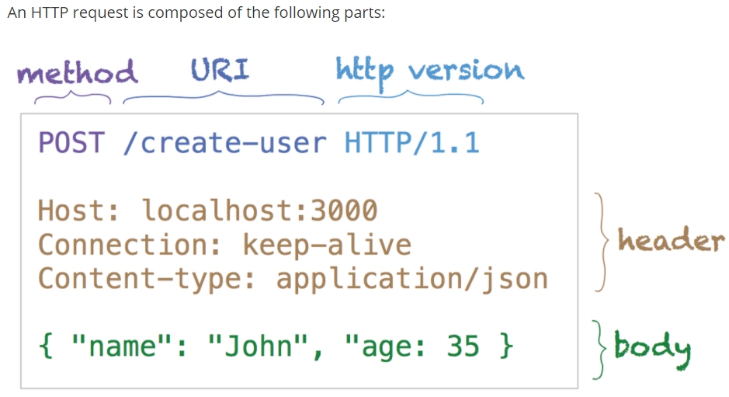
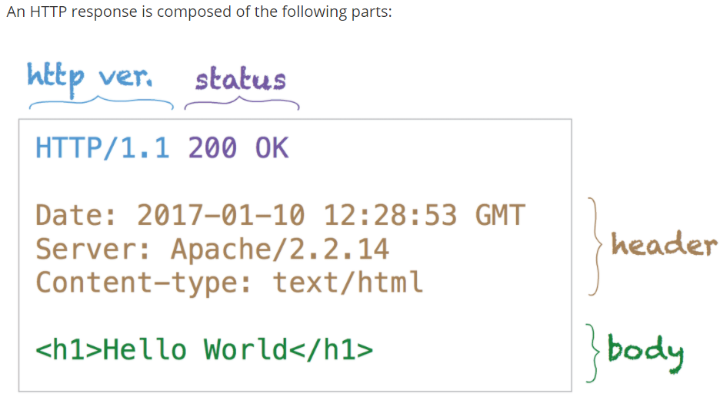
Http Request Response
References: https://www.webdevdrops.com/en/http-primer-for-frontend-developers-f091a2070637/

Slide 6
Web API and REST (REpresentational State Transfer)
Web API
A Web API is an application programming interface for either a web server or a web browser.
Reference: https://en.wikipedia.org/wiki/Web_API
REST (REpresentational State Transfer)
Representational state transfer (REST) is a software architectural style that defines a set of constraints to be used for creating Web services.
Web services that conform to the REST architectural style, called RESTful Web services, provide interoperability between computer systems on the internet.
RESTful Web services allow the requesting systems to access and manipulate textual representations of Web resources by using a uniform and predefined set of stateless operations.
Reference: https://en.wikipedia.org/wiki/Representational_state_transfer

Slide 7
REST Principles / Architectural Constrains
Client–server: The principle behind the client-server constraints is the separation of concerns. Separating the user interface concerns from the data storage concerns improves the portability of the user interfaces across multiple platforms.
Stateless: Each request from client to server must contain all the information necessary to full fill the request. Session state is therefore kept entirely on the client.
Cacheable: Cache constraints require that the data within a response to a request be implicitly or explicitly labeled as cacheable or non-cacheable.
Layered system: A client cannot ordinarily tell whether it is connected directly to the end server, or to an intermediary along the way. Intermediary servers can improve system scalability by enabling load balancing and by providing shared caches.
Uniform interface: In order to obtain a uniform interface, multiple architectural constraints are needed to guide the behavior of components. REST is defined by four interface constraints: identification of resources; manipulation of resources through representations; self-descriptive messages; and, hypermedia as the engine of application state.
Code on demand (optional): REST allows client functionality to be extended by downloading and executing code in the form of applets or scripts. Reference: https://en.wikipedia.org/wiki/Representational_state_transfer

Slide 8
Motivation for choosing Web API
For creating resource-oriented services, the web API services are the best to choose. By using HTTP or restful service, these services are established.
Uses the full features of HTTP (like URIs, request/response headers, caching, versioning, various content formats).
Best suits for CRUD operation services to a broad range of clients including browsers, mobiles and tablets etc.
Content Negotiation many format like XML, JSON, Text etc.
Light weighted and maintainable web services.
Good performance and fast development of services.

Slide 9
Motivation for ASP.Net Core
A unified framework for building web UI and web APIs.
Ability to develop and run on Windows, macOS, and Linux. Open-source and community-focused.
A cloud-ready, environment-based configuration system.
Built-in dependency injection.
A lightweight, high-performance, and modular HTTP request pipeline.
Ability to host on the following: Kestrel | IIS | HTTP.sys | Nginx | Apache | Docker
Side-by-side versioning.
Reference: https://docs.microsoft.com/en-gb/aspnet/core/fundamentals/choose-aspnet-framework?view=aspnetcore-3.1

Slide 10

Let’s make our hands dirt !!!

Slide 11
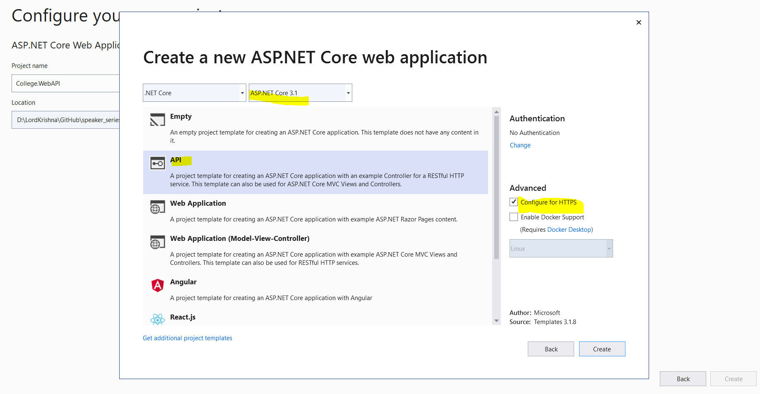
Web API Template

Slide 12
Creating our Web API
Demo
Creating First Web Api

Slide 13
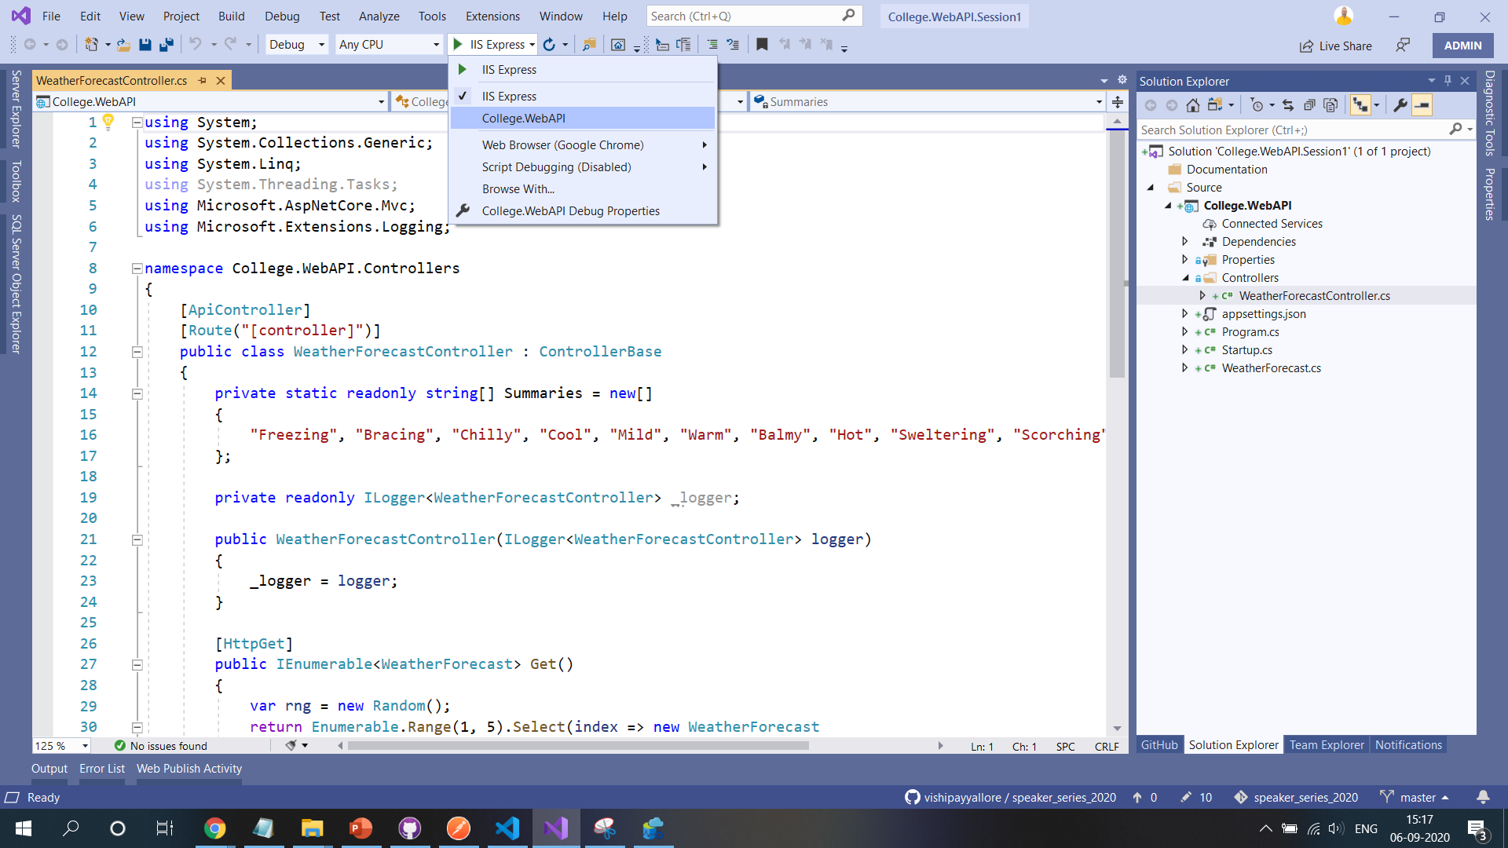
Executing using IIS Express / Kestrel
Executing the Web API using IIS Express and Kestrel.
Modifying the “launchSettings.json”.

Slide 14
Creating our Web API
Demo
Executing Web Api using
IIS Express, and Kestrel
Modifying launchSettings.json

Slide 15
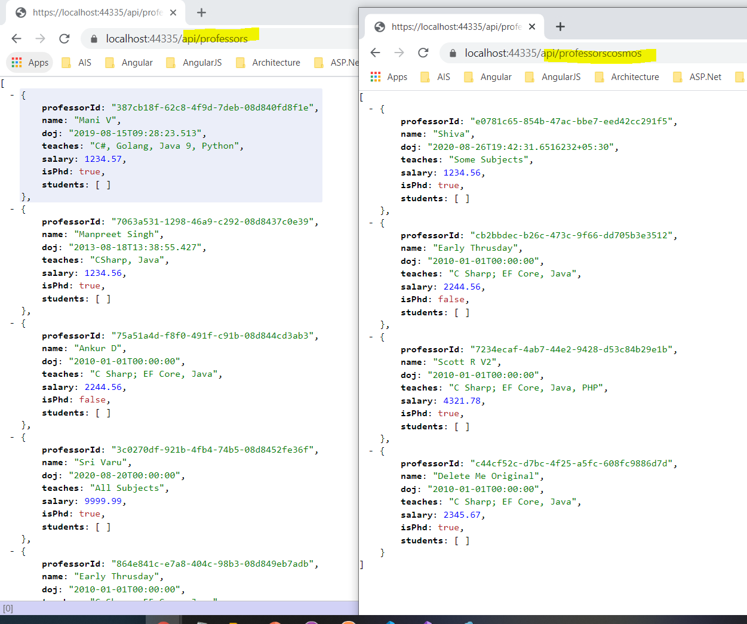
Building Professors Controller

Slide 16
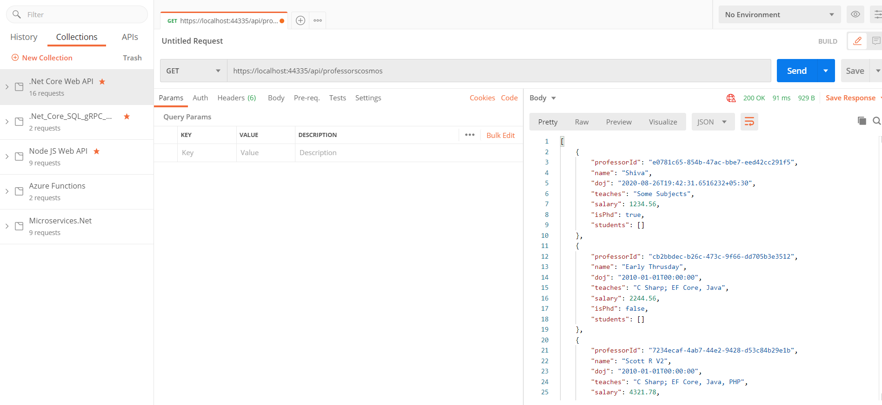
Postman Tool and creating Postman Collections

Slide 17
Controller
BLL
DAL
Db Context
Store

Slide 18
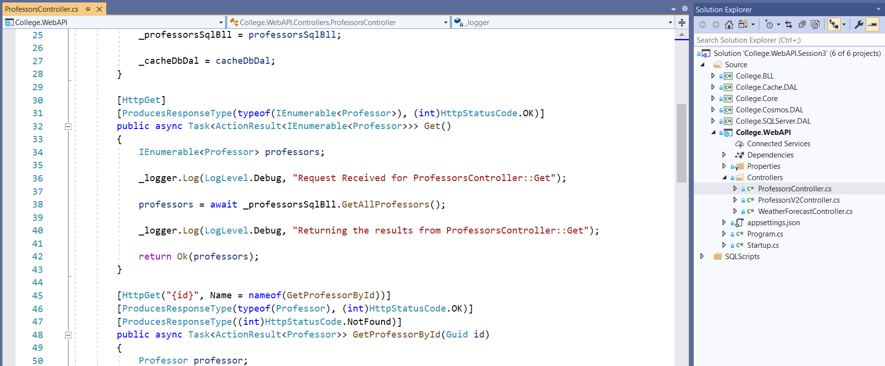
What is next?
What is next ???

Slide 19
Q & A

Slide 20
Thank You
Viswanatha Swamy
LinkedIn: https://www.linkedin.com/in/viswanatha-swamy-b57326128/
Twitter: https://twitter.com/vishipayyallore

