Slide 1
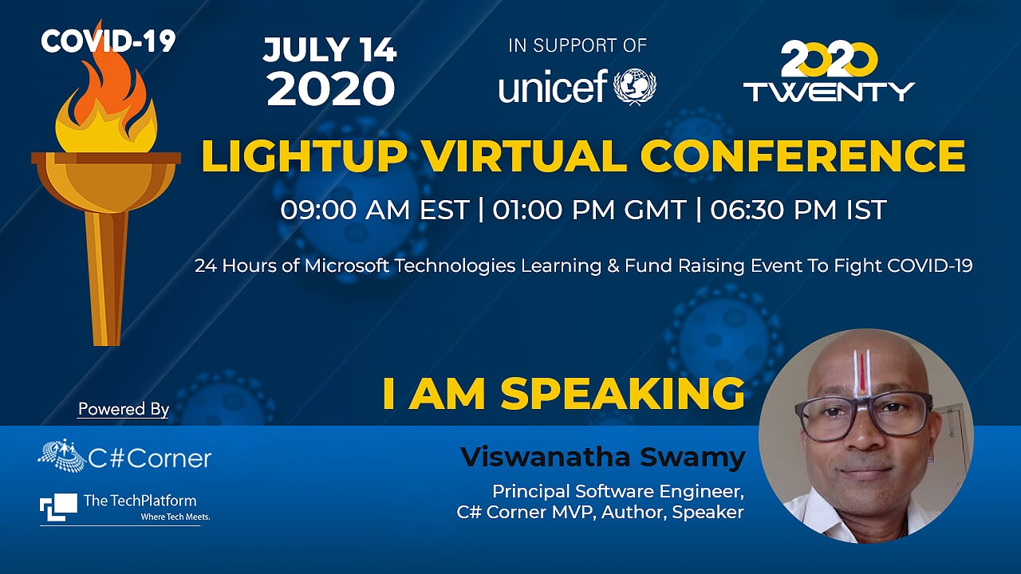
Light Up – July 2020
Light Up Virtual Conference

Slide 2

Light Up – July 2020
Hands-On Developing gRPC Service
and
Multiple Types of .NET Core Clients
Viswanatha Swamy
LinkedIn: https://www.linkedin.com/in/viswanatha-swamy-b57326128/
Twitter: https://twitter.com/vishipayyallore
Light Up Virtual Conference

Slide 3
Information
All the sessions will be hands on.
Will have parking lots for queries and other topics.
There are multiple ways to do, we will use one of the way.
The focus is more on concepts and demos are kept simple.
I am still a learner. What!!! … wait … Yes, I am still a learner.
Light Up Virtual Conference

Slide 4
Tools we use
Visual Studio 2019 Professional
Azure Data Studio
SQL Server
Light Up Virtual Conference

Slide 5

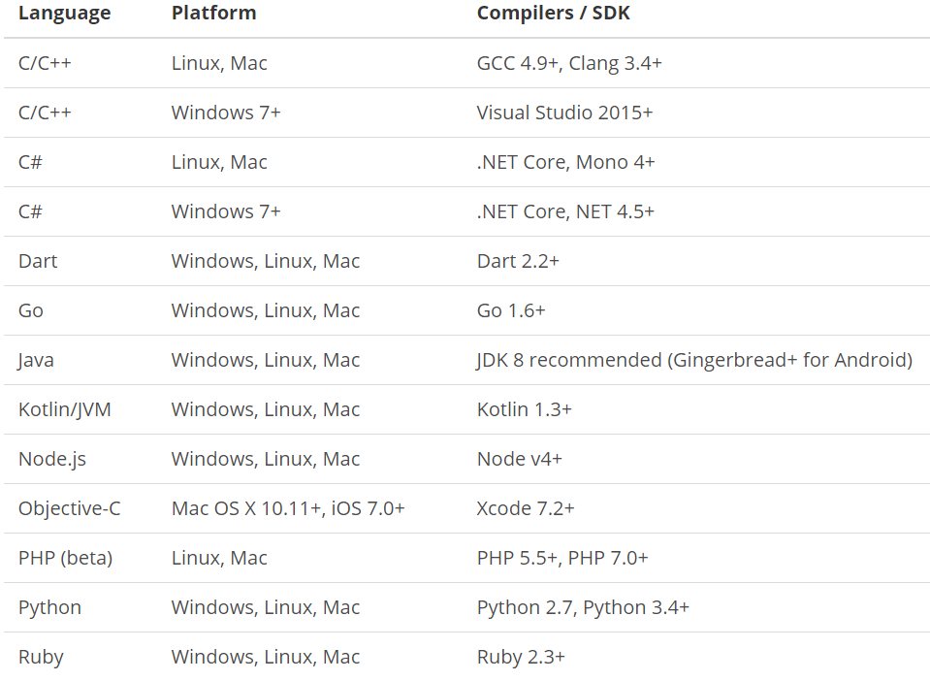
What is gRPC ?
is a modern open source high performance RPC framework that can run in any environment. It can efficiently connect services in and across data centers with pluggable support for load balancing, tracing, health checking and authentication. It is also applicable in last mile of distributed computing to connect devices, mobile applications and browsers to backend services.
https://docs.microsoft.com/en-us/aspnet/core/tutorials/grpc/grpc-start?view=aspnetcore-3.1&tabs=visual-studio
https://grpc.io/docs/guides/
https://grpc.io/docs/guides/concepts/
Motivation:
High Performance
IDL / Contract Based
Streaming (Unary, Client, Server, Bi-directional)
Security (https://developers.google.com/web/fundamentals/performance/http2)
Available across ecosystems
Supported Languages:
URL: https://grpc.io/about/#officially-supported-languages-and-platforms
Light Up Virtual Conference

Slide 6
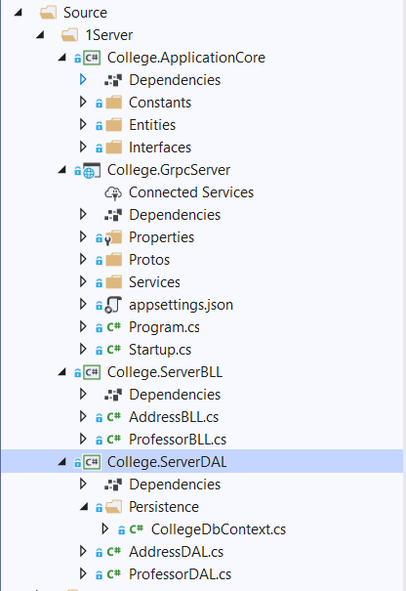
Improvising the gRPC Service into Layers
College.ApplicationCore:
Constants
Entities
Interfaces
College.GrpcServer:
.Proto files
gRPC Server implementations
Application Configuration
Start up and DI
College.ServerBLL:
Any Business Logic
College.ServerDAL:
Db Context
Data Access Layer which consumes Db Context
Light Up Virtual Conference

Slide 7
Improvising the gRPC Service into Layers
Demo
Improvising the gRPC Service
into Layers
Light Up Virtual Conference

Slide 8
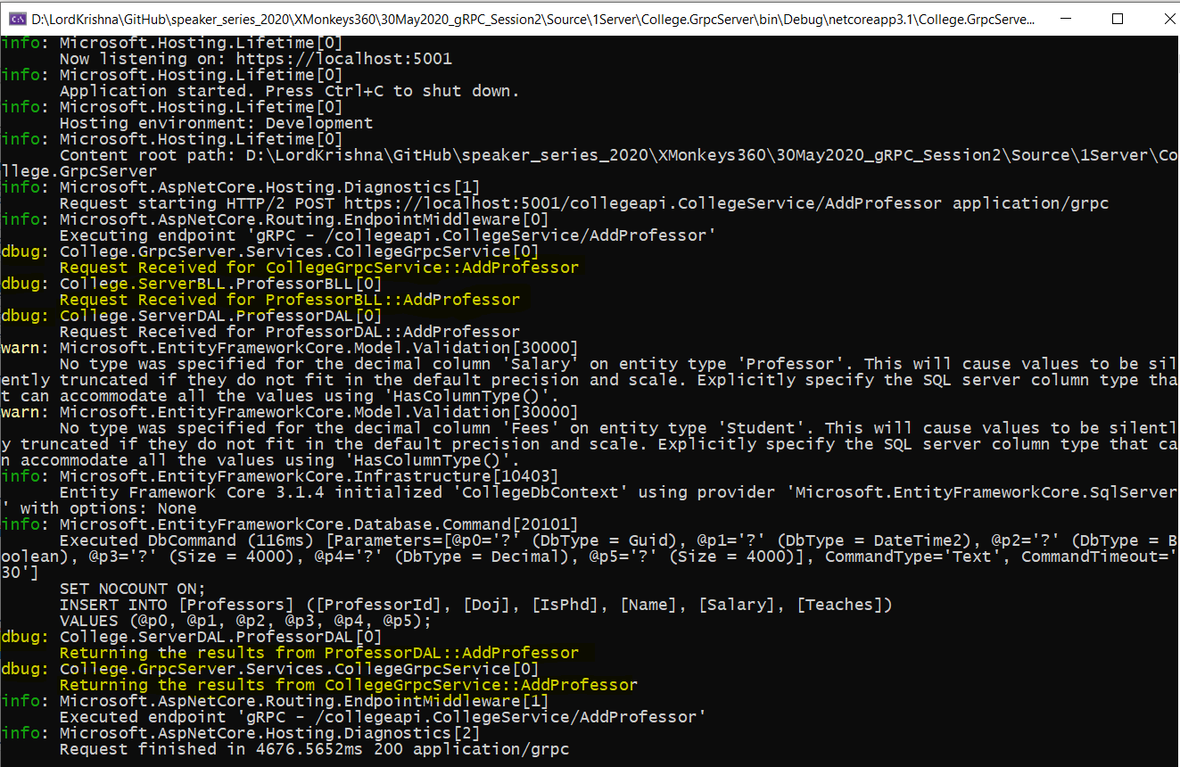
Adding Console Logging into gRPC Server and Client
Light Up Virtual Conference

Slide 9
Adding Console Logging into gRPC Server and Client
Demo
Adding Console Logging into
gRPC Server and Client
Light Up Virtual Conference

Slide 10
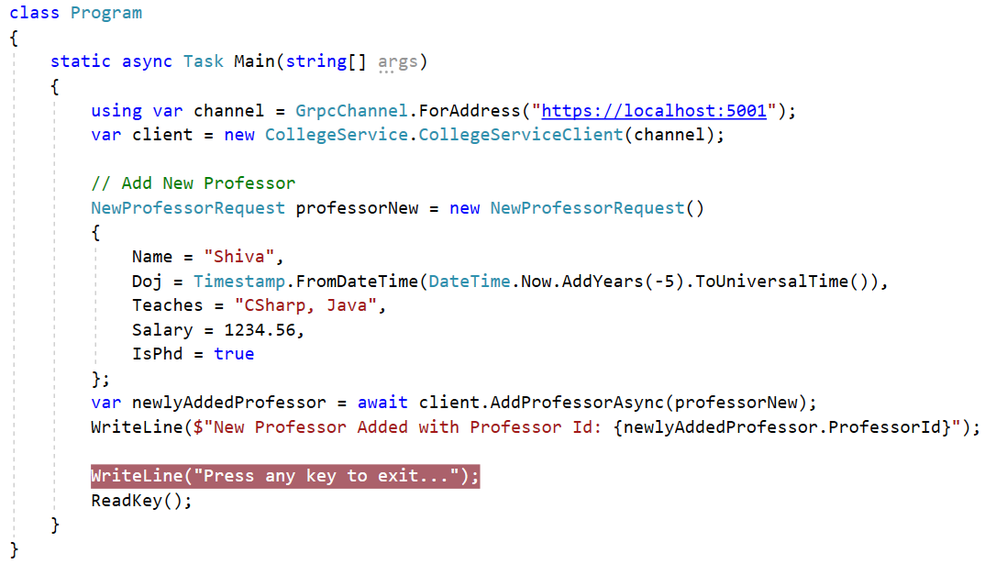
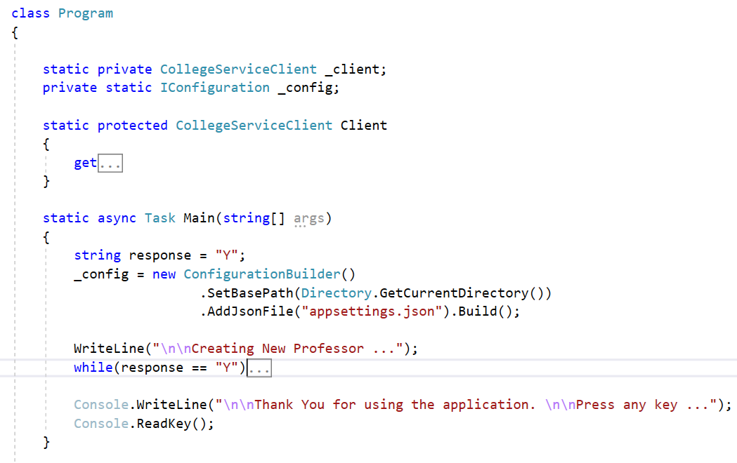
Improvising the gRPC Client
Light Up Virtual Conference

Slide 11
Improvising the gRPC Client
Demo
Improvising the gRPC Client
Light Up Virtual Conference

Slide 12
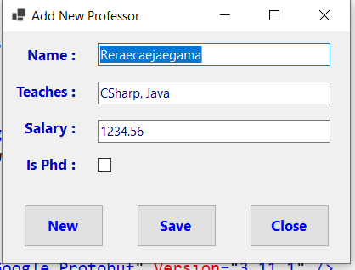
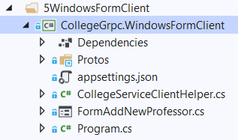
Windows Forms as gRPC Client
Light Up Virtual Conference

Slide 13
Windows Forms as gRPC Client
Demo
Windows Forms as gRPC Client
Light Up Virtual Conference

Slide 14
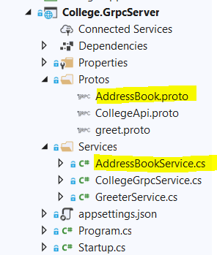
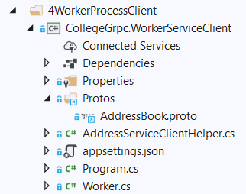
.NET Core Worker Process as gRPC Client
Light Up Virtual Conference

Slide 15
.NET Core Worker Process as gRPC Client
Demo
.NET Core Worker Process
as gRPC Client
Light Up Virtual Conference

Slide 16
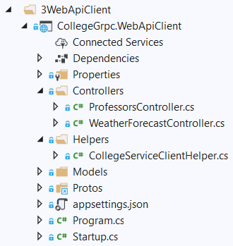
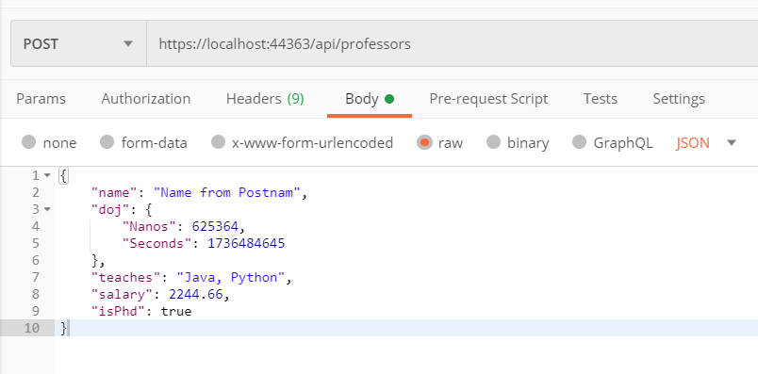
.NET Core Web API as gRPC Client
Light Up Virtual Conference

Slide 17
.NET Core Web API as gRPC Client
Demo
.NET Core Web API
as gRPC Client
Light Up Virtual Conference

Slide 18
Q & A
Light Up Virtual Conference

Slide 19
Thank You
Viswanatha Swamy
LinkedIn: https://www.linkedin.com/in/viswanatha-swamy-b57326128/
Twitter: https://twitter.com/vishipayyallore
Light Up Virtual Conference

