Slide 1
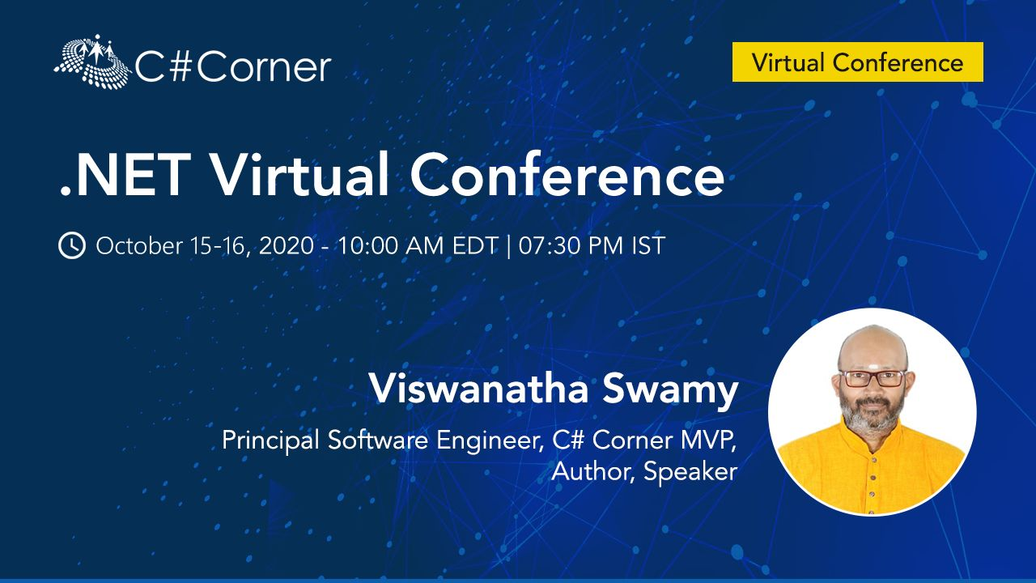
Hands-on Building Web API, gRPC Web, Blazor WASM and Angular 10
LinkedIn: https://www.linkedin.com/in/viswanatha-swamy-b57326128/
Twitter: https://twitter.com/vishipayyallore
C# Corner

Slide 2
Information
Session will be hands on.
Will have parking lots for queries and other topics.
Some of the concepts we will introduced and revisited in next sessions.
There are multiple ways to do, we will use one of the way.
The focus was more on concepts and demos are kept simple.
I am still a learner. What!!! … wait … Yes, I am still a learner.
C# Corner

Slide 3
Today’s Topics
Creating .NET Core Web API using Layered libraries
Add Professors Controller, Add 5 CRUD operations with SQL Server and Redis Cache
Verify the Endpoints using Postman Collections
Integrating Web API and Angular 10
Verify the items inside Redis Cache
Integrating Web API and Blazor WASM
Creating gRPC with Web Capabilities
Integrating Windows Forms with gRPC (without Web Channel).
Integrating gRPC Web with Blazor WASM
Integrating gRPC Web with Angular 10 UI
C# Corner

Slide 4
Please fasten
your
seat belt !!!
C# Corner

Slide 5
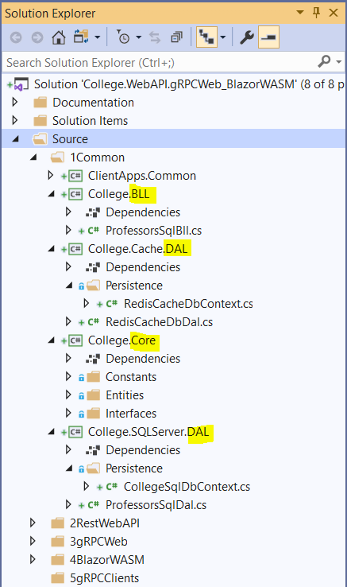
Web API and gRPC Service build using Layers
College.Core:
Constants
Entities
Interfaces
College.BLL:
Any Business Logic
College.SQLServer.DAL:
IRedisCacheDbContext
Data Access Layer which consumes Db Context
College.Cache.DAL:
DbContext
Data Access Layer which consumes Db Context
College.GrpcServer:
.Proto files
gRPC Server implementations
Application Configuration
Start up and DI
College.WebAPI:
Controllers implementations
Application Configuration
Start up and DI
C# Corner

Slide 6
Motivation for choosing Web API
For creating resource-oriented services, the web API services are the best to choose. By using HTTP or restful service, these services are established.
Uses the full features of HTTP (like URIs, request/response headers, caching, versioning, various content formats).
Best suits for CRUD operation services to a broad range of clients including browsers, mobiles and tablets etc.
Content Negotiation many format like XML, JSON, Text etc.
Light weighted and maintainable web services.
Good performance and fast development of services.
Reference: https://docs.microsoft.com/en-gb/aspnet/core/fundamentals/choose-aspnet-framework?view=aspnetcore-3.1
C# Corner

Slide 7
Web API using Layers
Demo
Web API using Layers
C# Corner

Slide 8
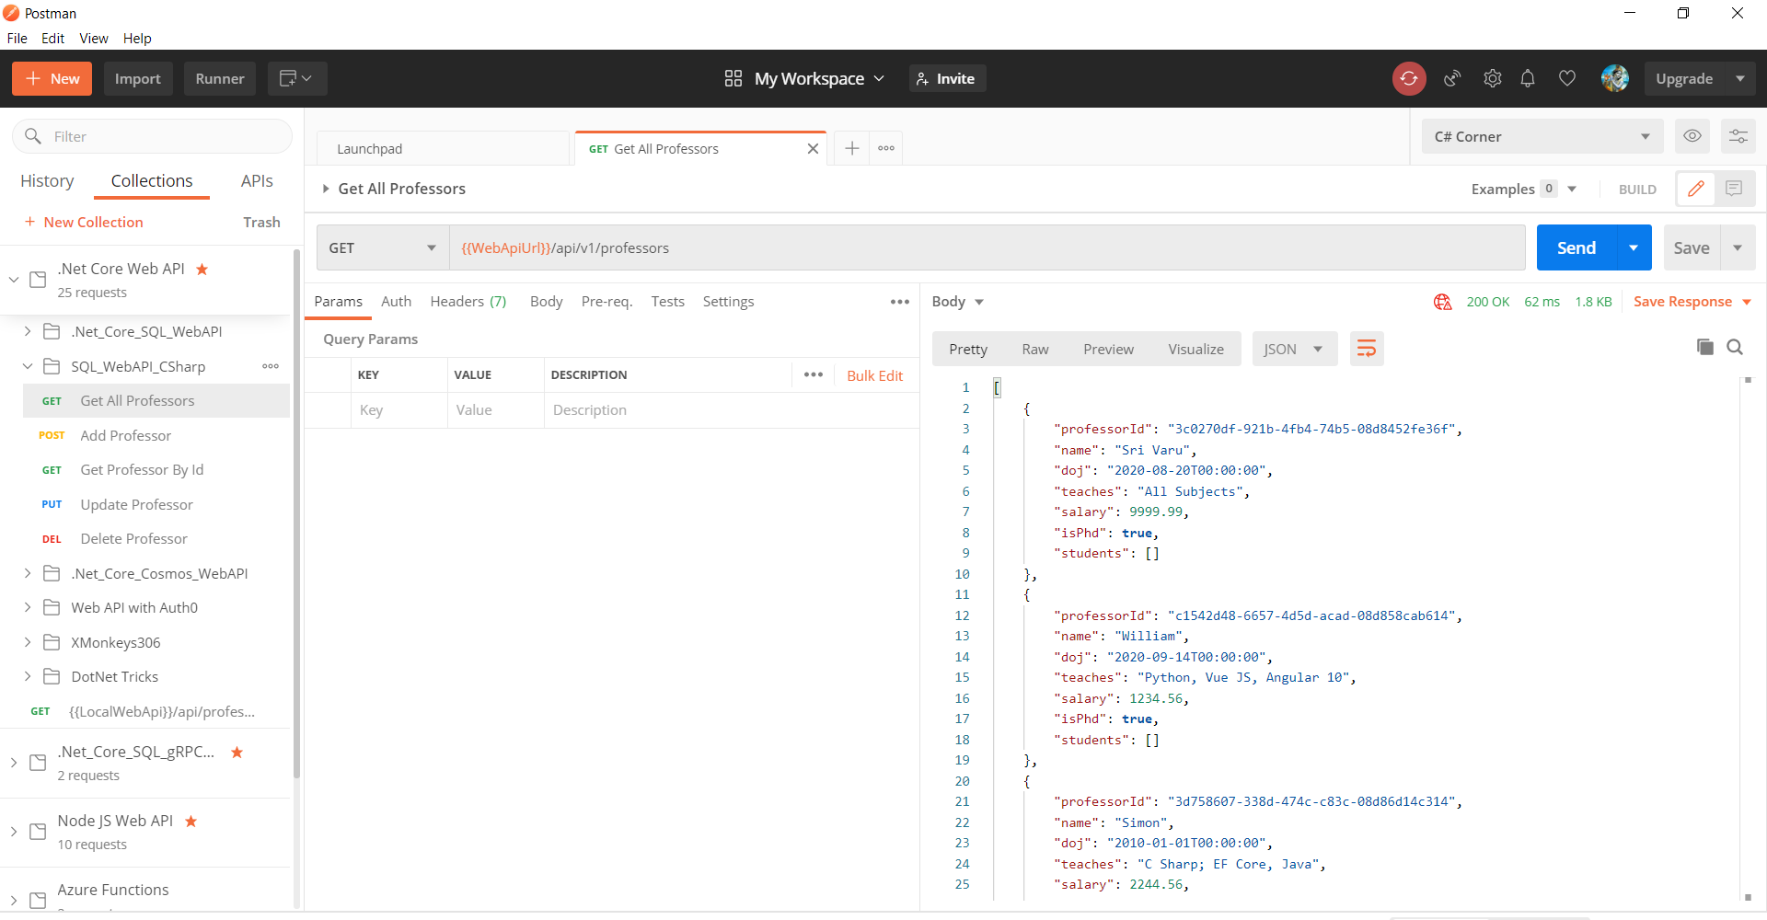
Web API Validation Using Postman
C# Corner

Slide 9
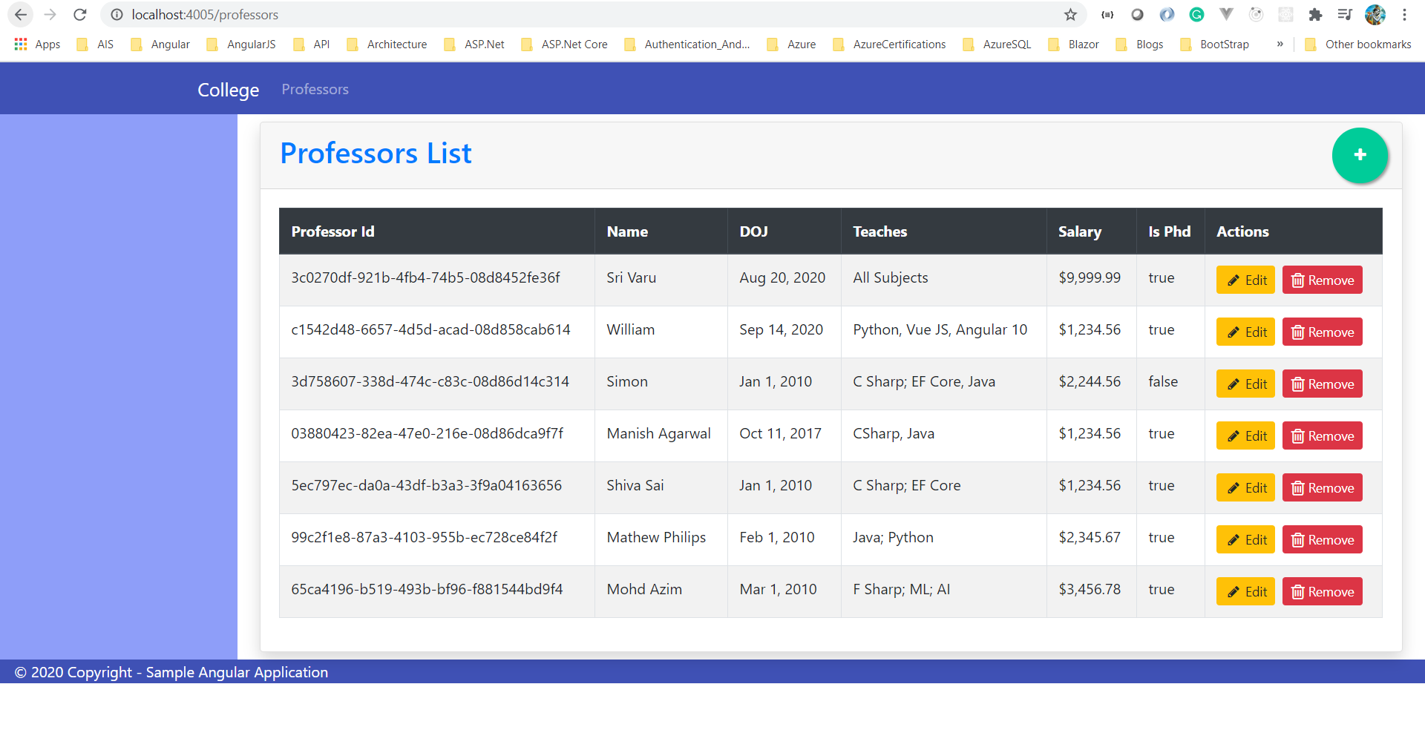
Web API and Angular 10 Validation
C# Corner

Slide 10
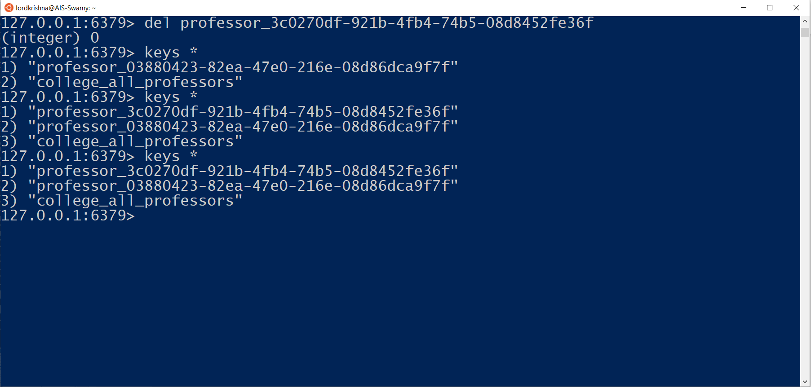
Verifying the items in Redis Cache
C# Corner

Slide 11

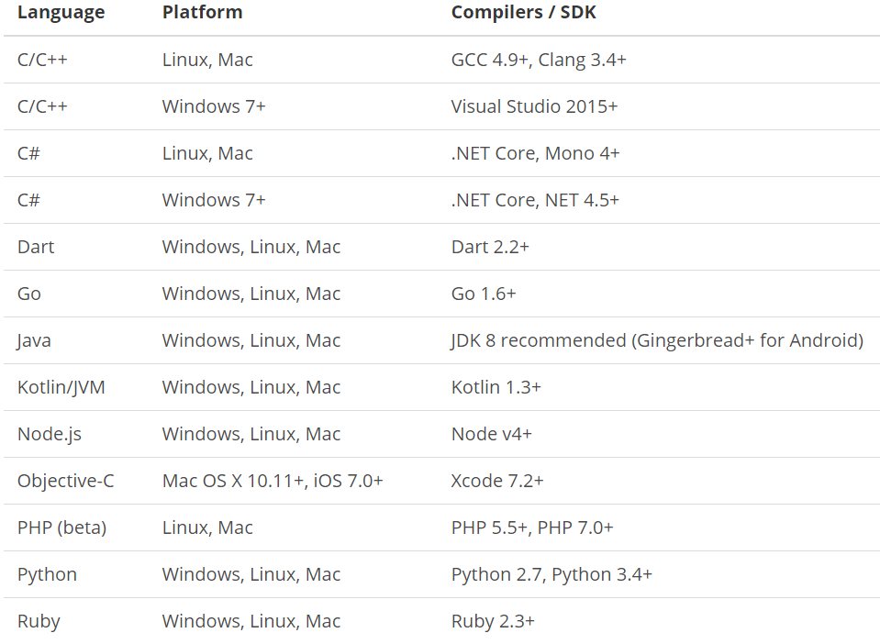
What is gRPC and Its Motivation
is a modern open source high performance RPC framework that can run in any environment. It can efficiently connect services in and across data centers with pluggable support for load balancing, tracing, health checking and authentication. It is also applicable in last mile of distributed computing to connect devices, mobile applications and browsers to backend services.
https://docs.microsoft.com/en-us/aspnet/core/tutorials/grpc/grpc-start?view=aspnetcore-3.1&tabs=visual-studio
https://grpc.io/docs/guides/
https://grpc.io/docs/guides/concepts/
Motivation:
High Performance
IDL / Contract Based
Streaming (Unary, Client, Server, Bi-directional)
Security (https://developers.google.com/web/fundamentals/performance/http2)
Available across ecosystems
Supported Languages:
URL: https://grpc.io/about/#officially-supported-languages-and-platforms
C# Corner

Slide 12
gRPC Service Using Layers
Demo
gRPC Service Layers
C# Corner

Slide 13
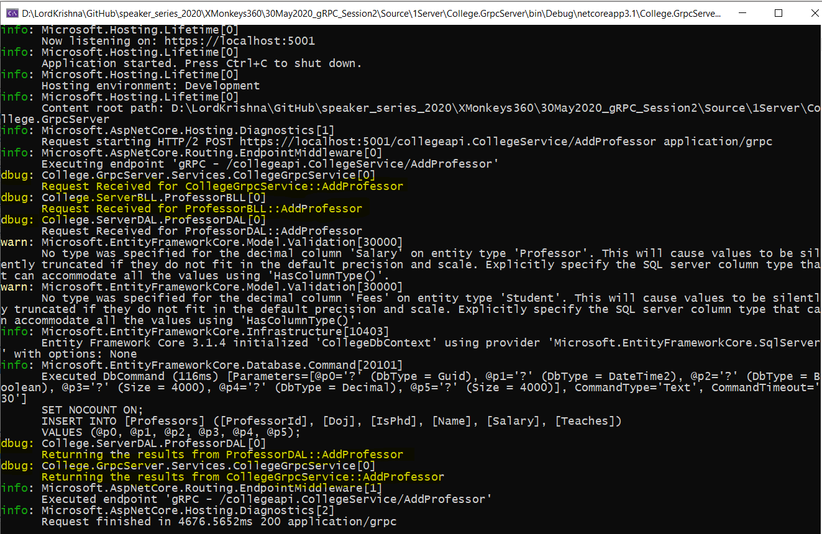
Adding Console Logging into gRPC Server and Client
C# Corner

Slide 14
Adding Console Logging into gRPC Server and Client
Demo
Adding Console Logging into
gRPC Server and Client
C# Corner

Slide 15
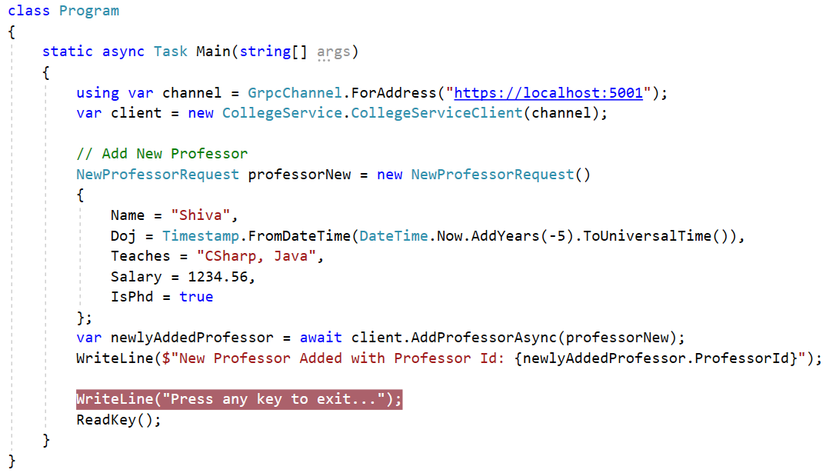
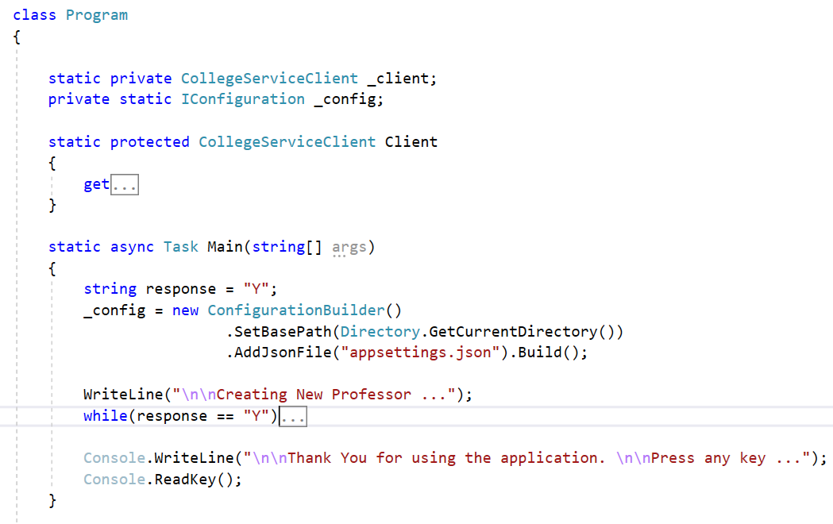
Improvising the gRPC Client
C# Corner

Slide 16
Improvising the gRPC Client
Demo
Improvising the gRPC Client
C# Corner

Slide 17
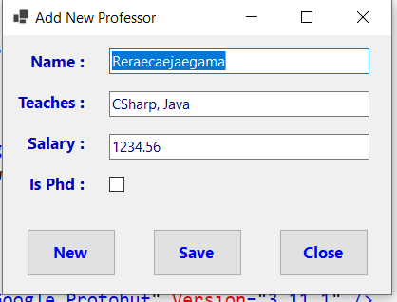
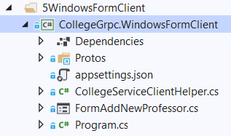
Windows Forms as gRPC Client
C# Corner

Slide 18
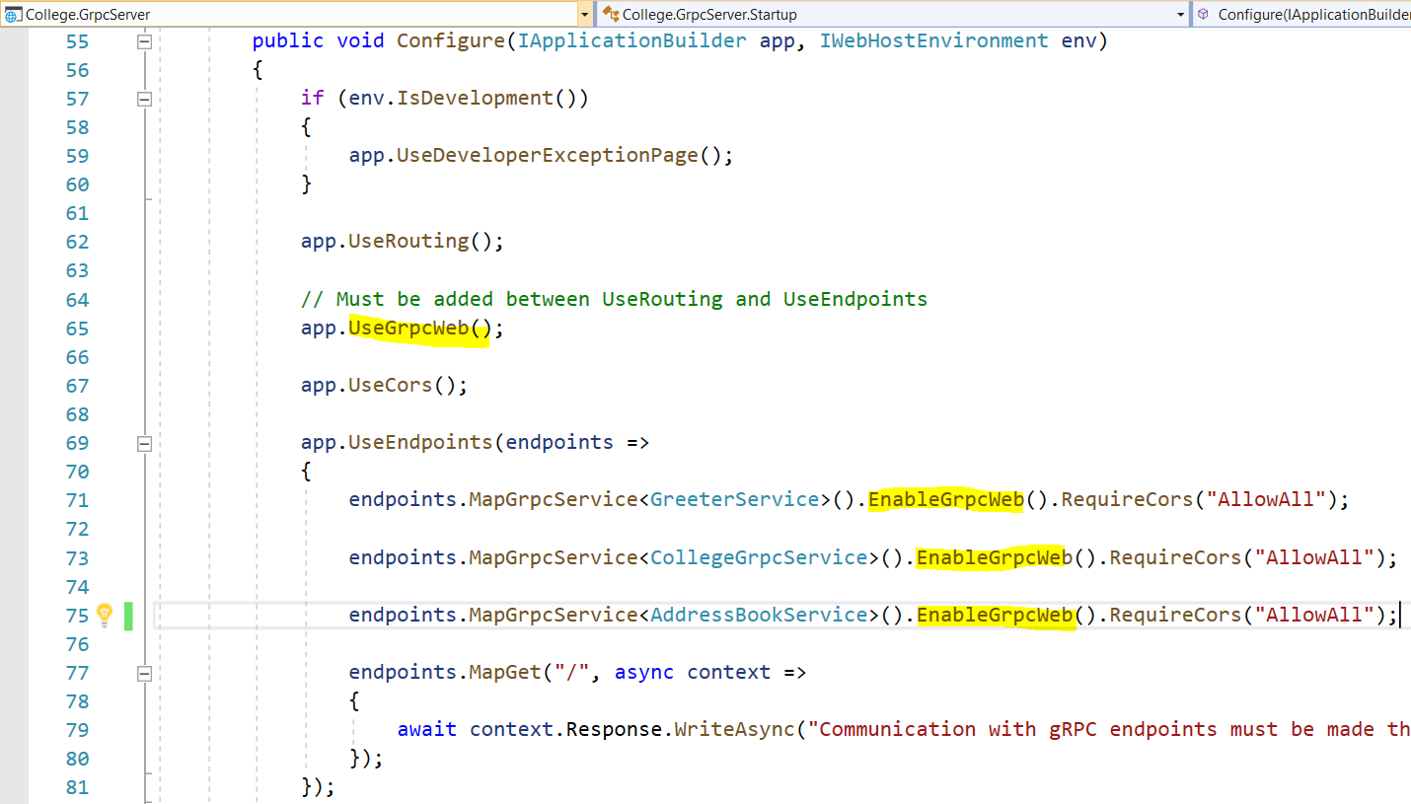
Adding gRPC Web Capability to existing gRPC Service
https://devblogs.microsoft.com/aspnet/grpc-web-for-net-now-available/
C# Corner

Slide 19
Adding gRPC Web Capability to existing gRPC Service
Demo
Adding gRPC Web
Capability to existing
gRPC Service
C# Corner

Slide 20
Blazor WASM communicating with gRPC Service and REST Web API
Demo
Blazor WASM communicating
With gRPC Service
and REST Web API
C# Corner

Slide 21
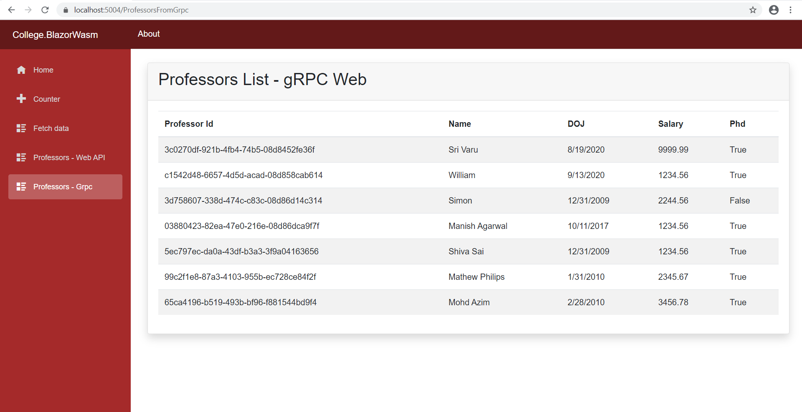
Blazor WASM communicating with gRPC Service
https://devblogs.microsoft.com/aspnet/blazor-webassembly-3-2-0-now-available/
C# Corner

Slide 22
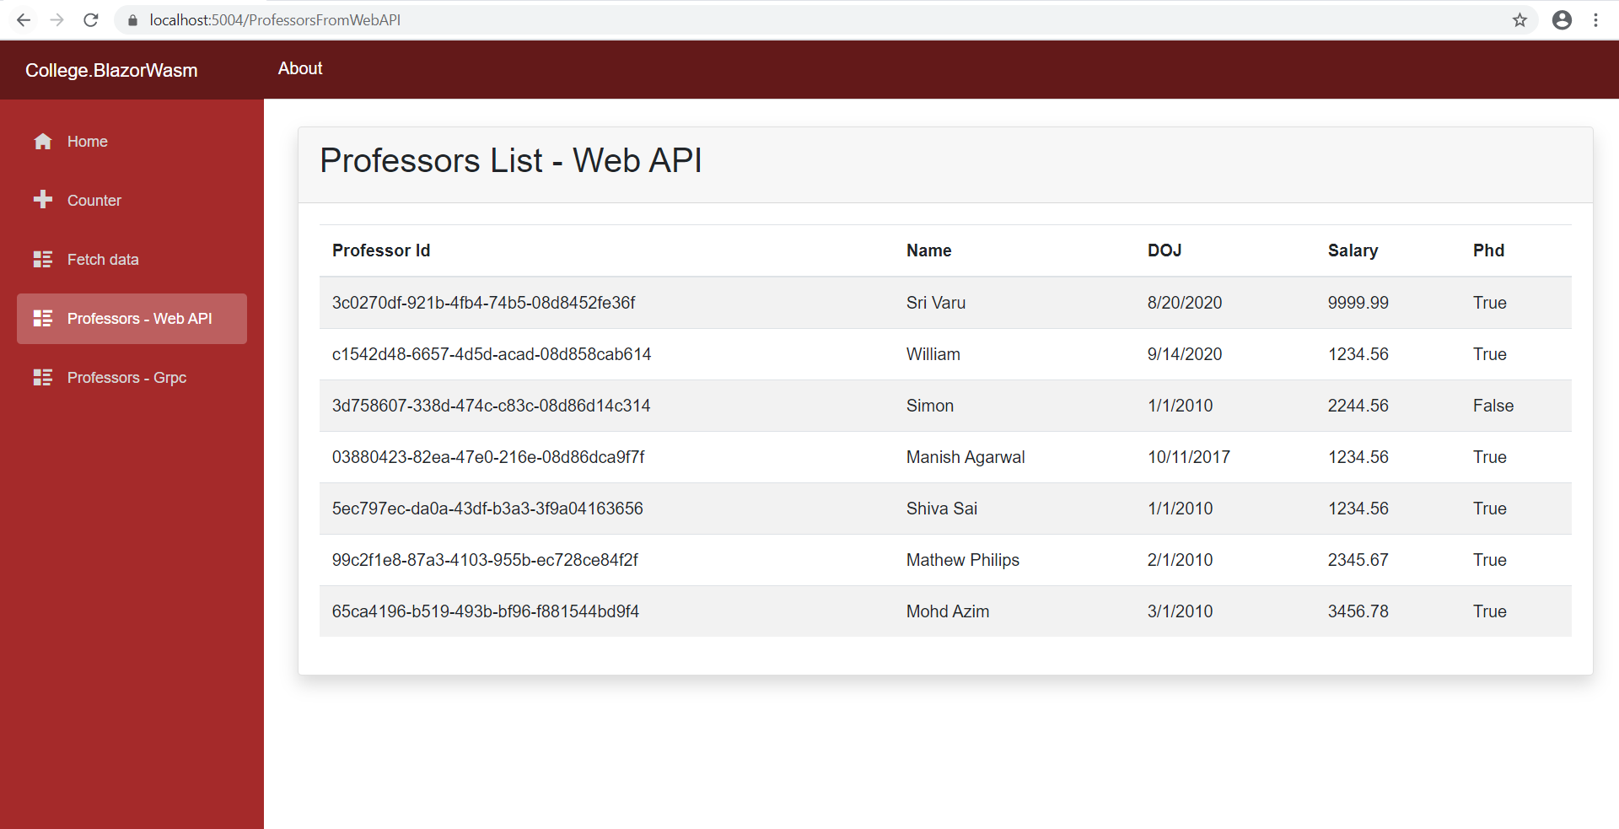
Blazor WASM communicating with REST Web API
C# Corner

Slide 23
Q & A
C# Corner

Slide 24
Thank You
Viswanatha Swamy
LinkedIn: https://www.linkedin.com/in/viswanatha-swamy-b57326128/
Twitter: https://twitter.com/vishipayyallore
C# Corner

