Slide 1
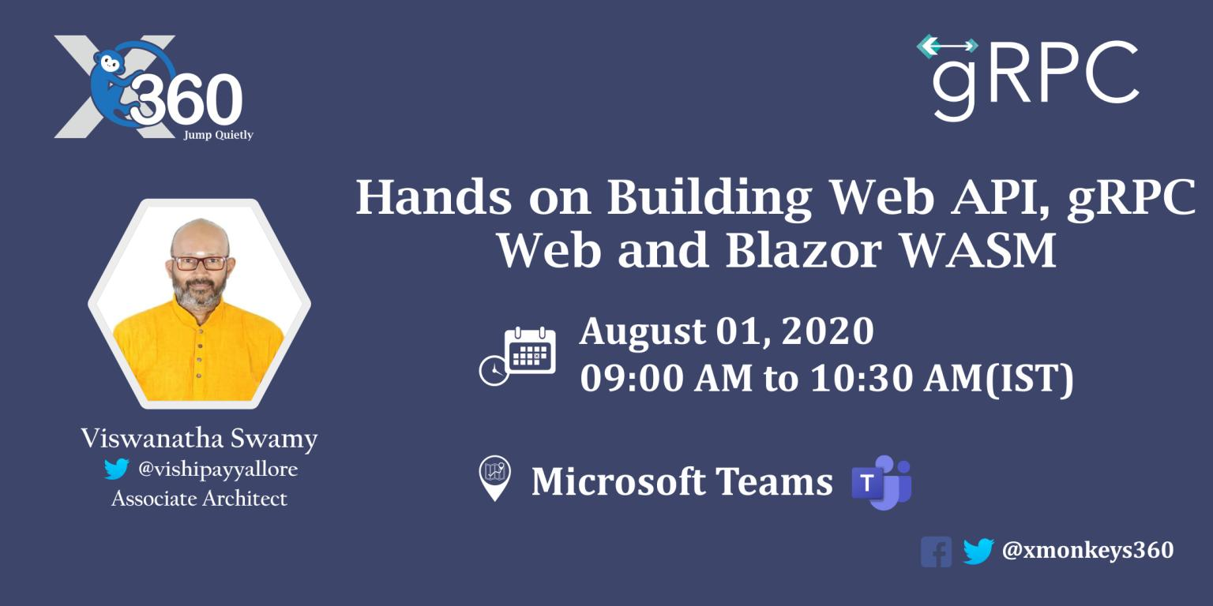
Session 8 of 12
Viswanatha Swamy
LinkedIn: https://www.linkedin.com/in/viswanatha-swamy-b57326128/
Twitter: https://twitter.com/vishipayyallore
XMonkeys360

Slide 2
Information
Today is session 8.
All the sessions will be hands on.
Sessions will be weekly.
Will have parking lots for queries and other topics.
Some of the concepts we will introduced and revisited in next sessions.
There are multiple ways to do, we will use one of the way.
The focus was more on concepts and demos are kept simple.
I am still a learner. What!!! … wait … Yes, I am still a learner.
XMonkeys360

Slide 3
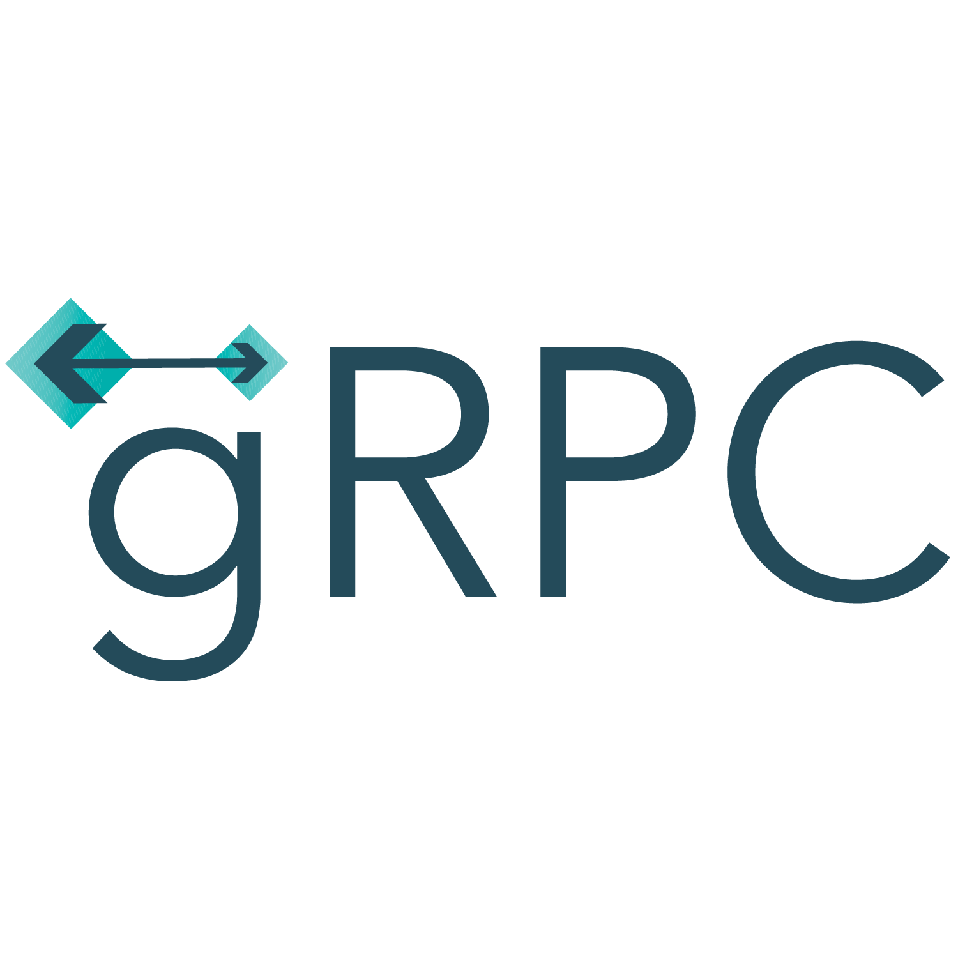
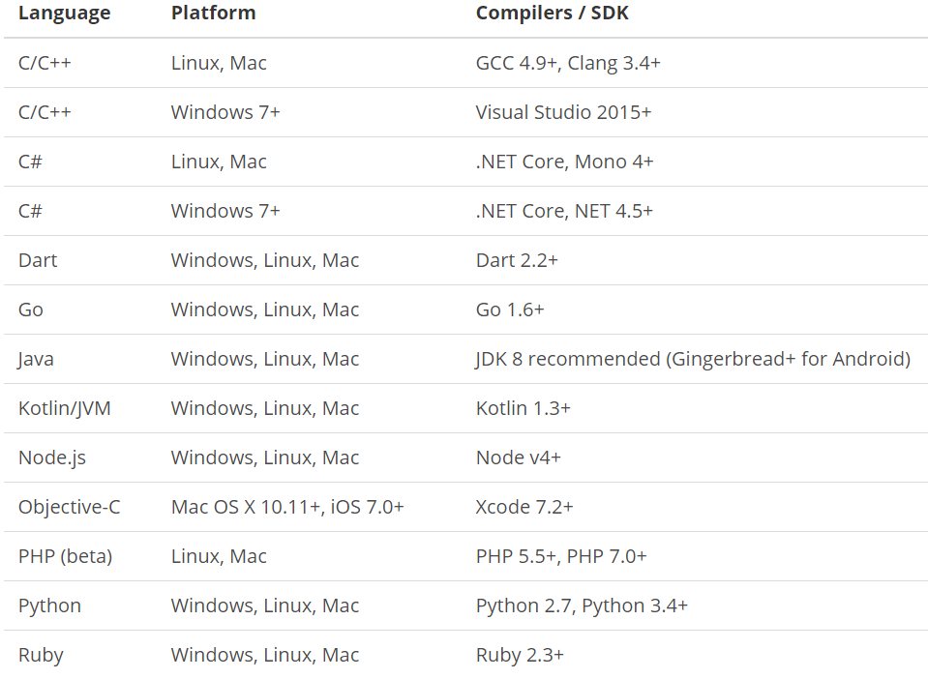
What is gRPC ?
is a modern open source high performance RPC framework that can run in any environment. It can efficiently connect services in and across data centers with pluggable support for load balancing, tracing, health checking and authentication. It is also applicable in last mile of distributed computing to connect devices, mobile applications and browsers to backend services.
https://docs.microsoft.com/en-us/aspnet/core/tutorials/grpc/grpc-start?view=aspnetcore-3.1&tabs=visual-studio
https://grpc.io/docs/guides/
https://grpc.io/docs/guides/concepts/
Motivation:
High Performance
IDL / Contract Based
Streaming (Unary, Client, Server, Bi-directional)
Security (https://developers.google.com/web/fundamentals/performance/http2)
Available across ecosystems
Supported Languages:
URL: https://grpc.io/about/#officially-supported-languages-and-platforms
XMonkeys360

Slide 4
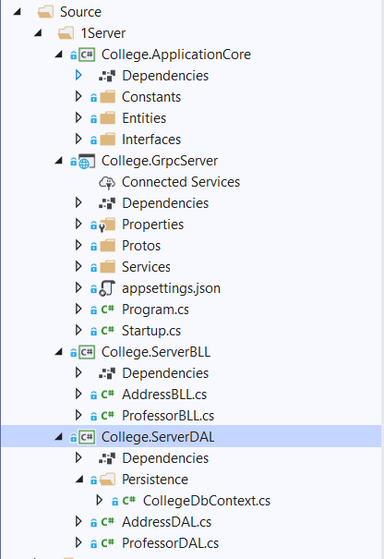
Improvising the gRPC Service into Layers
College.ApplicationCore:
Constants
Entities
Interfaces
College.GrpcServer:
.Proto files
gRPC Server implementations
Application Configuration
Start up and DI
College.ServerBLL:
Any Business Logic
College.ServerDAL:
Db Context
Data Access Layer which consumes Db Context
XMonkeys360

Slide 5
Improvising the gRPC Service into Layers
Demo
Improvising the gRPC Service
into Layers
XMonkeys360

Slide 6
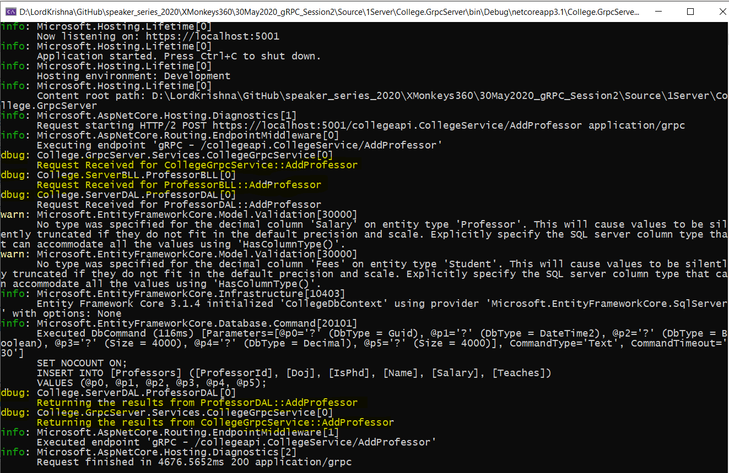
Adding Console Logging into gRPC Server and Client
XMonkeys360

Slide 7
Adding Console Logging into gRPC Server and Client
Demo
Adding Console Logging into
gRPC Server and Client
XMonkeys360

Slide 8
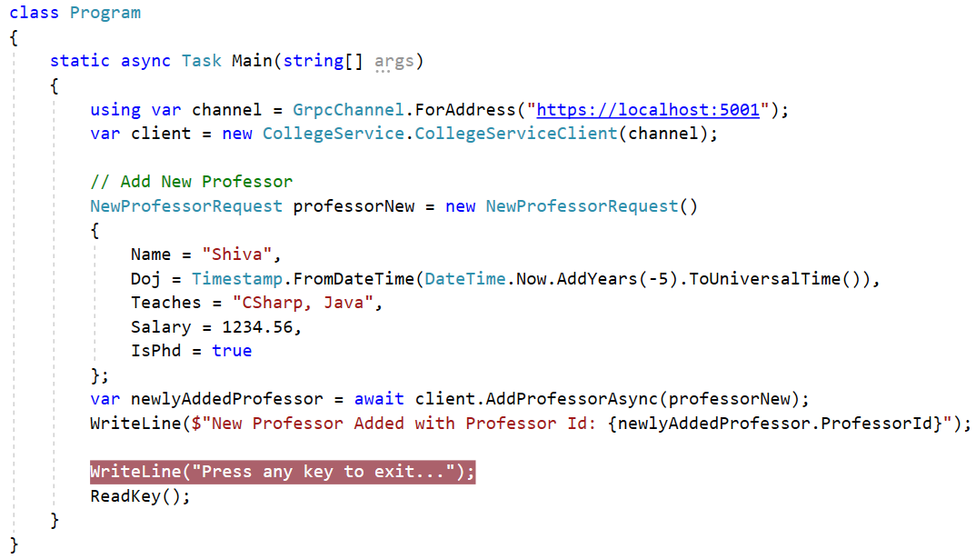
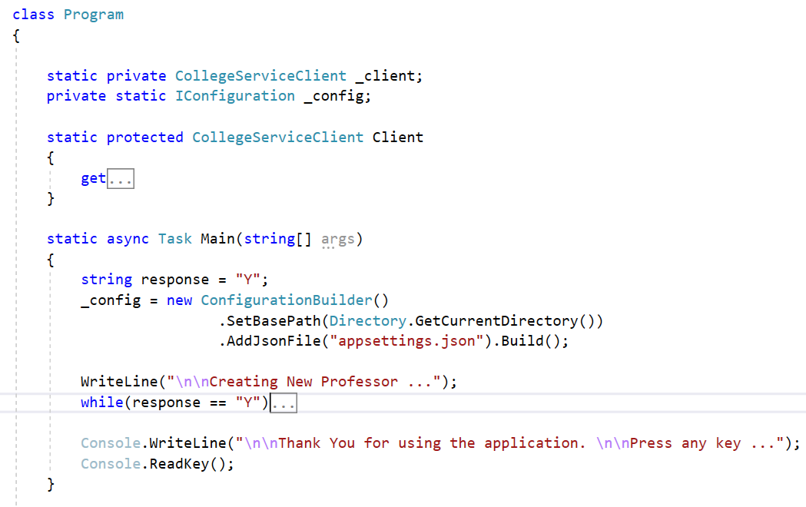
Improvising the gRPC Client
XMonkeys360

Slide 9
Improvising the gRPC Client
Demo
Improvising the gRPC Client
XMonkeys360

Slide 10
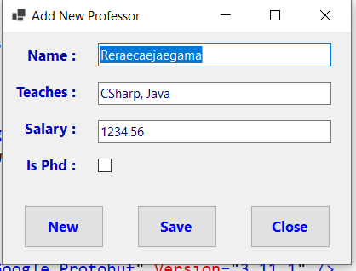
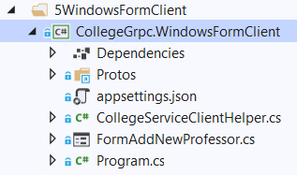
Windows Forms as gRPC Client
XMonkeys360

Slide 11
Windows Forms as gRPC Client
Demo
Windows Forms as gRPC Client
XMonkeys360

Slide 12
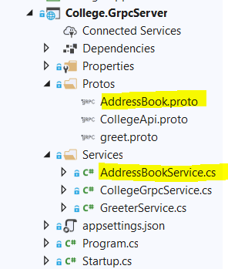
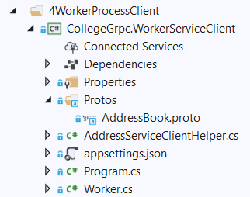
.NET Core Worker Process as gRPC Client
XMonkeys360

Slide 13
.NET Core Worker Process as gRPC Client
Demo
.NET Core Worker Process
as gRPC Client
XMonkeys360

Slide 14
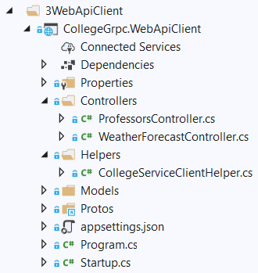
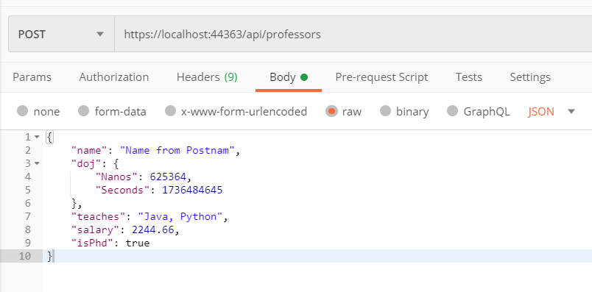
.NET Core Web API as gRPC Client
XMonkeys360

Slide 15
.NET Core Web API as gRPC Client
Demo
.NET Core Web API
as gRPC Client
XMonkeys360

Slide 16

What is next?
What is next ???
What we will discuss in next session (27-Jun-2020) ….
Service to Service Communication using REST and gRPC, Hosting it in Azure
Using Azure Redis Cache, and SQL Azure.
Hosting the gRPC Service on Ubuntu VM in Azure US Region.
Hosting the gRPC Client on Windows VM in Azure India Region.
Service to Service communication between REST/gRPC Service and Client.
XMonkeys360

Slide 17
Q & A
XMonkeys360

Slide 18
Thank You
Viswanatha Swamy
LinkedIn: https://www.linkedin.com/in/viswanatha-swamy-b57326128/
Twitter: https://twitter.com/vishipayyallore
XMonkeys360

