Slide 1

Session 2 of 4
Hands-On Developing gRPC Service and Client
using .NET Core 3.1, EF Core 3.1, SQL Server
Viswanatha Swamy
LinkedIn: https://www.linkedin.com/in/viswanatha-swamy-b57326128/
Twitter: https://twitter.com/vishipayyallore
BrewingCodes

Slide 2
Information
Today is session 1.
All the sessions will be hands on.
Sessions will be weekly.
Will have parking lots for queries and other topics.
Some of the concepts we will introduced and revisited in next sessions.
There are multiple ways to do, we will use one of the way.
The focus was more on concepts and demos are kept simple.
I am still a learner. What!!! … wait … Yes, I am still a learner.
BrewingCodes

Slide 3
Tools we use
Visual Studio 2019 Professional
Azure Data Studio
SQL Server
BrewingCodes

Slide 4
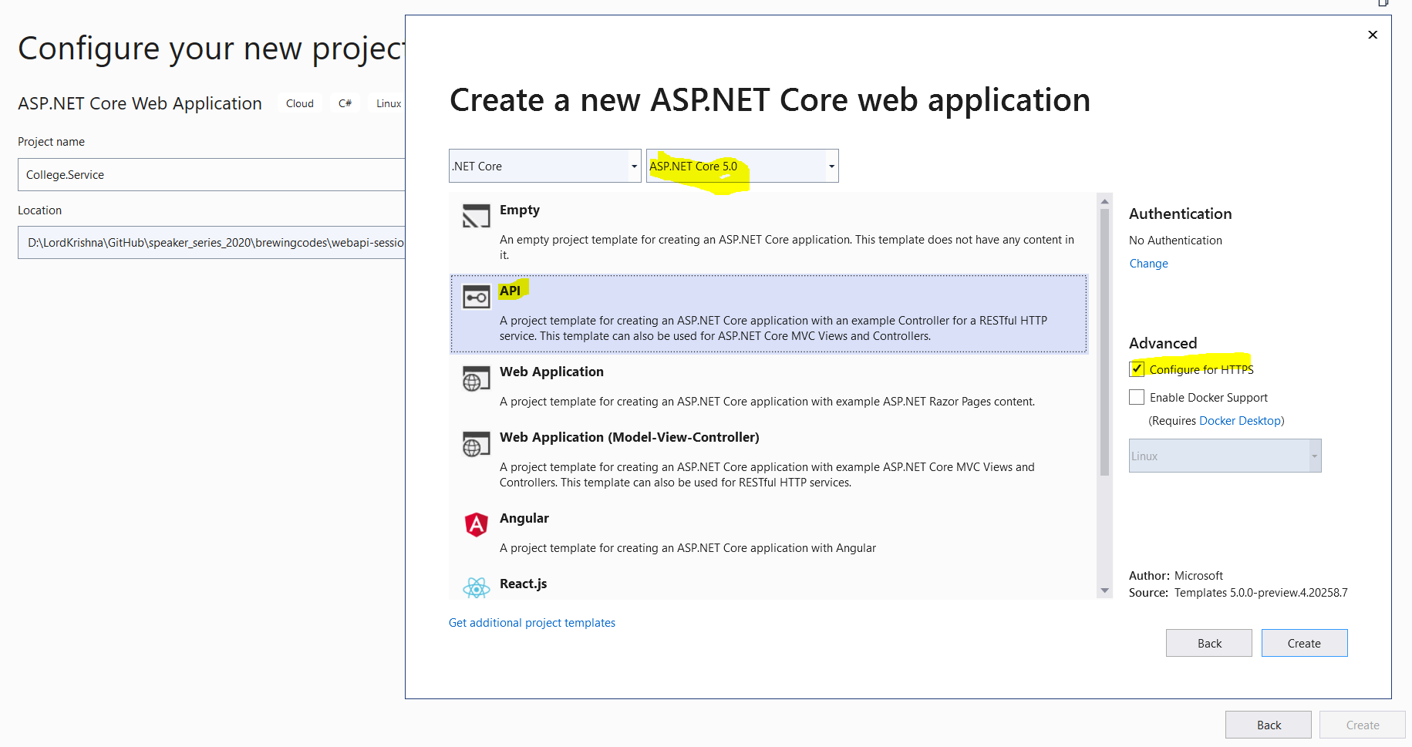
Web API Template
ToBeDone

Slide 5
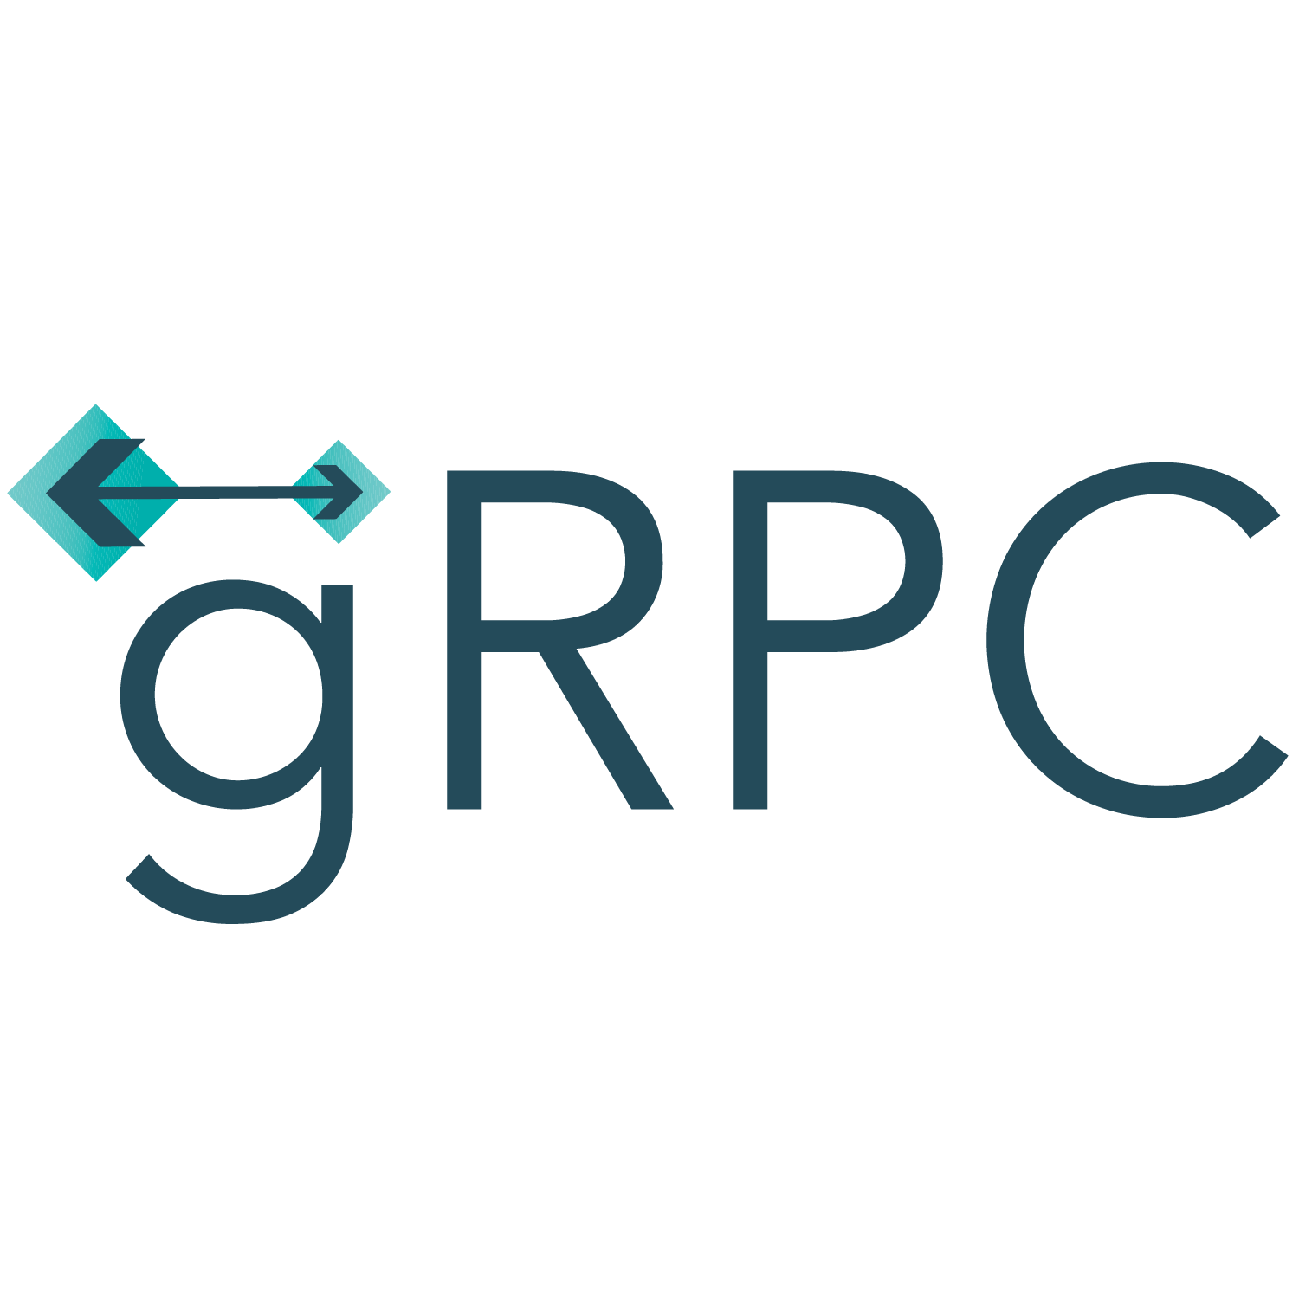
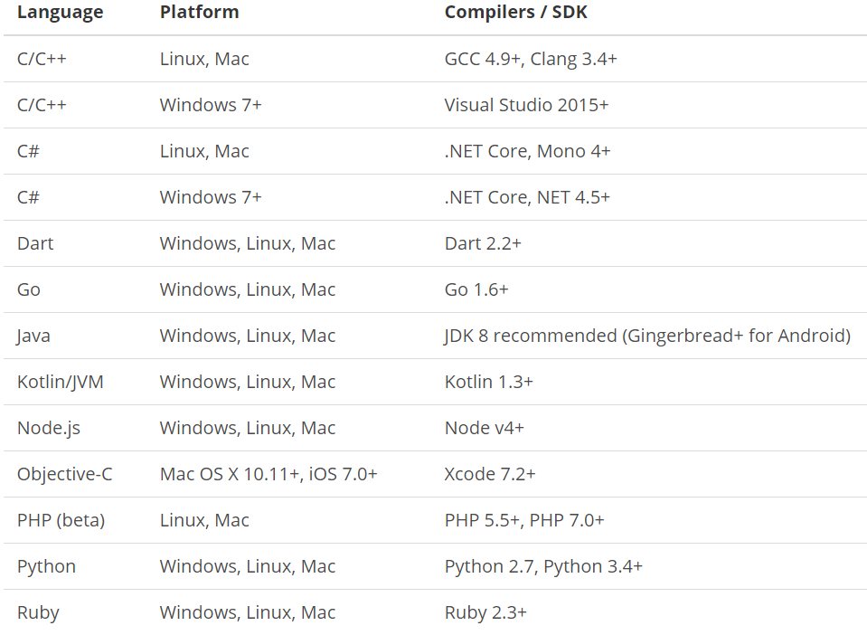
What is gRPC ?
is a modern open source high performance RPC framework that can run in any environment. It can efficiently connect services in and across data centers with pluggable support for load balancing, tracing, health checking and authentication. It is also applicable in last mile of distributed computing to connect devices, mobile applications and browsers to backend services.
https://docs.microsoft.com/en-us/aspnet/core/tutorials/grpc/grpc-start?view=aspnetcore-3.1&tabs=visual-studio
https://grpc.io/docs/guides/
https://grpc.io/docs/guides/concepts/
Motivation:
High Performance
IDL / Contract Based
Streaming (Unary, Client, Server, Bi-directional)
Security (https://developers.google.com/web/fundamentals/performance/http2)
Available across ecosystems
Supported Languages:
URL: https://grpc.io/about/#officially-supported-languages-and-platforms
BrewingCodes

Slide 6
gRPC Overview
Overview:
History: RPC, COM/DCOM/Java RMI, SOAP/XML, REST, gRPC
Binary communication | Contract-based | Available across ecosystems | Uni and Bi-directional streaming
gRPC requires HTTP/2 protocol to transport binary messages. (https://developers.google.com/web/fundamentals/performance/http2)
gRPC uses protocol buffers (Protobuf) as the Interface Definition Language (IDL) for describing both the service interface and the structure of the payload messages.
Where do I use it?
Micro Services - Low latency, highly scalable, distributed systems.
Best suits in Micro Service to Service direct communication.
Client-Server like Desktop – Server / Mobile – Server / Web Browser - Server
Language independent
Integration with 3rd Party Systems
Low powered IOT devices.
BrewingCodes

Slide 7
Who is winning the race ?
SOAP + XML (Active Server Method Extended) Web Service: provides the ability to build web services that send messages using the Simple Object Access Protocol (SOAP).
REST: Best suits for CURD Web API.
Signal R: Multi-casting and Web Messaging.
gRPC: Low Resource clients, service to service inter-data center communication and streaming.
Graph QL: Querying Large Datasets.
Webhooks: Webhooks are "HTTP callbacks". They are usually triggered by some event, such as pushing code to a repository.
BrewingCodes

Slide 8
Types of gRPC communications
Currently gRPC comes with four different types of RPC
Unary RPC: this is the simplest form of RPC. In this case, the client sends a request message to the server and receives a response.
Client streaming RPC: this is the case where the client sends a sequence of messages and receives a single response from the server.
Server streaming RPC: in this scenario, the client sends a request message to the server and receives a sequence of responses.
Bidirectional streaming RPC: in this case, the client and the server exchange messages in both directions.
BrewingCodes

Slide 9
Introduction to Protocol Buffers
Protocol Buffers is an interface language used to build contracts.
Tools are available for the most common programming languages to translate these Protobuf interfaces into code.
Interface Definition Language | Language-neutral | Platform-neutral | Serializable
Version 3 (proto3):
proto2 and proto3.
.proto File:
The first line of the file specifies proto3 syntax: if you don't do this the protocol buffer compiler will assume proto2.
We are using scalar type for the fields.
Each field in the message definition has a unique number.
It is used to identify the fields in the message binary format and should not be changed once your message type is in use.
We can define multiple message inside single .proto file.
Adding Comments // OR /* */
Defining A Message Type:
message SimpleRequest {
string userName = 1;
int32 userId = 2;
}
BrewingCodes

Slide 10
Introduction to Protocol Buffers
Scalar Value Types:
.proto type = C# Type
double = double
float = float
int32 = int
int64 = long
bool = bool
string = string
Default Values:
strings = the default value is the empty string.
bools = the default value is false.
numeric = the default value is zero.
BrewingCodes

Slide 11
Terminology
Service: It is interface/contract which is defined in .proto file. It is set of named methods with its input/output.
Method: It is the operation. It has a signature, input, and output.
Message: It is the type of data each operation’s uses (Input/Output).
Stream: A sequence of zero or more messages.
Service Implementation: Implementation of all the methods/operations defined in service. When a client invokes a method on its stub, the gRPC server receives the request and invokes the method in service implementation.
Server: A program that exposes one or more gRPC services using gRPC protocol and handles clients’ requests and replies to them. It handles accepting socket connections, translating requests, invoking methods on the server’s service implementations, and sending responses.
Client: A program that establishes the connections to a server and sends RPC requests. Client program that handles establishing connections to servers, sending requests, and translating responses.
Connection: A virtual pipe that connects the client to the server. In gRPC, connections always use the HTTP/ 2 protocol.
Stub: It is an object used by gRPC clients. Invoking a method on the stub hooks into the gRPC client to send a request to a server.
BrewingCodes

Slide 12
Creating Hello World gRPC Service
Dotnet Version Verification:
dotnet --list-sdks
dotnet --version
Creating the first gRPC Service
mkdir first-grpcdemo
cd first-grpcdemo
dotnet new grpc -o GrpcGreeter
dotnet run and verify it host the gRPC Server
Few touch points:
Verify the .csproj file
Verify the .cs files (Greet.cs, GreetGrpc.cs) auto generate GRPC tools
Verify the StartUp.cs
BrewingCodes

Slide 13
Creating Hello World gRPC Service
Demo
Creating gRPC Service
BrewingCodes

Slide 14
Creating Hello World gRPC Client
Step 1:
dotnet new console -o GrpcGreeterClient
Step 2:
<ItemGroup>
<PackageReference Include="Google.Protobuf" Version="3.11.1" />
<PackageReference Include="Grpc.Core" Version="2.25.0" />
<PackageReference Include="Grpc.Net.Client" Version="2.26.0-pre1" />
<PackageReference Include="Grpc.Tools" Version="2.26.0-pre1">
<PrivateAssets>all</PrivateAssets>
<IncludeAssets>runtime; build; native; contentfiles; analyzers; buildtransitive</IncludeAssets>
</PackageReference>
</ItemGroup>
<ItemGroup>
<Protobuf Include="Protos\greet.proto" GrpcServices="Client" />
</ItemGroup>
Step 3:
using var channel = GrpcChannel.ForAddress("https://localhost:5001");
var client = new Greeter.GreeterClient(channel);
var reply = await client.SayHelloAsync(
new HelloRequest { Name = "GreeterClient" });
Console.WriteLine("Greeting: " + reply.Message);
Console.WriteLine("Press any key to exit...");
Console.ReadKey();
BrewingCodes

Slide 15
Creating Hello World gRPC Client
Demo
Creating gRPC Client
and communicating with
gRPC Server
BrewingCodes

Slide 16
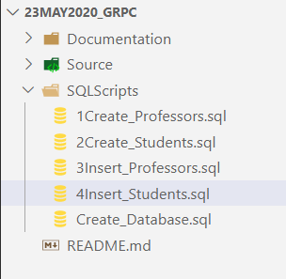
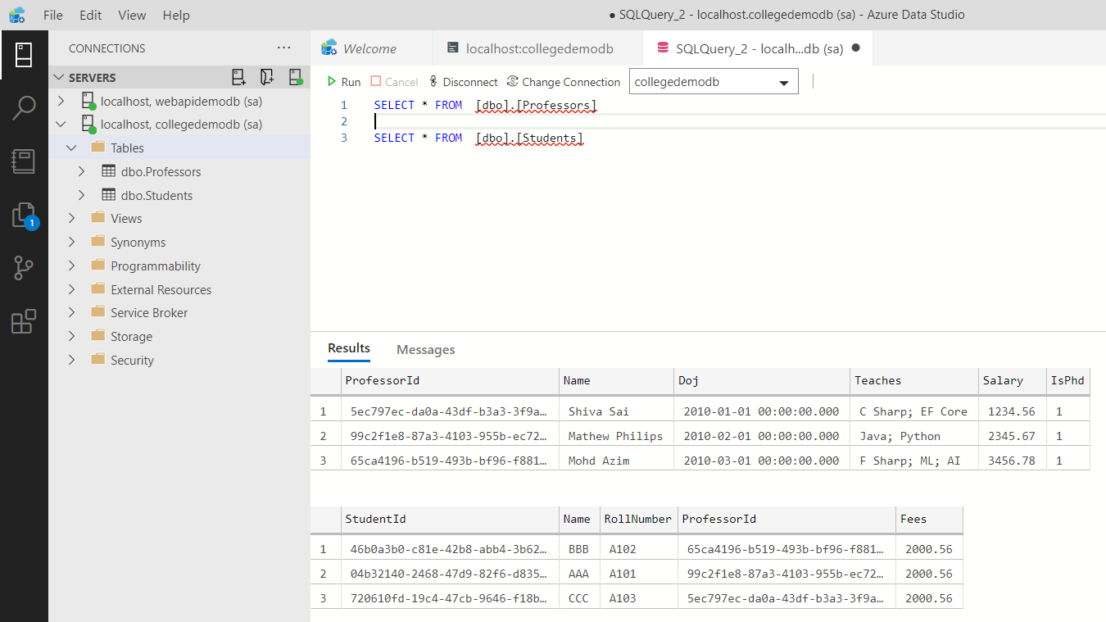
Setting up the Data Store
BrewingCodes

Slide 17
Setting up the Data Store
Demo
Creating SQL database
and tables using
Azure Data Studio
BrewingCodes

Slide 18
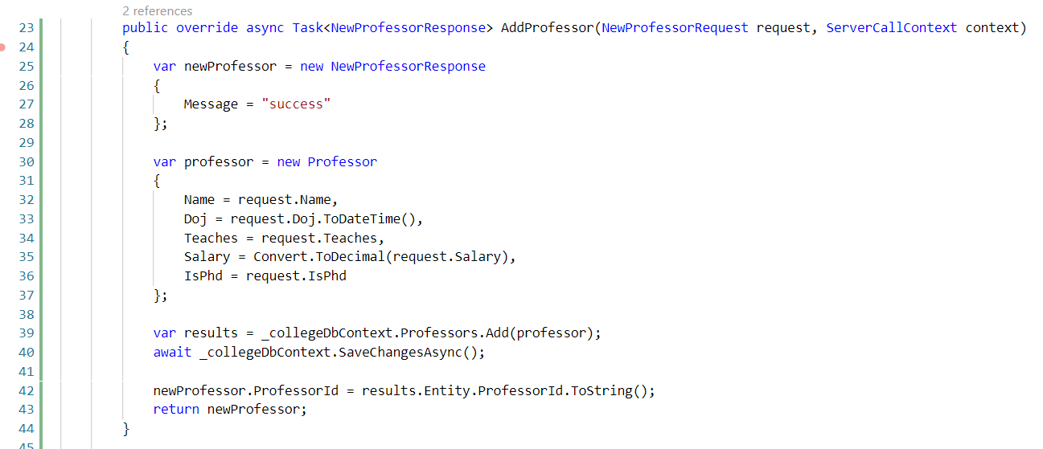
Creating gRPC Service to store data into SQL Server
BrewingCodes

Slide 19
Creating gRPC Service to store data into SQL Server
Demo
Creating gRPC Service
to stored data
into SQL Server
BrewingCodes

Slide 20
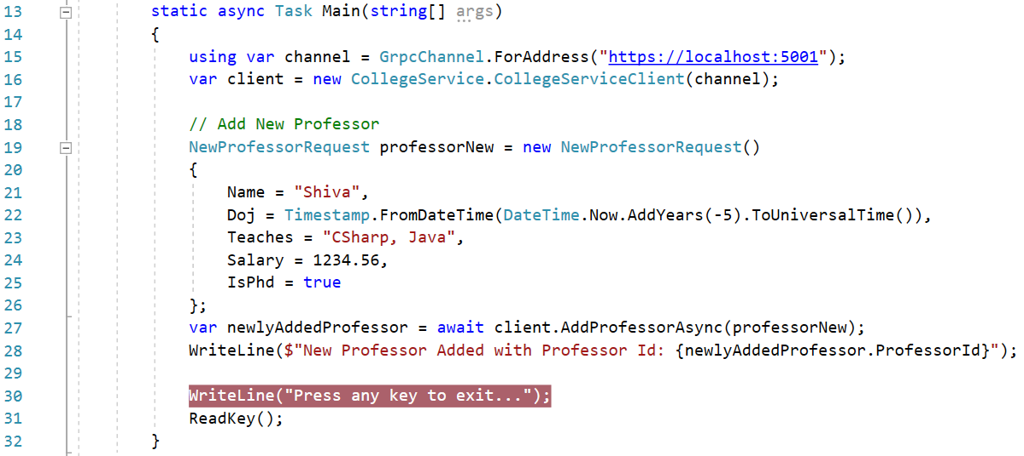
Creating gRPC Client to pass data gRPC Server
BrewingCodes

Slide 21
Creating gRPC Client to pass data gRPC Server
Demo
Creating gRPC Client
to pass data to
gRPC Service
BrewingCodes

Slide 22

What is next?
What is next ???
What we will discuss in next session ….
Improvising the gRPC Service into Layers.
Adding Console Logging into gRPC Server and Client.
Creating ASP.Net Web API .NET Core 3.1 as gRPC Client to consume GRPC Service.
Creating Worker Service in .NET Core 3.1 as gRPC Client to consume GRPC Service.
Creating Windows Forms in .NET Core 3.1 as gRPC Client to consume GRPC Service.
BrewingCodes

Slide 23
Q & A
BrewingCodes

Slide 24
Thank You
Viswanatha Swamy
LinkedIn: https://www.linkedin.com/in/viswanatha-swamy-b57326128/
Twitter: https://twitter.com/vishipayyallore
BrewingCodes

