Slide 1
Hands-On Working With Redis Cache With
.NET Core Web API, And Angular 9 UI
Viswanatha Swamy
LinkedIn: https://www.linkedin.com/in/viswanatha-swamy-b57326128/
Twitter: https://twitter.com/vishipayyallore
C# Corner

Slide 2
Information
This session will be hands on.
Will have parking lots for queries and other topics.
Some of the concepts we will introduced and revisited in next sessions.
There are multiple ways to do, we will use one of the way.
The focus was more on concepts and demos are kept simple.
I am still a learner. What!!! … wait … Yes, I am still a learner.
C# Corner

Slide 3
Tools we use
Visual Studio 2019 Professional
Azure Data Studio
SQL Server
C# Corner

Slide 4
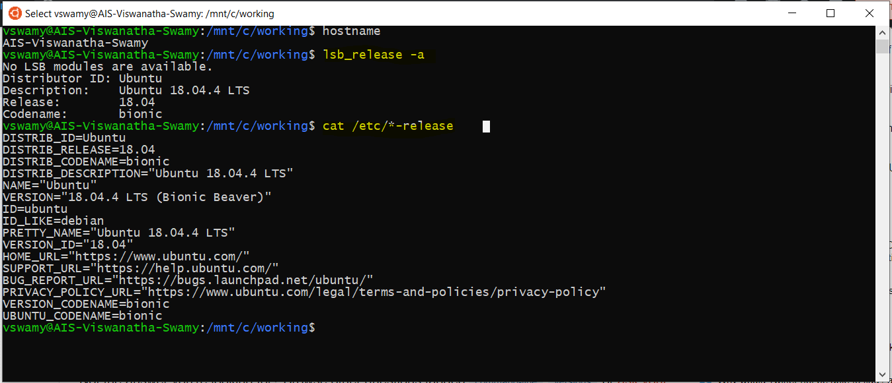
Install WSL on Windows 10
Please refer official documentation for detailed steps. URL: https://docs.microsoft.com/en-us/windows/wsl/install-win10
C# Corner

Slide 5
Install WSL on Windows 10
Demo
Verify the WSL on Windows 10
hostname
lsb_release -a
cat /etc/*-release
C# Corner

Slide 6
Install Redis Cache on WSL on Windows 10
Please refer official documentation for detailed steps. URL: https://redislabs.com/blog/redis-on-windows-10/
Install Redis Cache on WSL on Windows 10
sudo apt-get update
sudo apt-get upgrade
sudo apt-get install redis-server
To Start and Stop the Redis Service
sudo service redis-server restart
sudo service redis-server stop
To Start and Stop the Redis Service
redis-server -v
redis-cli -v
To Connect to Redis Server
redis-cli
C# Corner

Slide 7
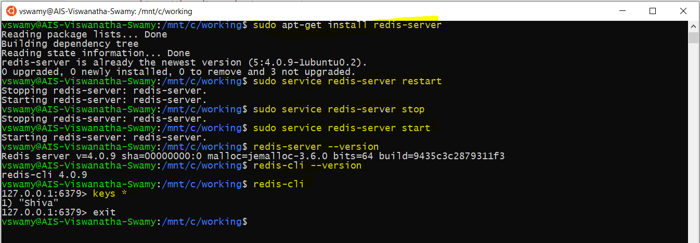
Install Redis Cache on WSL on Windows 10
C# Corner

Slide 8
Install Redis Cache on WSL on Windows 10
Demo
Install Redis Cache
on WSL on Windows 10
C# Corner

Slide 9
What is next?
What is next ???
What we will discuss in next session ….
Adding GetById(), and GetAll() into .Proto file.
Implementing the functionality to return Single and Multiple Records into gRPC Server.
Setting up and verifying Redis Cache in our Laptop.
To Install on WSL on Windows 10
To Start and Stop the Redis Service
To connect to Redis Server
Improving the Retrieval Time by using Redis Cache.
Verify the Time of retrieval of data with and without Redis Cache.
C# Corner

Slide 10
Q & A
C# Corner

Slide 11
Thank You
Viswanatha Swamy
LinkedIn: https://www.linkedin.com/in/viswanatha-swamy-b57326128/
Twitter: https://twitter.com/vishipayyallore
C# Corner

