Slide 1

July 2020 – Meet up
Hands-On Developing
Web API, gRPC Web and Blazor WASM
in .NET Core
Viswanatha Swamy
LinkedIn: https://www.linkedin.com/in/viswanatha-swamy-b57326128/
Twitter: https://twitter.com/vishipayyallore
bdotnet.in

Slide 2
Information:
All the sessions will be hands on.
Will have parking lots for queries and other topics.
There are multiple ways to do, we will use one of the way.
The focus was more on concepts and demos are kept simple.
I am still a learner. What!!! … wait … Yes, I am still a learner.
Tools Used:
Visual Studio 2019 Professional
Azure Data Studio
SQL Server
bdotnet.in

Slide 3
Tools we use
Visual Studio 2019 Professional
Azure Data Studio
SQL Server
bdotnet.in

Slide 4

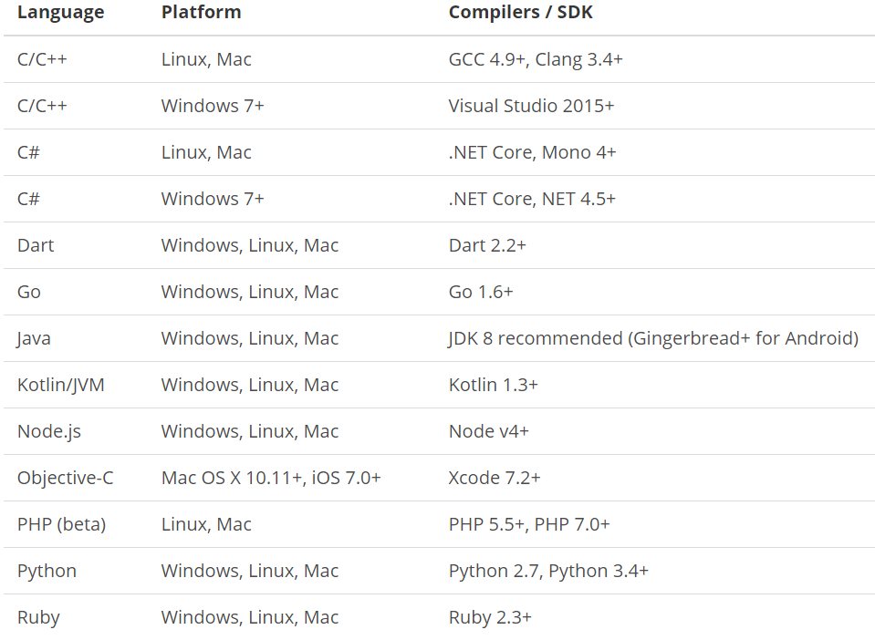
What is gRPC ?
is a modern open source high performance RPC framework that can run in any environment. It can efficiently connect services in and across data centers with pluggable support for load balancing, tracing, health checking and authentication. It is also applicable in last mile of distributed computing to connect devices, mobile applications and browsers to backend services.
https://docs.microsoft.com/en-us/aspnet/core/tutorials/grpc/grpc-start?view=aspnetcore-3.1&tabs=visual-studio
https://grpc.io/docs/guides/
https://grpc.io/docs/guides/concepts/
Motivation:
High Performance
IDL / Contract Based
Streaming (Unary, Client, Server, Bi-directional)
Security (https://developers.google.com/web/fundamentals/performance/http2)
Available across ecosystems
Supported Languages:
URL: https://grpc.io/about/#officially-supported-languages-and-platforms
bdotnet.in

Slide 5
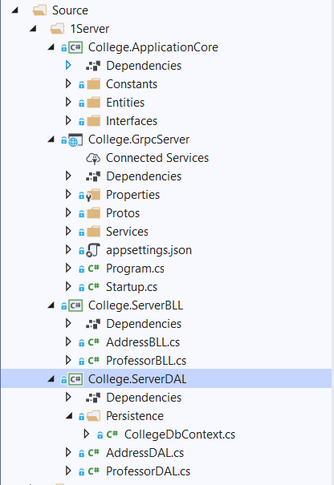
Improvising the gRPC Service into Layers
College.ApplicationCore:
Constants
Entities
Interfaces
College.GrpcServer:
.Proto files
gRPC Server implementations
Application Configuration
Start up and DI
College.ServerBLL:
Any Business Logic
College.ServerDAL:
Db Context
Data Access Layer which consumes Db Context
bdotnet.in

Slide 6
Improvising the gRPC Service into Layers
Demo
Improvising the gRPC Service
into Layers
bdotnet.in

Slide 7
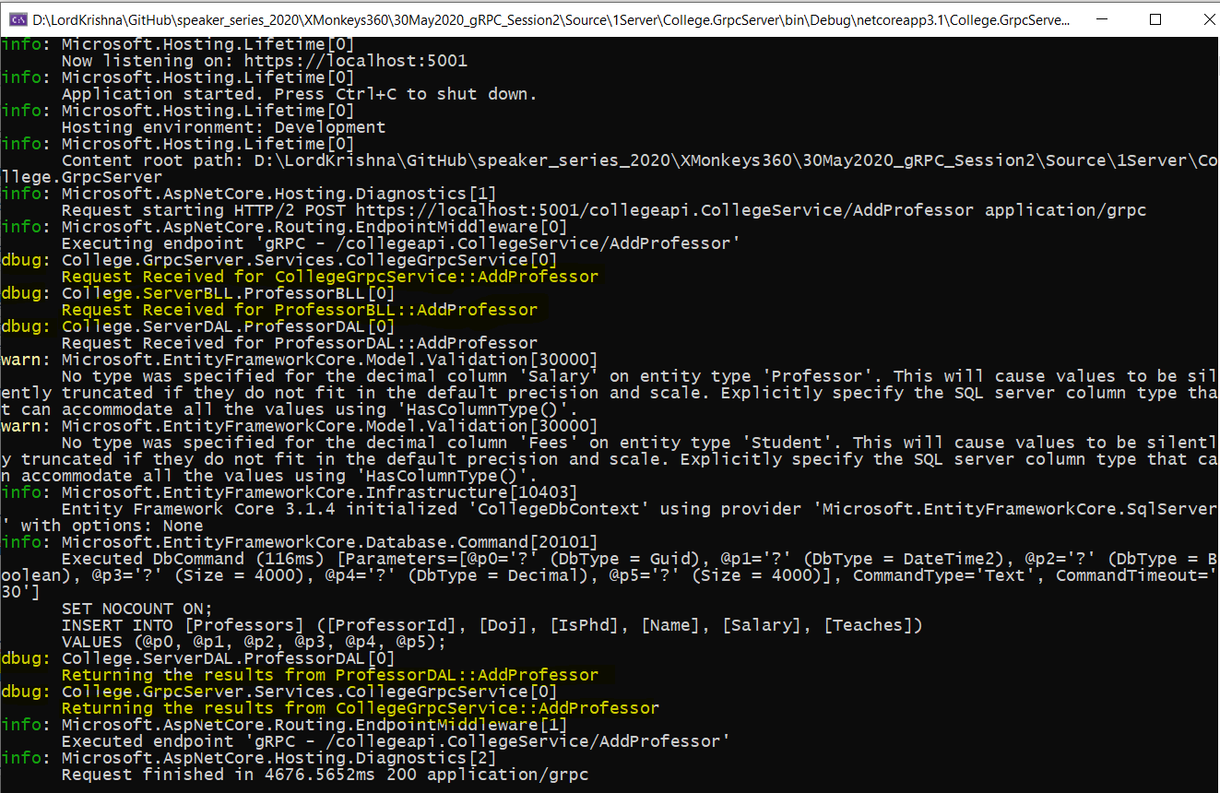
Adding Console Logging into gRPC Server and Client
bdotnet.in

Slide 8
Adding Console Logging into gRPC Server and Client
Demo
Adding Console Logging into
gRPC Server and Client
bdotnet.in

Slide 9
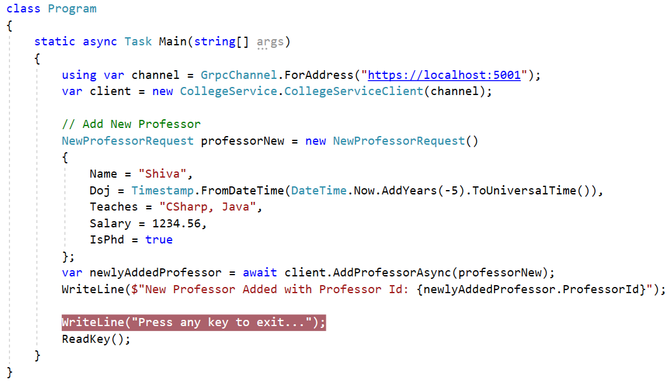
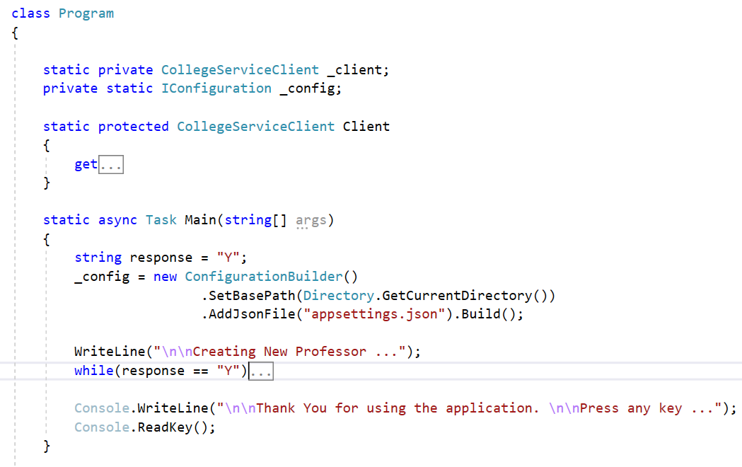
Improvising the gRPC Client
bdotnet.in

Slide 10
Improvising the gRPC Client
Demo
Improvising the gRPC Client
bdotnet.in

Slide 11
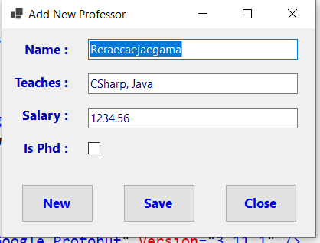
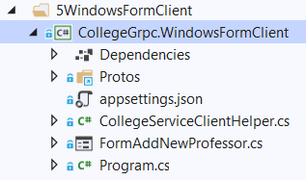
Windows Forms as gRPC Client
bdotnet.in

Slide 12
Windows Forms as gRPC Client
Demo
Windows Forms as gRPC Client
bdotnet.in

Slide 13
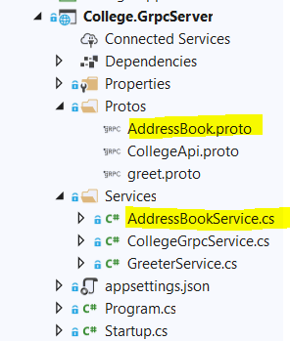
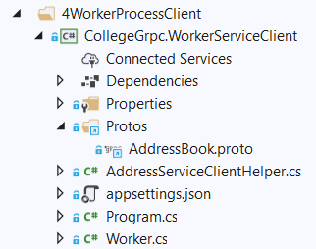
.NET Core Worker Process as gRPC Client
bdotnet.in

Slide 14
.NET Core Worker Process as gRPC Client
Demo
.NET Core Worker Process
as gRPC Client
bdotnet.in

Slide 15
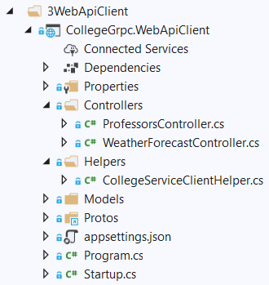
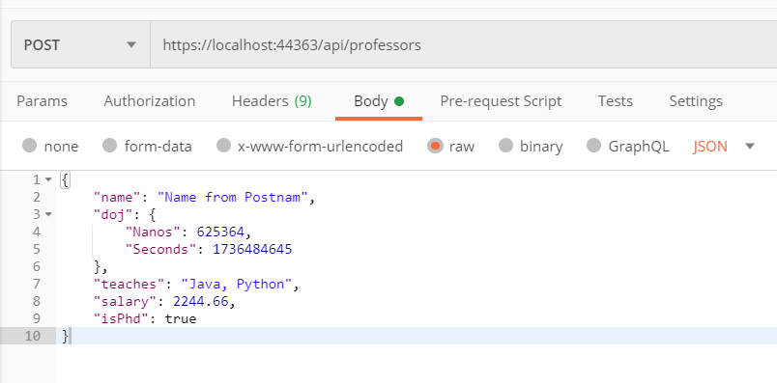
.NET Core Web API as gRPC Client
bdotnet.in

Slide 16
.NET Core Web API as gRPC Client
Demo
.NET Core Web API
as gRPC Client
bdotnet.in

Slide 17
Q & A
bdotnet.in

Slide 18
Thank You
Viswanatha Swamy
LinkedIn: https://www.linkedin.com/in/viswanatha-swamy-b57326128/
Twitter: https://twitter.com/vishipayyallore
bdotnet.in

