Slide 1
Hands-On Working With Redis Cache With
.NET Core Web API, And Angular 9 UI
Viswanatha Swamy
LinkedIn: https://www.linkedin.com/in/viswanatha-swamy-b57326128/
Twitter: https://twitter.com/vishipayyallore
C# Corner

Slide 2
Information
This session will be hands on.
Will have parking lots for queries and other topics.
Some of the concepts we will introduced and revisited in next sessions.
There are multiple ways to do, we will use one of the way.
The focus was more on concepts and demos are kept simple.
I am still a learner. What!!! … wait … Yes, I am still a learner.
C# Corner

Slide 3
Tools we use
Visual Studio 2019 Professional
Azure Data Studio
SQL Server
C# Corner

Slide 4
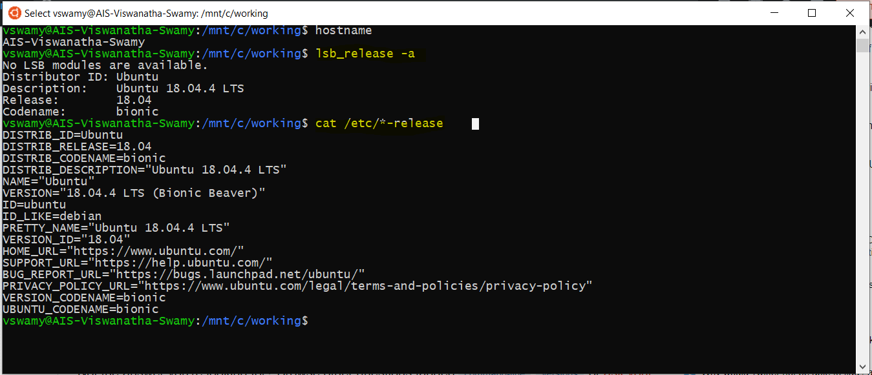
Install WSL on Windows 10
Please refer official documentation for detailed steps. URL: https://docs.microsoft.com/en-us/windows/wsl/install-win10
C# Corner

Slide 5
Install WSL on Windows 10
Demo
Verify the WSL on Windows 10
hostname
lsb_release -a
cat /etc/*-release
C# Corner

Slide 6
Install Redis Cache on WSL on Windows 10
Please refer official documentation for detailed steps. URL: https://redislabs.com/blog/redis-on-windows-10/
Install Redis Cache on WSL on Windows 10
sudo apt-get update
sudo apt-get upgrade
sudo apt-get install redis-server
To Start and Stop the Redis Service
sudo service redis-server restart
sudo service redis-server stop
To Start and Stop the Redis Service
redis-server -v
redis-cli -v
To Connect to Redis Server
redis-cli
C# Corner

Slide 7
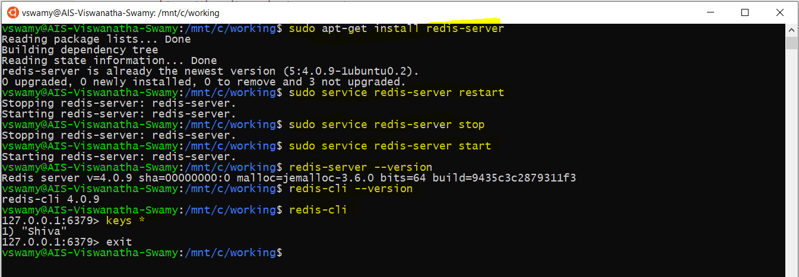
Install Redis Cache on WSL on Windows 10
C# Corner

Slide 8
Install Redis Cache on WSL on Windows 10
Demo
Install Redis Cache
on WSL on Windows 10
C# Corner

Slide 9
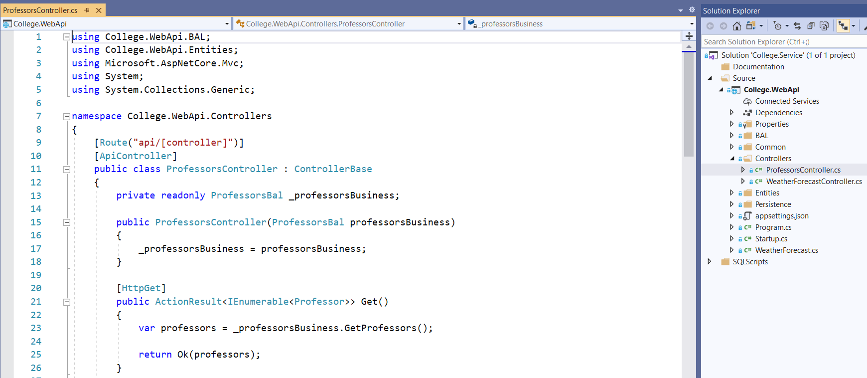
Creating Simple ASP.Net Core 3.1 Web API (EF Core)
We will create the Simple Web API using ASP.Net Core 3.1, EF Core 3.1.
We will verify the Web API using Postman.
C# Corner

Slide 10
Creating Simple ASP.Net Core 3.1 Web API (EF Core)
Demo
Creating Simple ASP.Net Core 3.1
Web API (EF Core)
C# Corner

Slide 11
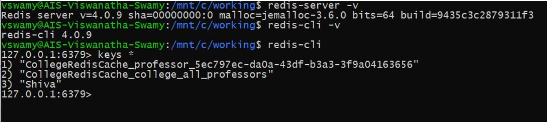
Adding Redis Cache into Web API
We will add the Redis Cache Nuget package and configure it in Start up class.
Verify the DI services Container using Shift + F9
Get All Professors. Verify the Redis Cache from Command line.
Verify the Time Stamps of retrieval with and without Redis Cache.
Retrieve a Professor. Verify the Redis Cache from Command line.
Verify the Time Stamps of retrieval with and without Redis Cache.
Delete OR Wait till the Cache Expiration and verify the time stamps.
C# Corner

Slide 12
Adding Redis Cache into Web API
Demo
Adding Redis Cache into Web API
C# Corner

Slide 13
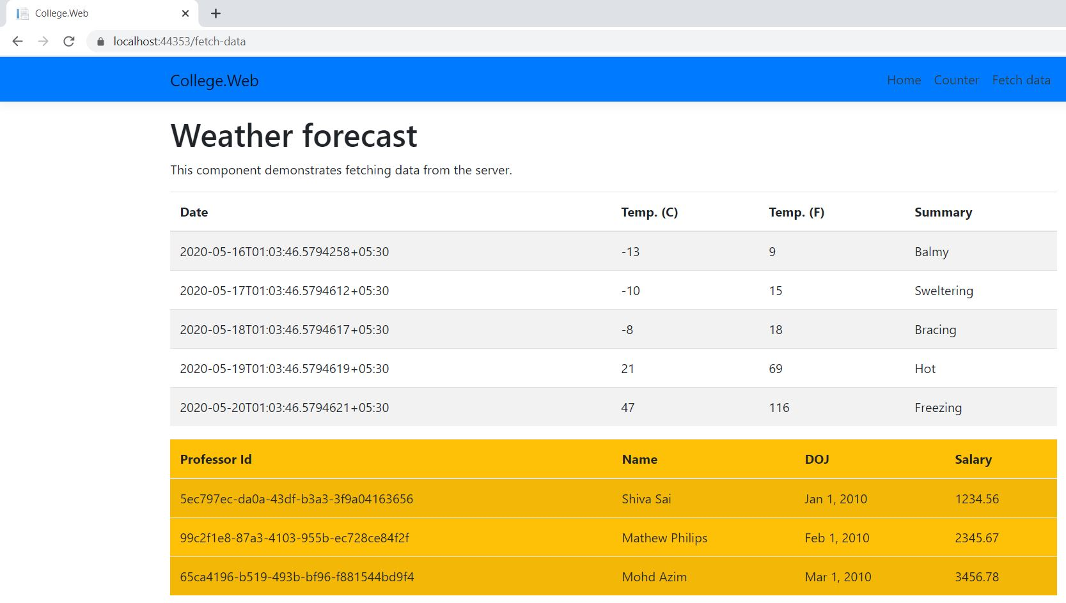
Consuming the ASP.net Core Web API in Client Application
C# Corner

Slide 14
Consuming the ASP.net Core Web API in Client Application
Demo
Consuming the ASP.net Core
Web API
in Client Application
C# Corner

Slide 15
What is next?
What is next ???
What we will discuss in next session ….
Improvising the Project into Layers.
Add, Edit, Delete methods added to Web API
Invalidate the Cache when Add/Edit/Delete.
Updating the Angular UI to accommodate Add/Edit/Delete.
Using the Redis Cache from Azure.
Using the SQL Server from Azure.
C# Corner

Slide 16
Q & A
C# Corner

Slide 17
Thank You
Viswanatha Swamy
LinkedIn: https://www.linkedin.com/in/viswanatha-swamy-b57326128/
Twitter: https://twitter.com/vishipayyallore
C# Corner

