Slide 1
Data Analysis in Healthcare
May 17, 2016
Andy Stemmler, Principal
Jina Corneau, Manager

Slide 2

today’s agenda
a little about Triage
healthcare overview
data in healthcare
Triage overview
data at Triage
technology in healthcare
looking ahead
Triage career opportunities
questions?

Slide 3

Quick facts & figures
Industry/Niche: Healthcare financial consulting
Clients: Hospitals
Locations: San Francisco + Atlanta
Founded: 1994
Total # of employees: 550
Impact: > $3 billion for hospitals
A great place to work? Yes!
Longstanding history w/ Davis: Absolutely
Are we hiring? Yes!
a little about Triage

Slide 4
healthcare overview
U.S. GDP
Industry overview
the U.S. spends more on healthcare
than any other nation in the world
Healthcare spending
2014: 17.5% of GDP ($3.0 trillion)
2024: 19.6% of GDP ($5.4 trillion)
healthcare 17.5%
hospitals make up the largest share
of these expenditures (one-third)
source: Centers for Medicare and Medicaid Services
Notes:
US spends more both as % of GDP and per capita. Spending increased 2.9% in 2013 and 5.3% in 2014. Faster growth in 2014 due to major coverage expansion under Affordable Care Act. Hospital spending increased 3.5% in 2014, and 4.1% in 2014 to $971.8 billion.

Slide 5
The Hospital Visit: A Patient’s Perspective
Patient Injured
Visit Hospital
Patient and/or Insurance Pays Bill
Schedule Hospital Visit

Slide 6
The Hospital Visit: A Hospital’s Perspective
Patient Registration
Utilization Management
Charge Capture
Claim Review & Submission
Contract Management
Denial Management
A/R Follow Up
Patient Exam
Payment Processing
Patient Collections
Reporting & Benchmarking
Documentation & Coding
Revenue Cycle

Slide 7
Revenue Cycle Simplified
Patient Access
Health Information Management (HIM)
Charging
Case Management
Billing & Collecting

Slide 8
data in healthcare

Slide 9
Data Analysis: Ideal Scenario
Data Capture
Acquire key data elements
Data Provisioning
Move data from transactional systems into an Electronic Data Warehouse (EDW)
Data Analysis
Discover new information in the data (data mining)
Assure data quality
Integrate data capture into operational workflow
Interpret data
Evaluate data quality

Slide 10
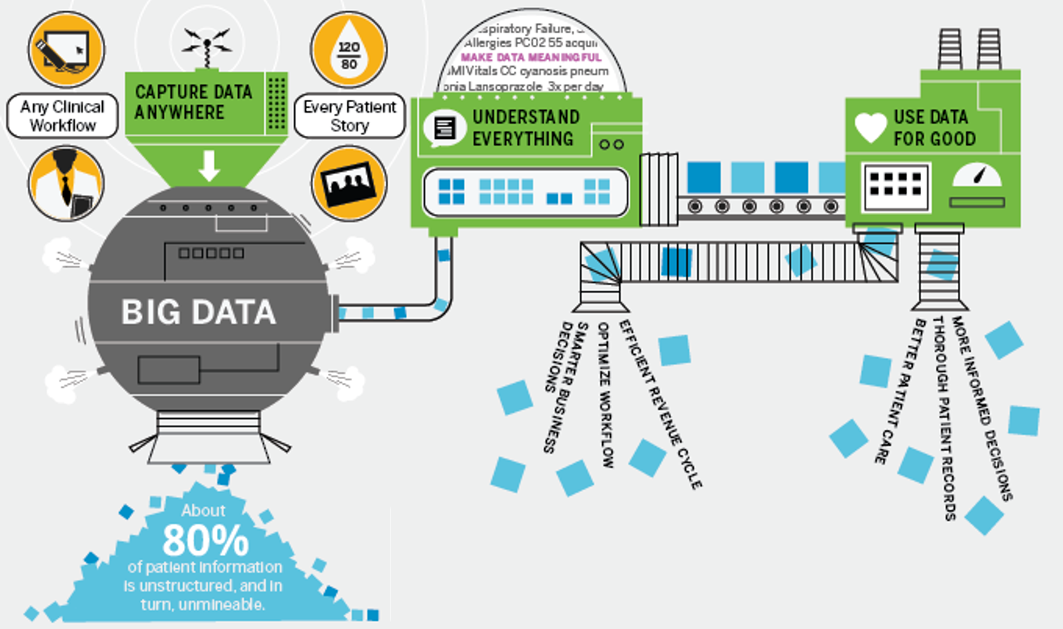
Healthcare Data Analysis

Slide 11
Healthcare Data Sources
OLTP Databases: Online Transaction Processing Databases
Practice Management System
Electronic Health Records (EHR)
Costing
Patient Satisfaction
Ambulatory Surgery
Radiology
Pathology
Claims Database
Financial System
HR System

Slide 12
Healthcare Data in Use
EDW: Electronic Data Warehouse
Built for analytics
Provides metadata, security, auditing, etc.
Sandbox/testing environment capabilities
Integrates with business intelligence (BI) tools

Slide 13

Where Triage Fits In

Slide 14
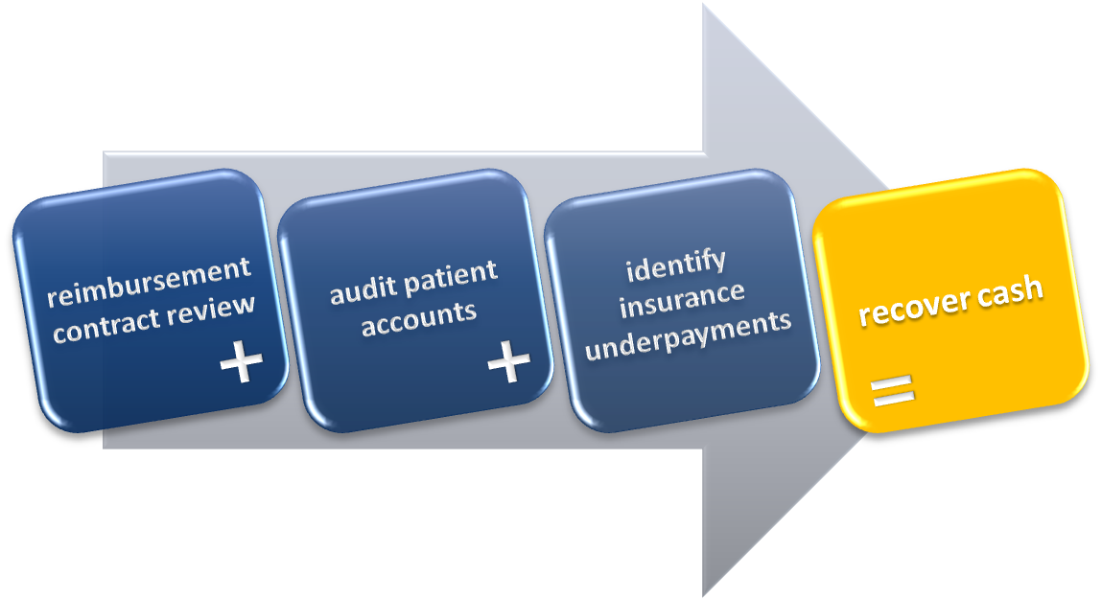
Triage overview

Slide 15
Revenue Cycle
Patient Registration
Utilization Management
Charge Capture
Claim Review & Submission
Contract Management
Denial Management
A/R Follow Up
Patient Exam
Payment Processing
Patient Collections
Reporting & Benchmarking
Documentation & Coding
A/R Follow Up
Denial Management

Slide 16
PRESENT
FUTURE
Microsoft Access
Proprietary Software
SQL Server Database + .NET Framework
data at Triage

Slide 17
EHR Mandate
As of January 1, 2014, all public and private healthcare providers and other eligible professionals must have adopted and demonstrated “meaningful use” of electronic medical records in order to maintain their existing Medicaid and Medicare reimbursement levels.
Meaningful use consists of using digital and medical and health records to achieve the following:
Improve quality, safety, efficiency, and reduce health disparities
Engage patients and family
Improve care coordination, and population and public health
Maintain privacy and security of patient health information
technology in healthcare
Notes:
American Recovery and Reinvestment Act of 2009

Slide 18
looking ahead

Slide 19
Careers at Triage
We’re hiring!
Our (Triage) stories
Learn more about Triage
Utilize your career center
We’ll be back on campus in the fall
How to apply
Triage Recruiting process

Slide 20
Andy Stemmler
andys@triageconsulting.com
Jina Corneau
jinac@triageconsulting.com
go ags! questions?

