Slide 1
简
单
的
C
P
U
设
计
智能1602 201608010624 牟清华

Slide 2

DAMEN POWEr
oeveroyouthfuloeveroweeping
ONE
It was the best of times, it was the worst of times; it was the age of wisdom, it was the age of foolishness. It was the epoch of belief, and it was the epoch of incredulity.

Slide 3
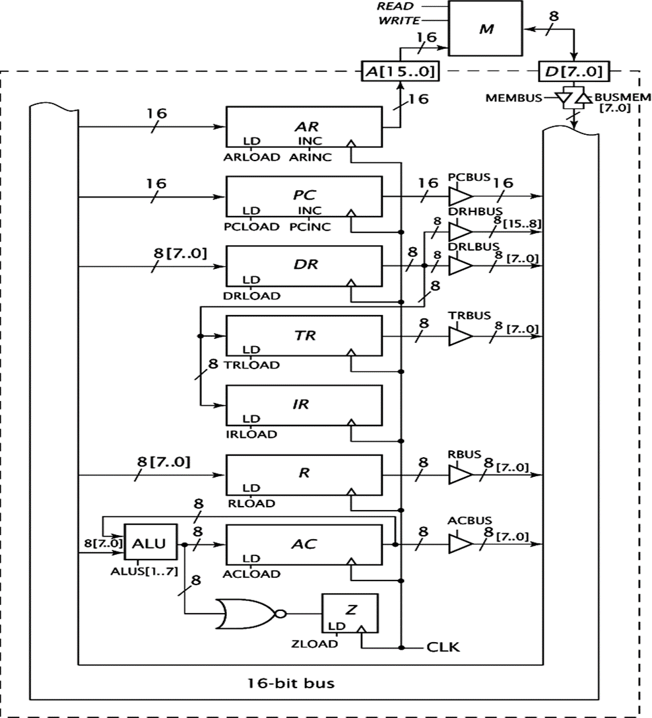
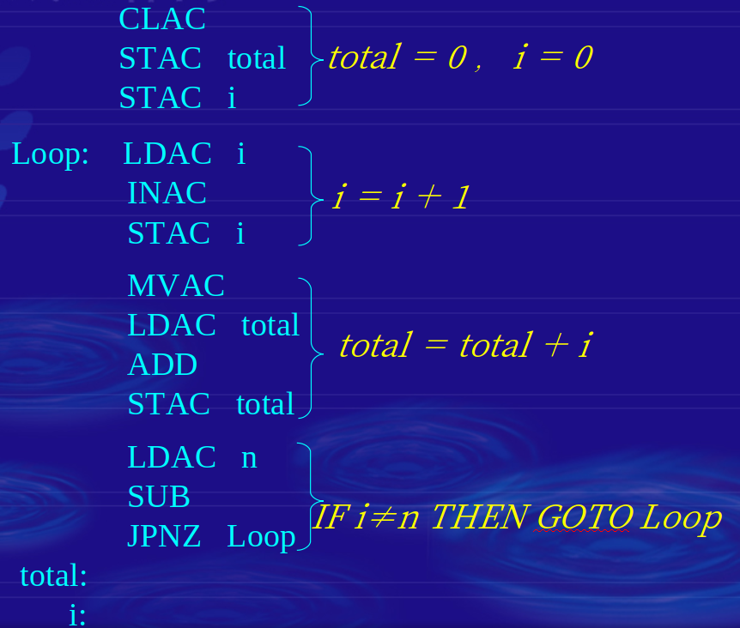
实验目的

Slide 4
DAMEN POWEr
oeveroyouthfuloeveroweeping
TWO
It was the best of times, it was the worst of times; it was the age of wisdom, it was the age of foolishness. It was the epoch of belief, and it was the epoch of incredulity. It was the season of light, and it was the season of darkness. It was the spring of hope, and it was the winter of despair.

Slide 5
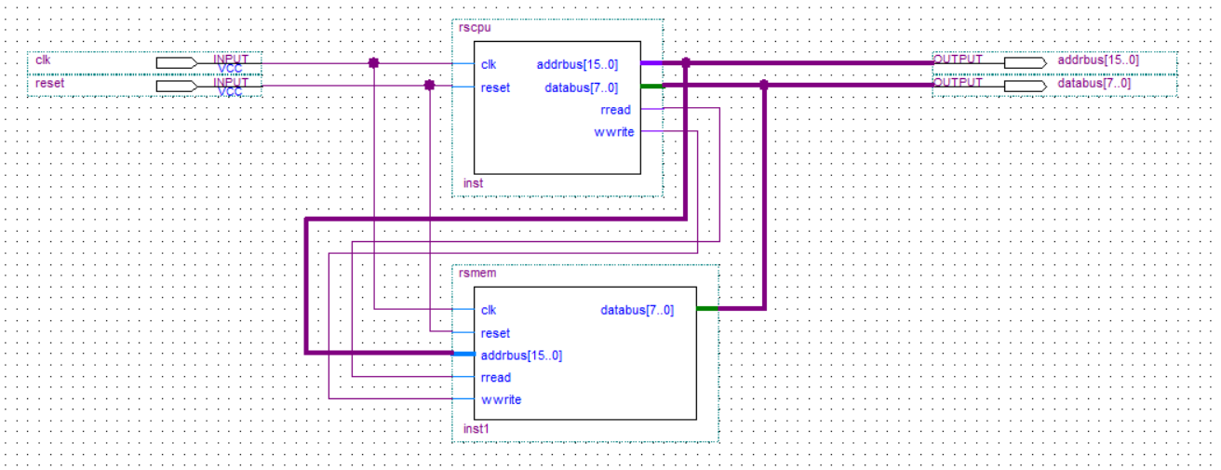
顶层设计

Slide 6
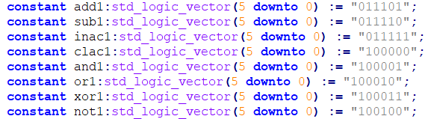
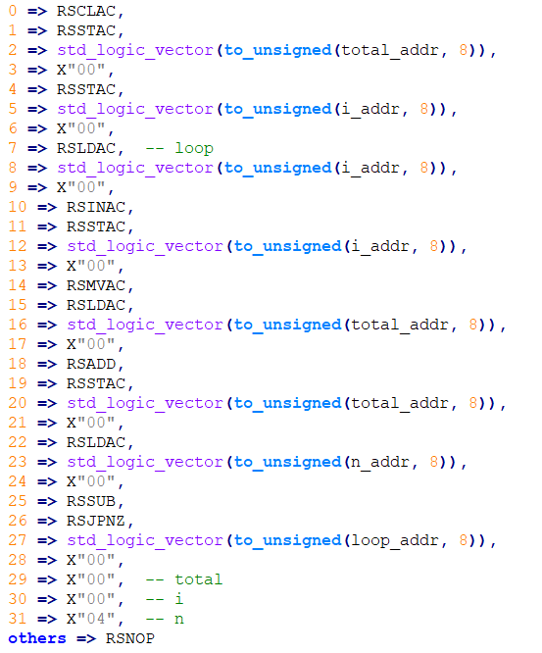
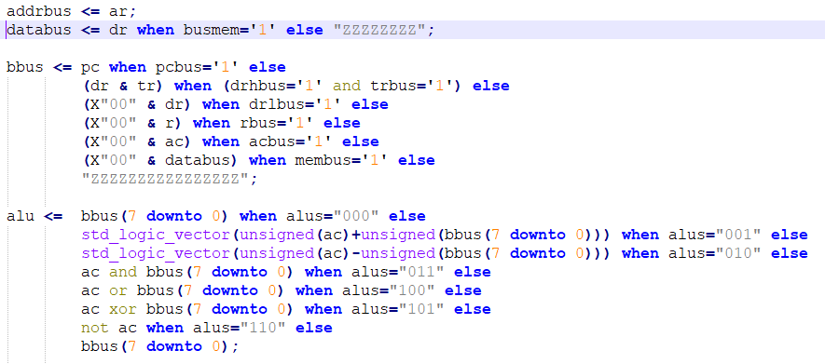

Slide 7

DAMEN POWEr
oeveroyouthfuloeveroweeping
THREE
It was the best of times, it was the worst of times; it was the age of wisdom, it was the age of foolishness. It was the epoch of belief, and it was the epoch of incredulity.

Slide 8
遇到的问题
使用 use ieee.numeric_std.all;
pc <= std_logic_vector(unsigned(pc)+1);
使用 use ieee.std_logic_unsigned.all;
pc <= pc+1;

Slide 9
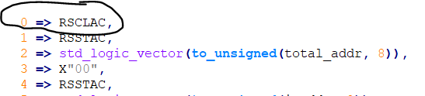
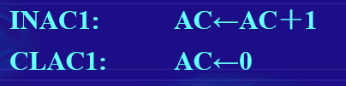
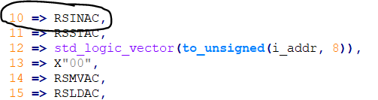
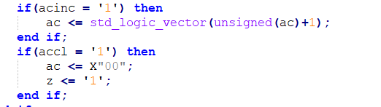

Slide 10
DAMEN POWEr
oeveroyouthfuloeveroweeping
FOUR
It was the best of times, it was the worst of times; it was the age of wisdom, it was the age of foolishness. It was the epoch of belief, and it was the epoch of incredulity. It was the season of light, and it was the season of darkness. It was the spring of hope, and it was the winter of despair.

Slide 11
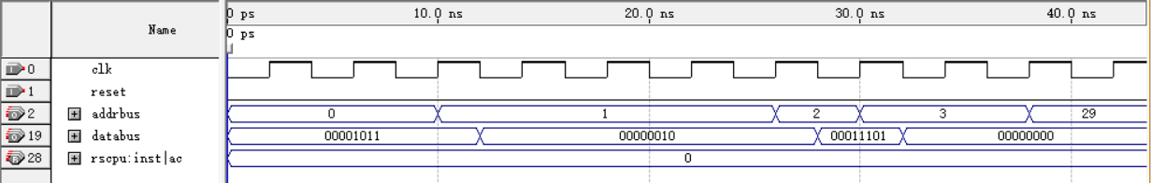
仿真结果
0 => RSCLAC
1 => RSSTAC
2 => std_logic_vector(to_unsigned(total_addr, 8))
3 => X"00"
It was the best of times, it was the worst of times; it was the age of wisdom, it was the age of foolishness. It was the epoch of belief, and it was the epoch of incredulity. It was the season of light

Slide 12
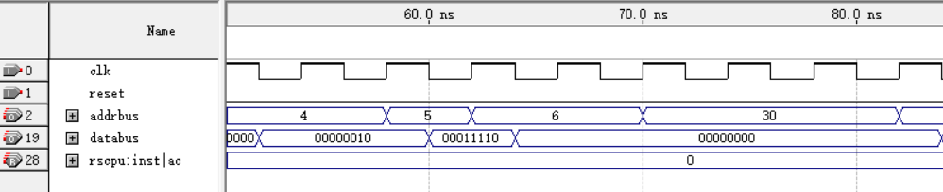
仿真结果
4 => RSSTAC
5 =>std_logic_vector(to_unsigned(i_addr, 8))
6 => X"00"
It was the best of times, it was the worst of times; it was the age of wisdom, it was the age of foolishness. It was the epoch of belief, and it was the epoch of incredulity. It was the season of light

Slide 13
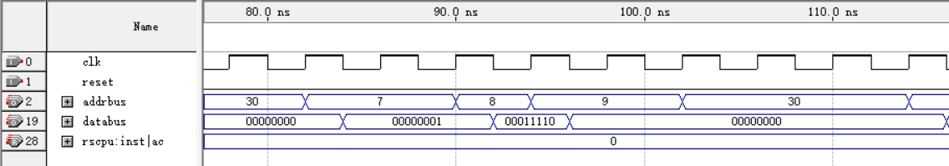
仿真结果
7 => RSLDAC
8 => std_logic_vector(to_unsigned(i_addr, 8))
9 => X"00"
It was the best of times, it was the worst of times; it was the age of wisdom, it was the age of foolishness. It was the epoch of belief, and it was the epoch of incredulity. It was the season of light

Slide 14
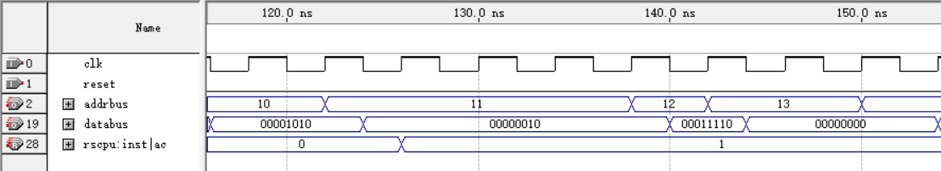
仿真结果
10 => RSINAC,
11 => RSSTAC
12 => std_logic_vector(to_unsigned(i_addr, 8))
13 => X"00"
It was the best of times, it was the worst of times; it was the age of wisdom, it was the age of foolishness. It was the epoch of belief, and it was the epoch of incredulity. It was the season of light

Slide 15
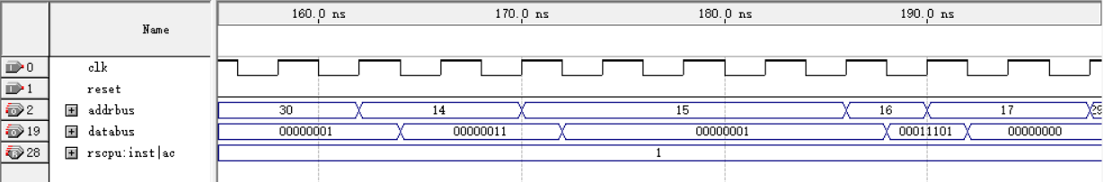
仿真结果
AC的值
14 => RSMVAC
15 => RSLDAC
16 => std_logic_vector(to_unsigned(total_addr, 8))
17 => X"00"
It was the best of times, it was the worst of times; it was the age of wisdom, it was the age of foolishness. It was the epoch of belief, and it was the epoch of incredulity. It was the season of light

Slide 16
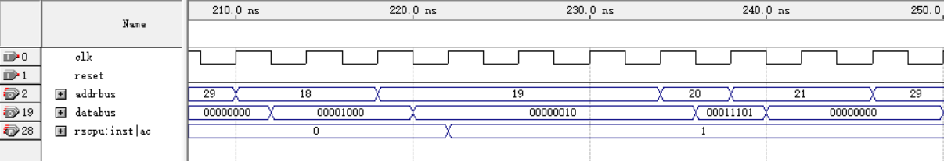
仿真结果
AC的值
18 => RSADD
19 => RSSTAC
20 => std_logic_vector(to_unsigned(total_addr, 8))
21 => X"00"
It was the best of times, it was the worst of times; it was the age of wisdom, it was the age of foolishness. It was the epoch of belief, and it was the epoch of incredulity. It was the season of light

Slide 17
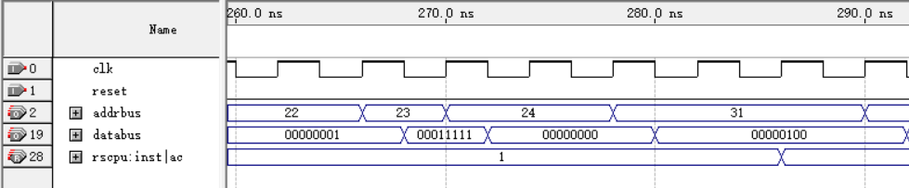
仿真结果
22 => RSLDAC
23 => std_logic_vector(to_unsigned(n_addr, 8))
24 => X"00"
AC的值
It was the best of times, it was the worst of times; it was the age of wisdom, it was the age of foolishness. It was the epoch of belief, and it was the epoch of incredulity. It was the season of light

Slide 18
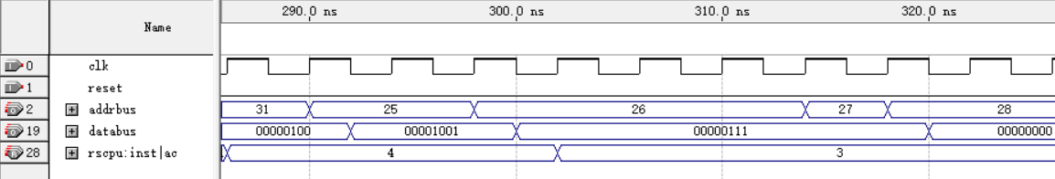
仿真结果
25 => RSSUB
26 => RSJPNZ
27 => std_logic_vector(to_unsigned(loop_addr, 8))
28 => X"00"
It was the best of times, it was the worst of times; it was the age of wisdom, it was the age of foolishness. It was the epoch of belief, and it was the epoch of incredulity. It was the season of light

Slide 19
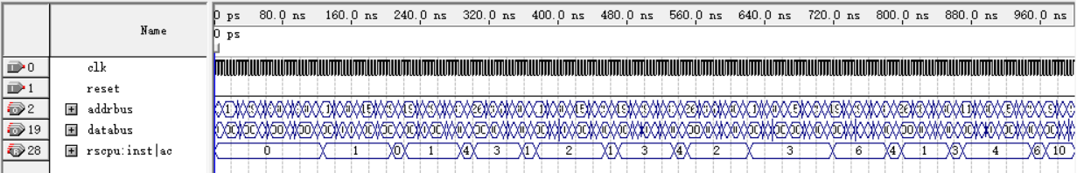
仿真结果
最后结果显示的是10
It was the best of times, it was the worst of times; it was the age of wisdom, it was the age of foolishness. It was the epoch of belief, and it was the epoch of incredulity. It was the season of light

Slide 20
THANKS

