Slide 1
Model To Detect rumor and fake news
ISSAC BALAJI , THAPASWINI CHOWDARY,S.M.ALI HUSSAINI , ANIMESH DAS

Slide 2
Motivation
In recent years we have seen a surge in rumours spreading like wild fires. These have not only affected personal lives but also can have serious global consequences. To combat this menace our group decided to use our deep learning knowledge to curb this menace and implement a model that can detect fake news and rumours with a certain level of accuracy.

Slide 3


Slide 4
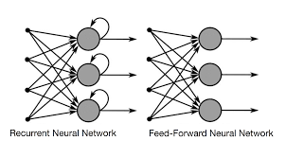
Recurrent Neural Networks

Slide 5
RNN
Recurrent Neural Networks (RNN) are a powerful and robust type of neural networks and belong to the most promising algorithms out there at the moment because they are the only ones with an internal memory.
A Recurrent Neural Network is able to remember exactly that, because of it’s internal memory. It produces output, copies that output and loops it back into the network.
In a RNN, the information cycles through a loop. When it makes a decision, it takes into consideration the current input and also what it has learned from the inputs it received previously.

Slide 6
LSTM
Vanishing Gradients ( when the values of a gradient are too small and the model stops learning or takes way too long because of that.) It was solved through the concept of LSTM
Long Short-Term Memory (LSTM) networks are an extension for recurrent neural networks, which basically extends their memory.
In an LSTM you have three gates: input, forget and output gate. These gates determine whether or not to let new input in (input gate), delete the information because it isn’t important (forget gate) or to let it impact the output at the current time step (output gate)

Slide 7
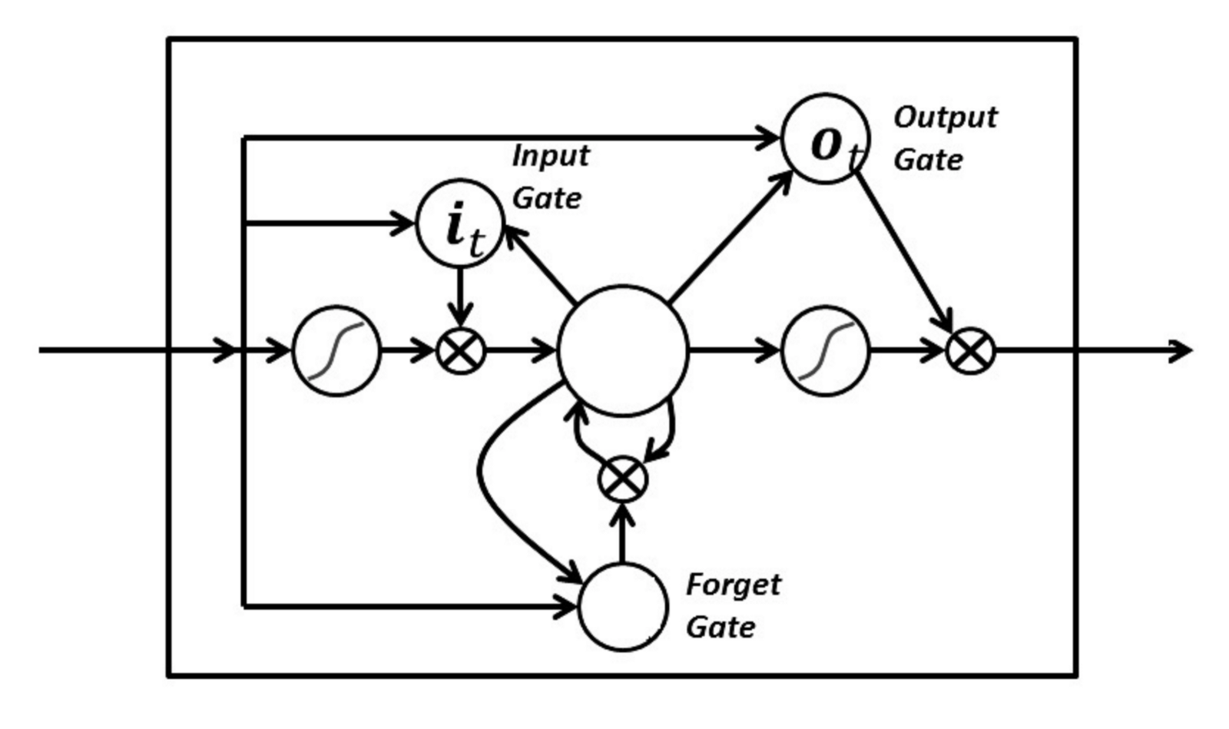
LSTM

Slide 8
GRU
Gated Recurrent Units (GRU) are a variation on Long Short Term Memory (LSTM) recurrent neural networks. Both LSTM and GRU networks have additional parameters that control when and how their memory is updated.
GRU and LSTM networks can capture both long and short term dependencies in sequences, but GRU networks involve less parameters and so are faster to train.
GRU network has a reset and forget "gate" that helps ensure its memory doesn't get taken over by tracking short term dependencies. The network learns how to use its gates to protect its memory so that it's able to make longer term predictions.
A GRU instead of having a simple neural network with four nodes as the RNN had previously has a cell containing multiple operations

Slide 9
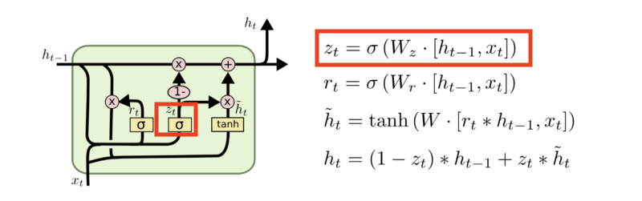
GRU
This gate calculate the update gate Zt at time step t executing the following steps:
The input Xt is multiplied by a weight Wzx
The previous output Ht-1 which hold information from previous units multiplied by a weight Wzh
Both are added together and a sigmoid function is applies to squeeze the output between 0 and 1.

Slide 10
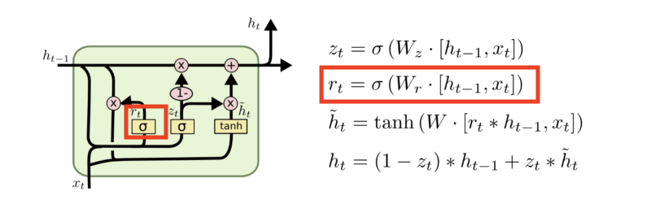
GRU
This gate calculate the update gate Rt at time step t executing the following steps:
The input Xt is multiplied by a weight Wrx
The previous output Ht-1 which hold information from previous units multiplied by a weight Wrh
Both are added together and a sigmoid function is applies to squeeze the output between 0 and 1.

Slide 11
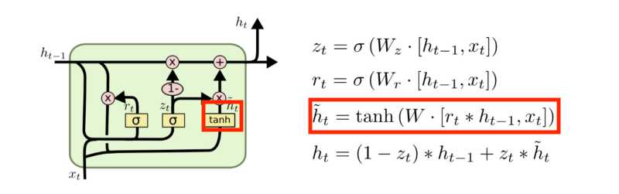
GRU
The calculation involve the following steps:
The input Xt is multiplied by a weight Wx
Apply element-wise multiplication to the reset gate Rt and the previous output Ht-1; this allows to pass only the relevant past information.
Both are added together and a tanh function is applied.

Slide 12
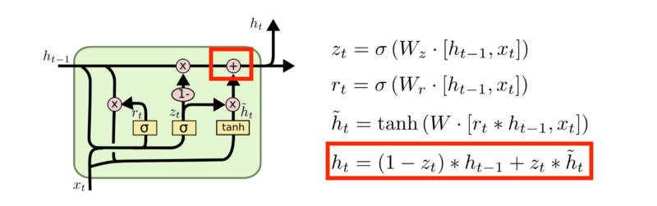
GRU
The calculation involve the following steps:
Apply element-wise multiplication to the update gate Zt and Ht.
Apply element-wise multiplication to one minus the update gate 1-Zt and H’t.
Both are added together.

Slide 13
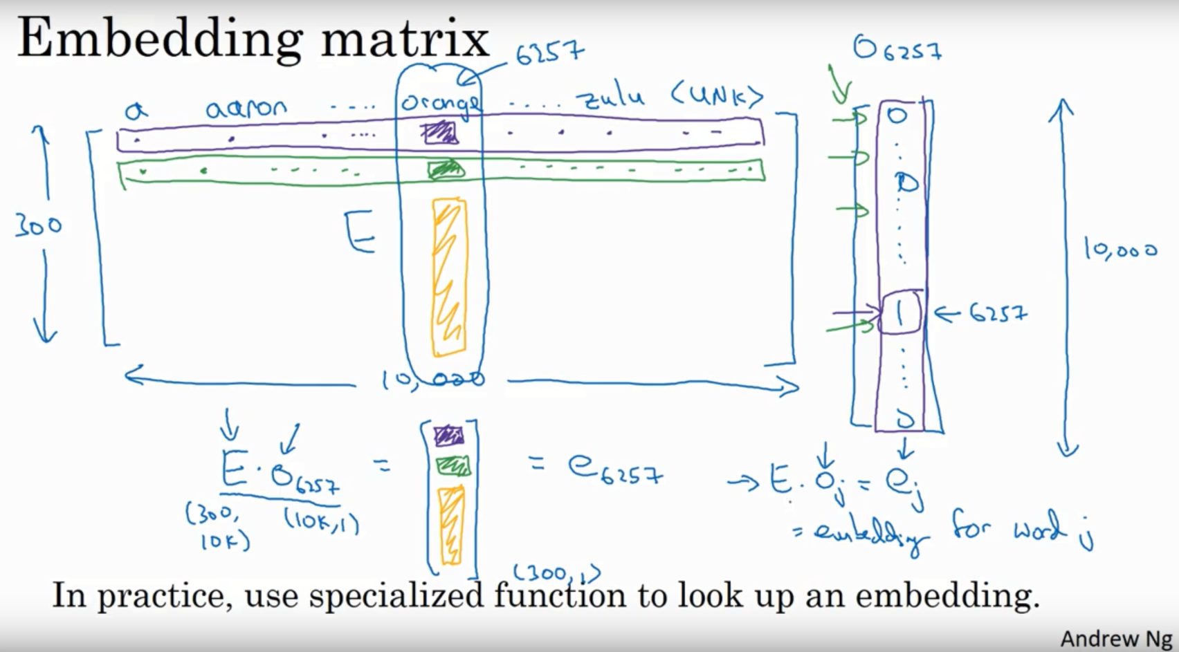
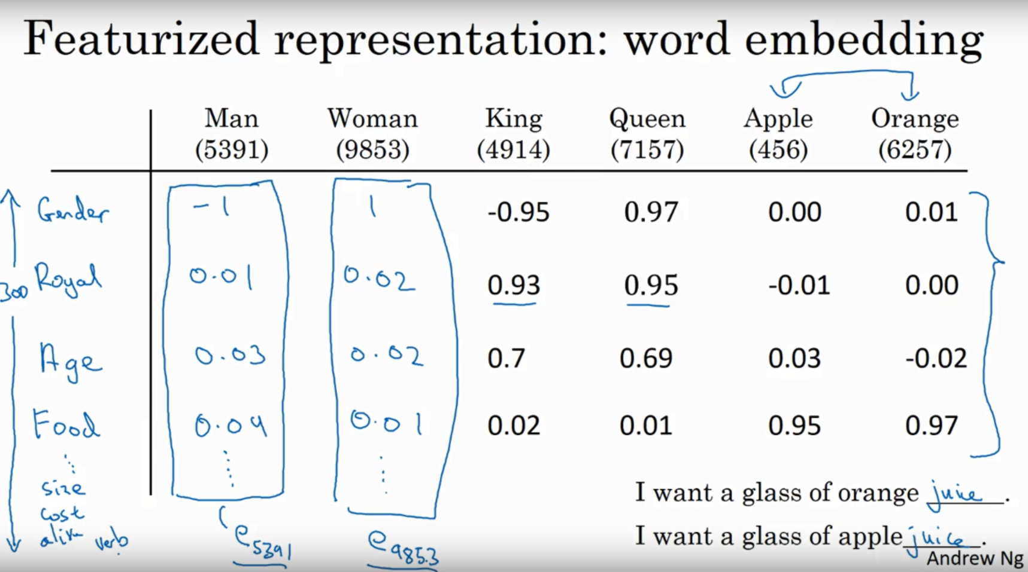
Dataset : Embedding Matrix
Word embedding is one of the most popular representation of document vocabulary. It is capable of capturing context of a word in a document, semantic and syntactic similarity, relation with other words, etc. They are vector representations of a particular word. Eg: GloVe, Word2Vec, FastText, ELMo….

Slide 14
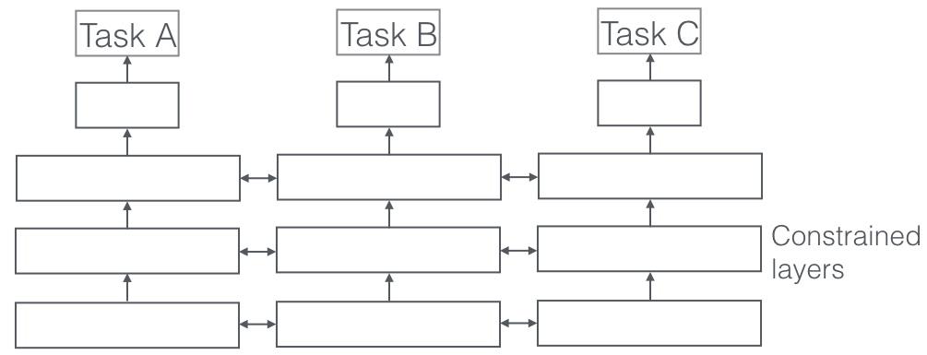
Multi-Task Learning
In Machine Learning (ML), we typically care about optimizing for a particular metric, whether this is a score on a certain benchmark or a business KPI. In order to do this, we generally train a single model or an ensemble of models to perform our desired task. We then fine-tune and tweak these models until their performance no longer increases. While we can generally achieve acceptable performance this way, by being laser-focused on our single task, we ignore information that might help us do even better on the metric we care about. Specifically, this information comes from the training signals of related tasks. By sharing representations between related tasks, we can enable our model to generalize better on our original task. This approach is called Multi-Task Learning (MTL).

Slide 15
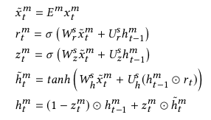
Uniform shared layer architecture & Enhanced shared layer architecture
To facilitate building the model we took two approaches of architecture : Uniform shared layer architecture and Enhanced shared layer architecture.
In Uniform shared layer architecture ,the different tasks share a same hidden layer and each task has its own task-specific input and embeddings, which is shown as the Uniform Shared-Layer Architecture in Figure 2(a). For a task m, given a sequence of posts or sentences {x t m } for an input claim, a straightforward strategy is to map each input unit x t m at time step t to a fixed-sized vector using one RNN, for which we adopt GRU as hidden representation. For each t, the GRU
transition equations are the following:
Notes:
where x t m is the t-th post and E m denotes the task-specific em-
bedding matrix, [W ∗ s , U ∗ s ] are the weight connections inside GRU
which are shared across different tasks. As defined in standard GRU,
m
h m
t and h t −1 refer to the current and previous state, respectively;
⊙ denotes element-wise multiplication; a reset gate r t m determines
how to combine the current input x t m with the previous memory,
and an update gate z m
t defines how much previous memory from
the previous posts is cascaded into the current time step; and h̃ m
t
denotes the candidate activation of the hidden state h m
t .

Slide 16
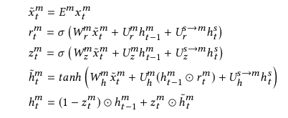
Uniform shared layer architecture & Enhanced shared layer architecture
The Enhanced Shared-Layer Architecture adopts two hidden layers for each task: one is used to extract
the common patterns via the shared parameters, and the other is used to capture task-specific features via the separate parameter sets. Accordingly, each task is assigned a shared GRU layer and a task-specific GRU layer, which hopefully can be used to capture the shared and local representations for different tasks
Notes:
where x t m is the t-th post and E m denotes the task-specific em-
bedding matrix, [W ∗ s , U ∗ s ] are the weight connections inside GRU
which are shared across different tasks. As defined in standard GRU,
m
h m
t and h t −1 refer to the current and previous state, respectively;
⊙ denotes element-wise multiplication; a reset gate r t m determines
how to combine the current input x t m with the previous memory,
and an update gate z m
t defines how much previous memory from
the previous posts is cascaded into the current time step; and h̃ m
t
denotes the candidate activation of the hidden state h m
t . new :where x t m is the t-th input of task m, and U ∗ s→m denotes the weight
matrix which connects the shared layer and the task-specific layer.
The other settings are same as standard GRU. We also tried using
a gate to decide how much information from the shared layer h st
should accept, just as the gating mechanism for h m
t −1.

Slide 17
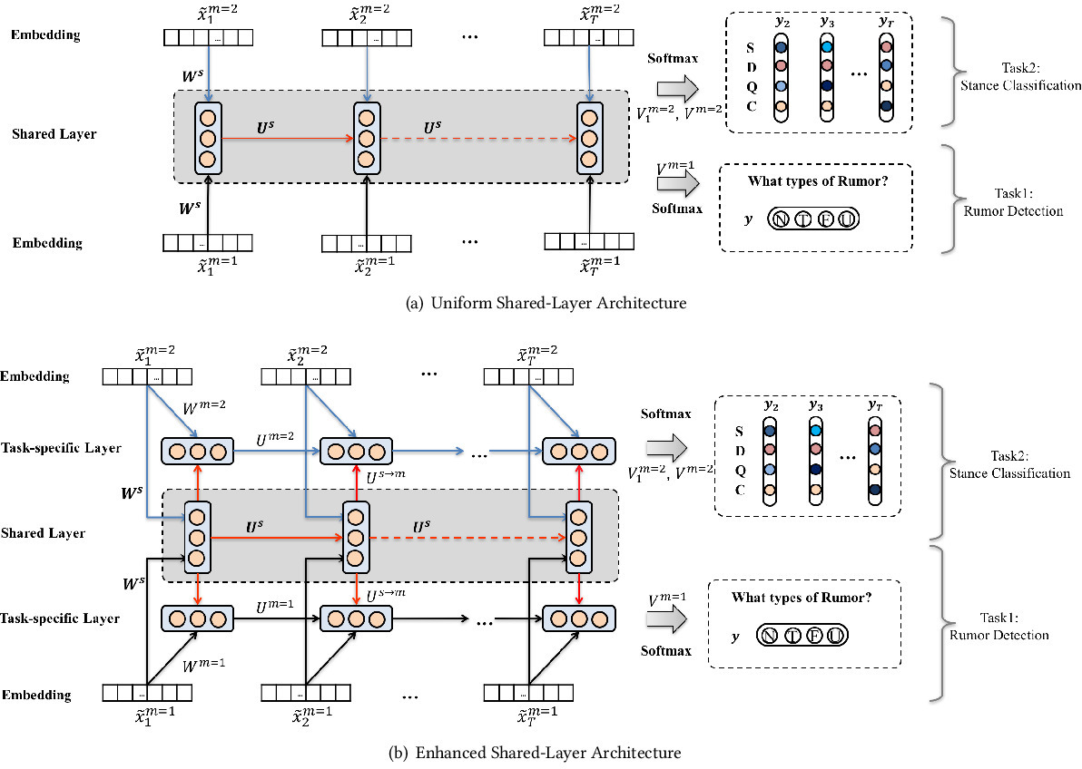
Notes:
where x t m is the t-th post and E m denotes the task-specific em-
bedding matrix, [W ∗ s , U ∗ s ] are the weight connections inside GRU
which are shared across different tasks. As defined in standard GRU,
m
h m
t and h t −1 refer to the current and previous state, respectively;
⊙ denotes element-wise multiplication; a reset gate r t m determines
how to combine the current input x t m with the previous memory,
and an update gate z m
t defines how much previous memory from
the previous posts is cascaded into the current time step; and h̃ m
t
denotes the candidate activation of the hidden state h m
t . new :where x t m is the t-th input of task m, and U ∗ s→m denotes the weight
matrix which connects the shared layer and the task-specific layer.
The other settings are same as standard GRU. We also tried using
a gate to decide how much information from the shared layer h st
should accept, just as the gating mechanism for h m
t −1.

Slide 18
Results

Slide 19
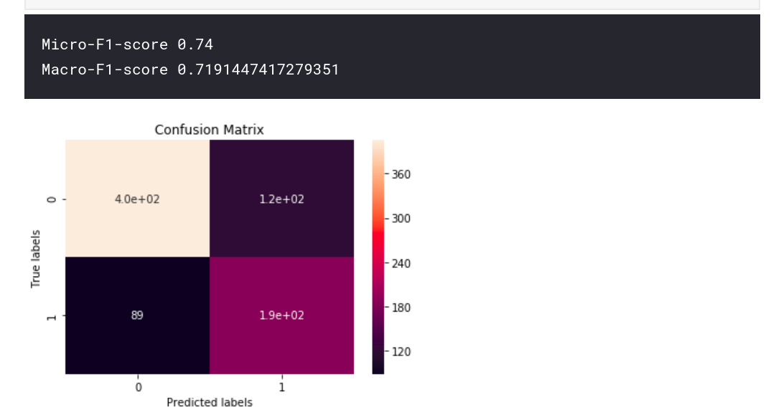
UNIFORM SHARED LAYER RESULTS

Slide 20
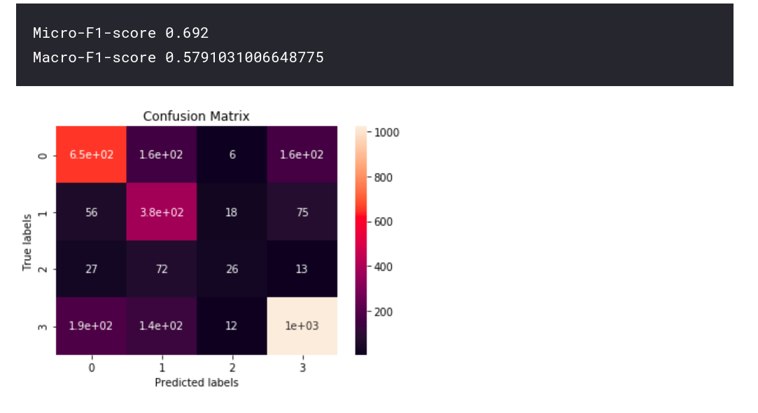
UNIFORM SHARED LAYER RESULTS

Slide 21
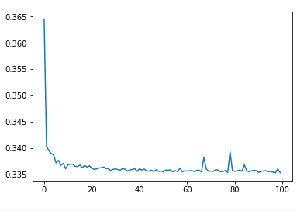
ENHANCED SHARED LAYER RESULTS

Slide 22
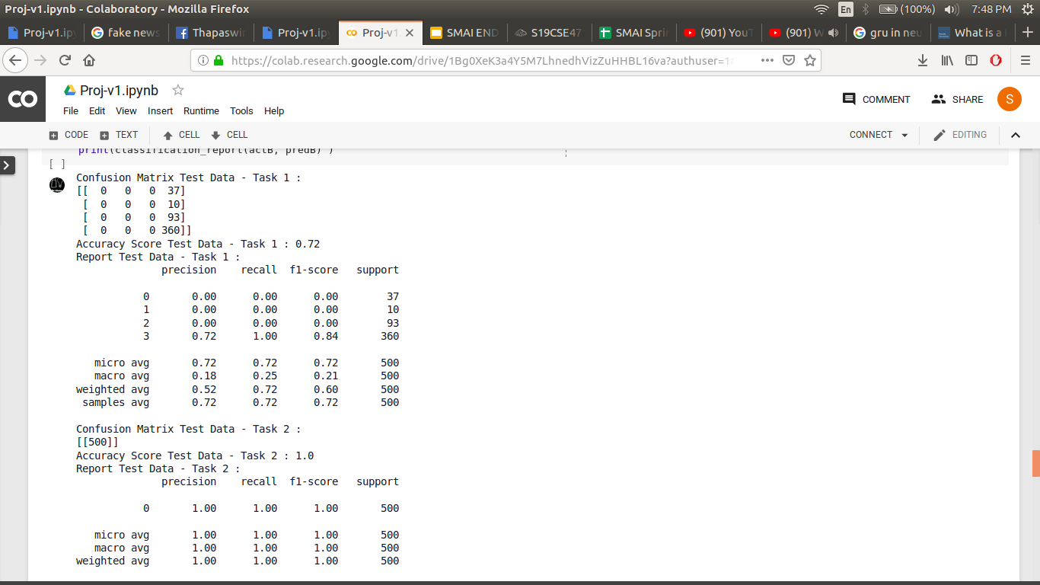
ENHANCED SHARED LAYER RESULTS

Slide 23
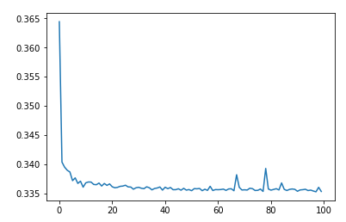
ENHANCED SHARED LAYER RESULTS

Slide 24
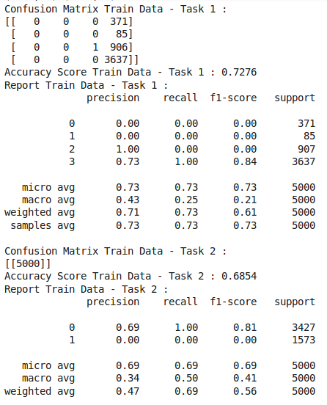
ENHANCED SHARED LAYER RESULTS

