Slide 1
SDPD ANDROID APP
SAURAV
OPENDRO
RAJESH
HARISH

Slide 2

LINK TO DOWNLOAD CODE
https://github.com/2016b093005/SDPDPROJECT
How to Clone this link Directly in your Android Studio.

Slide 3
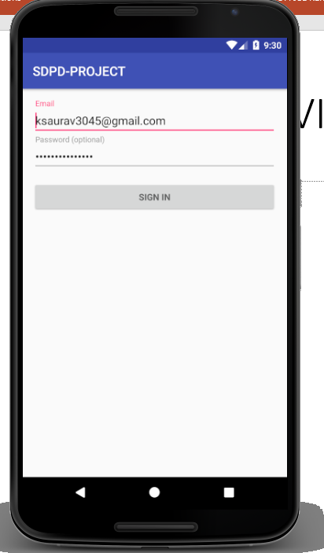
LOGIN ACTIVITY

Slide 4
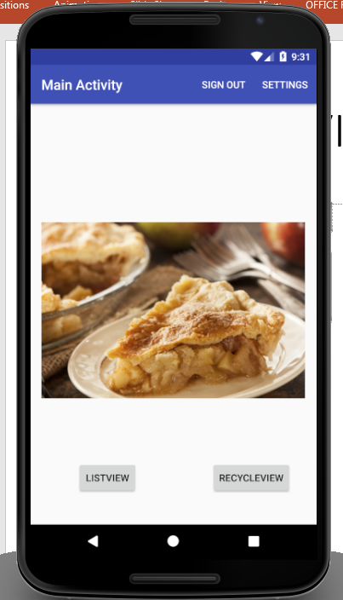
MAIN ACTIVITY
2 Button , Handled using on Click using Java code in Main Activity
One Image View To Show A Dummy Image .
Two Menu Items ( Sign Out And settings)

Slide 5
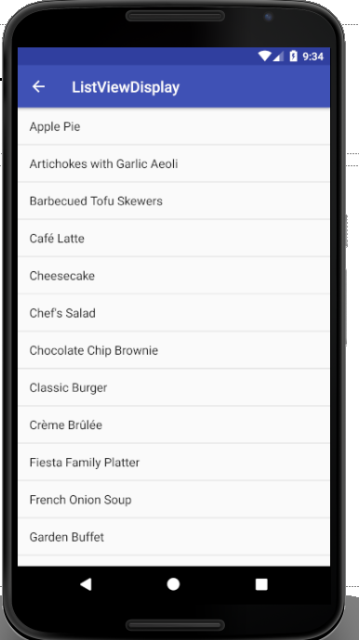
LIST VIEW DISPLAY
DISPLAYS LIST VIEW OF ITEMS from Sample Data Provider class
OnClickHandler is created to display TOAST Message with item name.

Slide 6
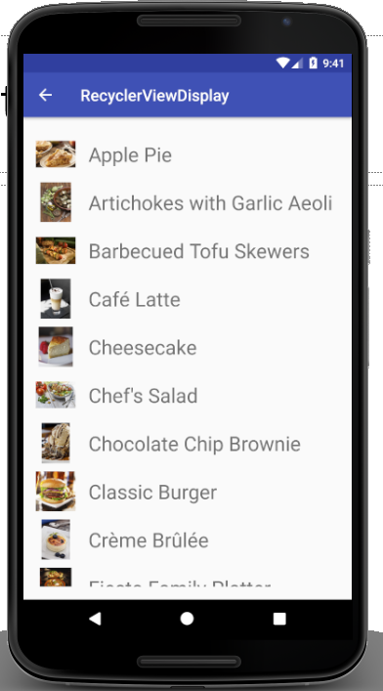
Recycler View Display
Uses Custom Adapter Class to render and Display Image and Item Name in List View

Slide 7
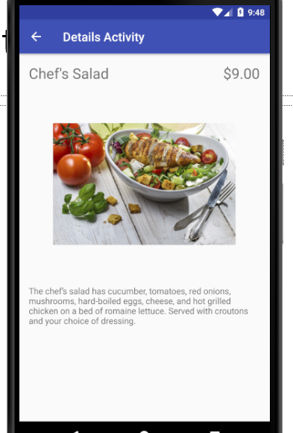
Details Activity
3 Text View and One Image view
Extracts and shows all the attribute of a particular Item

Slide 8
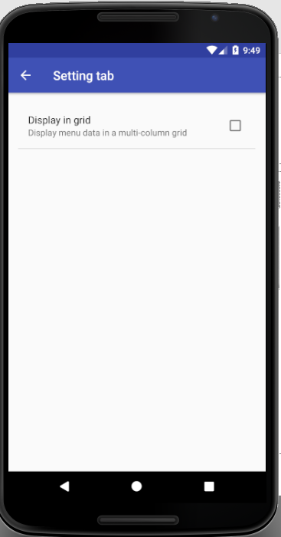
Setting Tab
Uses Named Preference to save check box value
Based on This Check Box Value Recycler View Renders its view.

Slide 9
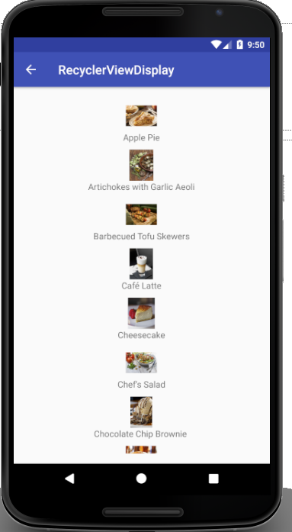
Recycler View , When Preference value is true

Slide 10
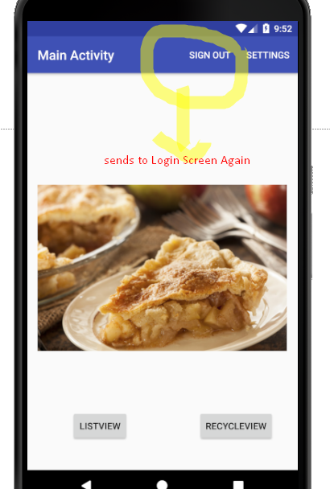
LOGOUT

