Slide 1
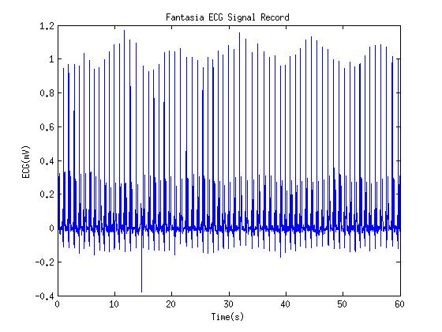
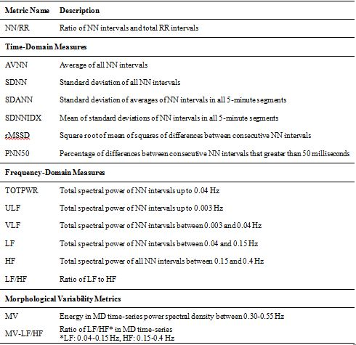
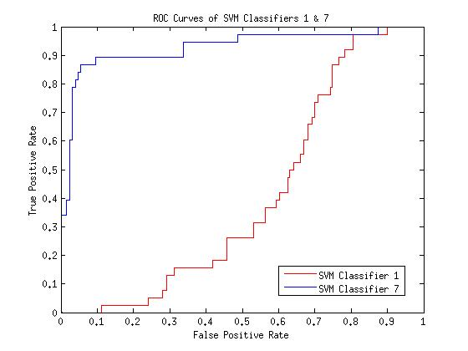
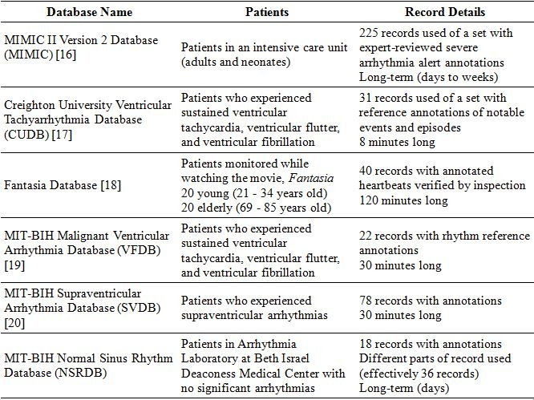
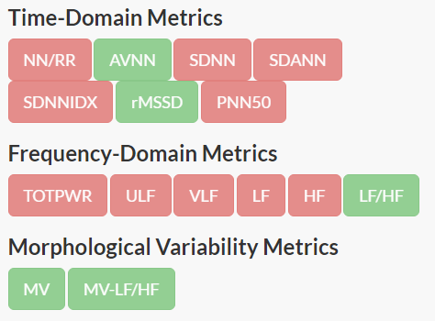
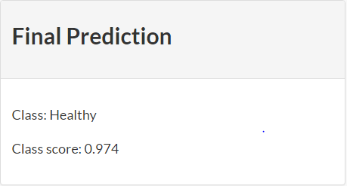
Prediction of Arrhythmias Using Support Vector Machines
and Reduced Feature Subset of ECG Variability Metrics
Christopher Hoang, Class of 2016
Computer Systems Research Lab
Thomas Jefferson High School for Science and Technology
Introduction
Methodology
Results
Sudden cardiac arrest, a life-threatening condition which causes the heart to suddenly stop beating, is caused by arrhythmias or irregular changes in heartbeat rhythm. This project predicts a patient’s short-term risk of suffering an arrhythmia episode based on samples of the patient’s electrocardio-gram (ECG) signal. A support vector machine (SVM) model classifies patients into two categor-ies: healthy and at-risk.
After passing patient ECG samples through two filters in order to clean out background noise, 15 different ECG variability metrics are calculated using the PhysioNet HRV Toolkit and a MATLAB script coded by following the methods in previous studies. These metrics are calculated for each patient.
The strongest classification model has an overall classification accuracy of 92.12% for 165 ECG signal records. A receiver operating characteristic (ROC) curve is also calculated, which shows the ratio between the true and false positive rate of the classification model. The area under the curve (AUC) value, an common indicator of classification performance, was also found to be 0.929. An AUC value of 1 represents a perfect classifier.
Patient Data
The patient data used in this project comes from PhysioBank, a free medical database containing deidentified ECG records from various hospitals and studies. ECG variability metrics are then deri-ved from 5-minute samples of these ECG records. The following databases, containing 465 individual patient ECG records, were used in this project:
Figure 2. ECG signal transformation. The derived variability metrics represent the different measures of variability within the 5-minute ECG sample, from amplitude differences between consecutive heartbeats to power within a specific range in the power spectral density of the ECG signal sample.
The collection of patients and their associated variability metrics are then separated into training and test sets. Using sequential fast forward feature selection, a subset of variability metrics is chosen from the fifteen that mini-mizes the error of the classification model.
Figure 4. ROC curves. This is a comparison of the ROC curves between the model which uses all metrics and final model with the reduced subset. The final model greatly outperforms the original model.
Conclusions & Future Work
Although the model has a high accuracy rate, it could be further improved by expanding the patient data set. The model could also be modified to differentiate between different types of arrhyth-mias. A website where users can upload their own ECG signal and see their risk prediction is currently under development.
Figure 3. Feature subset to final prediction. The strongest performing support vector machine classification model uses of the 15 variability metrics in order to classify the patients in the test set. Class scores represent the likelihood of being in a class (“Healthy” – positive, “at-risk” – negative).
Acknowledgements
The final SVM model is trained and subsequently used to classify the patients in the test set as either “healthy” or “at-risk.” The support vector machine model uses the training set in order to form a hyper-dimensional decision boundary that maximizes the number of correctly classified patients using the support vectors, or the patient data points closest to the decision boundary. This is completed in the MATLAB environment.
I would like to thank Dr. Peter Gabor, Dr. Shane Torbert, Professor Howie Huang, Professor Matthew Kay, and Hang Liu for guiding me throughout the research process. I would also like to thank George Washington University for allowing me to work as a research intern.
Figure 1. PhysioBank Databases. Patients are predetermined to be either “healthy” or “at-risk” based on whether they experienced an arrhythmia episode during the 5-minute sample collected.

