Slide 1
Rushi Shah BlaTeX
λ
Static Site Compilation for Advanced Markup Language Documents

Slide 2
Background
λ
Static sites (compare to dynamic sites)

Slide 3
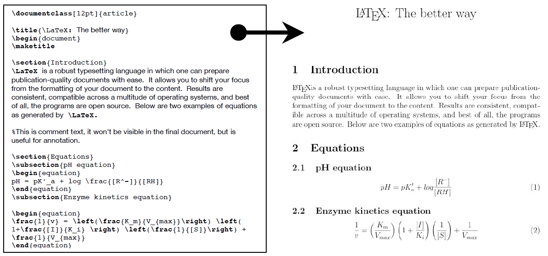
Background
λ
LaTeX (compare to Markdown)
Notes:
http://www.hypothesisjournal.com/?p=571

Slide 4
Background
λ
PDFs (compare to HTML)

Slide 5
Background
λ
Haskell (compare to Java)

Slide 6
BlaTeX
λ
Static site compiler written in Haskell for LaTeX documents

Slide 7
How it Works
λ
`cabal install blatex`
`blatex init`
Initialize a couple of boilerplate files and the skeleton structure
Write/edit posts
Find in`posts/FILENAME.tex`
Make your website pretty
Edit the layout file in `index.html.bltx`
`blatex build`
Open your static site at `index.html`

Slide 8
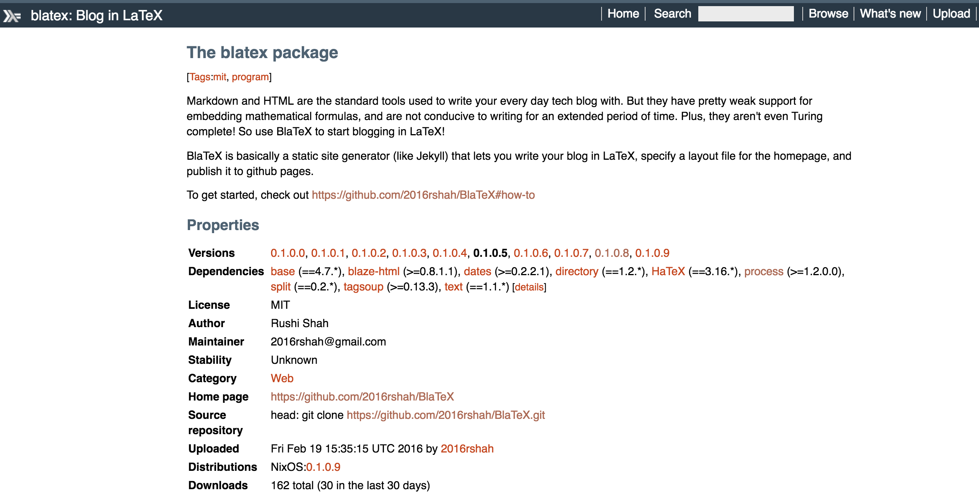
Install Hackage package
λ
`cabal install blatex`

Slide 9
Initialize site
λ
`blatex init`
`index.html.bltx`
`posts/` directory
`posts/example-post.tex` file
`posts/example-post.pdf` file

Slide 10
Write/edit posts
λ
Write and compile LaTeX documents as usual
BlaTeX looks in the `posts/` directory
No interruption in typical workflow

Slide 11
Design a static website
λ
Build your website in the `index.html.bltx` file
BlaTeX will use this template file to build your static site
Looks for the following code: `<ul id=“blog-posts”></ul>`
No interruption of typical workflow

Slide 12
Compile your static site
λ
`blatex build`
Looks in `posts/` directory for posts
Looks in `index.html.bltx` for site template
Produces a final static site in `index.html`

Slide 13
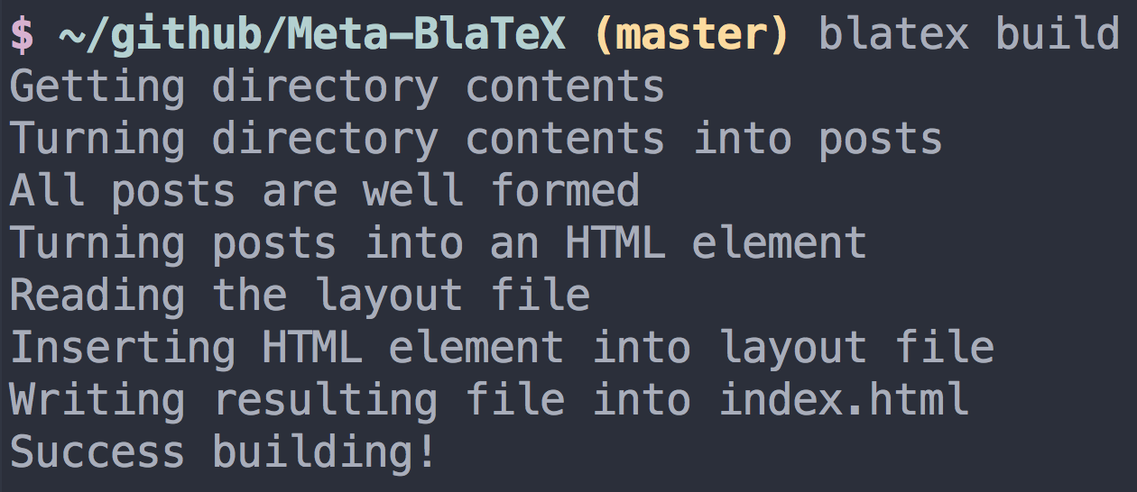
Possible Errors
λ
`Either` as an instance of an Applicative Functor

Slide 14
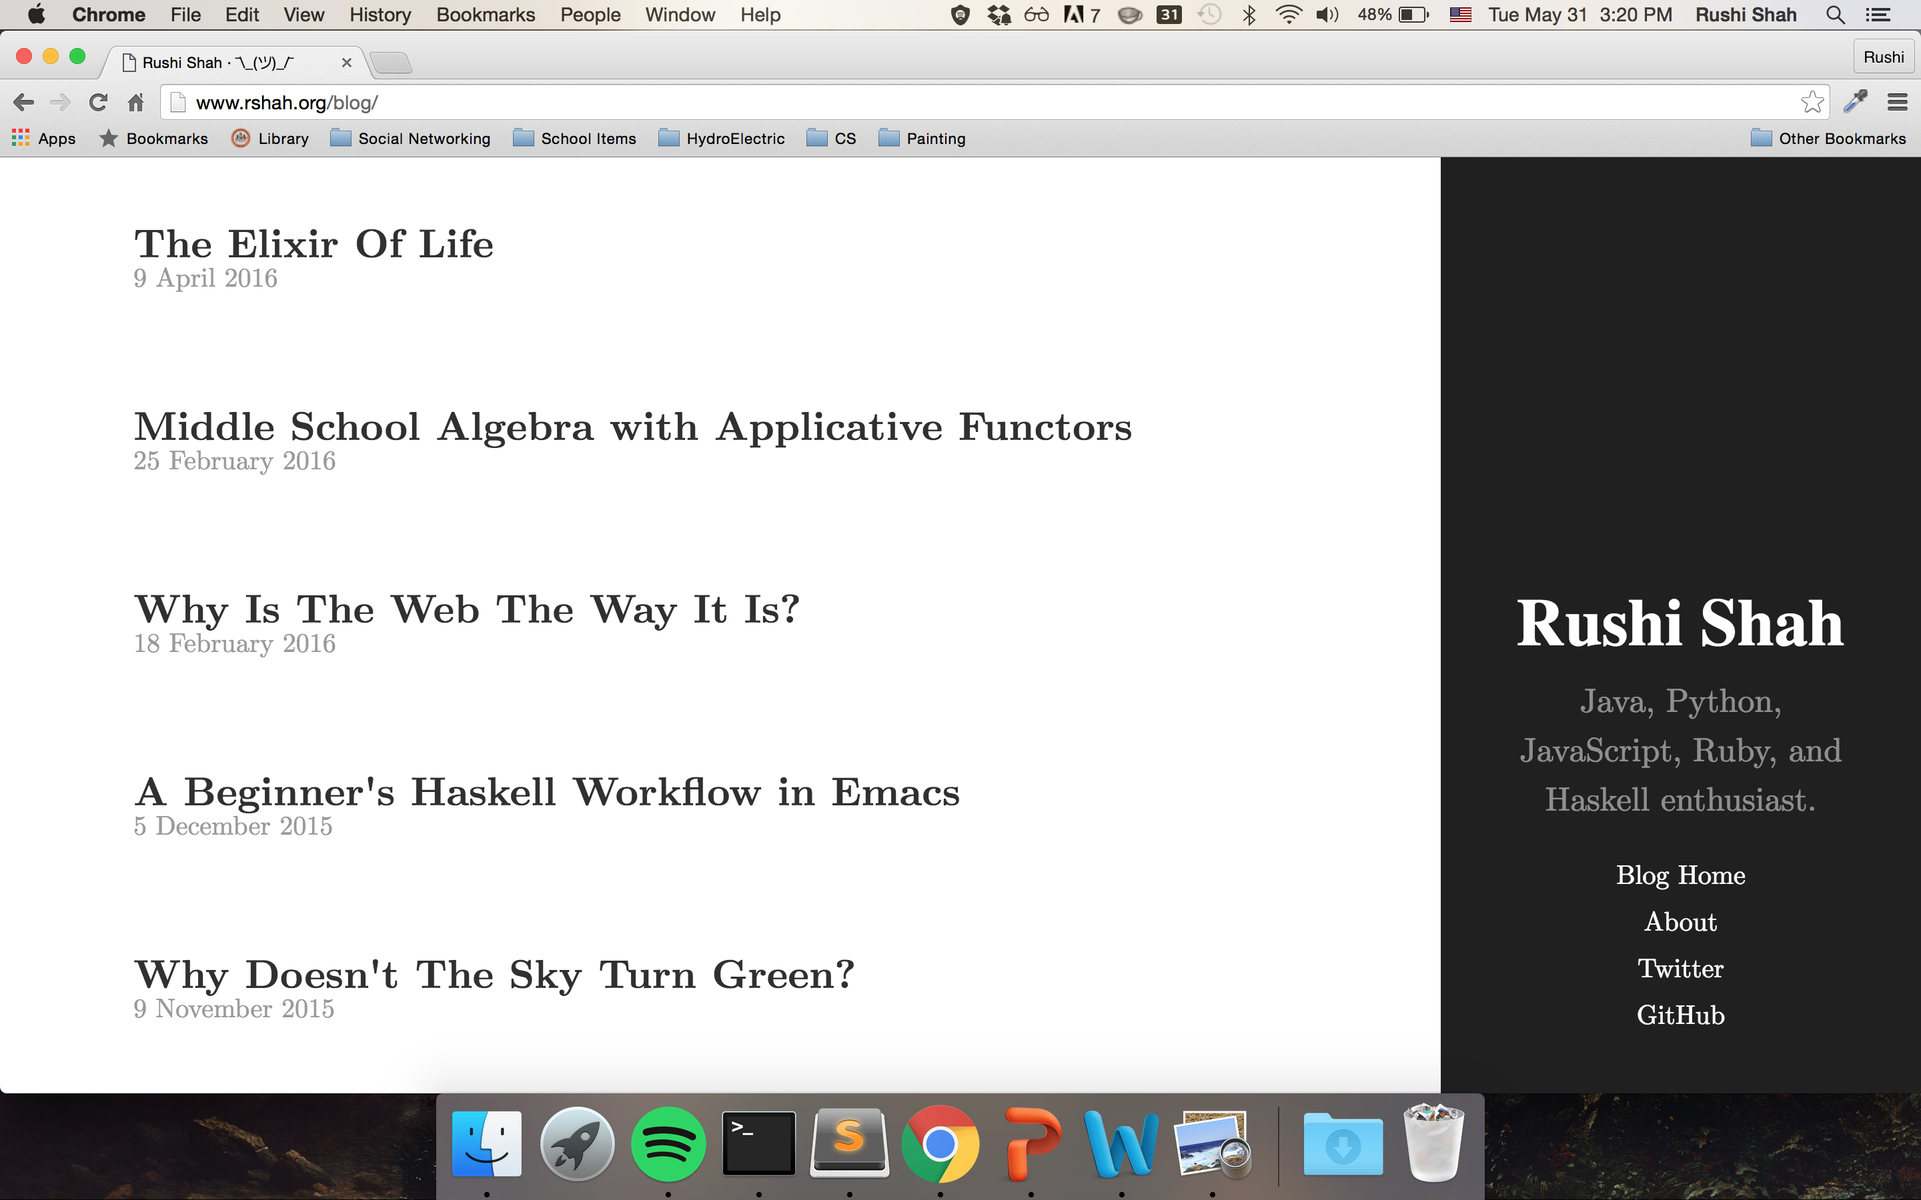
Compiled Site
λ
Open`index.html` in browser

