Slide 1
Functional Programming
λ
in Haskell

Slide 2
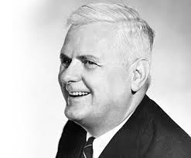


The Lambda Calculus
λ
Alonzo Church 1936
“any computable function can be evaluated in the context of λ-calculus” [1]
Turing equivalent

Slide 3
Object oriented programming v Functional programming
OOP:
Functions ->
Objects ->
Loops ->
Variables ->
Functional programming:
Functions
Algebraic Data Types (ADTs)
Recursion
Purity

Slide 4
Haskell Specifically
λ
Compiled
Statically typed
Purely functional
Lazy

Slide 5
Algebraic Data Types
λ
Basically the functional equivalent of objects
Type-classes are types of ADTs
Example:
data Maybe a = Just a | Nothing
data Tree = Node String Tree Tree | Leaf

Slide 6
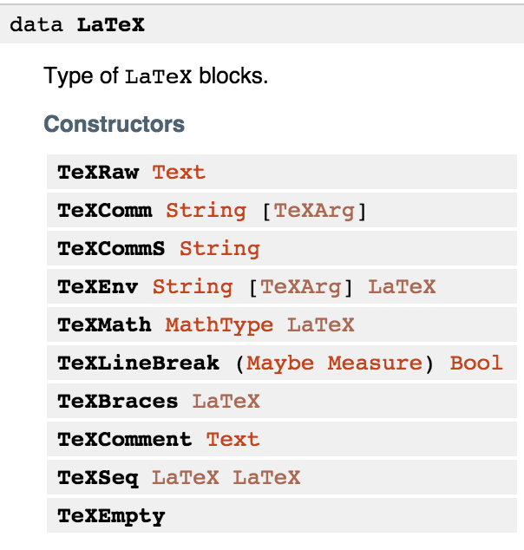
ADTs in Action
λ

Slide 7
A Worked Example
λ

Slide 8
References
[1] http://zeroturnaround.com/rebellabs/what-is-lambda-calculus-and-why-should-you-care/
[2]
http://www.seas.upenn.edu/~cis194/spring13/lectures.html
[3]
https://wiki.haskell.org/Typeclassopedia
[4]
https://hackage.haskell.org/package/HaTeX-3.16.2.0/docs/Text-LaTeX-Base-Syntax.html

