Slide 1

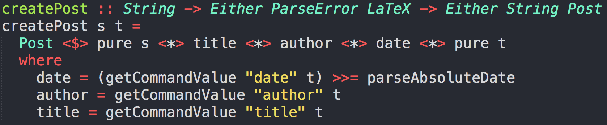
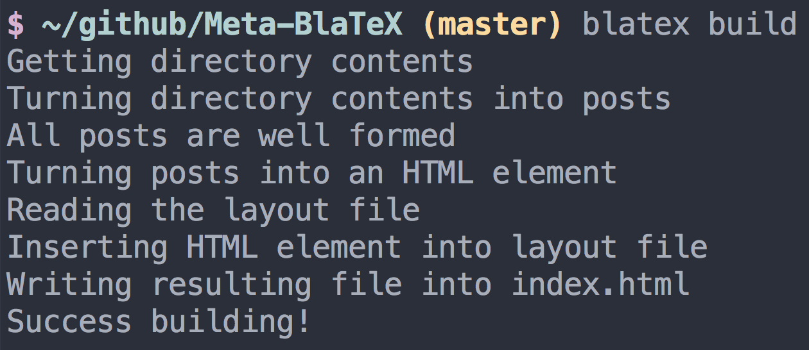
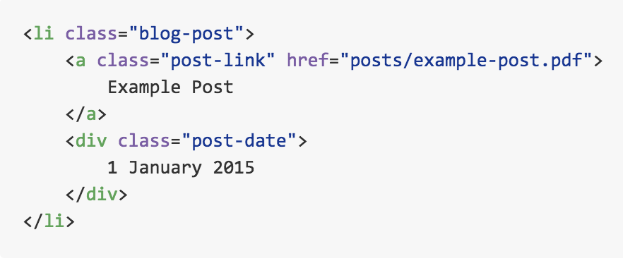
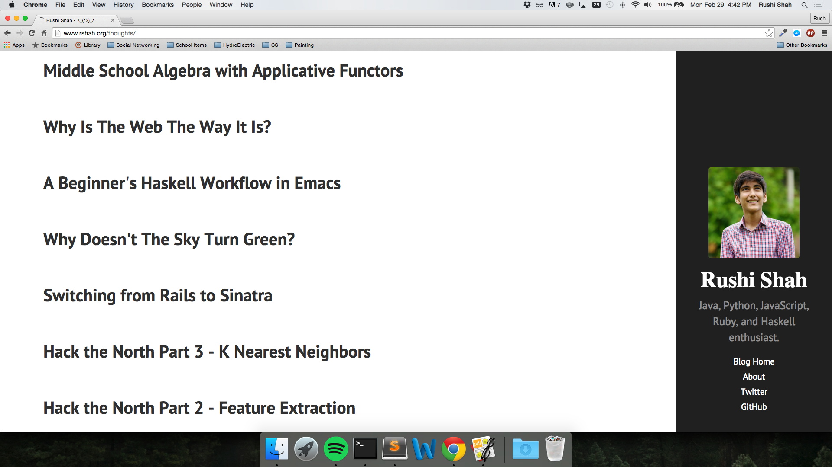
BlaTeX:
A Functional Approach to
Static Site Compilation of
LaTeX Documents
Install
Initialize
Build
Posts
Template
Figure 4: `Either` Algebraic Data Type Abstraction
Rushi Shah
Thomas Jefferson High School for Science and Technology
Implications
BlaTeX benefits mathemeticians, computer-scientists, and students of both disciplines who would like to maintain a technical blog about their work. It allows them to write their posts with the same advanced tools they use for their professional work.
The project is also a milestone for the language used to write it. Often the popularity of computer science languages is based heavily on the amount of open-source projects implemented with that language. Haskell is often disparaged because it is rarely used for personal projects, however the Haskell community is trying to refute this claim. Thus, BlaTeX contributes to the growing population of popular projects implemented in Haskell and demonstrates that Haskell is a reasonable choice for future open-source projects.
LaTeX is widely constrained to only being used in large-scale academic or professional projects, which is why it is such a mature piece of software. However BlaTeX broadens the scope of LaTeX itself by allowing people to utilize the strenght of LaTeX on a day-to-day basis.
Finished Static Website
Development / Techniques
In general terms: a directory containing posts is examined by BlaTeX, each post is parsed into an abstract syntax tree, information from this tree is parsed into a Haskell Post data structure, each post is stored into a linked-list, the list is sorted by the date, each object is converted into it's corresponding HTML, and this HTML is outputted into an output file at a user-specified location.
Figure 1: User Interface Flow Chart
Introduction
Markdown and HTML are the standard tools used to write standard tech blogs with. But they have weak support for embedding mathematical formulas, and are not conducive to writing for an extended period of time. So instead of writing posts in Markdown, my project allows writers to create posts in LaTeX (a powerful type-setting and markup language) and generate a static-site that can be deployed to any hosting service.
Background
My project, called BlaTeX, is a static-site compiler written in Haskell that compiles LaTeX posts into a deploy-able site. It is inspired by a similar Ruby tool called Jekyll that compiles Markdown posts into a static, deploy-able site. However, it allows the user to write posts in LaTeX rather than Markdown (because LaTeX is a more powerful tool) and is overall a more lightweight blogging software.
Figure 2: Program output
Design Criteria as Free Verse
Haskell Package on Hackage
For use as command line utility to
Compile LaTeX/PDF documents into
Static (HTML/CSS/JS) website
Conclusion
This project resulted in a simple, configurable, and useful tool called BlaTeX that lets users write posts in a powerful typesetting language and compile their posts into a beautiful static-site.
Requirements
This command line utility requires the Haskell Platform and LaTeX. The Haskell Platform includes GHC (a Haskell compiler) and Cabal, which is Haskell's primary package manager. LaTeX is needed to build LaTeX posts into their resulting PDFs. After the Haskell Platform has been installed, installing BlaTeX is simple:
> cabal install blatex
Figure 3: Generated HTML Element
Figure 5: Output at rshah.org/blog

