Slide 1
Rushi Shah BlaTeX
λ
Static Site Compilation for Advanced Markup Language Documents

Slide 2
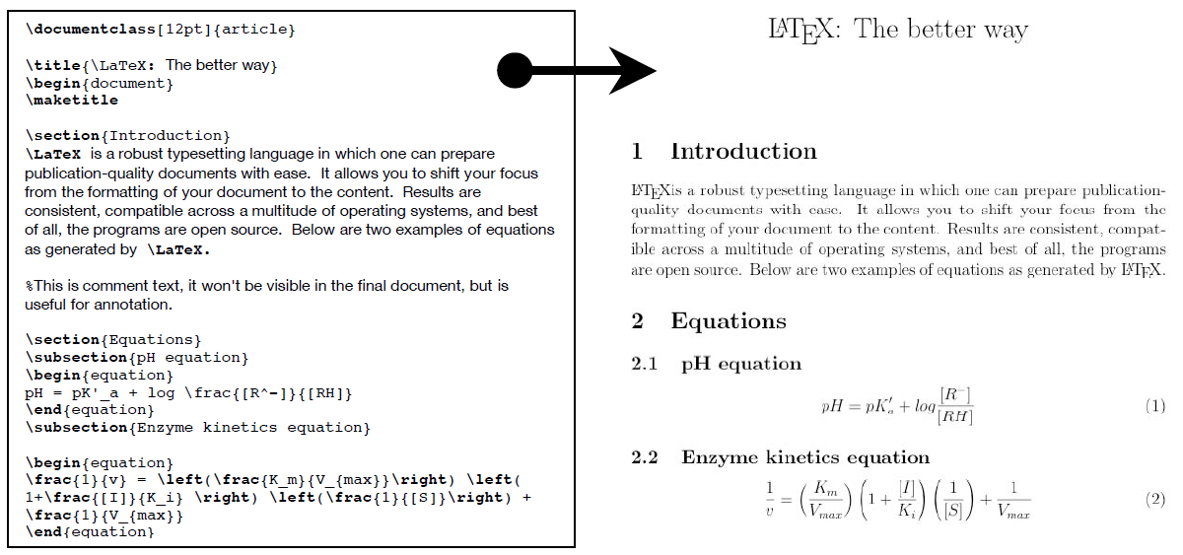
Background
λ
Static sites (compare to dynamic sites)
LaTeX (compare to Markdown)
Haskell (compare to Java)
PDFs (compare to HTML)

Slide 3
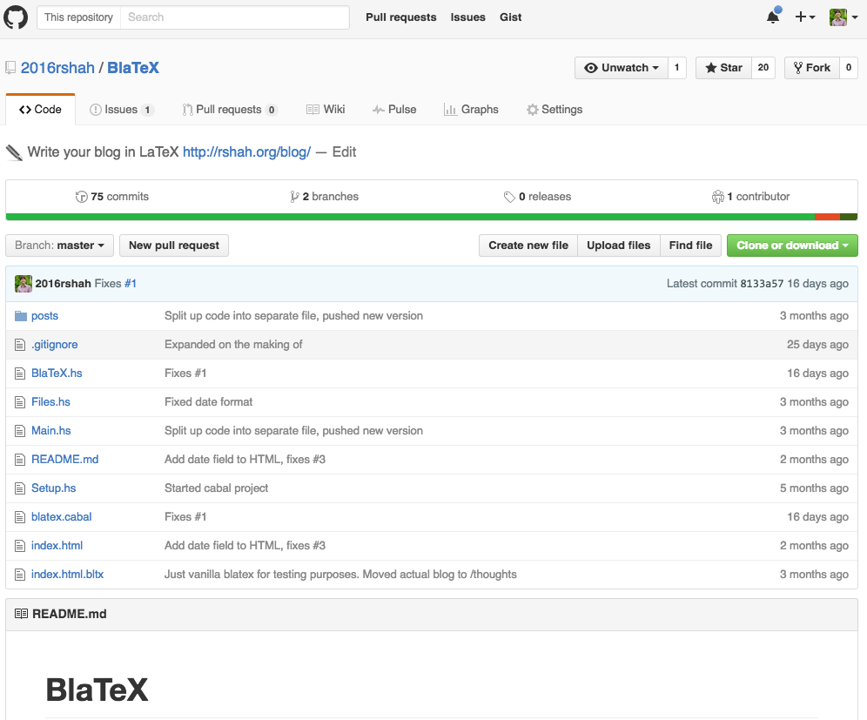
BlaTeX
λ
Static site compiler written in Haskell for LaTeX documents

Slide 4
How it Works
λ
Install
Initialize
Build
Posts
Template
Finished Static Website

Slide 5
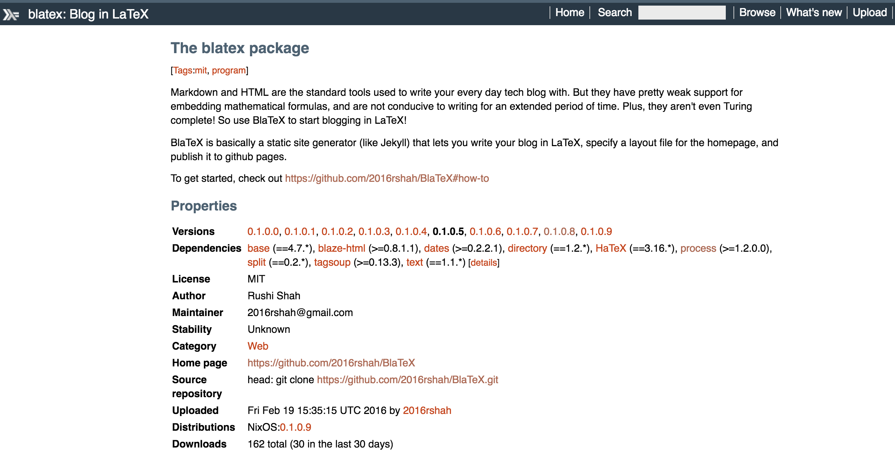
Install Hackage package
λ
`cabal install blatex`

Slide 6
Initialize site
λ
`blatex init`
`index.html.bltx`
`posts/` directory
`posts/example-post.tex` file
`posts/example-post.pdf` file

Slide 7

Write/edit posts
λ
Write and compile LaTeX documents as usual
BlaTeX looks in the `posts/` directory
No interruption in typical workflow

Slide 8

Design a static website
λ
Build your website in the `index.html.bltx` file
BlaTeX will use this template file to build your static site
Looks for the following code: `<ul id=“blog-posts”></ul>`

Slide 9
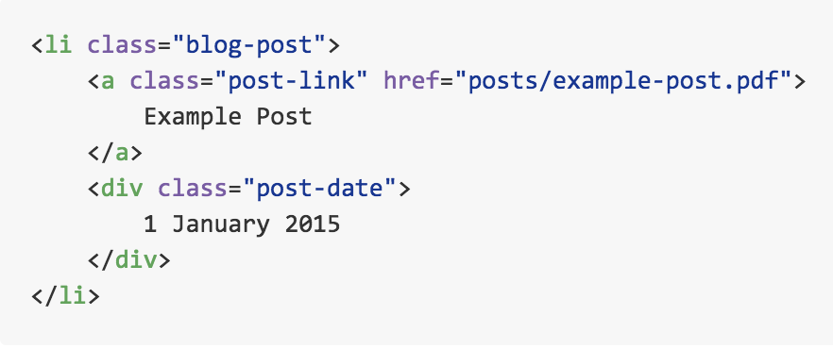
Style the HTML elements
λ
No interruption of typical workflow

Slide 10
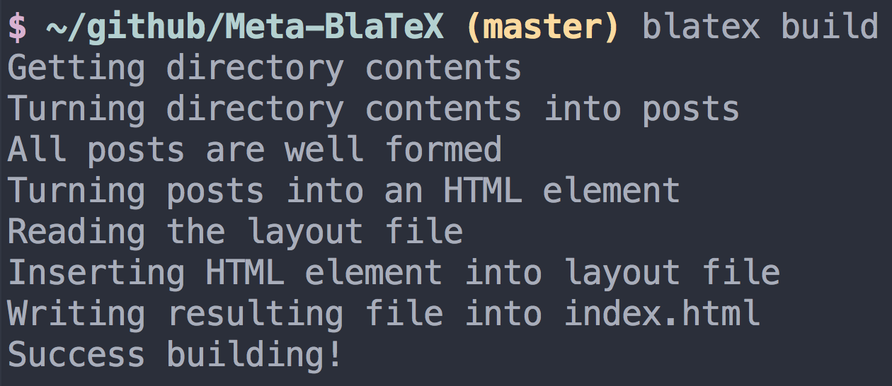
Compile your static site
λ

Slide 11
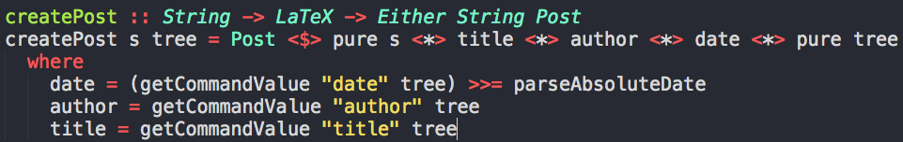
Possible Errors
λ
`Either`
Applicative Functor
Monad

Slide 12
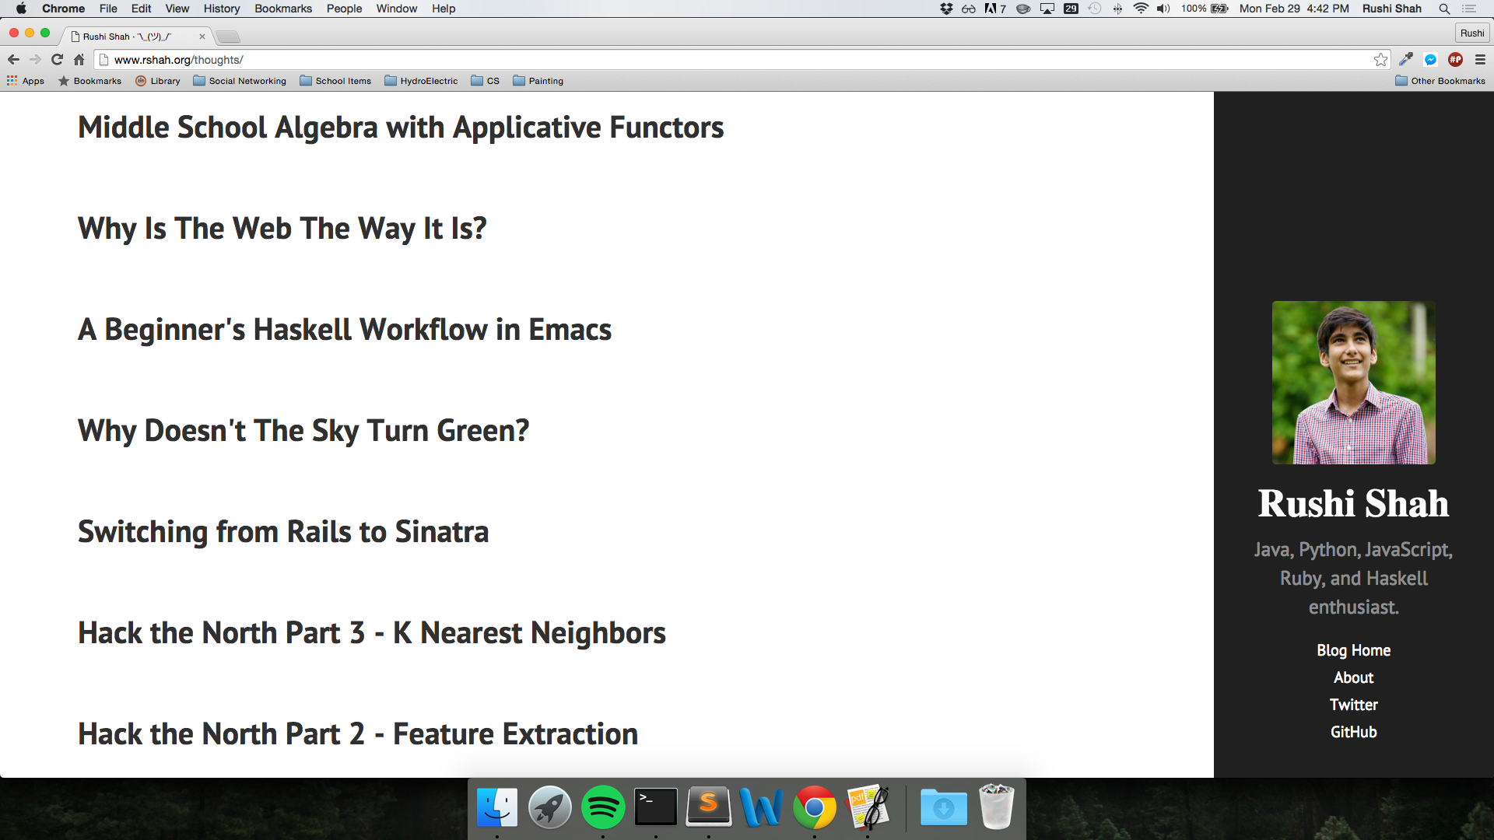
Compiled Site
λ
Open`index.html` in browser

Slide 13

Public Reception of BlaTeX
λ
Github
Facebook
DC Hack and Tell
tjSTAR Reception
tjSTAR

