Slide 1
Deep Reinforcement Learning Demo

Slide 2
Outline
Q learning
Deep Q Network (DQN)
Double Deep Q Network (DDQN)
OpenAI Gym

Slide 3


Q learning
A simple demo(treasure hunt)
Explorer in position 0, and treasure in position 5
Explorer can only go left or right
Using an 6x2 table to store Q(s,a)
Position 0
1
2
3
4
5

Slide 4
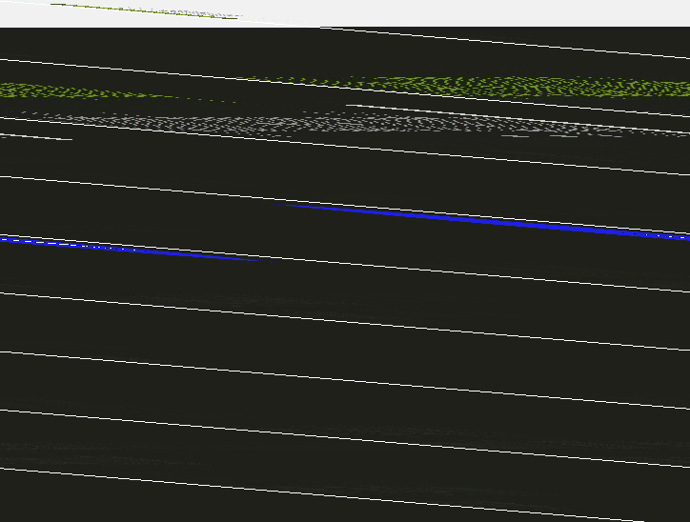
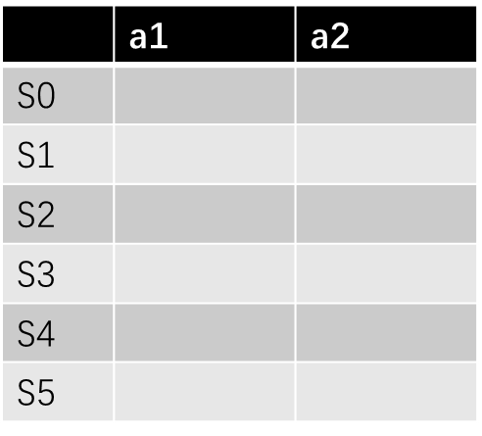
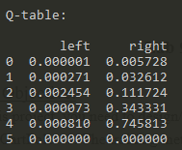
Q learning
Q table

Slide 5
Q learning
A simple demo(See treasure hunt)
Another Demo, See q_learning_demo.cpp

Slide 6
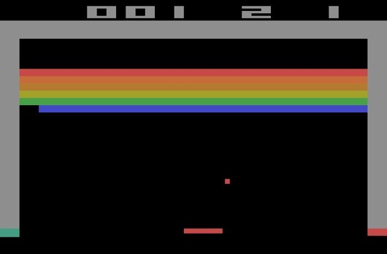
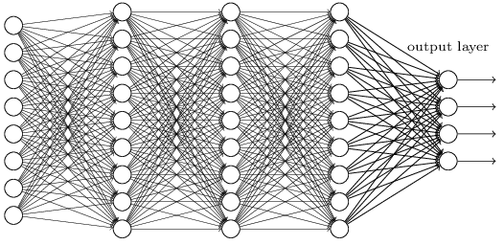

Deep Q Network (DQN)
 | a1 | a2 | a3 | a4 | …
S1
S2
S3
S4
…
Q learning

Slide 7
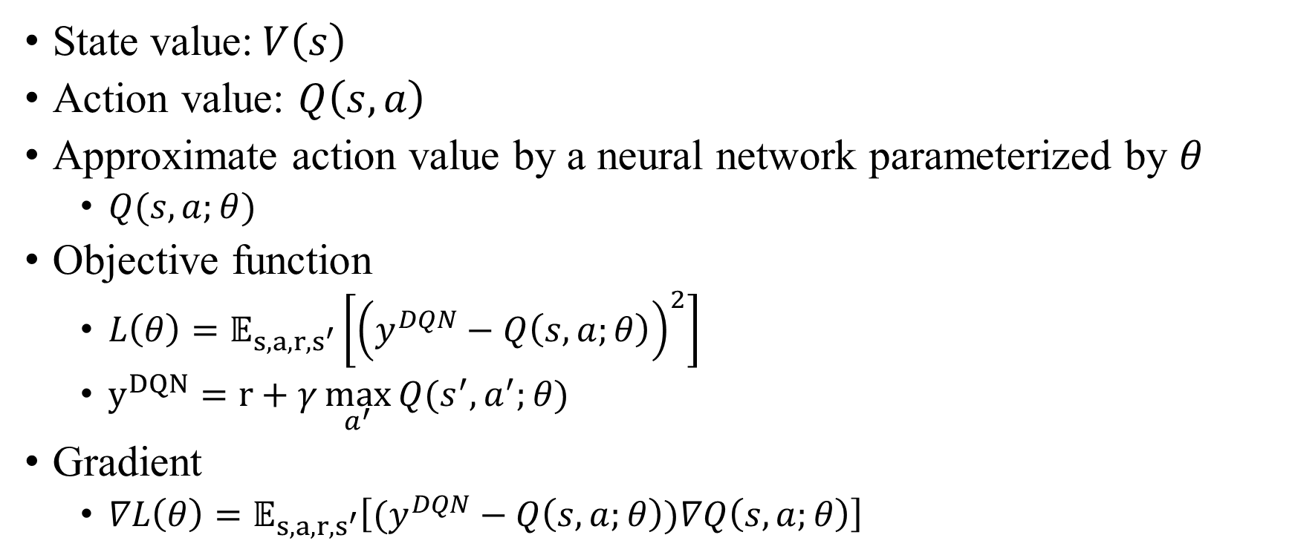
Deep Q Network
State value:$V\left(s\right)$
Action value: $Q\left(s,a\right)$
Approximate action value by a neural network parameterized by $θ$
$Q(s,a;θ)$
Objective function
$L\left(θ\right)=𝔼_{s,a,r,s^{′}}\left[{\left(y^{DQN}−Q\left(s,a;θ\right)\right)}^{2}\right]$
$y^{DQN}=r+γ\max_{a^{′}}{Q(s^{′},a^{′};θ)}$
Gradient
$∇L\left(θ\right)=𝔼_{s,a,r,s^{′}}\left[(y^{DQN}−Q\left(s,a;θ\right))∇Q\left(s,a;θ\right)\right]$

Slide 8
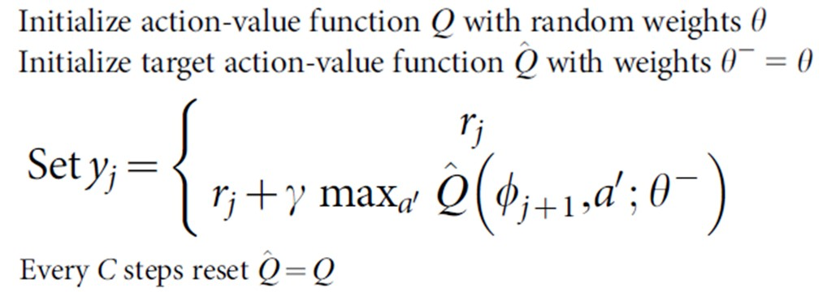
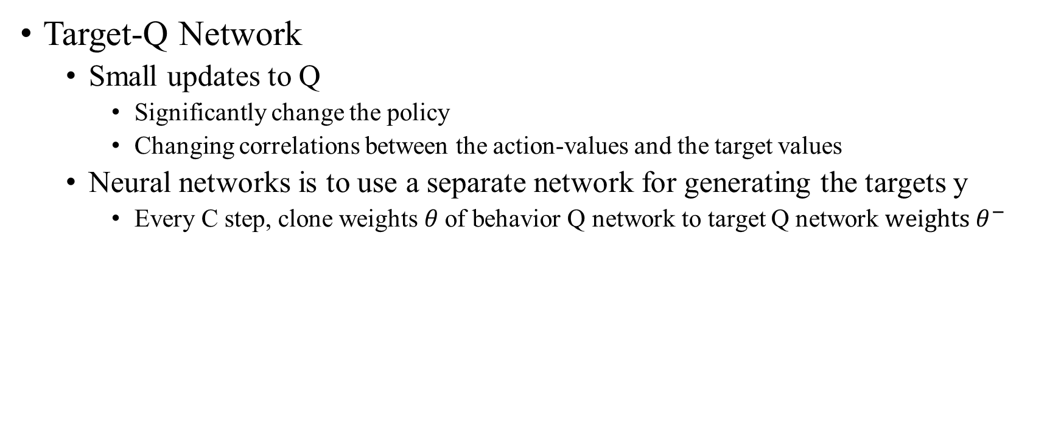
Deep Q Network(cont.)
Target-Q Network
Small updates to Q
Significantly change the policy
Changing correlations between the action-values and the target values
Neural networks is to use a separate network for generating the targets y
Every C step, clone weights$θ$ of behavior Q network to target Q network $weights θ^{−}$

Slide 9
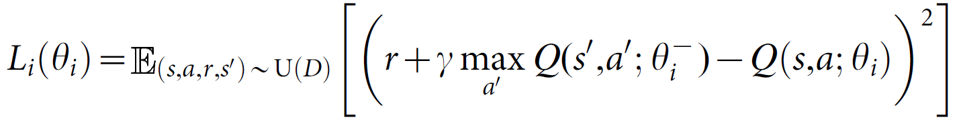
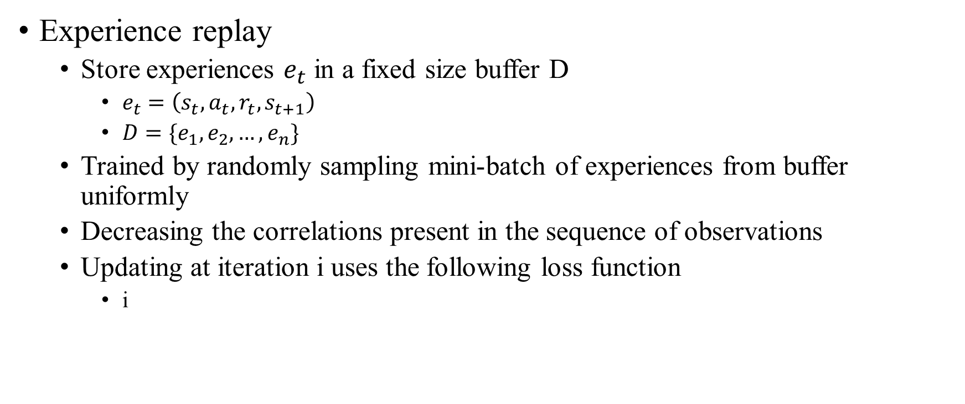
Deep Q Network(cont.)
Experience replay
Store experiences $e_{t}$ in a fixed size buffer D
$e_{t}=\left(s_{t},a_{t},r_{t},s_{t+1}\right)$
$D=\{e_{1},e_{2},…,e_{n}\}$
Trained by randomly sampling mini-batch of experiences from buffer uniformly
Decreasing the correlations present in the sequence of observations
Updating at iteration i uses the following loss function
i

Slide 10
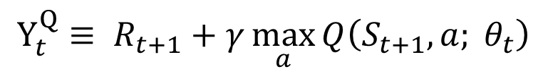
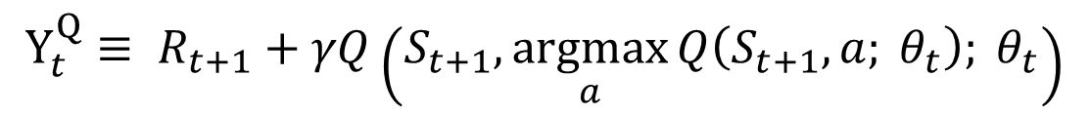
Double DQN
The max operator in standard Q-learning and DQN, uses the same values both to select and to evaluate an action.
This makes it more likely to select overestimated values, resulting in overoptimistic value estimates.
To prevent this, we can decouple the selection from the evaluation.
Q-learning:
$$Y_{t}^{Q}≡ R_{t+1}+γ\max_{a}{Q\left(S_{t+1}, a; θ_{t}\right)}$$
Decouple
$$Y_{t}^{Q}≡ R_{t+1}+γQ\left(S_{t+1}, \underset{a}{argmax}{Q\left(S_{t+1}, a; θ_{t}\right); θ_{t}}\right)$$
Double Q-learning:
$$Y_{t}^{DoubleQ}≡ R_{t+1}+γQ\left(S_{t+1}, \underset{a}{argmax}{Q\left(S_{t+1}, a; θ_{t}\right); θ_{t}^{′}}\right)$$
Notes:
The proof of max operator would makes Q-learning overestimate: http://papers.nips.cc/paper/3964-double-q-learning.pdf
In the original Double Q-learning algorithm, two value functions are learned by assigning each experience randomly
to update one of the two value functions, such that there are two sets of weights.

Slide 11
Double DQN
Overestimation of Q-Learning
Consider a real-valued continuous state space with 10 discrete actions in each state.
For simplicity, the true optimal action values in this example depend only on state so that in each state all actions have the same true value.
Notes:
這邊想要確認 function approximation 的維度 和 overoptimism 之間的關係。

Slide 12
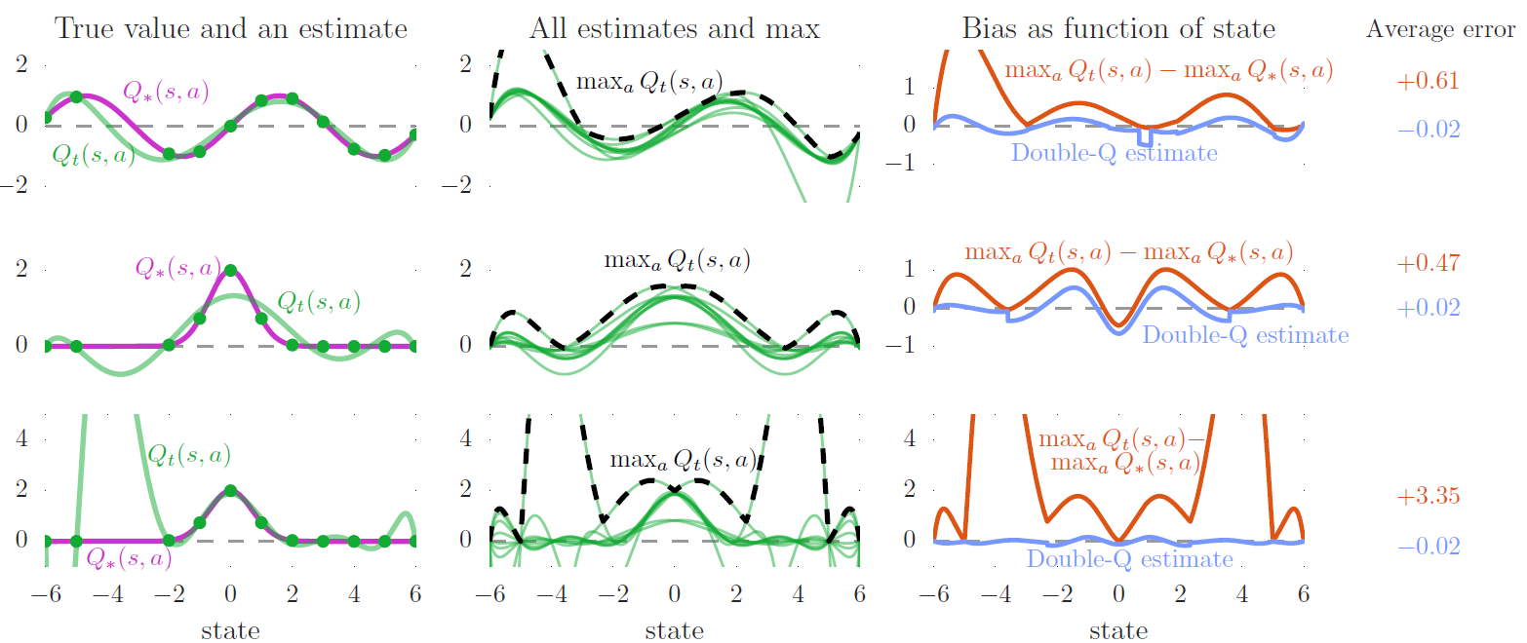


Double DQN(cont.)
$$Q_{∗}\left(s, a\right)=\sin{(s)}$$
Degree of polynomial: 6
Different True Value Function
$$Q_{∗}\left(s, a\right)=2\exp\left(−s^{2}\right)$$
Degree of polynomial: 6

Slide 13


Double DQN(cont.)
$$Q_{∗}\left(s, a\right)=2\exp\left(−s^{2}\right)$$
Degree of polynomial: 6
Different Degree of Polynomial
$$Q_{∗}\left(s, a\right)=2\exp\left(−s^{2}\right)$$
Degree of polynomial: 9

Slide 14
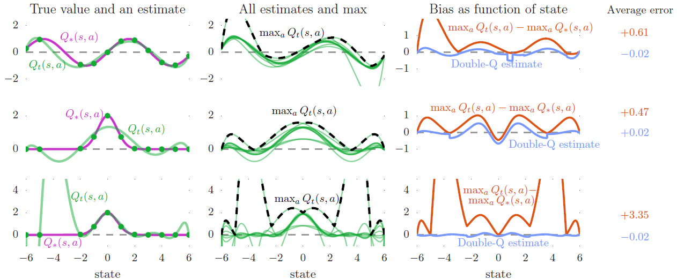
Double DQN(cont.)

Slide 15
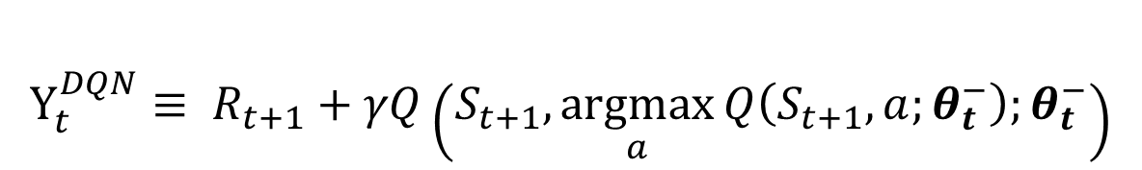
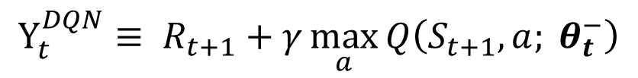
Double DQN(cont.)
The idea of Double Q-learning is to reduce overestimations by decomposing the max operation in the target into action selection and action evaluation.
Evaluate the greedy policy according to the online network.
Using the target network to estimate its value.
$$Y_{t}^{DQN}≡ R_{t+1}+γ\max_{a}{Q\left(S_{t+1}, a; θ_{t}^{−}\right)}$$
$$Y_{t}^{DQN}≡ R_{t+1}+γQ\left(S_{t+1}, \underset{a}{argmax}{Q\left(S_{t+1}, a;θ_{t}^{−}\right);θ_{t}^{−}}\right)$$
$$Y_{t}^{DoubleDQN}≡ R_{t+1}+γQ\left(S_{t+1}, \underset{a}{argmax}{Q\left(S_{t+1}, a; θ_{t}\right); θ_{t}^{−}}\right)$$

Slide 16
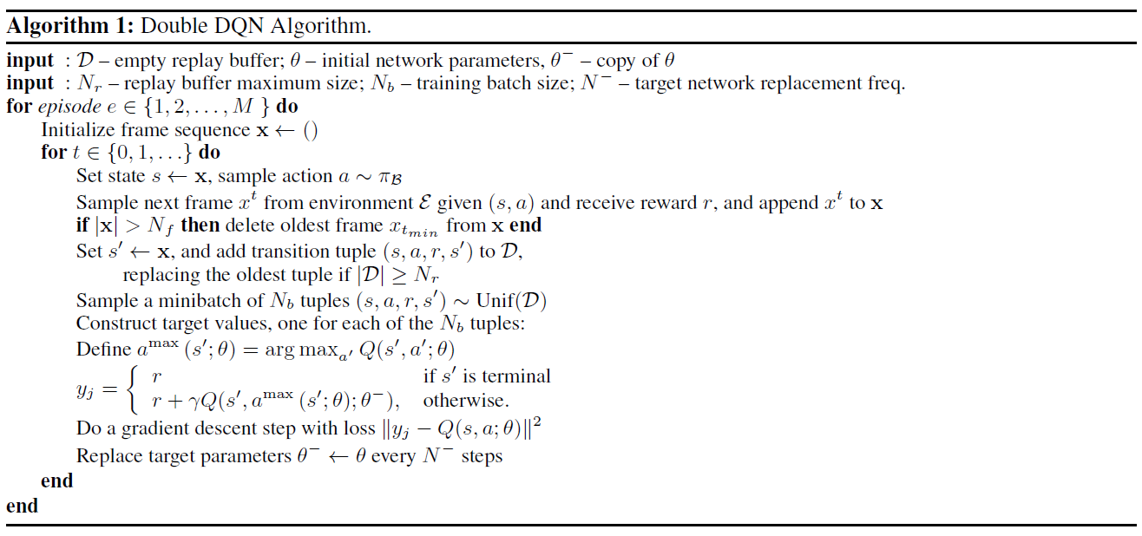


Double DQN(cont.)
$θ_{}^{}$
$θ_{}^{−}$

Slide 17
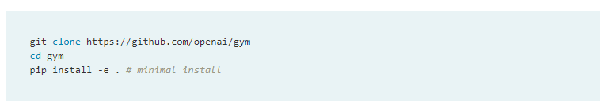
OpenAI Gym
OpenAI Gym is a toolkit for developing and comparing reinforcement learning algorithms.
Installation
or use command pip install gym[all]

Slide 18
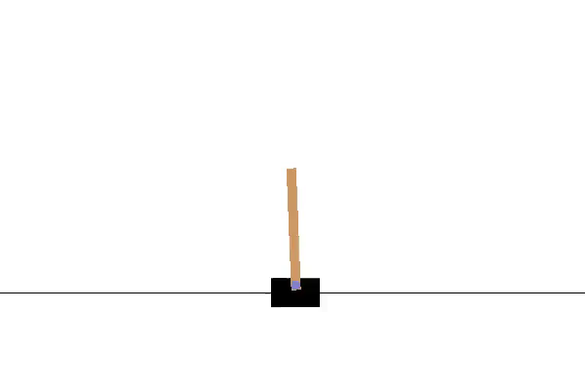
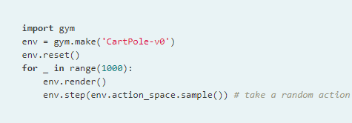
OpenAI Gym(cont.)
Running an environment

Slide 19
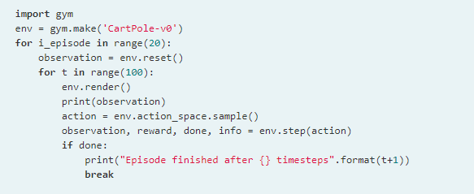
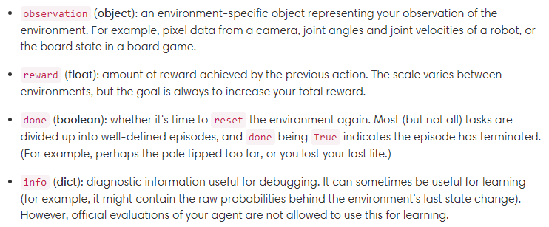
OpenAI Gym(cont.)

