Slide 1
Optimization of Travelling salesman problem Group : 6
Assigned By : Prof. Nabinkumar Sahu

Slide 2
Problem Statement
The travelling salesman problem (TSP) asks the following question: "Given a list of cities and the distances between each pair of cities, what is the shortest possible route that visits each city once and returns to the origin city?“. Being Popular problem, TSP can be solved by try every permutation and find which of them has shortest path. This trial method need optimization. Optimization of TSP can be done by many Optimization methods. We are doing Genetic algorithm as optimization method.

Slide 3
Problem Definition
The TSP can be defined on a complete undirected graph G=(V,E), where V={1,2,…,n} is the set of n vertices (Cities) and E={ ( i, j) ; i , j ∈ V and I ≠j } the set of edges (connections between cities). A cost cij (can be distance, time, etc.) is assigned to each edge (i, j), where all the costs satisfy the constraint cij ≤ cik +ckj for all i,j,k∈V. In the current study, the vertices are assumed to be points Pi=(Xi,Yi) in the plane and cij=sqrt((Xi−Xj)^2+(Yi−Yj)^2) the Euclidean distance between Pi and Pj.

Slide 4
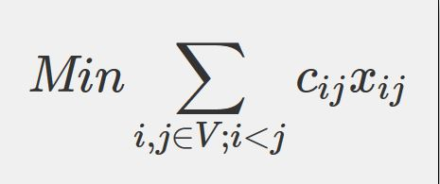
Objective function
WHERE, binary variable x_{ij} associated with each edge (i, j) in the graph G. The values 1 and 0 of x_{ij} indicate respectively the inclusion or exclusion of edge (i, j) in the optimal tour.

Slide 5
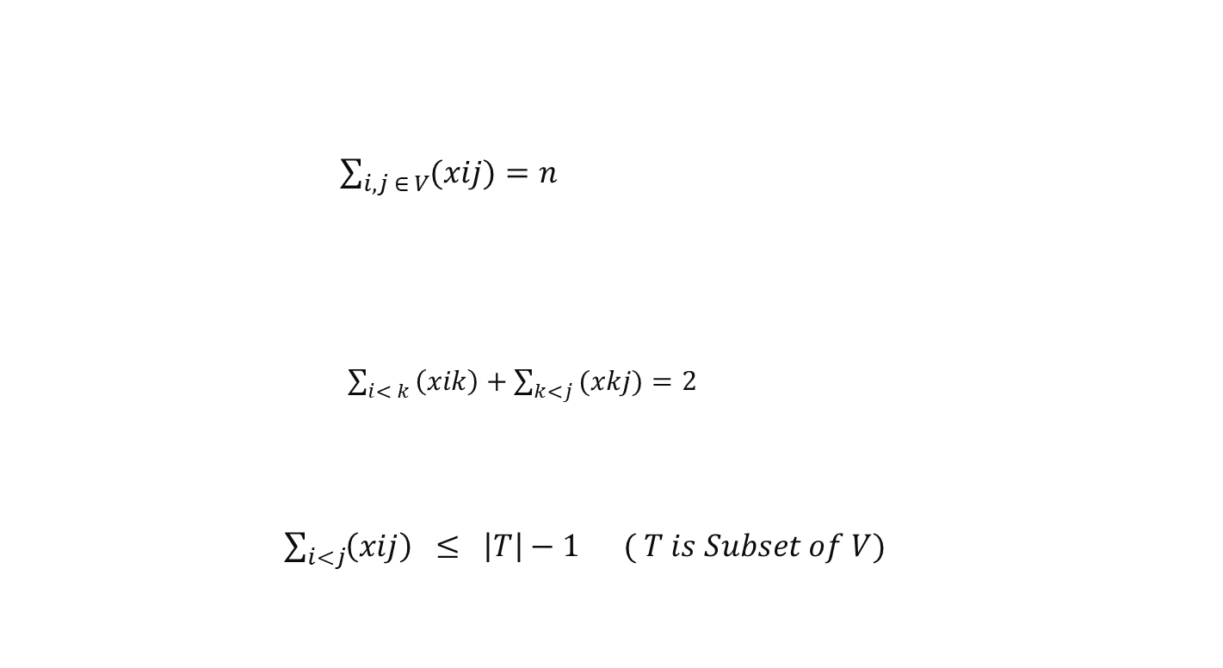
Constraints
Any feasible tour, including the optimal tour, must contain exactly n edges.
$\sum_{i,j ∈ V}{(xij)=n}$
only two edges must be selected for each vertex. This constraint allows to produce tours where every city is visited only once and the salesman returns back to the start city.
$\sum_{i< k }{\left(xik\right)+\sum_{k<j }{(xkj)}=2}$
the formation of sub tours containing a number of vertices smaller than n. This constraint guarantees the visit of all cities.
$\sum_{i<j}{\left(xij\right) } ≤ \left|T\right|−1 ( T is Subset of V)$

Slide 6
Genetic algorithm
Generate Initial Solution
Evaluation : Find fitness value for all of them
Selection : Select candidate for reproduction
Crossover and mutation
Select best individuals to form new Population
If Stopping condition reached then go to step 7 else go to step 2
The fittest solution maybe the optimal or near to optimal solution.

Slide 7
Create initial solution :
All nearest neighbours (ANN)
Four permutation rules-based heuristic (4Perm)

Slide 8
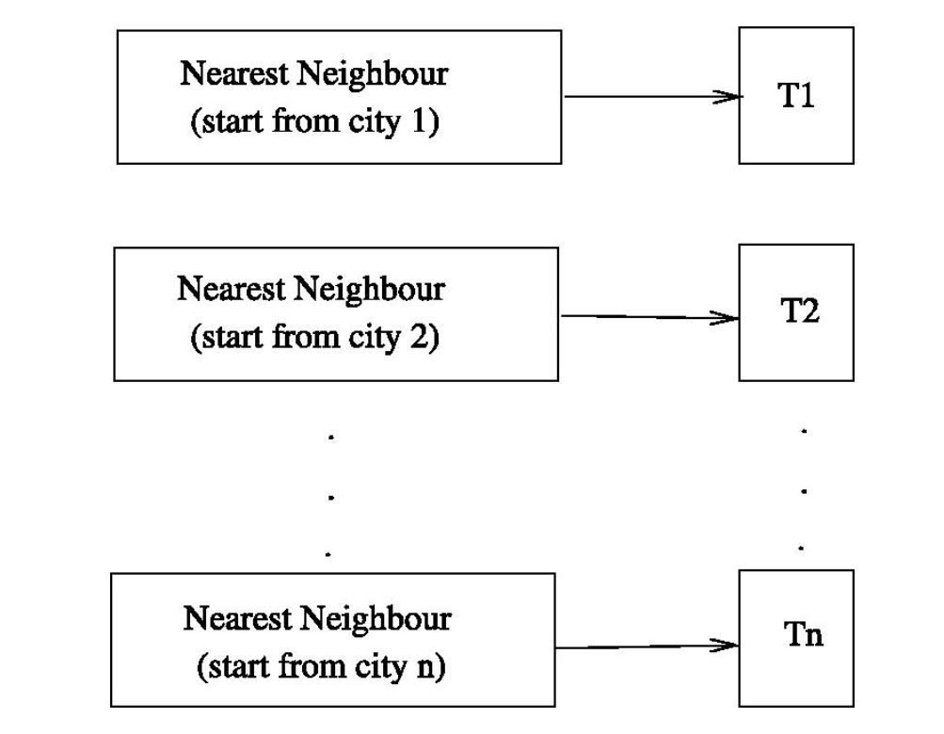

All nearest neighbours (ANN)
ANN is a generalization of the classical Nearest Neighbor heuristic (NN) that consists of constructing a solution to the TSP starting always from city 1 (initial city). In every step, the salesman has to visit the non-visited city next nearest to his current location. We generalized this rule to generate n tours T_{i}, ($1≤i ≤n$), where each tour T_{i} starts from city i. The reason behind this is simply because all the generated tours via some rotations will all start from the initial city 1. But, the intermediate cities will have different orders of visits.
Computational complexity : O($n^{3}$)

Slide 9
Four permutation rules-based heuristic (4Perm)
The idea of the second heuristic is to check whether or not successive local and slight changes of a tour can lead to a better one. Since graphically a tour can be represented as a Hamiltonian cycle, replacing two carefully-selected edges (i, j) and (k, l) from the tour having no common city with two other edges that are not in the tour, can lead to a new and more feasible tour. Following are four proposed rules to perform the edge permutations in a feasible tour T with n edges. The digit 1 in the rule’s name indicates the addition of an edge (i,j)∈E, which is currently not in the tour, to the tour. However, the digit 0 indicates the removal of an edge from the tour.
Rule 1 (Perm₀₀₁₁)
Rule 2 (Perm₁₁₀₀)
Rule 3 (Perm₁₀₁₀)
Rule 4 (Perm₀₁₀₁)
Computational complexity : polynomial

Slide 10
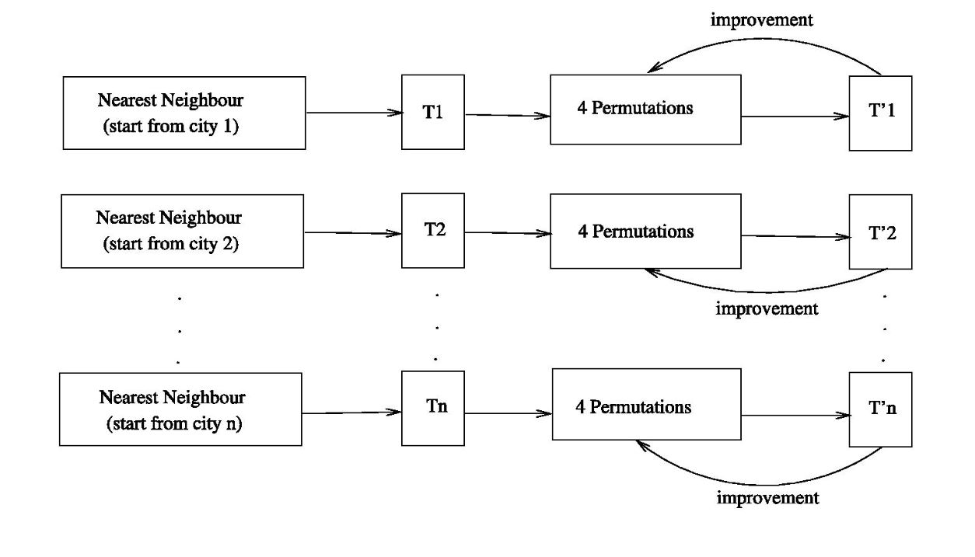
Initial solutions :
The aim of 4Perm heuristic is to improve the solutions generated by ANN. The idea is to iteratively apply the four permutation rules to every solution. At every iteration, the best tour obtained is kept for the next iteration. This step generates n new tours with lower costs.
congested.

Slide 11
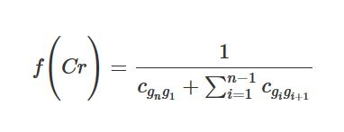
Evaluation:
The evaluation function is used to assign to each chromosome in the population a fitness value. For the TSP problem, the fitness value is the inverse of the resulting tour’s length. Therefore, the higher the fitness, the better the chromosome. The fitness function f of a chromosome Cr=(g1,g2,…,gn) is given by

