Slide 1
AFRICAN_CHILD DONATION WEB APP
Name : Uwimana Therese ID : 2017070162

Slide 2
AFRICAN_CHILD
This is a website that will allow anyone to donate and to see how good it is to help someone. This website is going to help people who wants to become our volunteers to register
This website is in English and I created it to help children who needs help in Africa and for African_child project to be known and trusted.

Slide 3
AFRICAN_CHILD PROJECT
African_child, is a project that is there to help children in Africa as we know poverty is common in many African countries and millions of children are at risk of hunger, HIV, AIDS, malnutrition, malaria and preventable disease.
Why African_child?
African_Child intervenes on behalf of children who have severely ill parents or who are at risk of abuse or exploitation, offering extra attention and protection.
Donations to African_Child project AIDS Initiative are used to provide support to children infected by AIDS, living with the HIV virus, or who are living with parents or siblings who are HIV+ or infected by AIDS.

Slide 4
PROJECT PLAN ( My project plan is in two parts)
Part 1(FRONTEND)
Week 8 : Github update
Week 9 : Setting home
Week 10 : Making home page responsive
Week 11 : Completion of Front-End
Week 12 : Frontend Optimization and URL from Glitch
Technologies
html
bootstrap
css
java script

Slide 5
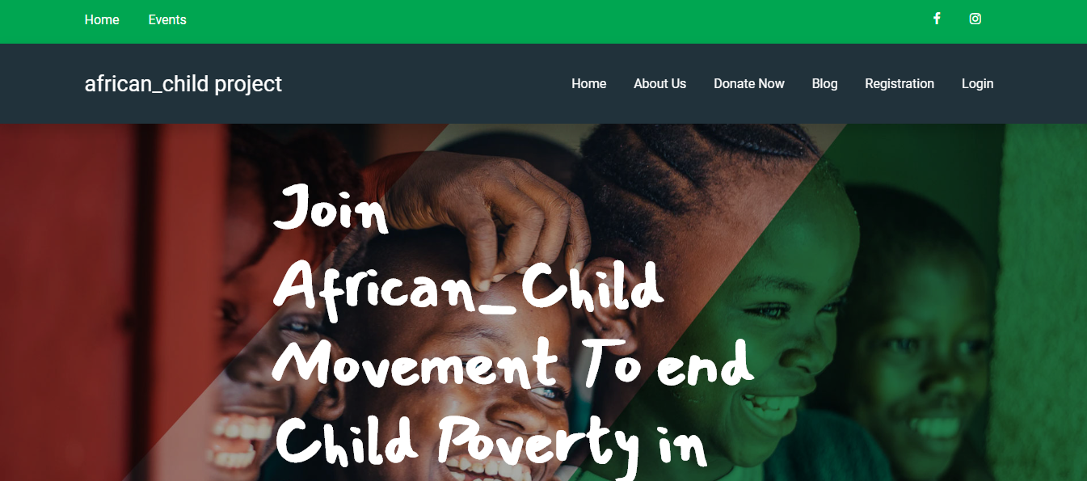
MY WEBSITE (This website contain 7 html pages)

Slide 6
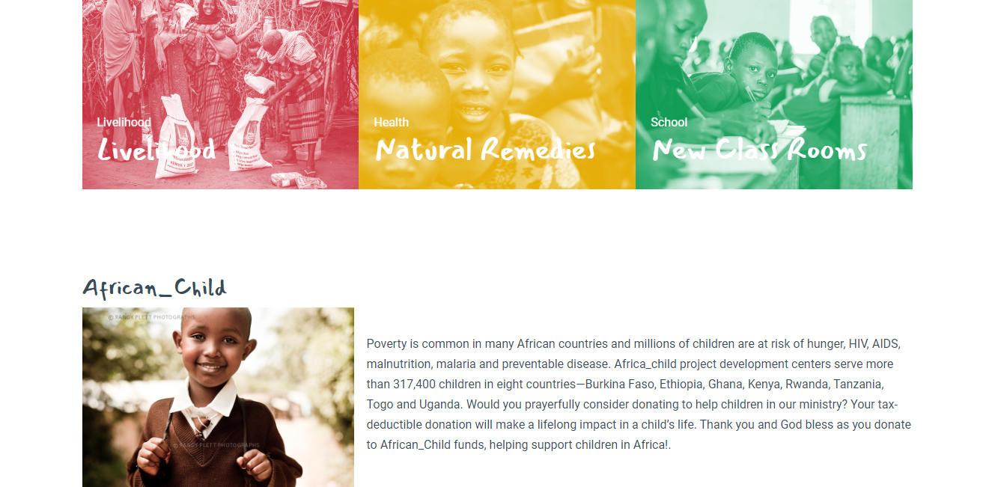
MY WEBSITE

Slide 7
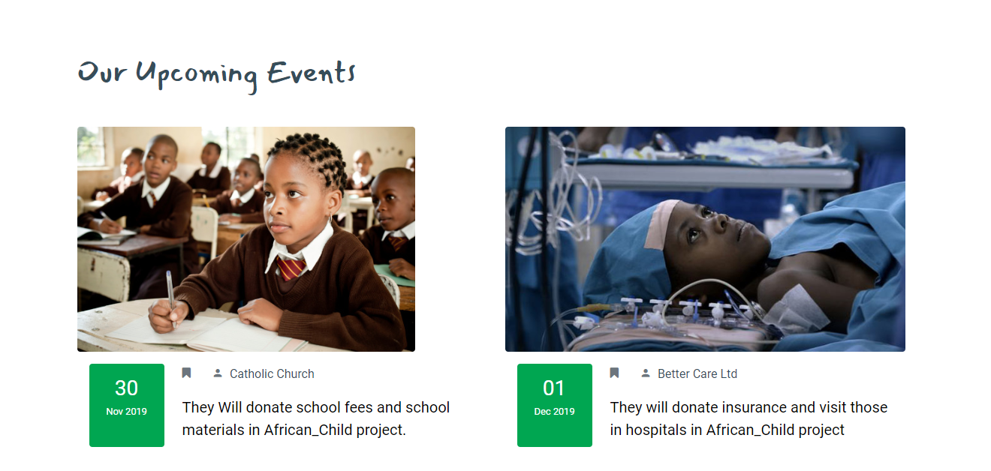
EVENTS

Slide 8
PROJECT PLAN
Part 2(BACKEND)
Week 13 : Getting ready the user account with back end technology.
Week 14 : Create and Delete method has been implemented from CRUD operation,
week 15 :finished the CRUD operation
User can create account
User can change the information
User can delate account
Technologies
Node js
Include CRUD operations

Slide 9
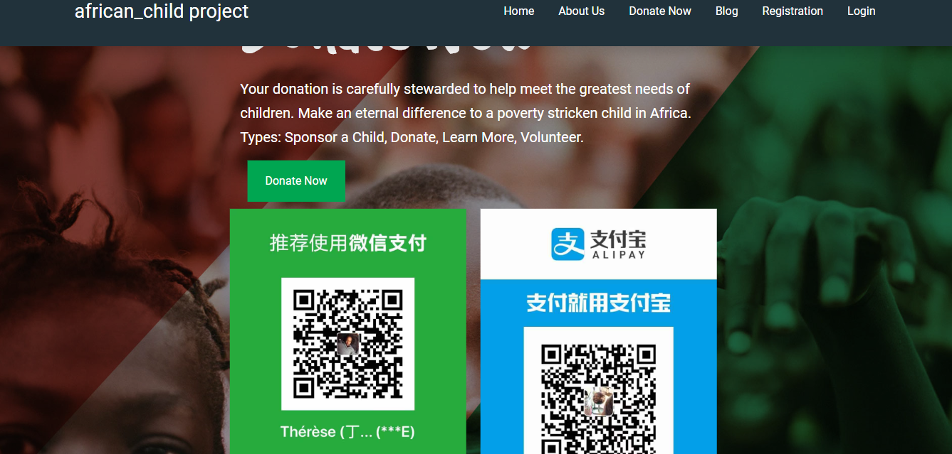
DONATE

Slide 10
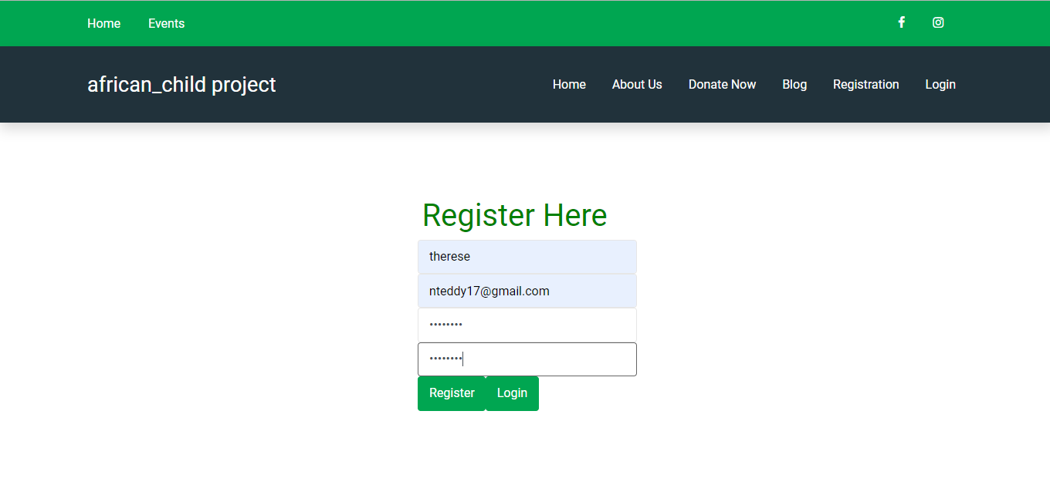
Registration (you have to register to become a volunteer)

Slide 11
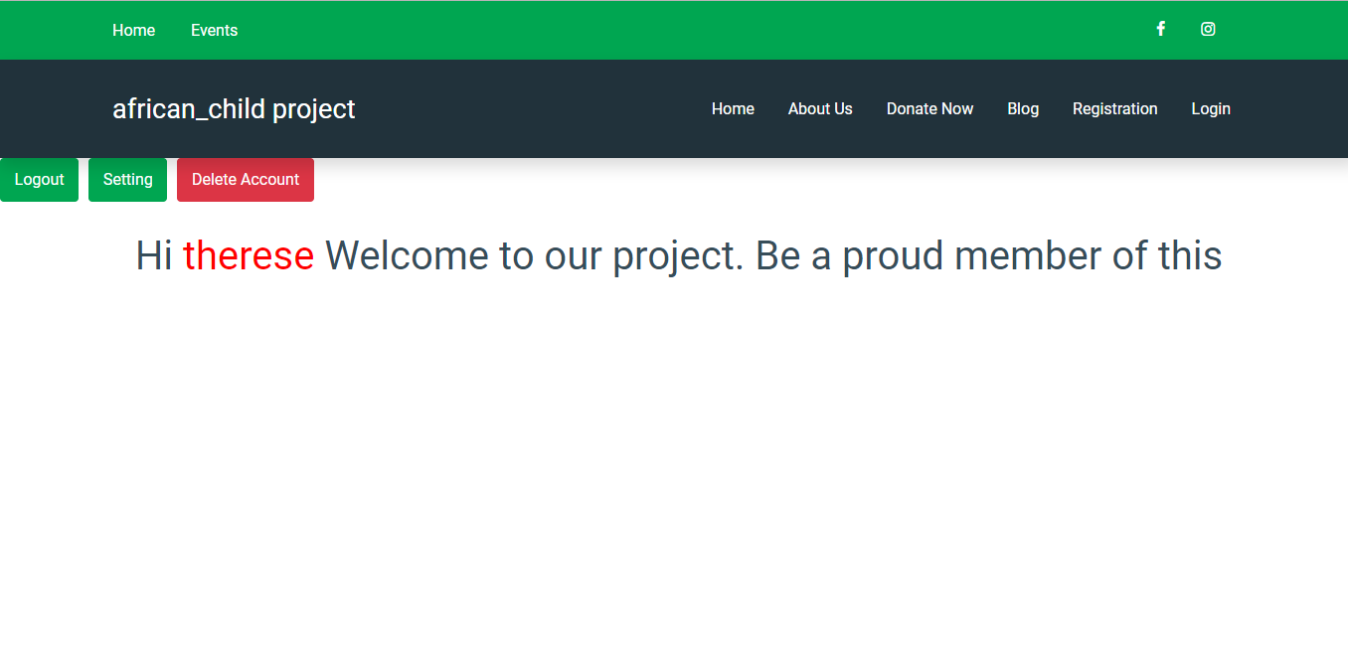
LOGIN (a user can delete his/her account)

Slide 12
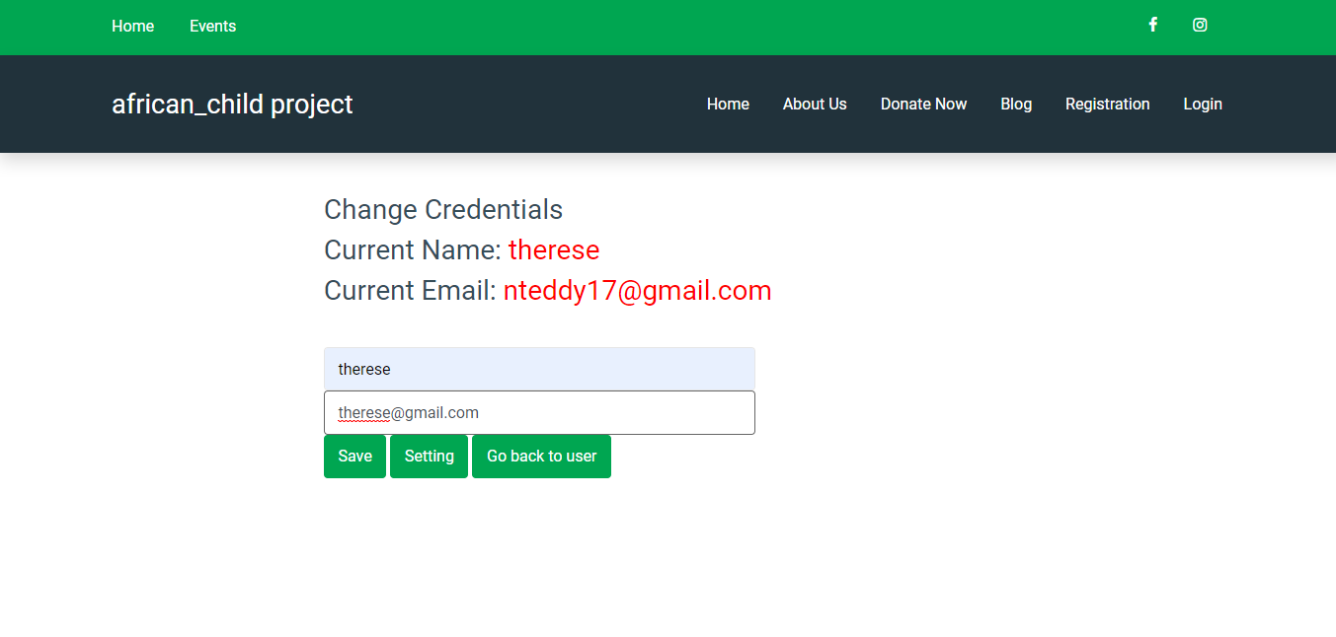
SETTING (user can change his/her information)

Slide 13

Thank you and God bless you as you donate to African_Child funds, Helping the Homeless, Hungry and Hurting Children in Africa!

