Slide 1
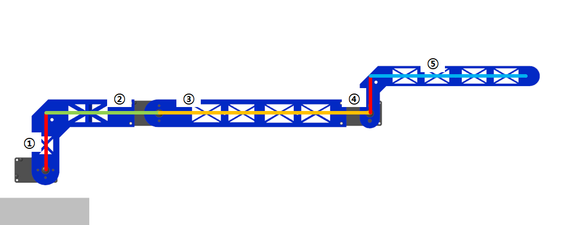
[mm]
1. 44.957 => 0.044957
2. 89.827 => 0.089827
3. 166.5 => 0.1665
4. 29.479 => 0.029479
5. 123.155 => 0.123155

Slide 2
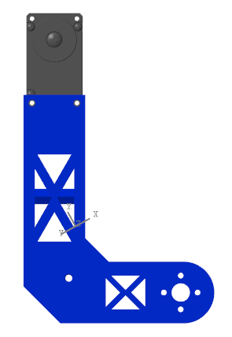
LINK1 -

Slide 3
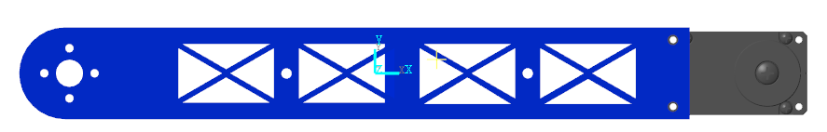
LINK2 -

Slide 4
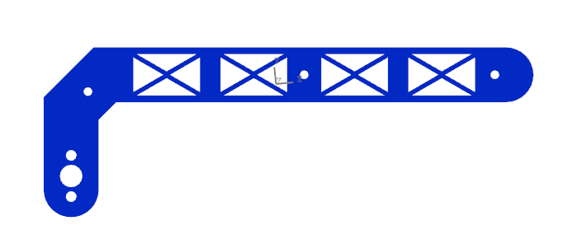
LINK3 -

Slide 5
