Slide 1
Lab meeting
2025.05.20
김채윤

Slide 2
One-arm
1. Simulation/verify of predicates
Simulation/verify of System state
Vaildating FSM logic

Slide 3
FSM State definition

Slide 4

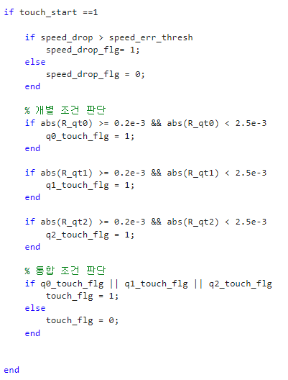
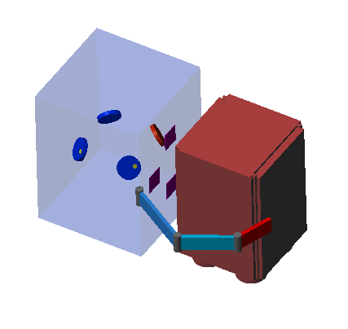
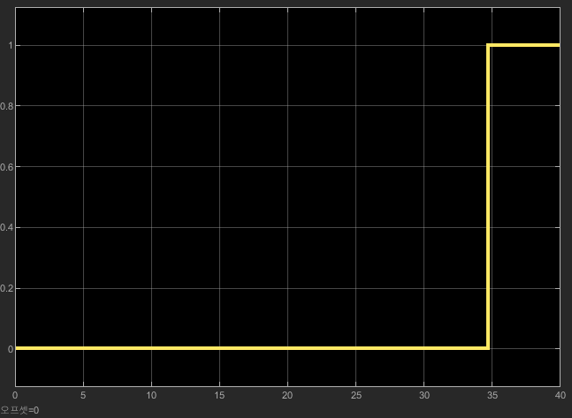
Simulation/verify of predicates / Touch
- Parameter
- Is touch occurred during grasping?
- Target : 12U ( 0.35, 0, 0 )
- Input : touch start flag, motor current
- Touch flag start
$$− current min<current_{motor_{i}}<current max$$
$$if any qi touch flag==1 then touch flag==1$$

Slide 5

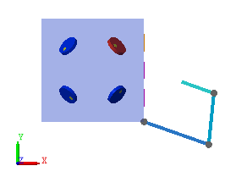
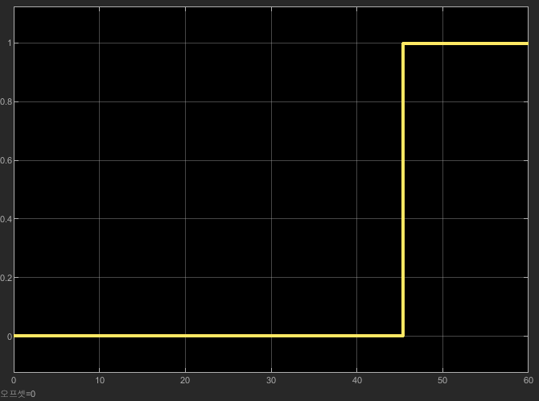


Simulation/verify of predicates
Empty
- Parameter
- Is empty occurred during grasping?
- Target : none
- Input : EE position, motor current
$$x_{body}$$
$$if all joint current flag \&\& EE x position<26$$
$$then empty flag==1$$

Slide 6

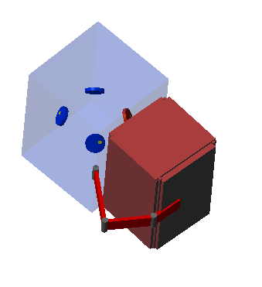
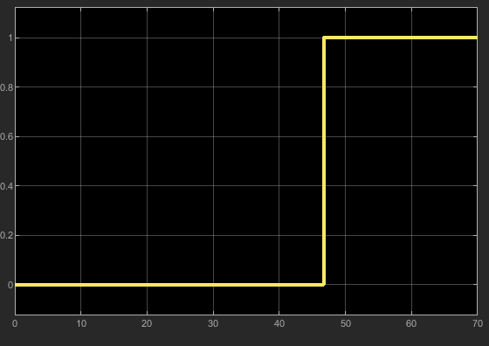

Simulation/verify of predicates
Overload
- Parameter
- Is touch occurred during grasping?
- Target : 12U ( 0.35, 0, 0 )
- Input : touch start flag, motor current
$$if any joint current flag==1$$
$$then overload flag==1$$

Slide 7
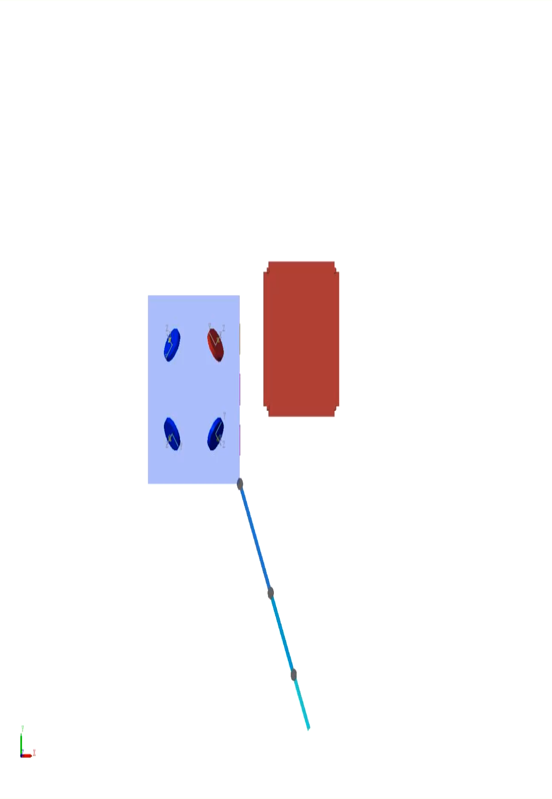



Simulation/verify of predicates
Slip
$$touch flag==1$$
$$I_{abs}>sliping threshold$$
$$dI>slip drop threshold$$

Slide 8
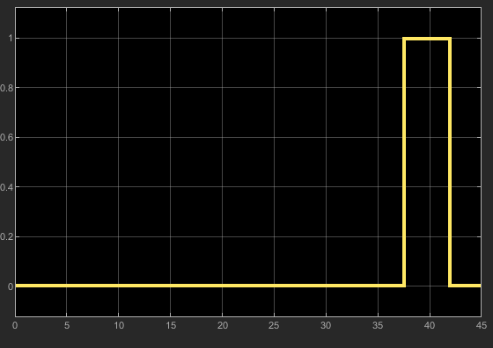
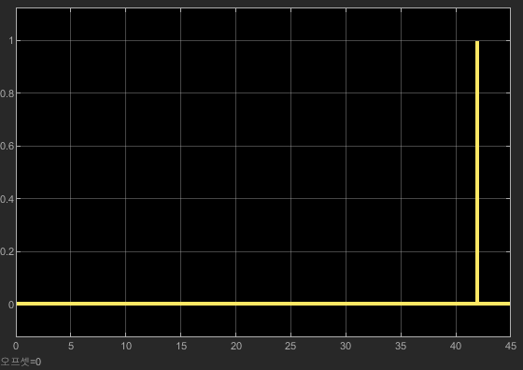
Simulation/verify of predicates
Slip
$$touch flag==1$$
$$I_{abs}>sliping threshold$$
$$dI>slip drop threshold$$

