Slide 1
Multilevel Linear Models
Notes from:
Field’s Discovering Statistics in R

Slide 2
Aims
What are Multilevel Models?
How do I analyze those models?

Slide 3
Hierarchical Data
Data structures are often hierarchical
Examples:
Children nested within classrooms
Data points nested within people
Repeated data that you want to analyze using each data point, rather than creating averages for participants.

Slide 4
A Two-Level Hierarchy
Level
2
Class 1
Class 2
Class 3
Class 4
Class 5
Class 6
...
Class n
Child 1
Child 9
Child 13
Child 20
Child 28
Child 33
Child a
Child 2
Child 10
Child 14
Child 21
Child 29
Child 34
Child b
Child 3
Child 11
Child 15
Child 22
Child 30
Child 35
Child c
1
Child 4
Child 12
Child 16
Child 23
Child 31
Child 36
Child d
Child 5
Child 17
Child 24
Child 32
Child 37
Child e
Child 6
Child 18
Child 25
Child 38
Child 7
Child 19
Child 26
Child 8
Child 27

Slide 5
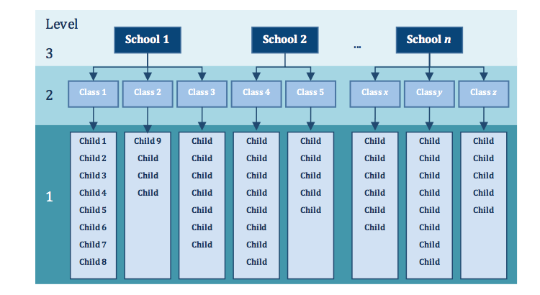
A Three-Level Hierarchy

Slide 6
Example Designs
Judgment studies:
Each person judges 120 items that fit certain characteristics. Rather than creating an average judgment score, each item can be correlated/regressed onto the item statistics.

Slide 7
Example Designs
Participant data is collected on the same dependent variables over a span of several days.

Slide 8
A book funny:
Ordinary regression turns itself into cheese and hides in the fridge at the prospect of cases of data that are related. Multilevel models eat these data for breakfast, with a piece of regression-flavoured cheese.

Slide 9
Benefits of Multilevel Models
Homoscedasticity can be broken
Model the variability in regression slopes
Assumption of independence
You can model the relationships between cases
(Regression for repeated observations)
Missing data
MLMs can cope with missing data

Slide 10
Benefits of Multilevel Models
POWER!
Instead of 50 participants, I now am analyzing 120 points X 50 participants = much better sampling.

Slide 11
Example Data
Graciously provided by the Eating Disorders Lab!
Level 1: Participant
Potential other levels:
Level 2: Type of question
Level 3: Time Point
Level 4: Day
IV: Intervention
DV: Body Checking

Slide 12
Fixed vs. Random Coefficients
Fixed coefficients
Intercepts/slopes are assumed to be the same across different contexts
Basic regression/ANOVA
Random coefficients
Intercepts/slopes are allowed to vary across different contexts
Allows flexibility in interpreting the data

Slide 13
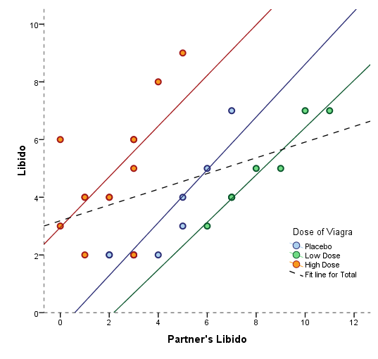
Fixed Slope, Random Intercept

Slide 14
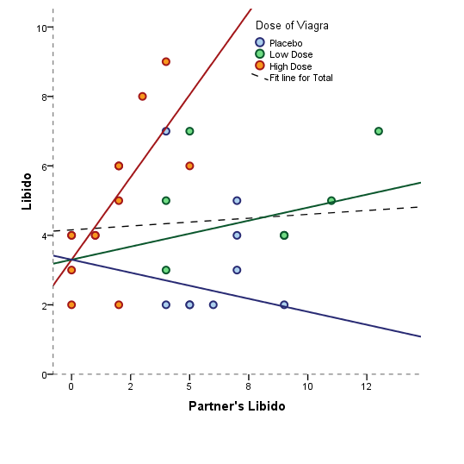
Random Slope, Fixed Intercept

Slide 15
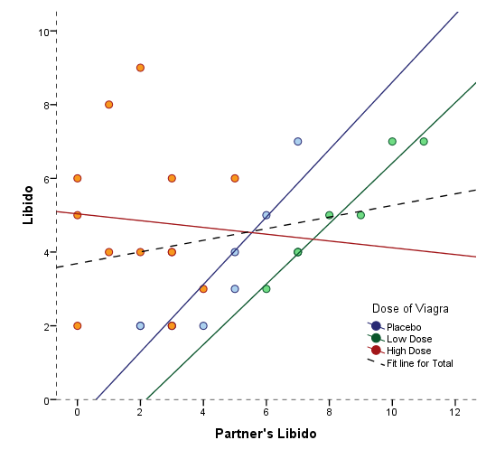
Random Slope, Random Intercept

Slide 16
So, which one?
You can test them against each other to determine which is the best fit.
Likely, random intercepts and slopes are going to be the best fit.

Slide 17
Comparing Models
Models should be built up gradually
Start with fixed coefficients
Change one aspect of the model and compare to the previous with the change in the log likelihoods

Slide 18
Comparing Models
Assessing fit
AIC - Akaike’s information criterion
BIC - Schwarz’s Bayesian criterion
Both criteria are such that lower values are better fit to the model
Lower values mean less error.

Slide 19
Comparing Models
You can also directly compare the log likelihood values using a chi-square difference test.
Test value = Model 1 LL – Model 2 LL
Critical value =
df difference = df Model 1 – df Model 2
Chi-square table for alpha = .05

Slide 20
Assumptions
Check for: accuracy, missing, outliers
Independence
Additivity (multicollinearity) - centering
Linearity
Normality
Homogeneity
Homoscedasticity

Slide 21
Some Basic R Stuff
Importing the data
Note I did have to clean it up first from Qualtrics.
Packages you need for this analysis.
Factor variables
Wide versus long format

Slide 22
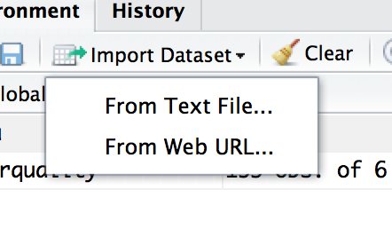
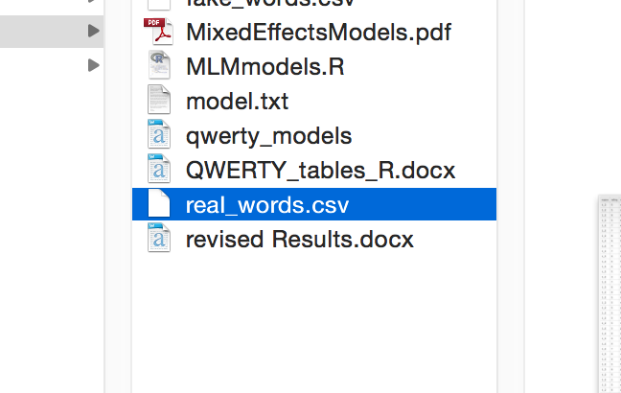
Working with Files
Import from Rstudio
Pick your file and click open

Slide 23
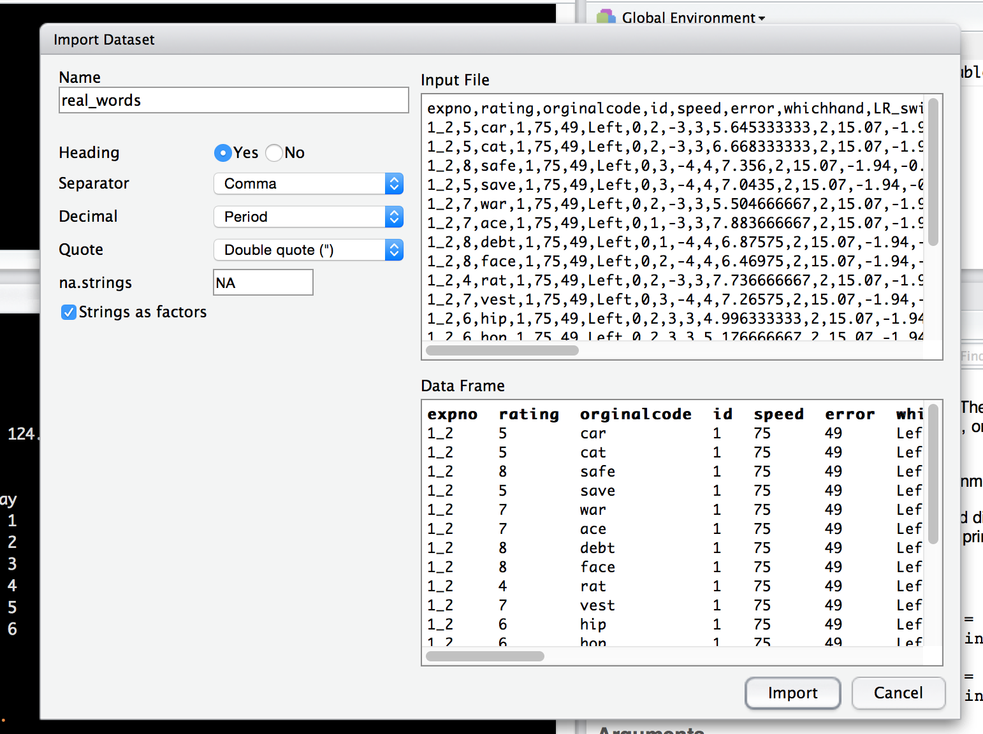
Working with Files

Slide 24
Working with Files
You can also use file.choose() to find the file you are looking for.
Tip: once you create your code, save the code that indicates were the file is, so you can run that one line again, rather than the longer clicks to import.

Slide 25
Packages
Packages are add-ons to R that allow you to do different types of analyses, rather than code them yourself.
R comes with many pre-programming functions – lovingly called base R.

Slide 26
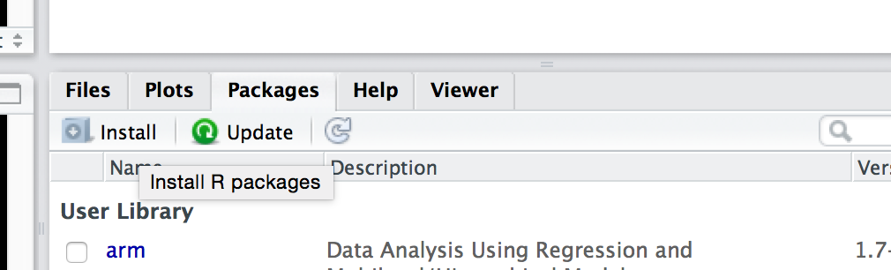
Packages
How to install:
Through RStudio
Click on packages, click on install.
Note: you can see here in this window what all you have installed, and if you click on them, you will load that help file (or click the check box to load them).

Slide 27
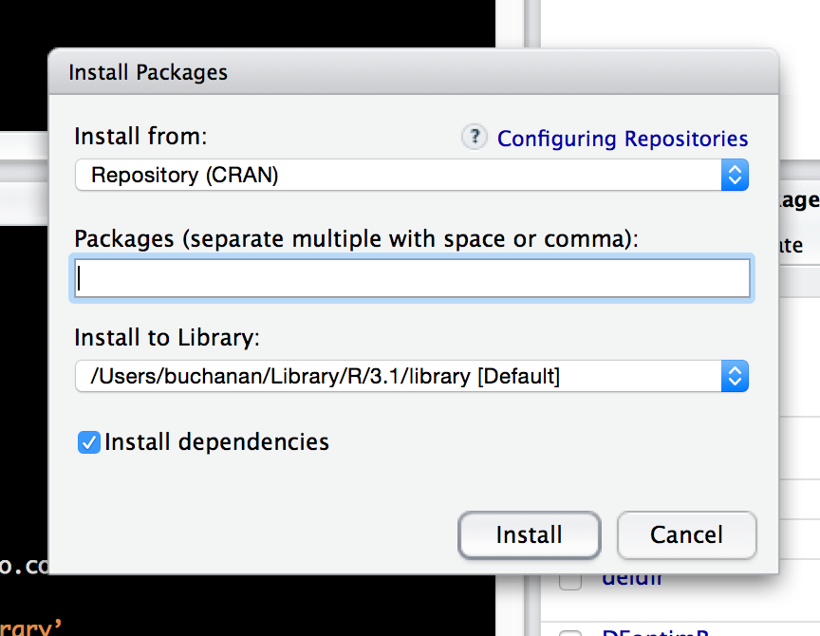
Packages
Start typing the name of the package – a drop down will appear with all the options.

Slide 28
Packages
Now it’s installed! Awesome!
That doesn’t mean that it loads every time.
Imagine this: if SPSS had a function that knew how to do regression, but it didn’t load every time.
Annoying!
But this saves computing power by not loading unless you need it.
You will run something without turning on the right package. It’s cool – all the cool kids do it.

Slide 29
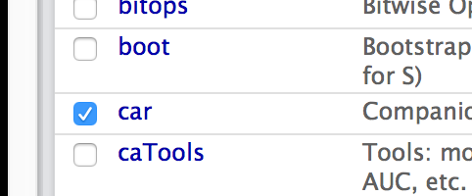
Packages
Packages are also called libraries.
You can load them two ways:
In the console: library(car) (look no “” this time).
In the packages window by clicking on the check box.

Slide 30
Packages
nlme
reshape

Slide 31
Factor Functions
Let’s say you have a categorical variable, which has to be dummy coded in regression
You can set up this variable as a factor in R (which does the dummy coding for you! Woo!).
Also, this function allows you to add labels and reorder the factors.

Slide 32
Factor Functions
Create a factor that’s set up as numbers:
factor(column name, ##data column name
levels = c(1,2…), ##original numbers/labels in dataset
labels = c(“labels”, “labels”,…)) ###new labels you want

Slide 33
Factor Functions
Reorder a factor:
factor(column name, ##data column name
levels = c(“label”,”label”…)) ##labels in dataset in the right order

Slide 34
Wide versus Long
In WIDE formats, rows are participants and columns are variables.
In the LONG format, rows are the multiple measurements of the participants.

Slide 35
Wide to Long
MELT(
Dataframe name,
id = c(“var”, “var”) – constant variables you do not want to change
These will stay their own column but get repeated when necessary
measured = c(“var”, “var”) – dependent variables you want to combine into one column
)

Slide 36
Back to MLM
How to run the analysis!
Model 1: Baseline intercept only
Model 2: Random intercept only
Compare these two models:
If Model 2 > Model 1, you need an MLM
If not, happily ANOVA dance (you know, minus all those pesky reviewers)

Slide 37
Basic Set Up
Regression functions are always set up as:
Y ~ X,
Data = datasetname,
Other important stuff

Slide 38
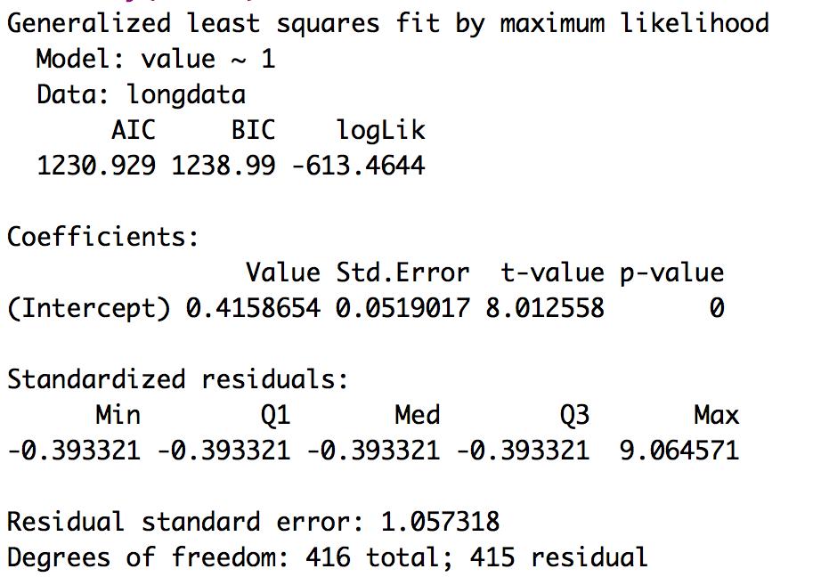
Intercept Only Model

Slide 39
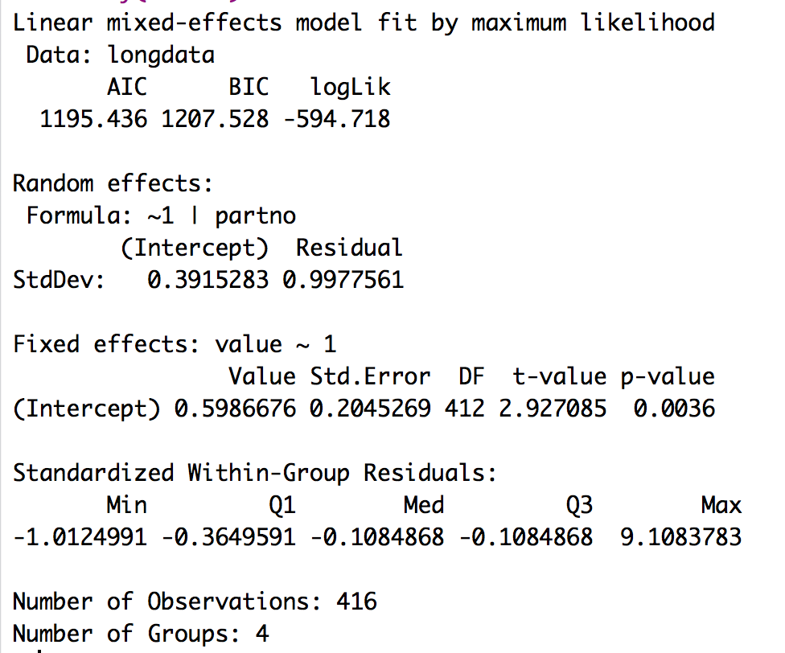
Intercept + Random effects

Slide 40
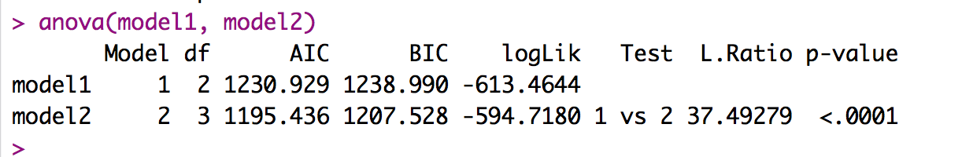
Test of random intercepts
So, yes we need to do a MLM. ☹

Slide 41
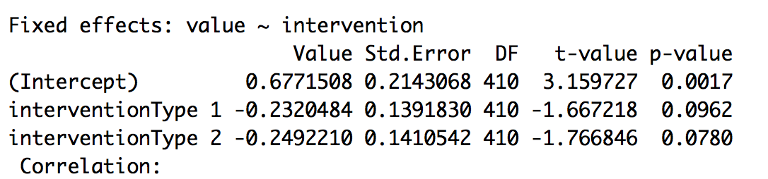
Independent Variables
Add fixed effects to your model.
Change out the 1 (for intercept only) to the variable names you are interested in.
Note: there’s not really an F statistic for the overall model,
you use the comparison against other models to show the
overall model is important.

Slide 42
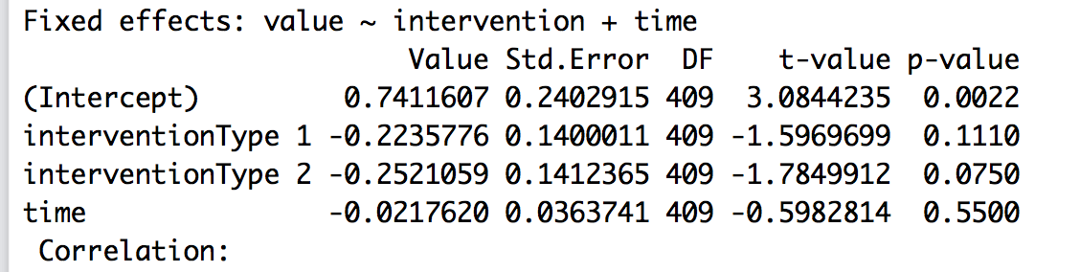
Independent Variables
Add another fixed effect:

Slide 43
Random Slopes
Random slopes will vary across groups (akin to moderation analyses for continuous variables).
You change the ~1 in the random section to the IV variable name.

Slide 44
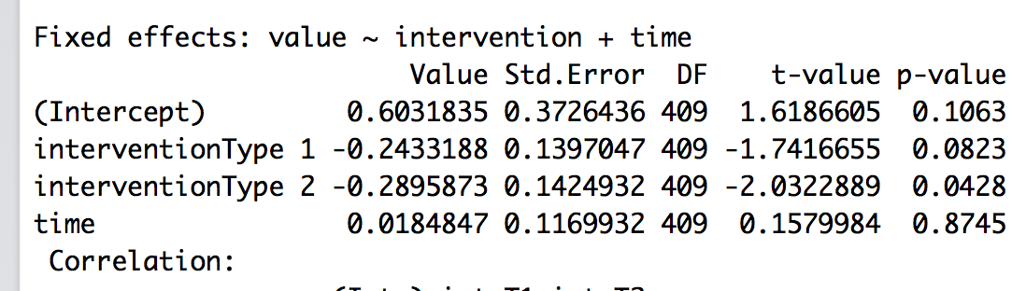
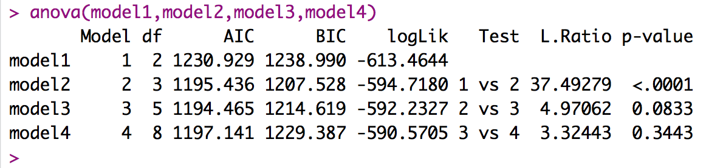
Random Slopes

Slide 45
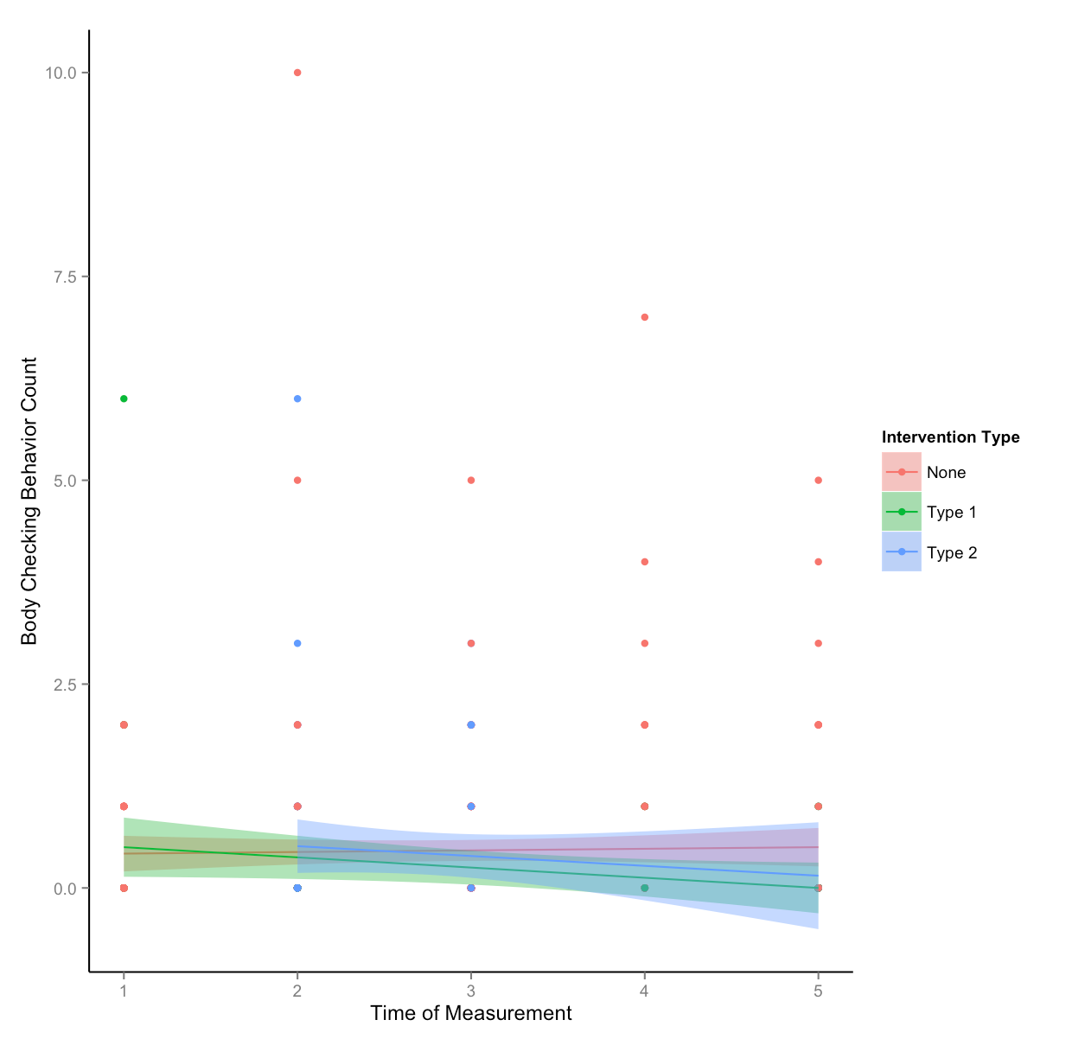

Slide 46
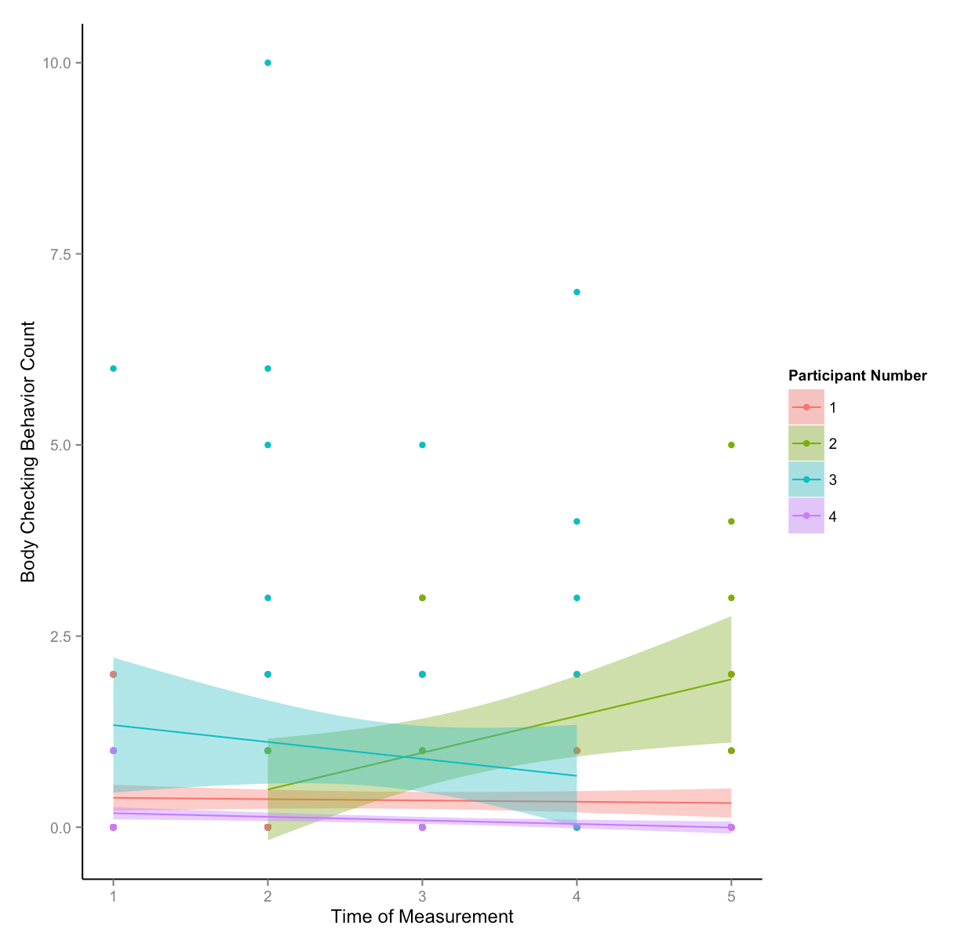

Slide 47
Other Issues/Topics
Growth models
Covariance structures
Effect size

