Slide 1
Clustering / Scaling

Slide 2
Cluster Analysis
Objective:
Partitions observations into meaningful groups with individuals in a group being more “similar” to each other than to individuals in other groups

Slide 3
Cluster Analysis
Similar to factor analysis (which groups IVs) but instead groups people in groups.
Cluster will also partition variables into groups (but FA is better for this)

Slide 4
Cluster Analysis
Orders individuals into similarity groups while simultaneously ordering variables according to importance.

Slide 5
Cluster Analysis
We are always trying to identify groups
Discriminate analysis (which we are going to do later) – we know who is in what group and figure out a good way to classify them
Then log regression – nonparametric version of discriminate analysis

Slide 6
Cluster Analysis
Cluster tells you if there are groups in the data that you didn’t know about
If there are groups – are there differences in the means?
ANOVA/MANOVA
If I have somebody new, what group do they go in?
Discriminate analysis

Slide 7
What’s CA give us?
Taxonomic description –
Use this partitioning to generate hypothesis about how to group people (or how people should be grouped)
Maybe then used for classification (schools military memory, etc)

Slide 8
What’s CA give us?
Data simplification –
Observations are no longer individuals but parts of groups

Slide 9
What’s CA give us?
Relationship identification –
Reveals relationships among observations that are not immediately obvious when considering only one variable at a time

Slide 10
What’s CA give us?
Outlier detection –
Observations that are very different, in multivariate sense, will not classify

Slide 11
Several Approaches to Clustering
Graphical approaches
Distance approaches
SPSS stuff

Slide 12
Graphical
Objective: map variables to separate plot characteristics then group observations visually
Approaches
Profile plots
Andrews plots
Faces
Stars
Trees

Slide 13
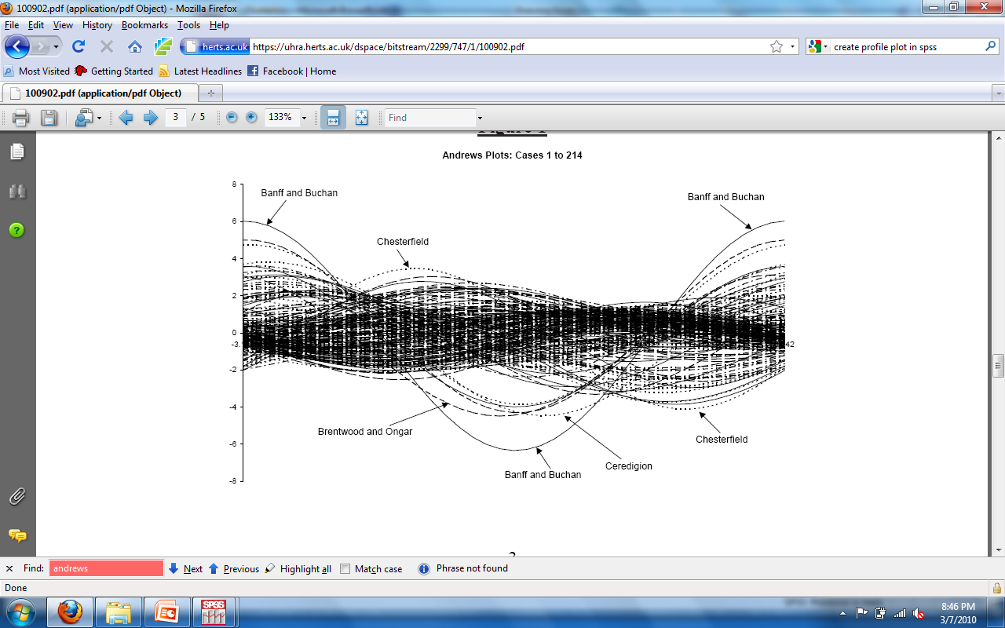
Graphical
Cereal data

Slide 14
Distance Approaches
Inter-object similarity – measure of resemblance between individuals to be clustered
Dissimilarity – lack of resemblance between individuals
Distance = measures are all dissimilarity measures

Slide 15
Distance Approaches
For continuous variables – Euclidean or ruler distance
Square root of (x-x)transpose (x-x)

Slide 16
Distance Approaches
For data with different scales, may be better to z-score them first, so they don’t weight differently
Normalized ruler distance (same formula with z-scores)

Slide 17
Distance Approaches
Mahalanobis distance!

Slide 18
How distance measures translate to ways to do this…
Hierarchical approaches
Agglomerative methods – each object starts out as its own cluster
The two closest clusters are combined into a new aggregate cluster
Continues until clusters no longer make sense

Slide 19
How distance measures translate to ways to do this…
Hierarchical approaches
Divisive Methods – opposite of agglomerative methods
All observations are one cluster and then each cluster is split until all observations are left

Slide 20
What does that mean?
Most programs are agglomerative
They use the distance measures to figure out which individuals/clusters to combine

Slide 21
K-means cluster analysis
Uses squared Euclidean distance
Initial cluster centers are chosen in the “first pass” of the data
Adds values to the cluster based on the cluster mean
Stops when means do not change

Slide 22
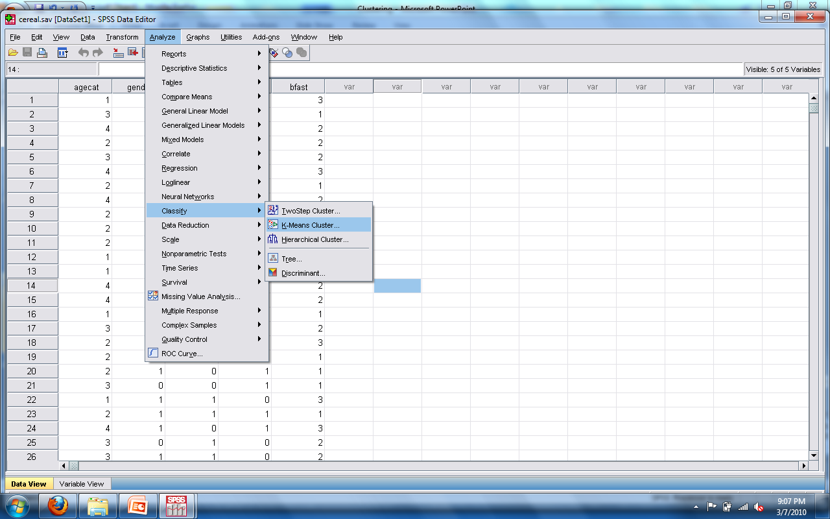

Slide 23
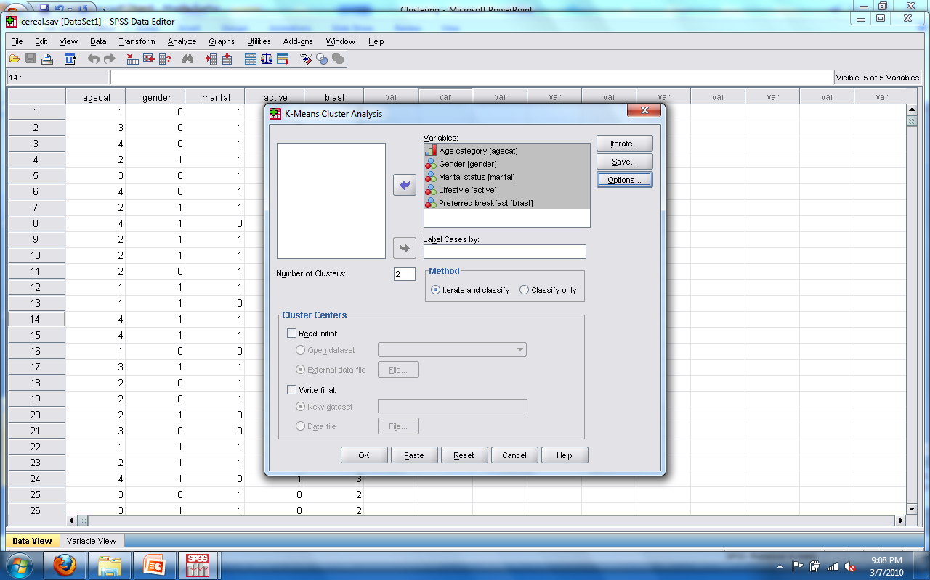

Slide 24
K-Means cluster
You need to have an idea of how many clusters you expect – then you can see if there are differences on the IVs when they are clustered into these groups

Slide 25
Hierarchical clustering
More common type of clustering analysis
Because it’s pretty pictures!
Dendrogram – tree diagram that represents the results of a cluster analysis

Slide 26
Hierarchical clustering
Trees are usually depicted horizontally
Cases with high similarity are adjacent
Lines indicate the degree of similarity or dissimilarity between cases

Slide 27
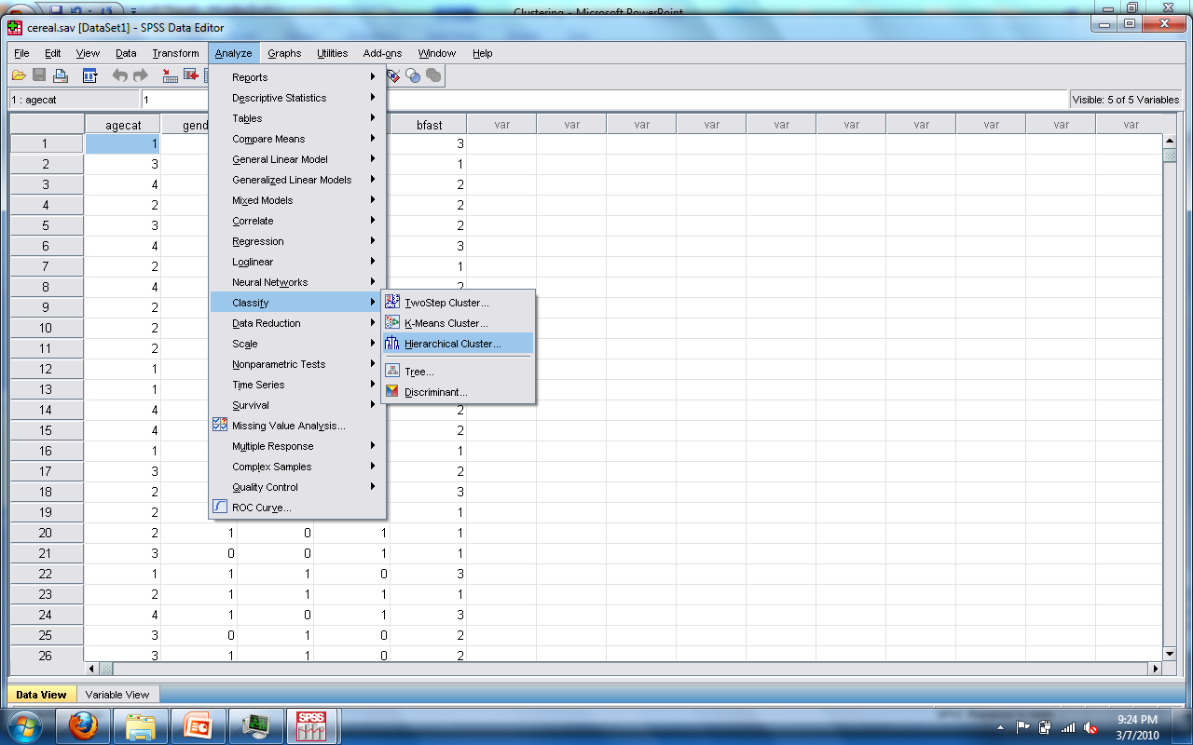

Slide 28
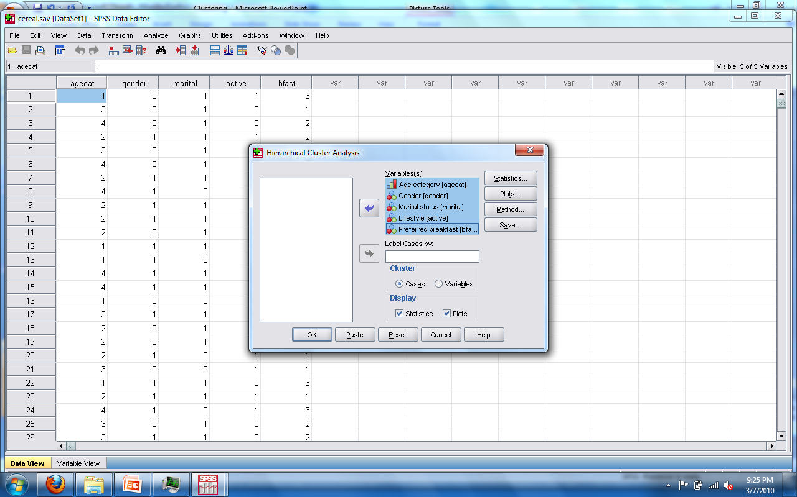

Slide 29
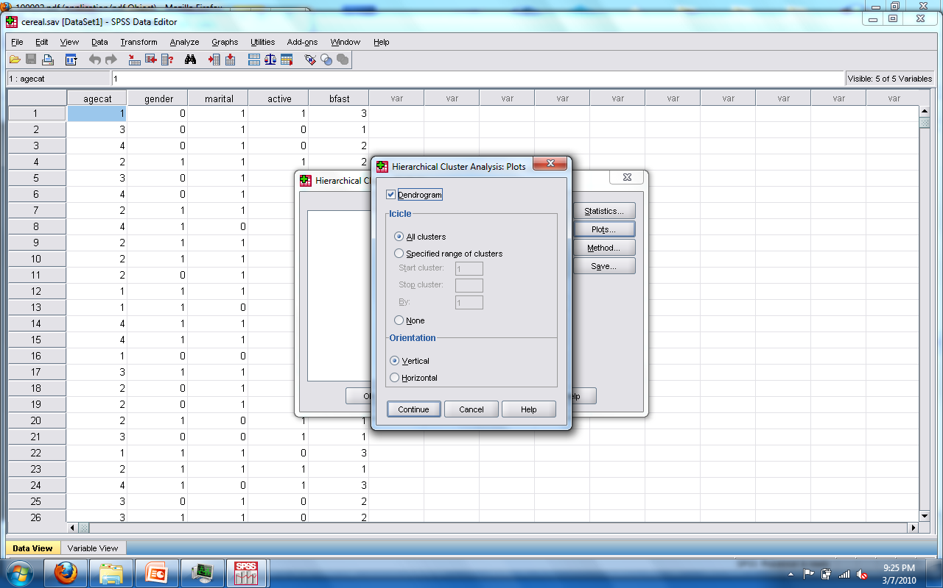

Slide 30
2-step clustering
Better with very large datasets
Great for continuous and categorical data
In step one – pre-cluster into smaller clusters
Step two – create the desired clusters
Unless you don’t know – then the program will decide the best for you.

Slide 31
Which one?
K-means is much faster than hierarchical
Does not compute the distances between all pairs
Only Euclidean distance
Needs standardized data for best

Slide 32
Which one?
Hierarchical is much more flexible
All types of data, all types of distance measures
Don’t need to know the number of clusters
Take those saved clusters and use to analyze with anova or crosstabs

Slide 33
Assumptions
Data are continuous truly OR real dichotomous
Same assumptions as correlation/regression
Outliers are OK
K-Means = big samples >200

Slide 34
Issues
Different methods (distance procedures) will give you drastically different results
Clustering is usually a descriptive procedure

