Slide 1
クイズ
B4グループ

Slide 2
Question 1
What does HMM stand for?
1 . Hidden Markov Model
2 . Hyper Main Memory
3 . Happy Music Maker
4 . “Hige” means mustache.

Slide 3
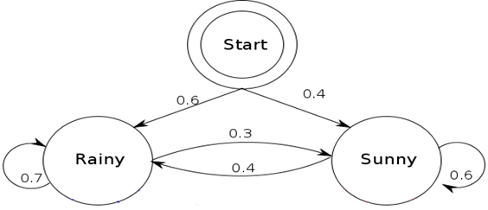
Question 2
P (x | y) represents the probability that x will occur when event y occurs.
In the lower right figure, choose the appropriate answer of P(‘Sunny’|’Rainy`).
1 . 0.4
2 . 0.3
0.6
0.4
3 . 0.6
0.3
4 . 0.7
0.7
0.6
0.4

Slide 4
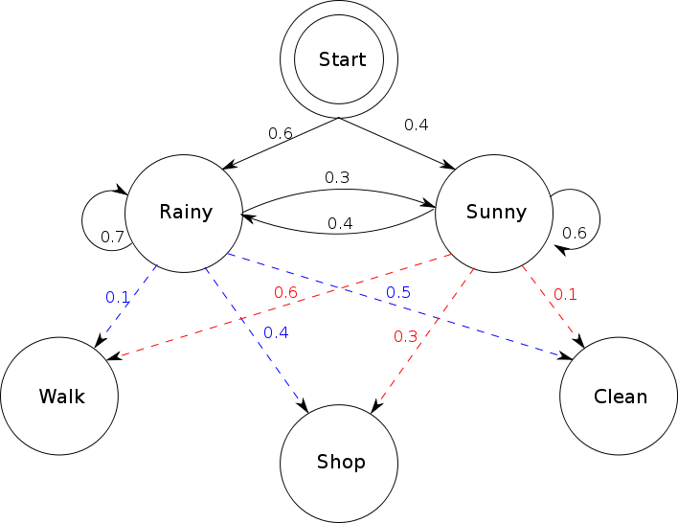
Question 3
In the blank space
on the right side,
choose the correct word.
？
state
1 . weather
2 . transition
3 . hidden
4 . non-hiding

Slide 5
Question 4
In the blank space
on the right side,
choose the correct word.
1 . output
？
sign
2 . behavior
3 . State transition
4 . probability

Slide 6
Question 5
What are the parameters
shown in the figure
on the right?
？
1 . state transition probability
2 . initial state probability
3 . probability of precipitation
4 . output probability

Slide 7
Question 6
What are the parameters
shown in the figure
on the right?
？
1 . state transition probability
2 . initial state probability
3 . probability of precipitation
4 . output probability

Slide 8
Question 7
What are the parameters
shown in the figure
on the right?
？
1 . state transition probability
2 . initial state probability
3 . probability of precipitation
4 . output probability

Slide 9
Question 8
Problem of finding likelihood of sequence of observations output from HMM
1 . decoding problem
2 . shortest path problem
3 . estimation problem
4 . Evaluation problem

Slide 10
Question 9
A problem of finding the maximum likelihood state transition series from observation sequences outputted from HMMs whose parameters are already known.
Use Viterbi algorithm etc.
1 . decoding problem
2 . shortest path problem
3 . estimation problem
4 . Evaluation problem

Slide 11
Question 10
Problem of finding each parameter by using observation sequence outputted from HMM whose parameters are unknown. Use Baum-Welch algorithm etc.
1 . decoding problem
2 . shortest path problem
3 . estimation problem
4 . Evaluation problem

