Slide 1
Tensorflow: From 1.x to 2.x

Slide 2
Agenda
Tensorflow= Tensor + Flow
Tensorflow 1.X vs Tensorflow 2.x
Tensorflow API: Low-level High Level
Tensorflow Keras API
Tensorflow Data API[Day 2]
Tensorflow Estimator API[Day 2]
TensorBoard
TensorFlow Hub [Day 2]
常用的 Function:tf.cast

Slide 3
Tensorflow
Tensor + Flow

Slide 4
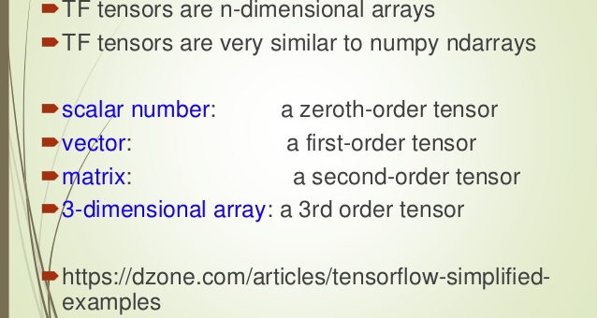
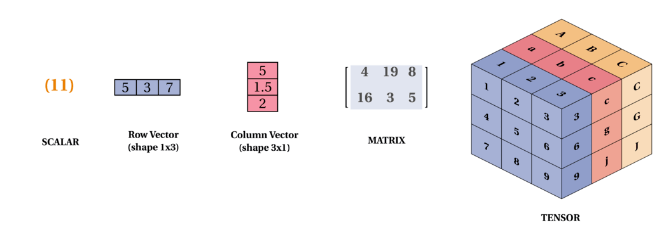
Tensor

Slide 5
import tensorflow as tf
print("簡單的Python加法:")
print(8 + 7)
print("TensorFlow的加法:")
eight = tf.constant(8)
seven = tf.constant(7)
add = tf.add(eight, seven)
with tf.Session() as sess:
print(sess.run(add))

Slide 6
tf.constant() 創造常數張量
tf.zeros() ：建構內容數值皆為 0 的常數張量
tf.ones() ：建構內容數值皆為 1 的常數張量
tf.fill() ：建構內容數值皆為特定值的常數張量
tf.range() ：建構內容數值為 (start, limit, delta) 數列的常數張量
tf.random_normal() ：建構內容數值為符合常態分佈數列的常數張量
tf.random_uniform() ：建構內容數值為符合均勻分佈數列的常數張量

Slide 7
Tensorflow
1.X vs 2.x

Slide 8
Tensorflow版本
https://github.com/tensorflow/tensorflow/blob/master/RELEASE.md
Initial release November 9, 2015
1.0.0版本發布於2017年2月11日
1.4.0版本發布於2017年11月3日
Stable release 1.15.3 / 18 May, 2020
Aug. 24, 2019: TensorFlow 2.0 rc0
Jun. 8, 2019: TensorFlow 2.0 Beta
Mar. 7, 2019: Tensorflow 2.0 Alpha
Jan. 11, 2019: TensorFlow r2.0 preview
Aug. 14, 2018: TensorFlow 2.0 is coming
2019.4.23 TensorFlow Dev Summit 2019
2019年3月6日
!pip3 install -q tensorflow==2.0.0-alpha0
2019年6月7日
!pip install tensorflow==2.0.0-beta0
2019年08月24日
https://github.com/tensorflow/tensorflow/releases/tag/v2.0.0-rc0

Slide 9
TensorFlow computation models
靜態圖
static computation graph
graph control flow
先定義computation graph,
後建session執行上述計算圖
動態圖
Dynamic control flow
使用eager execution
Tensorflow 1.4後開始

Slide 10
Matrix Multiplication or matrix product
import tensorflow as tf
a = tf.Variable([[0,1], [2,3]], name="matrix_a")
b = tf.Variable([[2,4], [8,9]], name="matrix_b")
add = tf.add(a, b)
final = tf.multiply(add, a)
final2= tf.matmul(add, a)
with tf.Session() as s:
init = tf.variables_initializer([a, b], name="init")
s.run(init)
print(s.run(final))
print(s.run(final2))

Slide 11
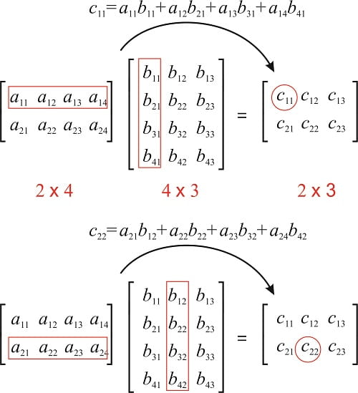
https://morioh.com/p/d669c3deea75/deep-learning-with-tensorflow-2-0

Slide 12
Tensorflow 2.x
import tensorflow as tf
a = tf.Variable([[0,1], [2,3]], name="matrix_a")
b = tf.Variable([[2,4], [8,9]], name="matrix_b")
add = tf.add(a, b)
final = tf.multiply(add, a)
final2= tf.matmul(add, a)
print(final)
print(final2)

Slide 13
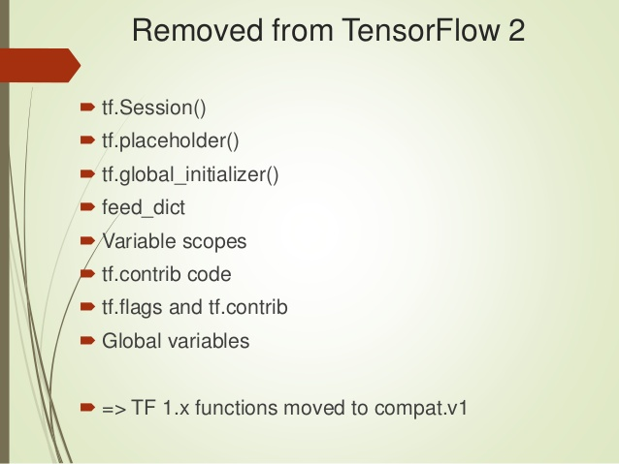
https://www.slideshare.net/ocampesato/introduction-to-tensorflow-2-152333392

Slide 14
Learning Tensorflow

Slide 15
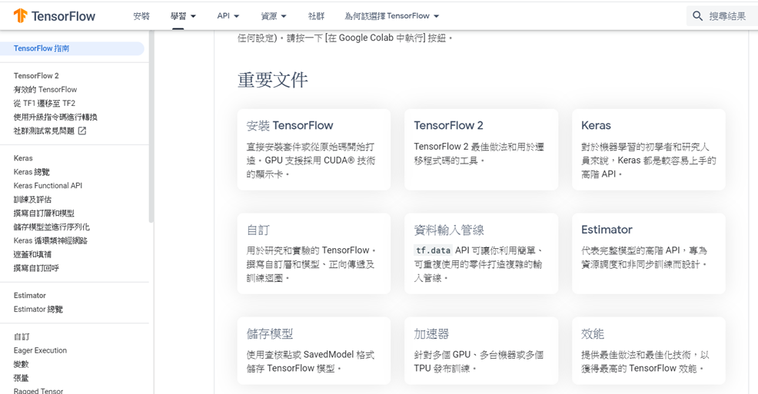
指南Guide https://www.tensorflow.org/guide

Slide 16
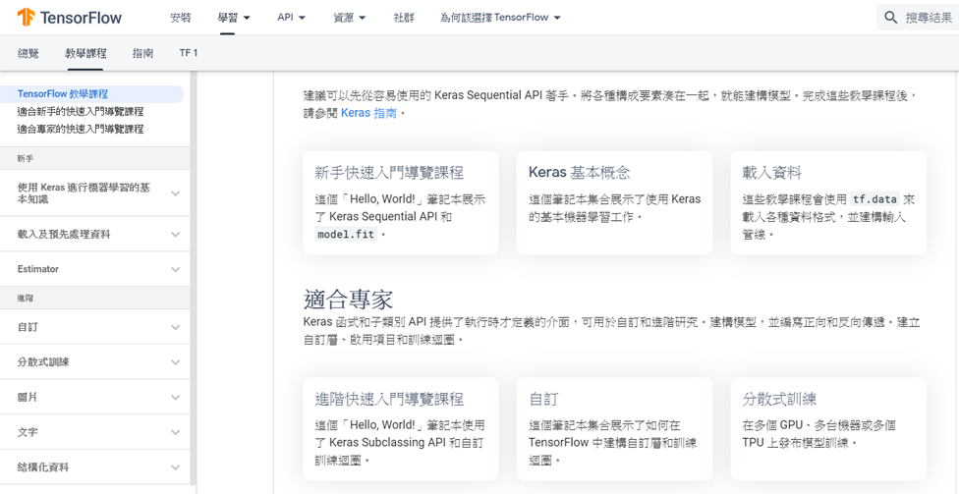

教學課程Tutorials
https://www.tensorflow.org/tutorials

Slide 17
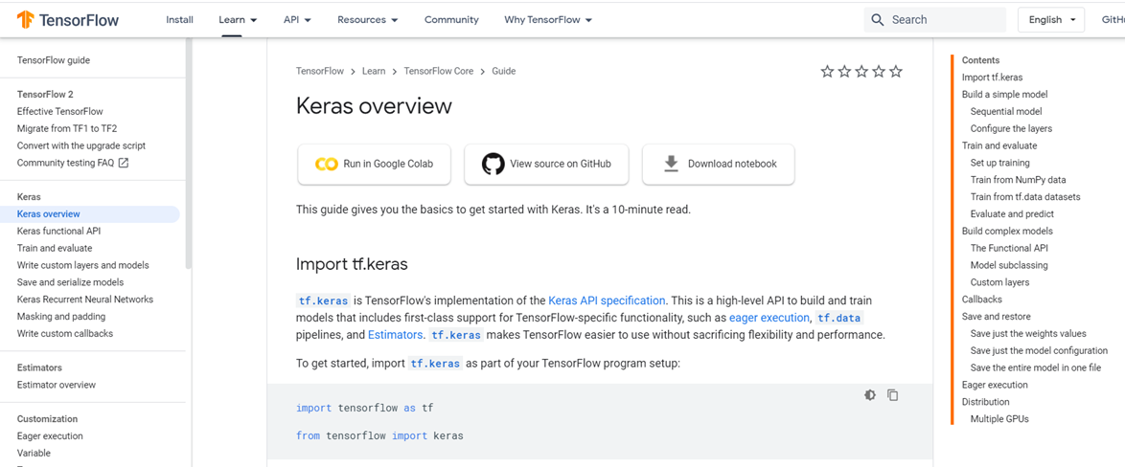
Keras
https://www.tensorflow.org/guide/keras/overview

Slide 18
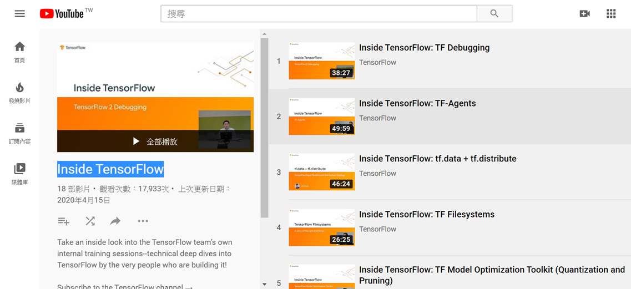
Youtube頻道: Inside TensorFlow
https://www.youtube.com/playlist?list=PLQY2H8rRoyvzIuB8rZXs7pfyjiSUs8Vza

Slide 19
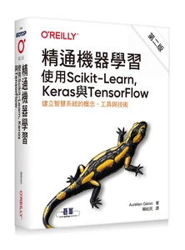
handson-ml2/docker
【第一部分 機器學習基本知識】
chapter 01 機器學習領域
chapter 02 端對端機器學習專案
chapter 03 分類
chapter 04 訓練模型
chapter 05 支援向量機
chapter 06 決策樹
chapter 07 整體學習與隨機森林
chapter 08 降維
chapter 09 無監督學習技術
【第二部分 神經網路與深度學習】
chapter 10 以 Keras 介紹人工神經網路
chapter 11 訓練深度神經網路
chapter 12 用 TensorFlow 來自製模型和進行訓練
chapter 13 使用 TensorFlow 來載入和預先處理資料
chapter 14 使用摺積神經網路來製作深度電腦視覺
chapter 15 使用 RNN 和 CNN 來處理序列
chapter 16 用 RNN 與 Attention 處理自然語言
chapter 17 使用自動編碼網路與 GAN 來進行表徵學習與生成學習
chapter 18 強化學習
chapter 19 大規模訓練與部署 TensorFlow 模型
https://github.com/ageron/handson-ml2

Slide 20
TOPIC
Tensorflow模組

Slide 21
https://www.tensorflow.org/api_docs/python/tf
模組名稱
tf
tf.math | 數學運算
tf.linalg | 矩陣運算與線性代數(linear algebra)
tf.random | 隨機函數
tf.distributions | 各類型的機率分布
tf.nn | 各種類神經網路運算的運算單元＋activation function tf.nn.rnn_cell.BasicLSTMCell
tf.layers | 各種運算層 Batch Normalization layer
tf.train | 優化器 tf.train.AdamOptimizer tf.train.GradientDescentOptimizer
tf.initializers | 各類型的初始化
tf.losses | 各類型的損失函數
tf.metrics | 模型的判斷指標
tf.keras
tf.estimator

Slide 22
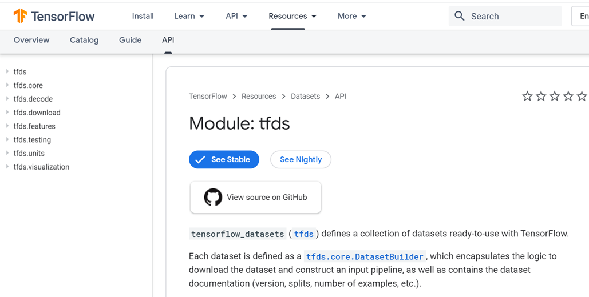
tensorflow_datasets (tfds)
https://www.tensorflow.org/datasets/api_docs/python/tfds

Slide 23
TOPIC
TensorFlow Hub

Slide 24
TensorFlow Hub
TensorFlow Hub 是一種程式庫，內容是可重複利用的機器學習模組。
TensorFlow Hub 程式庫是用來發布、探索和使用機器學習模型中可重複利用的部分。模組是 TensorFlow 圖形的獨立部分，包含權重和資產，可在不同的工作中重複使用，這個流程稱為「遷移學習」。
遷移學習可以：
使用較小的資料集訓練模型
改善一般化功能
加快訓練速度

Slide 25
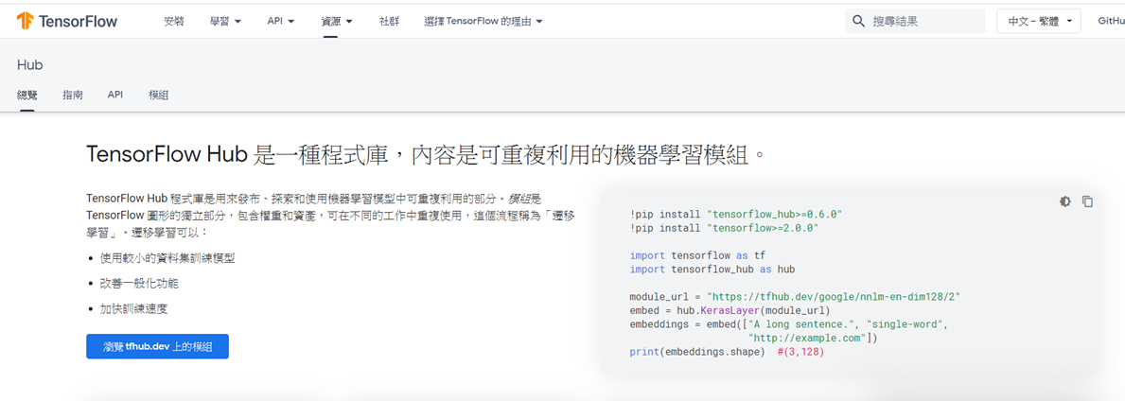
TensorFlow Hub
https://www.tensorflow.org/hub

Slide 26
Transfer Learning會展示…
!pip install "tensorflow_hub>=0.6.0"
!pip install "tensorflow>=2.0.0"
import tensorflow as tf
import tensorflow_hub as hub
module_url = https://tfhub.dev/google/nnlm-en-dim128/2
embed = hub.KerasLayer(module_url)
embeddings = embed(["A long sentence.", "single-word", "http://example.com"])
print(embeddings.shape) #(3,128)

Slide 27
TOPIC
Tensorflow DATA API
tf.data.Dataset

Slide 28
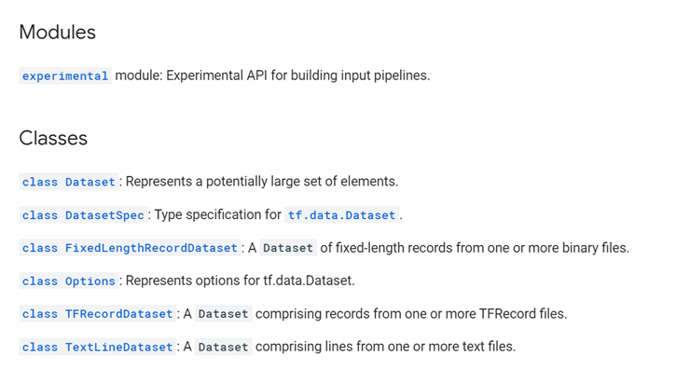
Tf.data模組
https://www.tensorflow.org/api_docs/python/tf/data

Slide 29
tf.data.Dataset API
The tf.data.Dataset API supports writing descriptive and efficient input pipelines.
Dataset usage follows a common pattern:
Create a source dataset from your input data.
Apply dataset transformations to preprocess the data.
Iterate over the dataset and process the elements.
Iteration happens in a streaming fashion, so the full dataset does not need to fit into memory.

Slide 30
CNN 處理MINST 手寫資料集
資料集讀進後要如何提取打包成一批一批以供供模型訓練?
mnist.train.next_batch()函數，再配合feed_dict 饋入模型
用此函數執行時會產生警告表示此函數已被退化
要使用tf.data方法取代

Slide 31
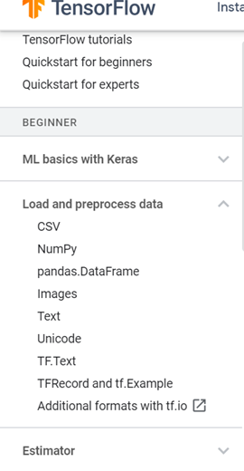
資料載入
資料預處理
AI

Slide 32
tf.data: Build TensorFlow input pipelines
The tf.data.Dataset API supports writing descriptive and efficient input pipelines.
Dataset usage follows a common pattern:
Create a source dataset from your input data.
Apply dataset transformations to preprocess the data.
Iterate over the dataset and process the elements.
Iteration happens in a streaming fashion, so the full dataset does not need to fit into memory

Slide 33
tf.data: Build TensorFlow input pipelines
data source
tf.data.Dataset.from_tensors()
tf.data.TFRecordDataset()
tf.data.Dataset.from_tensor_slices()
dataset object
Dataset.map()
data transformation
per-element transformations
Dataset.batch()
資料集讀進後
要如何提取打包成一批一批
以供供模型訓練
multi-element transformations

Slide 34
tf.data.Dataset支援許多
data transformation的
Methods
apply
as_numpy_iterator
batch
cache
concatenate
enumerate
filter
flat_map
from_generator
from_tensor_slices
from_tensors
interleave
list_files
map
options
padded_batch
prefetch
range
reduce
repeat
shard
shuffle
skip
take
unbatch
window
with_options
zip
__iter__

Slide 35
apply() | Applies a transformation function to this dataset
as_numpy_iterator() | Returns an iterator which converts all elements of the dataset to numpy
batch() | Combines consecutive elements of this dataset into batches
cache() | Caches the elements in this dataset
concatenate() | Creates a `Dataset` by concatenating the given dataset with this dataset
element_spec() | The type specification of an element of this dataset
enumerate() | Enumerates the elements of this dataset.
filter() 過濾 | Filters this dataset according to `predicate`. filter( predicate )
flat_map() | Maps `map_func` across this dataset and flattens the result
from_generator() | Creates a `Dataset` whose elements are generated by `generator`.
from_tensor_slices() | Creates a `Dataset` whose elements are slices of the given tensors
from_tensors() | Creates a `Dataset` with a single element, comprising the given tensors
.
.

Slide 36
interleave() | Maps `map_func` across this dataset, and interleaves the results.
list_files() | A dataset of all files matching one or more glob patterns.
map() | Maps `map_func` across the elements of this dataset
options() | Returns the options for this dataset and its inputs
padded_batch() | Combines consecutive elements of this dataset into padded batches
prefetch() | Creates a `Dataset` that prefetches elements from this dataset
range() | Creates a `Dataset` of a step-separated range of values
reduce() | Reduces the input dataset to a single element
repeat() | Repeats this dataset so each original value is seen `count` times
shard() | Creates a `Dataset` that includes only 1/`num_shards` of this dataset.
shuffle() | Randomly shuffles the elements of this dataset
skip() | Creates a `Dataset` that skips `count` elements from this dataset
take() | Creates a `Dataset` with at most `count` elements from this dataset
unbatch() | Splits elements of a dataset into multiple elements
window() | Combines (nests of) input elements into a dataset of (nests of) windows
with_options() | Returns a new `tf.data.Dataset` with the given options set
zip() | Creates a `Dataset` by zipping together the given datasets

Slide 37
產生dataset object

Slide 38
產生dataset object
a python list
data source
dataset object
dataset = tf.data.Dataset.from_tensor_slices([1, 2, 3])
for element in dataset:
print(element)
a python list
https://laoweizz.blogspot.com/2019/01/tensorflow-dataset.html

Slide 39
x = np.random.sample((100,2))
dataset = tf.data.Dataset.from_tensor_slices(x)
list(dataset)

Slide 40
產生dataset object
data source
dataset object
文字型資料
dataset = tf.data.TextLineDataset(["file1.txt", "file2.txt"])
TFRecord 格式的資料
dataset = tf.data.TFRecordDataset(["file1.tfrecords", "file2.tfrecords"])
To create a dataset of all files matching a pattern, use tf.data.Dataset.list_files
dataset = tf.data.Dataset.list_files("/path/*.txt")

Slide 41
tf.data.Dataset.from_generator
import itertools
def gen():
for i in itertools.count(1):
yield (i, [1] * i)
dataset = tf.data.Dataset.from_generator(
gen,
(tf.int64, tf.int64),
(tf.TensorShape([]), tf.TensorShape([None])))
list(dataset.take(3).as_numpy_iterator())
定義 python的產生器generator
使用 python的產生器generator

Slide 42
data transformation 資料轉換

Slide 43
data transformation 資料轉換 技術
import tensorflow as tf
dataset = tf.data.Dataset.from_tensor_slices([1, 2, 3])
dataset = dataset.map(lambda x: x*2+5)
list(dataset.as_numpy_iterator())
https://www.tensorflow.org/api_docs/python/tf/data/Dataset
[7, 9, 11]

Slide 44
flat_map(
map_func
)
程式執行後結果為何?
Maps map_func across this dataset and flattens the result
dataset = Dataset.from_tensor_slices([[1, 2, 3], [4, 5, 6], [7, 8, 9]])
dataset = dataset.flat_map(lambda x: Dataset.from_tensor_slices(x))
list(dataset.as_numpy_iterator())
flat_map()與map()有何差異?

Slide 45
filter(
predicate
)
程式執行後結果為何?
dataset = tf.data.Dataset.range(100)
def dataset_fn(ds):
return ds.filter(lambda x: x < 15)
dataset = dataset.apply(dataset_fn)
list(dataset.as_numpy_iterator())

Slide 46
程式執行後結果為何?
import tensorflow as tf
dataset = tf.data.Dataset.from_tensor_slices([1, 2, 3])
def filter_fn(x):
return tf.math.equal(x, 1)
dataset = dataset.filter(filter_fn)
list(dataset.as_numpy_iterator())

Slide 47
TOPIC
Tensorflow Estimator API

Slide 48
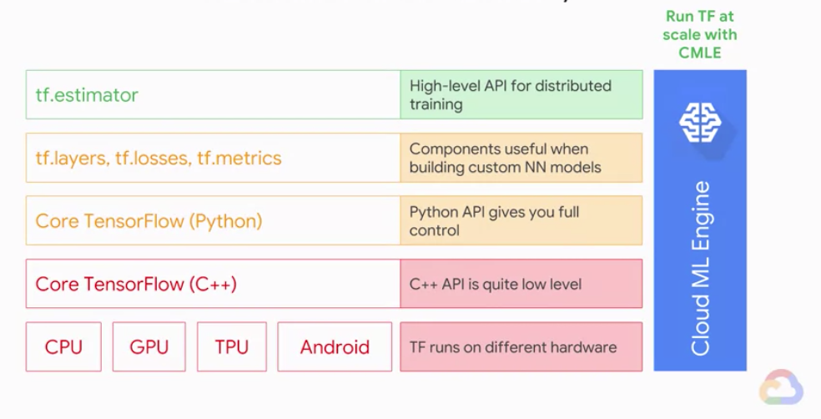
https://ithelp.ithome.com.tw/articles/10214949

Slide 49
Estimator API: High-level TensorFlow API
使用Estimator API有下列優點：
快速的建構模型
產生checkpoint檔案(*.ckpt檔案)，用於暫停或繼續訓練
訓練在超出記憶體的資料量上
訓練、評估、監測都可以輕鬆做到
分散式訓練
超參數的搜索、調整
提供生產用模型
https://ithelp.ithome.com.tw/articles/10215232

Slide 50
tf.estimator框架可以很方便地通過高級Estimator API來構建和訓練機器學習模型。
Estimator提供了一些類別，你可以快速配置產生實體來創建regressors和classifiers：
tf.estimator.LinearClassifier: 線性分類模型
tf.estimator.LinearRegressor: 線性回歸模型
tf.estimator.DNNClassifier: 創建一個神經網路分類模型
tf.estimator.DNNRegressor: 創建一個神經網路回歸模型
tf.estimator.DNNLinearCombinedClassifier: 創建一個deep&wide分類模型
tf.estimator.DNNLinearCombinedRegressor: 創建一個deep&wide回歸模型
http://d0evi1.com/tensorflow/estimators/

Slide 51
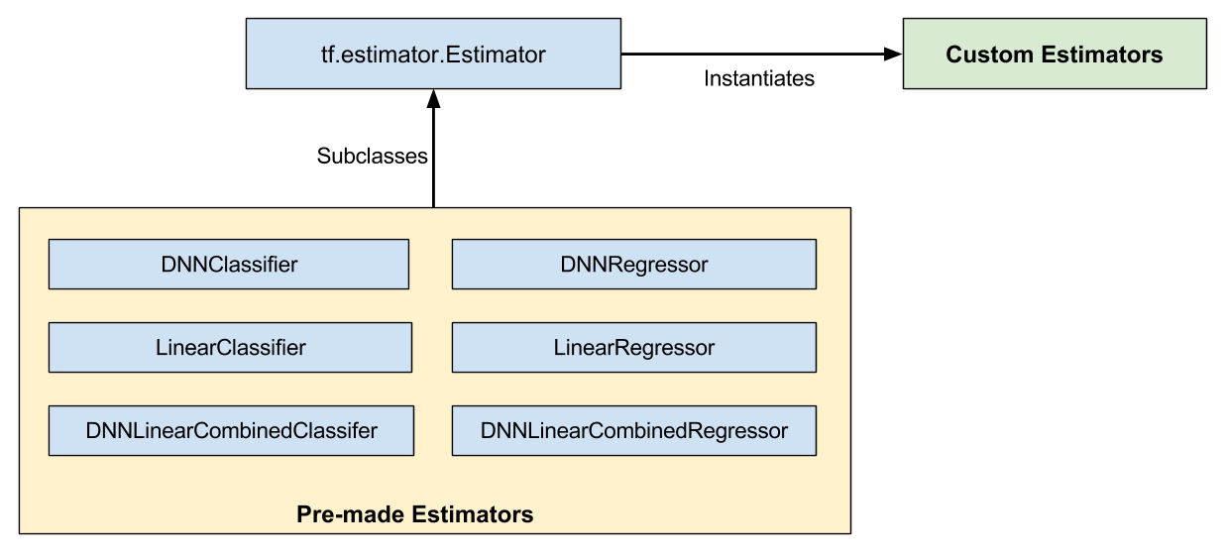
https://tensorflow.juejin.im/get_started/custom_estimators.html

Slide 52
Build a linear model with Estimators
https://tensorflow.google.cn/tutorials/estimator/linear
Boosted trees using Estimators
在 Tensorflow 中訓練提升樹Boosted Trees模型
https://tensorflow.google.cn/tutorials/estimator/boosted_trees
鮑魚年齡預測
http://d0evi1.com/tensorflow/estimators/

Slide 53
思考題
如何將現有的scikit-learn, scipy,……
整合到Tensorflow Framework
並提供性能更優異的執行環境

Slide 54
TOPIC
常用的Function:tf.cast

Slide 55
tf.cast：用於改變某個張量的資料類型
tf.cast(
x, dtype, name=None
)
import tensorflow as tf;
import numpy as np;
A = tf.convert_to_tensor(np.array([[1,1,2,4], [3,4,8,5]]))
print(A.dtype)
b = tf.cast(A, tf.float32)
print(b.dtype)

Slide 56
tf.cast：用於改變某個張量的資料類型
https://tensorflow.google.cn/api_docs/python/tf/cast?hl=uk
tf.cast(
x, dtype, name=None
)
Returns
A Tensor or SparseTensor or IndexedSlices with same shape as x and same type as dtype.
Args
x | A Tensor or SparseTensor or IndexedSlices of numeric type. It could be uint8, uint16, uint32, uint64, int8, int16, int32, int64, float16, float32, float64, complex64, complex128, bfloat16.
dtype | The destination type. The list of supported dtypes is the same as x.
name | A name for the operation (optional).
Raises
TypeError | If x cannot be cast to the dtype.

Slide 57
More
TOPICs

Slide 58
Tensorflow模型訓練技術
tf.GradientTape
tf.summary與TensorBoard
tf.distribute[進階課程]
分散式訓練 Distributed Training
使用 Keras, Tensorflow 進行分散式訓練初探
(Distributed Training in Keras and Tensorflow)
https://www.slideshare.net/JianKaiWang2/keras-tensorflow-distributed-training-in-keras-and-tensorflow
https://github.com/jiankaiwang/

Slide 59
tf.summary
https://www.tensorflow.org/api_docs/python/tf/summary
Operations for writing summary data, for use in analysis and visualization.
The tf.summary module provides APIs for writing summary data. This data can be visualized in TensorBoard, the visualization toolkit that comes with TensorFlow

Slide 60
TensorBoard：TensorFlow 的視覺化工具包
https://www.tensorflow.org/tensorboard
TensorBoard 提供機器學習實驗所需的視覺化呈現和工具：
追蹤損失和準確率等指標，並以視覺化的方式呈現
以視覺化的方式呈現模型圖 (運算和層)
檢視權重、偏誤或其他張量隨時間變化的直方圖
將嵌入投影至較低維度的空間
顯示圖片、文字和音訊資料
剖析 TensorFlow 程式
還有更多功能
在Google Colab使用TensorBoard
%load_ext tensorboard
%tensorboard --logdir lab2-logs
實戰
Using TensorBoard in Notebooks
https://www.tensorflow.org/tensorboard/tensorboard_in_notebooks
進階研讀:
輕鬆學會 Google TensorFlow 2.0 人工智慧深度學習實作開發, 2/e
黃士嘉、林邑撰 著/博碩文化
Ch2.4與Ch7
Hands-on TensorBoard (TensorFlow Dev Summit 2017)
https://www.youtube.com/watch?v=eBbEDRsCmv4

Slide 61
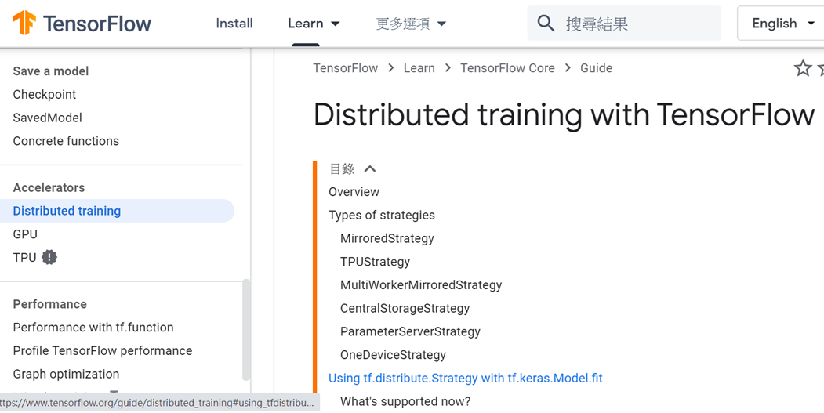
tf.distribute
Distributed training with TensorFlow
多台機器上分散式運算用
Library for running a computation across multiple devices.
https://www.tensorflow.org/guide/distributed_training
Distributed TensorFlow training (Google I/O '18)
https://www.youtube.com/watch?v=bRMGoPqsn20
Inside TensorFlow: tf.distribute.Strategy
https://www.youtube.com/watch?v=jKV53r9-H14
Performant, scalable models in TensorFlow 2 with tf.data, tf.function & tf.distribute (TF World '19)
https://www.youtube.com/watch?v=yH1cF7GnoIo

Slide 62
tf.GradientTape
Record operations for automatic differentiation
https://www.tensorflow.org/api_docs/python/tf/GradientTape

Slide 63
tf.GradientTape
Record operations for automatic differentiation.
tf.GradientTape定義在tensorflow/python/eager/backprop.py檔中
GradientTape是eager模式下計算梯度用的
eager模式是TensorFlow 2.0的預設模式
tf.GradientTape是官方大力推薦的用法
https://tensorflow.google.cn/api_docs/python/tf/GradientTape
https://blog.csdn.net/guanxs/java/article/details/102471843

Slide 64
x = tf.constant(3.0)
with tf.GradientTape() as g: g.watch(x) y = x * x
dy_dx = g.gradient(y, x)
# y’ = 2*x = 2*3 = 6
GradientTape默認只監控由tf.Variable創建的traiable=True屬性（預設）的變數
上面例子中的x是constant，因此計算梯度需要增加g.watch(x)函數

Slide 65
Methods
batch_jacobian | Computes and stacks per-example jacobians
gradient | Computes the gradient using operations recorded in context of this tape
jacobian | Computes the jacobian using operations recorded in context of this tape
reset | Clears all information stored in this tape. Equivalent to exiting and reentering the tape context manager with a new tape
stop_recording | Temporarily stops recording operations on this tape. Operations executed while this context manager is active will not be recorded on the tape. This is useful for reducing the memory used by tracing all computations
Yields
watch | Ensures that tensor is being traced by this tape
watched_variables | Returns variables watched by this tape in order of construction
__enter__ | Enters a context inside which operations are recorded on this tape.
__exit__ | Exits the recording context, no further operations are traced.

Slide 66
https://github.com/tensorflow/tensorflow/blob/r2.0/tensorflow/python/eager/backprop.py
def gradients_function(f, params=None):
"""Returns a function which differentiates f with respect to params.
Example:
```python
# f(x, y) = (x ^ 3) * y - x * (y ^ 2)
# Therefore, the 1st order derivatives are:
# df / dx = 3 * (x ^ 2) * y - y ^ 2
# df / dy = x ^ 3 - 2 * x * y
# The 2nd order derivatives with respect to x is:
# d^2 f / (dx)^2 = 6 * x * y
def f(x, y):
return x * x * x * y - x * y * y

Slide 67
# Obtain a function that returns 1st order gradients.
grad_fn = tfe.gradients_function(f)
x = 2.0
y = 3.0
# Invoke the 1st order gradient function.
x_grad, y_grad = grad_fn(x, y)
assert x_grad.numpy() == 3 * (2 ** 2) * 3 - 3 ** 2
assert y_grad.numpy() == (2 ** 3) - 2 * 2 * 3
# Obtain a function that returns the 2nd order gradient with respect to x.
gradgrad_fn = tfe.gradients_function(lambda x, y: grad_fn(x, y)[0])
# Invoke the 2nd order gradient function.
x_gradgrad = gradgrad_fn(x, y)[0]
assert x_gradgrad.numpy() == 6 * 2 * 3
# To obtain a callable that returns the gradient(s) of `f` with respect to a
# subset of its inputs, use the `params` keyword argument with
# `gradients_function()`.
ygrad_fn = tfe.gradients_function(f, params=[1])
(y_grad,) = ygrad_fn(x, y)
assert y_grad.numpy() == (2 ** 3) - 2 * 2 * 3

