Slide 1
Genetic Algorithms by using MapReduce
Fei Teng
Doga Tuncay

Slide 2
Outline
Goal
Genetic Algorithm
Why MapReduce
Hadoop/Twister
Performance Issues
References

Slide 3
Goal
Implement a genetic algorithm on Twister to prove that Twister is an ideal MapReduce framework for genetic algorithms for its iterative essence.
Analyze the GA performance results from both the Twister and Hadoop.
We BELIEVE that Twister will be faster than Hadoop

Slide 4
Genetic algorithm
A heuristic algorithm based on Darwin Evolution
Good genes of a population are preserved by natural selection
Basic idea
Exert selection pressure on the problem search space to make it converge on the optimal solution
How to
Represent a solution
Evaluate gene fitness
Design genetic operators

Slide 5
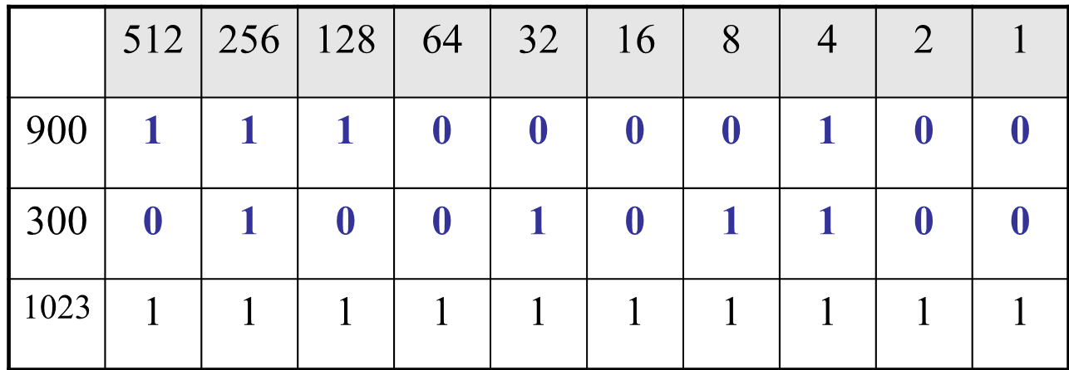
Problem representative
Encode a problem solution into a gene
For example, encode two integers 300 and 900 into genes
GA’s often encode solutions as fixed length “bitstrings” (e.g. 101110, 111111, 000101)

Slide 6
Fitness value evaluation
Fitness function
generate a score as fitness value for each gene representative given a function of “how good” each solution is
For a simple function f(x) the search space is one dimensional, but by encoding several values into a gene, many dimensions can be searched
Fitness landscape
Search space an be visualised as a surface in which fitness dictates height

Slide 7
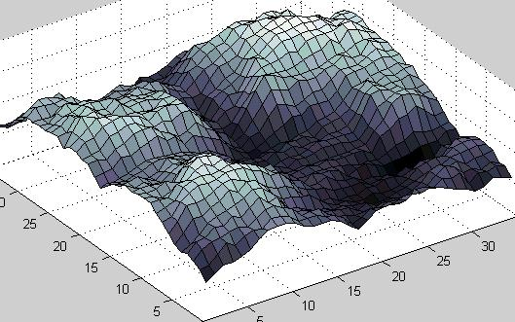
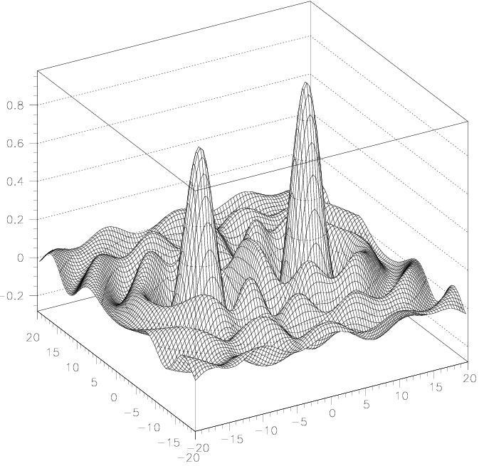
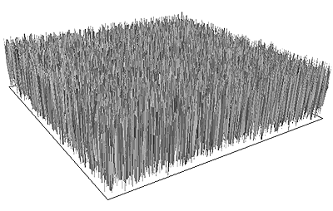
Fitness landscape

Slide 8
Genetic operators
Selection
A operator which selects the best genes into the reproduction pool
For example, Tournament selection
Crossover
Two parent genes combines their genes to produce the new offspring
Mutation
Mimic the mutation caused by environment with some small probability(mutation rate)
Notes:
Best means the genes with the highest fitness values in the current population

Slide 9
Normal GA procedure
Generate a population of random chromosomes
Repeat (each generation)
Calculate fitness of each chromosome
Repeat
Use a selection method to select pairs of parents
Generate offspring with crossover and mutation
Until a new population has been produced
Until best solution is good enough

Slide 10
Why’s ?
Why MapReduce ?
Genetic algorithms are naturally parallel
Divide a population into several sub-populations
Parallel genetic algorithm has long history on MPI
Genetic algorithms are naturally iterative
Iterate from one generation to the next until GA convergences
Why Twister?
Good at iterative MapReduce
Genetic algorithms on Iterative MapReduce is a new topic and worthy of exploring

Slide 11
Initial design
Mapper
<key, value> pair: gene representative and its fitness value
Override Map() to implement fitness function
Reducer
Conduct selection and crossover to produce new offspring and generate new sub-population
Driver
Combined results are checked to see if current population is good enough for stopping criterion

Slide 12
Initial Design(cont’d)
Intermediate
<key,value>
New offspring
Seed Population
partition
Map
Reducer
Twister Driver
partition
.
.
.
.
.
.
.
.
.
Combiner
.
.
.
partition
Map
Reducer

Slide 13
Potential research objects
Trivial problem
Onemax problem
a simple problem consisting in maximizing the number of ones of a bitstring
For example, for a bitstring with a length of 10⁶ , GA needs to find the answer 10⁶ by heuristic search
Non-trivial problem
Try to determine the linear relation between child-obesity health data and environment data with GA

Slide 14
Performance Analysis
Some research about the Onemax Problem by using Hadoop
Better scalability
Easy to program
We believe Twister will have better performance because
Twister explicitly supports iterative MapReduce
Twister caches static data in memory
Twister does not do hard disk I/O between mappers and reducers

Slide 15
Rough schedule
Workload split
Fei is working on the Twister GA
Doga is working on the Hadoop GA
Timeline
Detailed design before Oct.30
Complete implementation before Nov.30
Analyze the performance data on Dec

Slide 16
References
http://en.wikipedia.org/wiki/Genetic_algorithm
http://www.iterativemapreduce.org/
Chao Jin, Christian Vecchiola and Rajkumar Buyya MRPGA: An Extension of MapReduce for Parallelizing Genetic Algorithms
Abhishek Verma, Xavier Llora, David E. Goldberg, Scaling Simple and Compact Genetic Algorithms using MapReduce

Slide 17
Thank you
Questions?

Slide 18
Example population
No. | Chromosome | Fitness
1 | 1010011010 | 1
2 | 1111100001 | 2
3 | 1011001100 | 3
4 | 1010000000 | 1
5 | 0000010000 | 3
6 | 1001011111 | 5
7 | 0101010101 | 1
8 | 1011100111 | 2

Slide 19
Roulette Wheel Selection
1
2
3
4
5
6
7
8
1
2
3
1
3
5
1
2
0
Rnd[0..18] = 7
Chromosome4
Parent1
Rnd[0..18] = 12
Chromosome6
Parent2
18

Slide 20
Crossover - Recombination
1010000000
Parent1
Offspring1
1011011111
1001011111
Parent2
Offspring2
1010000000
Crossover single point - random
With some high probability (crossover rate) apply crossover to the parents. (typical values are 0.8 to 0.95)

Slide 21
Mutation
mutate
Offspring1
1011011111
Offspring1
1011001111
Offspring2
1010000000
Offspring2
1000000000
Original offspring
Mutated offspring
With some small probability (the mutation rate) flip each bit in the offspring (typical values between 0.1 and 0.001)

