Slide 1
Mini Project 1
Talk Tayo

Slide 2
Introduction
We are now in an era where people lost hope because of a different problems they are facing not to mention the toxic social media that influence them to give up in life. While there are people who are doing their best to fight their problems in order to survive and have a positive outlook in life. There are also people who needs help for they feel that they are being left behind and that no one understand them. They somehow start to ask what have they done wrong to experience such problem and why only them who are having a hard time in life, is life just being unfair to them? Are they really being left out in this world? And is there anyone out there who has the same problem as they are? And so, how do they manage it? This are some questions that we might find an answer as we go on. That is why this website has been created to collect different stories from different people who manage to survive their battle in life.

Slide 3
Problem
Every people has their own struggle, they somehow overthink on something and most of them feel that they are the only one who’s having that certain kind of struggle. That they are being left behind and no one can relate to them.

Slide 4
Solution
This blog site tend to collect stories that might connect to each people who are having a hard time coping in life. This will serve as an eye opener to them that what they feel is normal since we are just human being made by dust. It tends to make them realize that every problem has a solution and they are not alone. It includes stories of different people having different problem and how they manage to overcome it.

Slide 5
Objectives
To be able to inform people to see the beautiful side of life and that problems are just part of being human, therefore they should not give up easily because they are not alone and each of us are facing the same struggle it is up to us how to fight it. But one thing is for sure that God won’t give us problem that we cannot bare. It tends to collect stories that they can relate to help them bost there confident that they can over come whatever problem they are facing today.
Target Users: Everyone, specially those who feel that they are alone facing their own struggle.

Slide 6
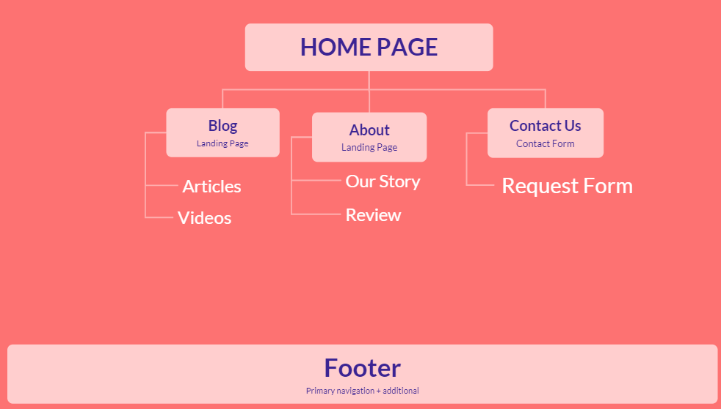
Site Map

Slide 7

Wire Frame

Slide 8
Features
Blog
Articles
Videos
About
Our Story
Reviews
Contact Us
Request Form

