Slide 1
InfoGAN
助教：鄧駿智

Slide 2
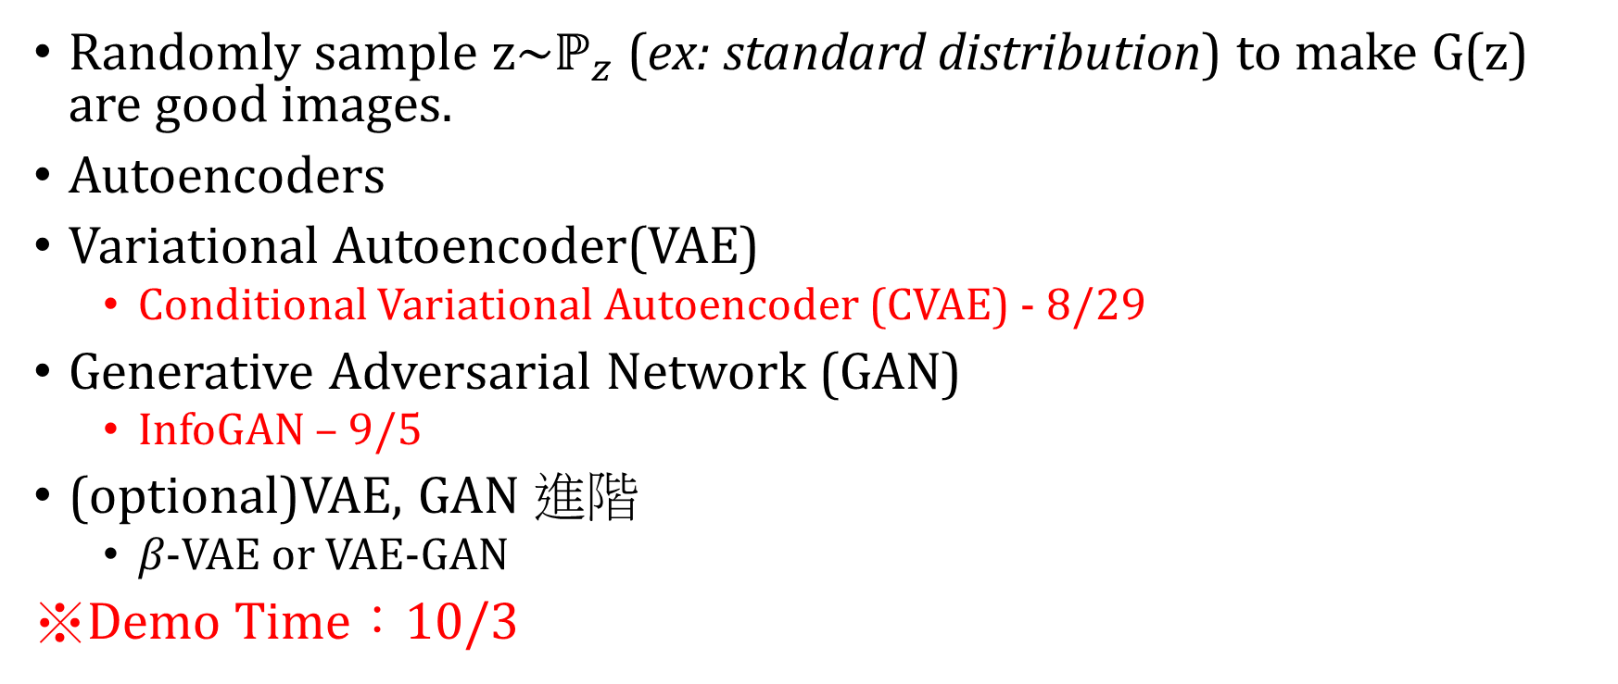
Generative Model
Randomly sample z~$ℙ_{z}$(ex: standard distribution) to make G(z) are good images.
Autoencoders
Variational Autoencoder(VAE)
Conditional Variational Autoencoder (CVAE) - 8/29
Generative Adversarial Network (GAN)
InfoGAN – 9/5
(optional)VAE, GAN 進階
$β−$VAE or VAE-GAN
※Demo Time：10/3

Slide 3
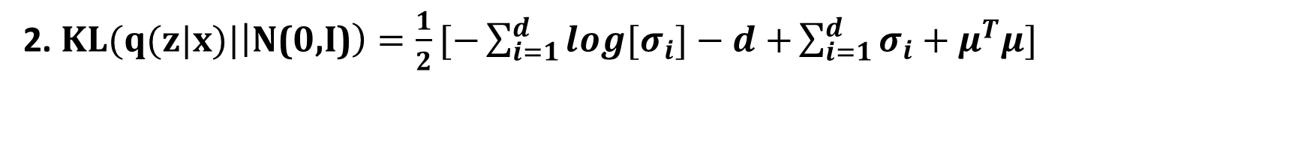
Conditional Variational Autoencoders (CVAE) Loss
1. $Loss$：$KL\left(q\left(z|x\right)||p(z)\right)+{\left\|G\left(q\left(z\right)\right)−x\right\|}_{2}^{2}$
KL Divergence Reconstruction Loss
2. $KL(q(z|x)|\left|\text{N}\text{(0,}\text{I}\text{)}\right)=\frac{1}{2}[−\sum_{i=1}^{d}{\log{[σ_{i}]}−d+}\sum_{i=1}^{d}{σ_{i}+μ^{T}μ}]$

Slide 4



Model architectures
c
[0,0,0,1,0,0,0,0,0,0]
Reshape=(batch size, 2, 14, 14)
fc21
$$μ_{enc}$$
fc3
[0,0,0,1,0,0,0,0,0,0]
Conv1
Conv2
fc1
$$\log\left(σ_{enc}^{2}\right)$$
fc22
$$z\sim N(μ_{enc}, σ_{enc}^{2})$$

Slide 5
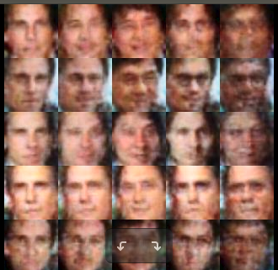
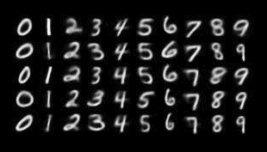
Share the same styles (Gaussian noise)
Share the same styles (Gaussian noise)
Share the same one-hot vector (label)
Share the same one-hot vector (label)

Slide 6
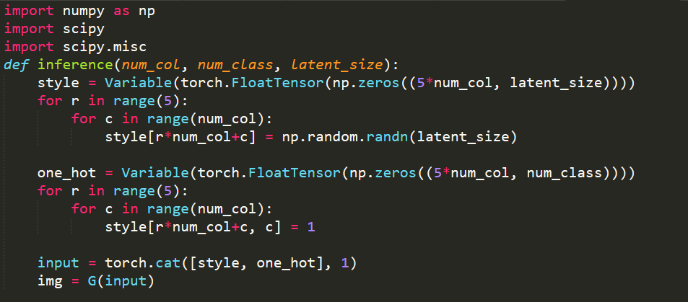
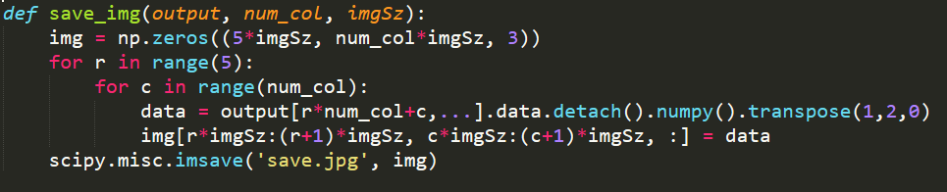

Slide 7
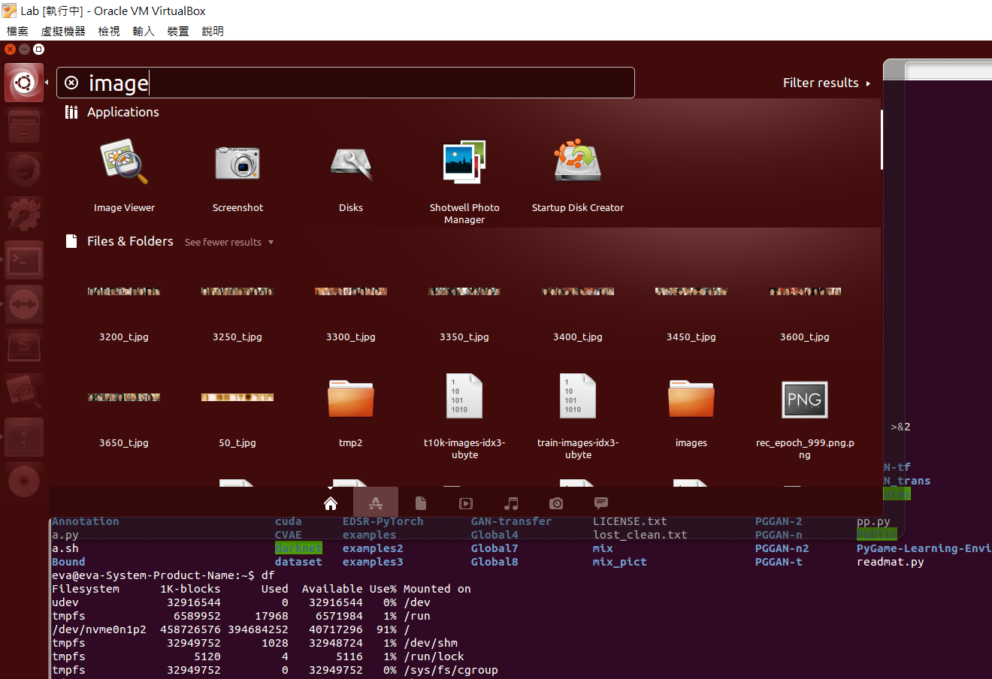
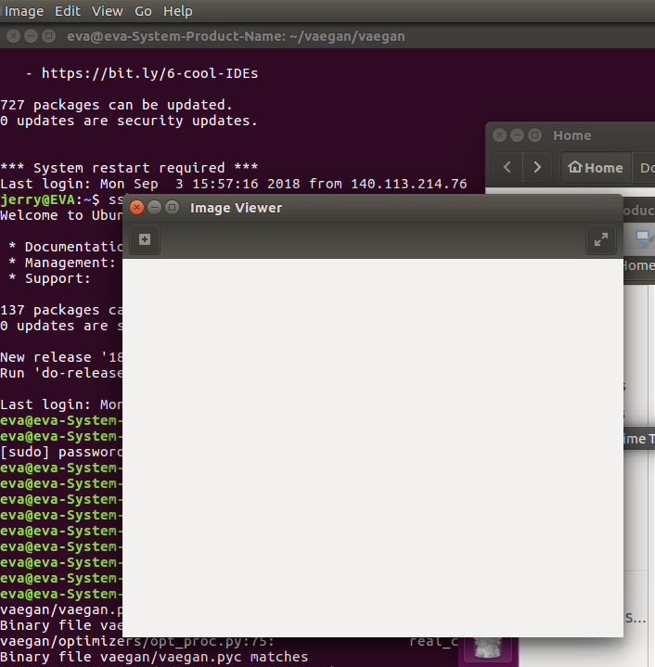

Slide 8
InfoGAN

Slide 9
CVAE Report Spec
1. Introduction (5%)
2. Experiment setups (20%):
A. How you implement a (conditional) VAE
B. How you provide labels as additional input channels to both the encoder and the decoder
3. Results (45%):
A. Results of your disentanglement experiments (30%)
MNIST
Facescrub-5
B. Loss curve during the training phase (15%)
4. Discussion (10%)
5. Demo (20%)
A. Given a label, you have to generate corresponding images
MNIST
Facescrub-5

Slide 10
Conv Layer v.s. ConvTranspose Layer
Conv Layer
ConvTranspose Layer

Slide 11





(nxn)
(nxn)
DCGAN - Generator
ConvTranspose2d
ConvTranspose2d
example code:
https://github.com/pytorch/examples/blob/master/dcgan/main.py
BatchNorm2d
BatchNorm2d
ReLU
ReLU
(2nx2n)
(2nx2n)
$$z\sim P(z)$$
ConvTranspose2d
Conv2d
Generator
BatchNorm2d
BatchNorm2d
ReLU
ReLU
$$fake_img$$
$$real_img$$
(4nx4n)
(2nx2n)
…………
…………
Discriminator
ConvTranspose2d
ConvTranspose2d
$$fake_score$$
$$real_score$$
Tanh
Tanh
Notes:
沒有fc layer
使用 convtrans2d 取代 upsampling
使用 stride=2 的 conv2d 取代 max pooling

Slide 12

(4nx4n)
(nxn)
DCGAN - Discriminator
Conv2d(stride=2)
Conv2d(stride=2)
BatchNorm2d
BatchNorm2d
LeakyReLU
LeakyReLU
(2nx2n)
(2nx2n)
$$z\sim P(z)$$
Conv2d(stride=2)
Conv2d(stride=1)
Generator
BatchNorm2d
BatchNorm2d
LeakyReLU
LeakyReLU
$$fake_img$$
$$real_img$$
(nxn)
(2nx2n)
…………
…………
Discriminator
(mxm)
(mxm)
Conv2d(ks=m,pd=0)
Conv2d(ks=m,pd=0)
$$fake_score$$
$$real_score$$
Sigmoid
Sigmoid

Slide 13

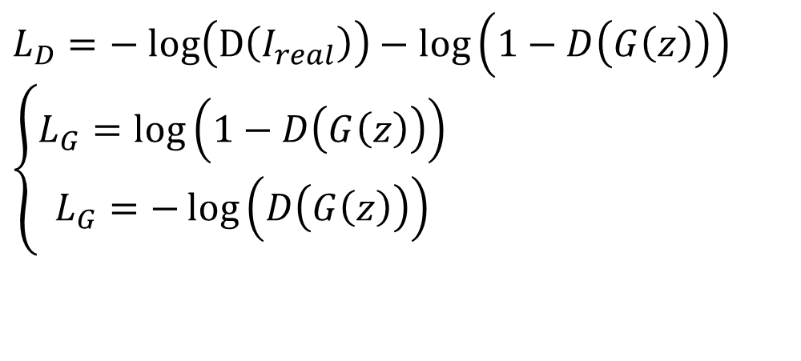




Standard GAN
$$z\sim P(z)$$
Generator
$$fake_img$$
$$real_img$$
$$L_{D}=− log\left(D\left(I_{real}\right)\right)−\log\left(1−D\left(G\left(z\right)\right)\right)$$
$$\left\{\begin{aligned}L_{G}=\log\left(1−D\left(G\left(z\right)\right)\right) \\ L_{G}=−\log\left(D\left(G\left(z\right)\right)\right)\end{aligned}\right.$$
Discriminator
$$fake_score$$
$$real_score$$
In this lab, you can use either of them, but you should tell me which one you use in your report.

Slide 14
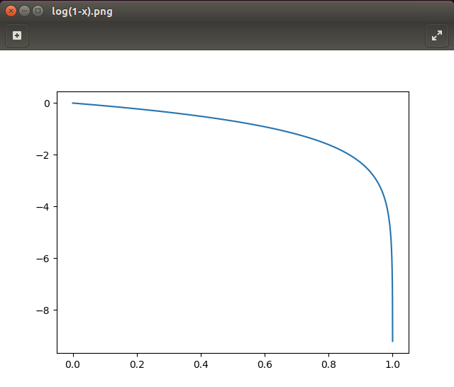
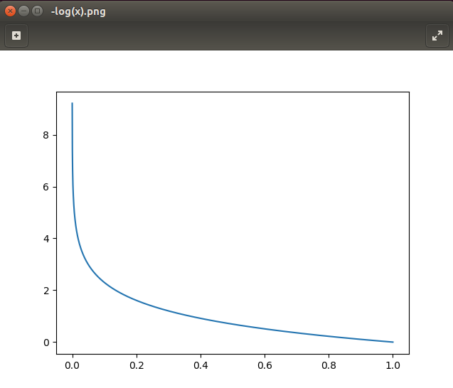
Standard GAN Loss

Slide 15











Info-GAN
$$E_{c\sim P\left(c\right), x\sim G(z,c)}\left[logQ\left(c | x\right)\right]$$
DCGAN
Info-GAN
Information Loss
$$z\sim P(z)$$
$$z\sim P(z)$$
$$c$$
Generator
Generator
No
Constraint
$$img$$
$$img$$
Discriminator
Discriminator
Q
$$Real/False$$
$$Real/False$$
$$Output$$
$$Adversarial Loss$$
$$Adversarial Loss$$

Slide 16

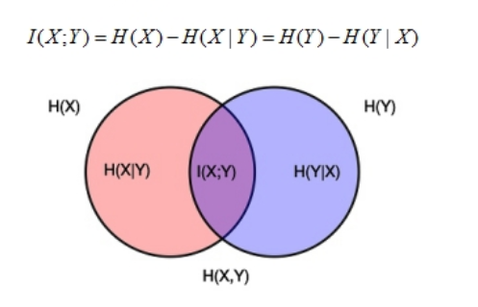




Info-GAN
In Information Theory:
Mutual Information: I(X;Y) = H(X)-H(X|Y) = H(Y)-H(Y|X)
H(Y) =
$$z\sim P(z)$$
$$c$$
Generator
$$I(c;G(z,c))$$
$$img$$

Slide 17
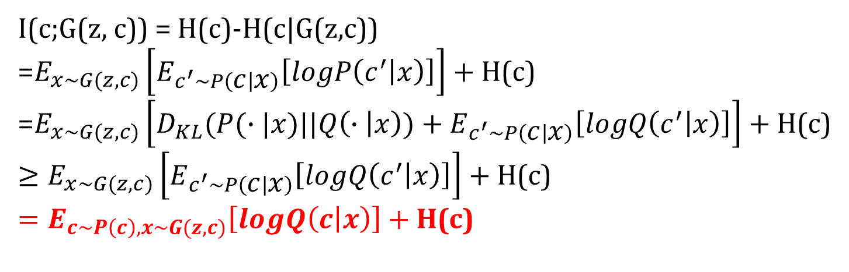
Info-GAN pf.
I(c;G(z, c)) = H(c)-H(c|G(z,c))
=$E_{x\sim G(z,c)}\left[E_{c^{′}\sim P\left(c | x\right)}\left[logP\left(c^{′} | x\right)\right]\right]+\text{H}\text{(}\text{c}\text{)}$
=$E_{x\sim G(z,c)}\left[D_{KL}(P(∙|x)||Q\left(∙ | x\right))+E_{c^{′}\sim P\left(c | x\right)}\left[logQ\left(c^{′} | x\right)\right]\right]+\text{H}\text{(}\text{c}\text{)}$
$$≥E_{x\sim G(z,c)}\left[E_{c^{′}\sim P\left(c | x\right)}\left[logQ\left(c^{′} | x\right)\right]\right]+\text{H}\text{(}\text{c}\text{)}$$
$$=E_{c\sim P\left(c\right), x\sim G(z,c)}\left[logQ\left(c | x\right)\right]+\text{H}\text{(}\text{c}\text{)}$$
We can increase the lower bound of mutual Information by other distribution!!

Slide 18
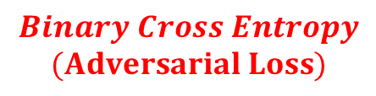





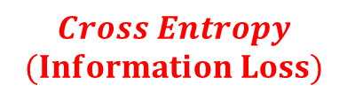


Info-GAN Flow
Info-GAN
[0,0,1,0,0…]
Take MNIST for example
$z\sim P(z)$ [54]
$c$[10]
Generator
$$E_{c\sim P\left(c\right), x\sim G(z,c)}\left[logQ\left(c | x\right)\right]$$
$$Cross Entropy$$
$$(Information Loss)$$
$$real_img$$
$$fake_img$$
Discriminator
Classifier
(Q)
$$Real/False$$
$$Output$$
$$Binary Cross Entropy$$
$$(Adversarial Loss)$$

Slide 19
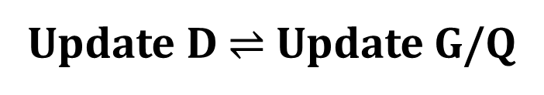
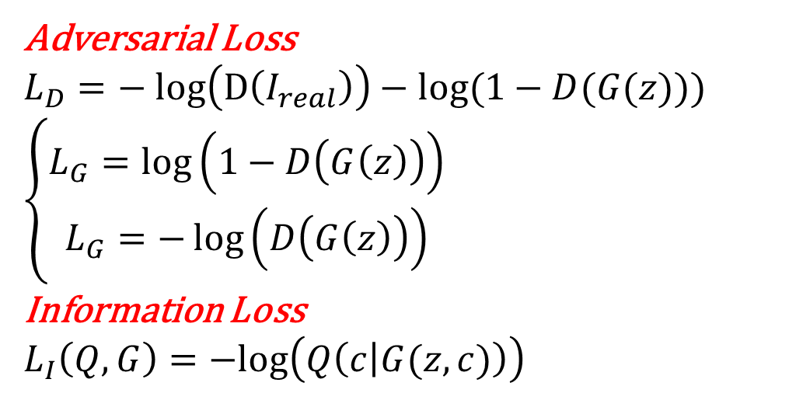
Info-GAN Loss
Adversarial Loss
$$L_{D}=− log\left(D\left(I_{real}\right)\right)−log⁡(1−D(G(z)))$$
$$\left\{\begin{aligned}L_{G}=\log\left(1−D\left(G\left(z\right)\right)\right) \\ L_{G}=−\log\left(D\left(G\left(z\right)\right)\right)\end{aligned}\right.$$
Information Loss
$$L_{I}\left(Q,G\right)=−log\left(Q\left(c | G(z,c)\right)\right)$$
Update D $⇌$Update G/Q

Slide 20
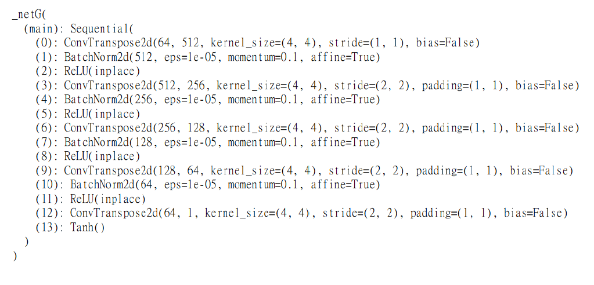
Info-GAN Generator
ConvTranspose2d
Example code:
https://github.com/pianomania/infoGAN-pytorch
BatchNorm2d
ReLU
(2nx2n)
ConvTranspose2d
BatchNorm2d
ReLU
…………
(4nx4n)
ConvTranspose2d
Tanh

Slide 21
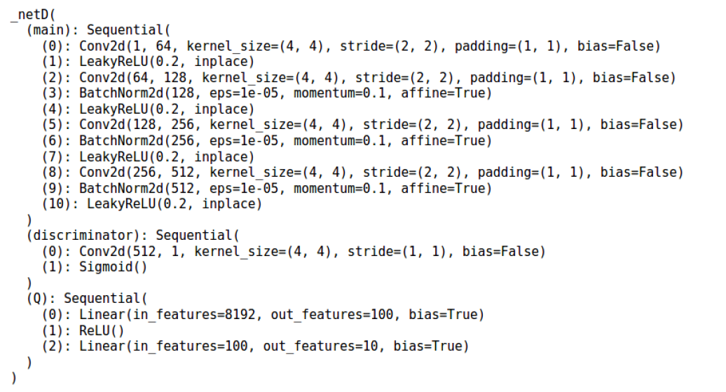


Info-GAN Discriminator
$$fake_img$$
Share weight between D/Q
Discriminator
Classifier
$$fake_img$$
Shared
D
Q

Slide 22
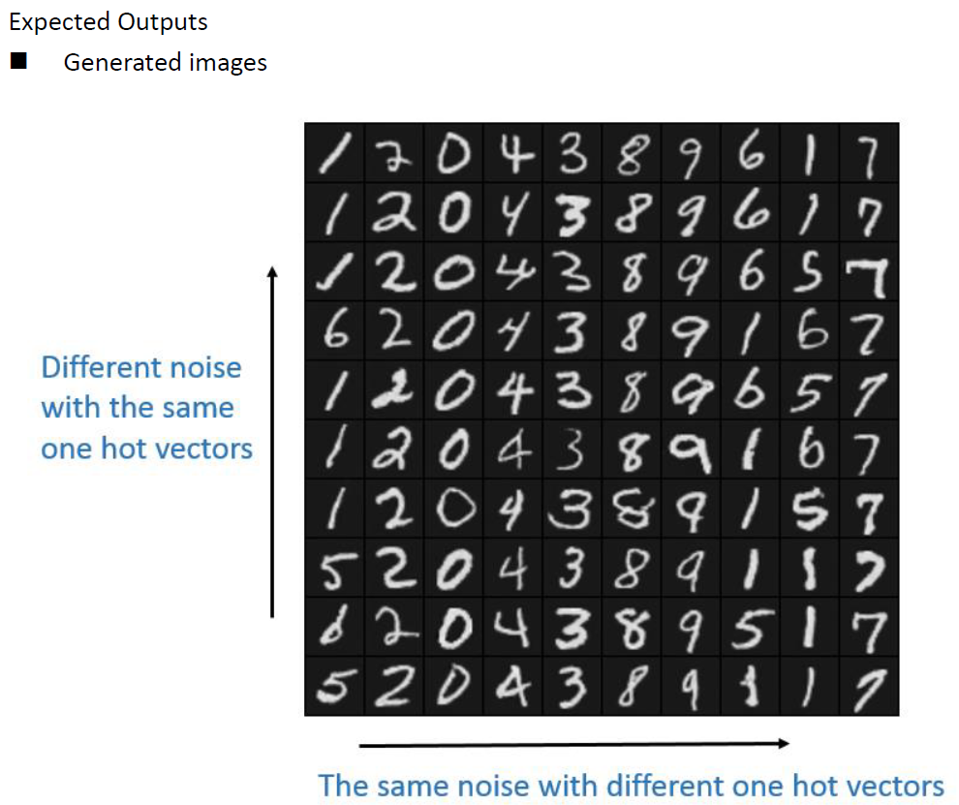
Expected Outputs
More Realistic Output

Slide 23
Hyper-parameters
Batch size: 64
Learning rate for the discriminator: 2e-4
Learning rate for the generator and Q: 1e-3
c_size (size of meaningful codes) = 10
Total epochs = 80
Optimizer: Adam

Slide 24
Info-GAN Report Spec
MNIST
1. Introduction (5%)
2. Experiment setups: (20%)
A. How you implement InfoGAN
i. Adversarial loss
ii. Maximizing mutual information
B. Which loss function of generator you used? What’s different?
3. Results (30%)
A. Results of your samples (shown as in the expected results section)
B. Training loss curves
4. Discussion (15%)
5. Demo (20%)
A. Given a label, you have to generate corresponding images
(optional) Bonus: Facescrub-5 (10%)
Results of your samples (5%)
Demo (5%)

