Slide 1
Group 17
IT314
-Under Professor Saurabh Tiwari

Slide 2
Online Faculty Staff Directory for Multi University
Online faculty staff directory empowers user to easily view college faculty details.
Student can easily view different college faculty details anywhere required at any time as this application is handy.
This system is built with effective graphical user interface which enables user friendliness.
User can search faculty details and view their respective details such as name, department, courses, area of expertise, and professional interest.
This system reduced time and cost of user.
Here there are two entities who will access this system i.e. admin and student.
Admin is authorized to add and manage all the faculty details. User doesn’t require any registration or login to access this system.
User can directly search for faculty and view their details. Data in database are maintained securely without any maintenance cost.

Slide 3
Functional Requirements
● Search Faculty Data.
● Apply Filter in Searches.
● Login facility for admin and faculty.
● The system admin can add, remove and manage the faculty details.
● Faculty can edit their profile and their course details.
● General users can search and filter faculty details without registration.

Slide 4
Non-Functional Requirements
● Availability of Faculty Details.
● Interactive User Interface and easy to use.
● Website should be lightweight and scalable on different devices.
● System should be available 24x7 except for maintenance time.
● Website should run on low network bandwidth.
● Data in the database is maintained securely without any maintenance cost.
● Real-time data updation

Slide 5
Requirement Elicitation Techniques
Elicitation technique contains:
Stake holders
Actors
Use case diagram

Slide 6
Requirement Elicitation Techniques
Stakeholders : Basically there are 6 stakeholders.
Admin
Faculty/Staff
General users (Students)
Project Developers
Project Sponsors
Project Manager
Actors: There are three kind of people that interact with the system:
Admin
Faculty/Staff
General users (Students)

Slide 7
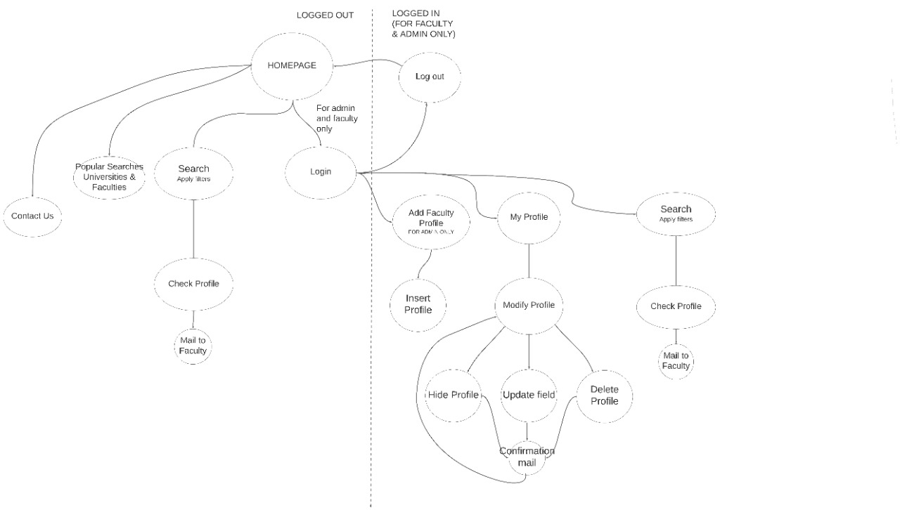
Concept Map

Slide 8
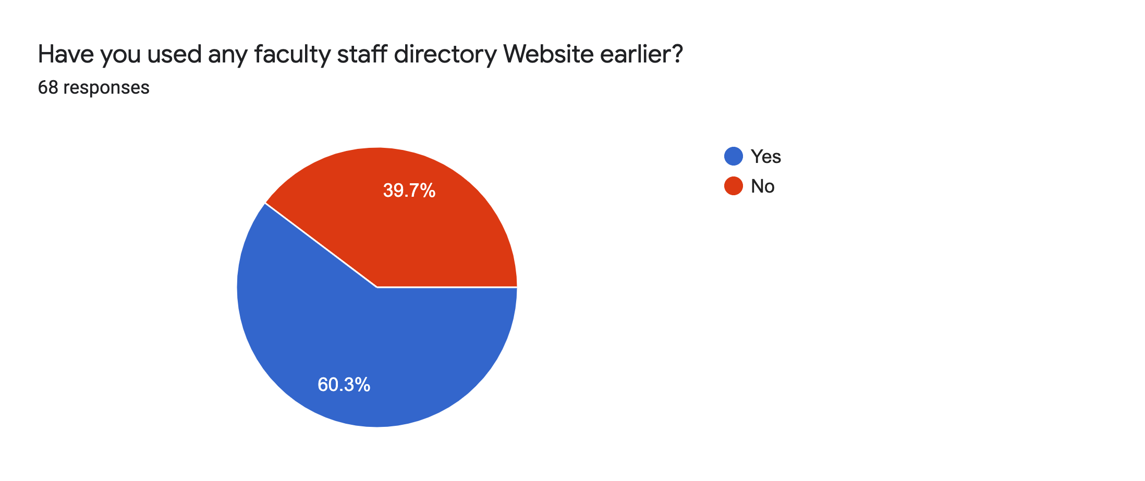
Have you used any faculty staff directory Website earlier?

Slide 9
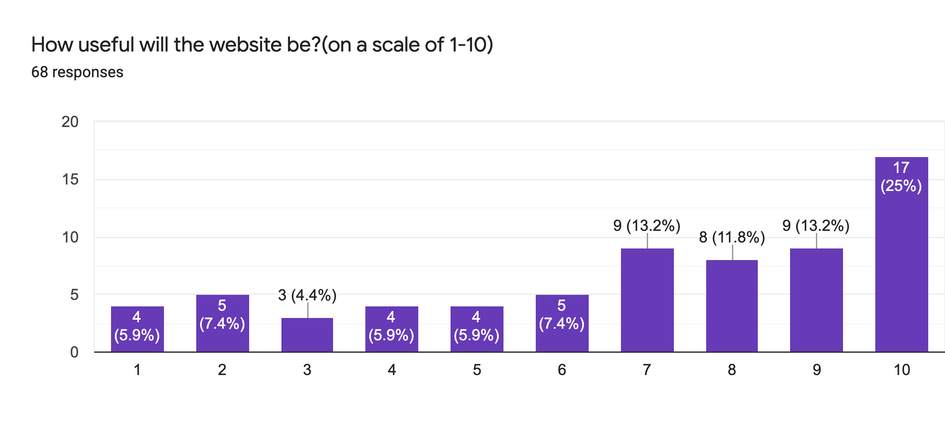
How useful will the website be?(on a scale of 1-10)

Slide 10
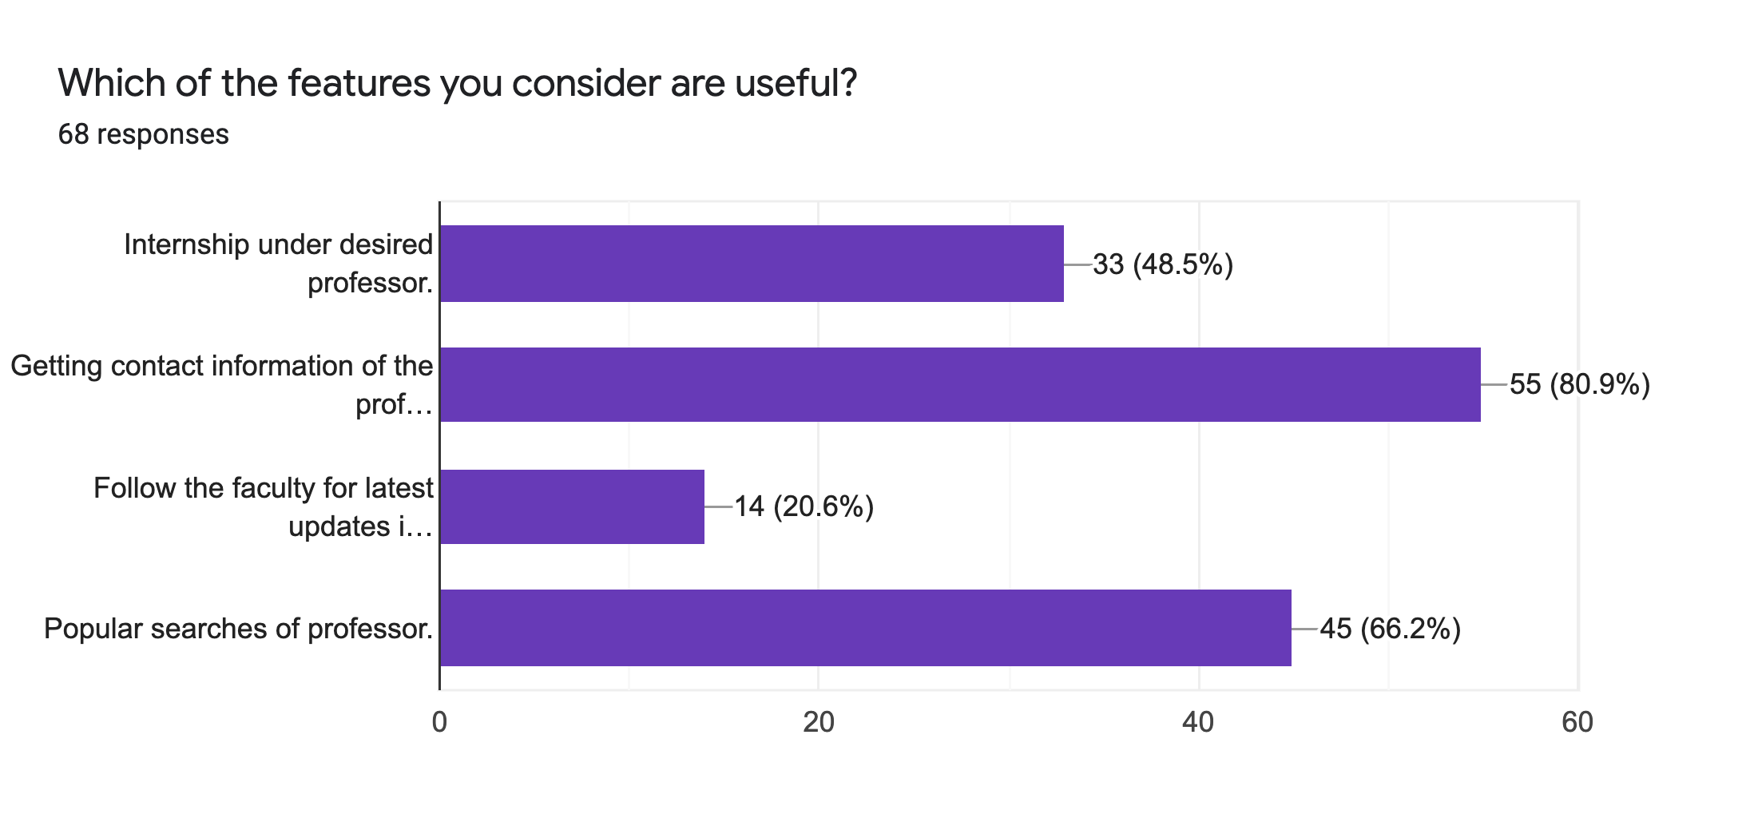
Which of the features you consider are useful?

Slide 11
USE CASE MODEL
Iterative waterfall model:
We choose iterative waterfall model as our requirements were straight forward.
Iterative waterfall model is easy to understand and use.

Slide 12
Use Case Diagram

Slide 13
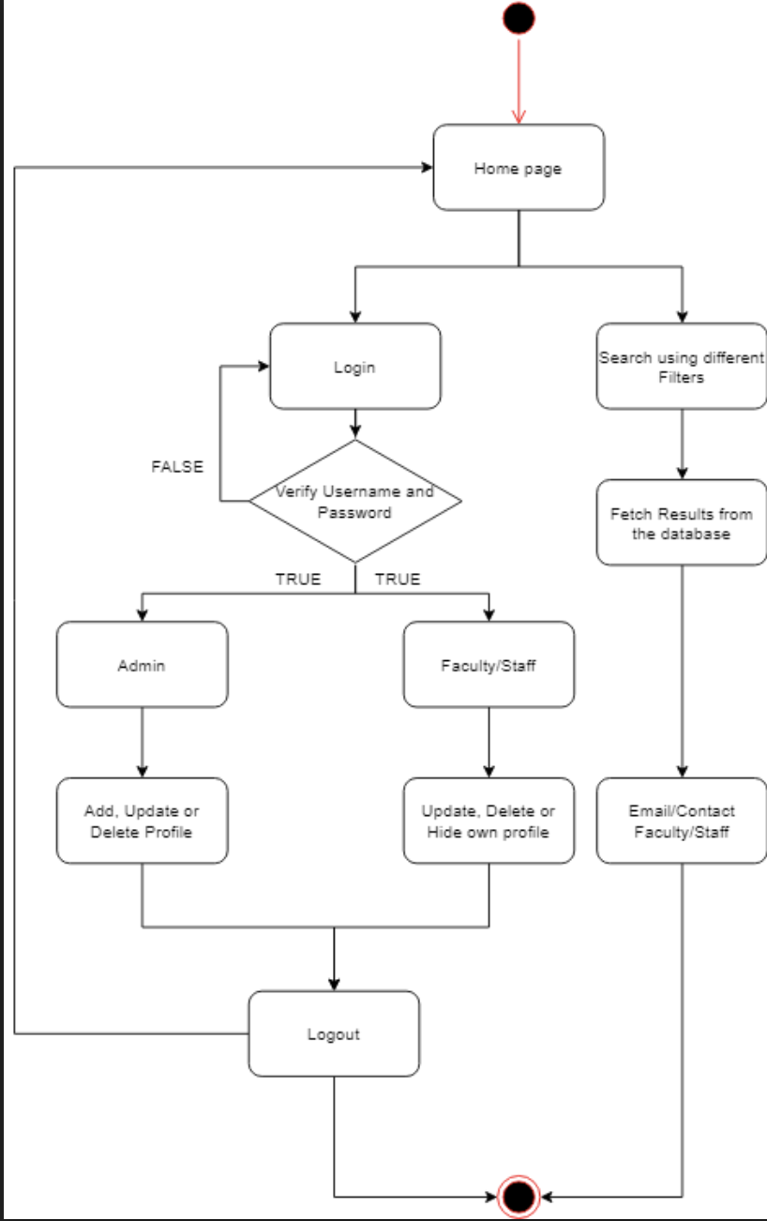
Activity diagram

Slide 14
Wire framing using Figma
We have created UI/UX prototype.
https://www.figma.com/proto/qqlIxgBJwvIN7l5YwnEt4I/Untitled?node-id=183%3A0&viewport=-425%2C290%2C0.09960786253213882&scaling=scale-down.

Slide 15
Meet the team
AYAN KHOKHAR - 201801057 - FrontEnd
RUTVIK SHAH - 201801113 - Documentation, Presentation
URMIK MAKANI - 201801117 - UI/UX designing
TULSI SHAH - 201801180 - Login, Delete, Admin Option (Backend)
ANAND NADPARA - 201801192 - Search, Homepage, Update Profile (Backend)
JHANVI SHROFF – 201801198- Testing, FrontEnd(HTML/CSS)
AKASH PARAMAR - 201801212 - Testing, frontend(HTML/CSS)
SHYAM VAGHELA - 201801214 - Signup Request (Backend)
NISHTHA CHAUDHARY - 201801235 - Profile, Logout (Backend)
TUSHAR PATIL - 201801440 – FrontEnd
Lab/Assignments were done by all members.

