Slide 1
GROUP 17 ONLINE FACULTY STAFF DIRECTORY FOR MULTI UNIVERSITY IT314: SOFTWARE ENGINEERING INSTRUCTOR: PROF. SAURABH TIWARI

Slide 2
MEET OUR TEAM
AYAN KHOKHAR - 201801057
RUTVIK SHAH - 201801113
URMIK MAKANI - 201801117
TULSI SHAH - 201801180
ANAND NADPARA - 201801192
JHANVI SHROFF - 201801198
AKASH PARMAR - 201801212
SHYAM VAGHELA - 201801214
NISHTHA CHAUDHARY - 201801235
TUSHAR PATIL - 201801440

Slide 3
OBJECTIVES
To make an online faculty staff directory with low database maintenance cost.
Students can easily view university and professors details from a trusted website without any kind of login.
To basically encourage students to be more aware of their course, university and professor.
The system is intended to reduce time and cost of the user.

Slide 4
MILESTONES
Reliable database with Real-time data updation.
Portability (App is supported by maximum devices)
User friendly interface.
Fully Responsive Web Design.
Authentication & Authorization.
User Filtering and Search.

Slide 5
KEY TAKEAWAYS
Learnt how to manage project using Github and how to collaborate in a team.
We learnt how to list essential functional and non-functional requirements using various requirements elicitation techniques.
Used UML diagrams to develop a clear vision about the project tasks and how the actors will interact with the system.
Resolved conflicts and misunderstandings.
Planning is the key to any big project and to stick to it.
Team members adapted and were dynamic in their approach.
Everyone in the team had different qualities and utilizing those to their best.

Slide 6
ACHIEVEMENTS
Previously we had worked in teams but never experienced such an industrial methodology of developing a software project. As a team we learnt how to collaborate with each other and develop an industrial strength project with technologies such as React JS, Bootstrap, Material UI, Django and Firebase.
As a result, we developed a fully responsive web application with beautiful user interface that acts as platform to help students to discover and find perfect university and professor for their intended courses.

Slide 7
MISTAKES
Rest API issue:
At the very beginning of the project we decided to go with Tech Stack of React + Django but there were some problems in integration of both FrontEnd and BackEnd so we then changed our Tech Stack to React + Firebase. So we get to know to choose proper tech stack that can be implemented in given time frame.
First UI Design
The first design of the prototype didn’t match its purpose. After user testing, many user felt that the design did not match the purpose of the website. The design didn’t portray professionalism.

Slide 8
Usability Testing (UI/UX)
Users were asked to perform 5 tasks without any prior knowledge of the navigational aspects of the website.
Upon that users were asked 6 questions after testing (2 UI and 4 UX) to understand the overall impact of the design.
New design was made from the given feedback

Slide 9
TESTING
We have done three types of testing
1.Unit testing
Unit testing is the testing of every component independently.
We test it using jest and react testing library.
2.Blackbox testing
In blackBox testing we took boundary values and equivalence classes and show output as a valid or invalid.
3. Acceptance testing
We found out bugs and issues by keeping requirements of our website in mind and then fixed that issues .

Slide 10
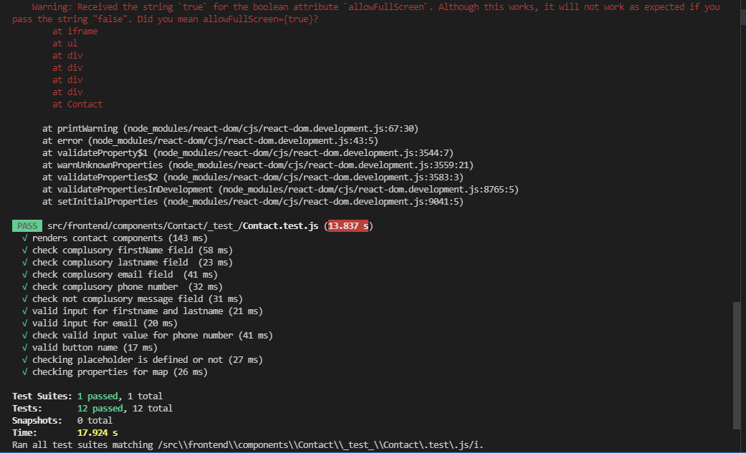
UNIT TESTING

Slide 11
RATING OF SOFTWARE ARTIFACTS
Rating (4.5/5)
From the start of the project we were focused on preparation of code component by component keeping requirements in the mind. For constructing the individual web-pages we just used a combination of these components.

Slide 12
OVERALL RATING
Rating (9/10)
From the beginning of the project we emphasized more on learning the relevant languages and frameworks and tried to implement most of the identified requirements.
As a result, we developed a fully responsive website with beautiful GUI,
portable across most of the devices.

Slide 13
DEMONSTRATION(PROJECT)
https://maven-se17.netlify.app/

Slide 14
DEMONSTRATION(GITHUB)
https://github.com/201801057/Group-17-Faculty-Staff-Directory

Slide 15
THANK YOU

