Slide 1






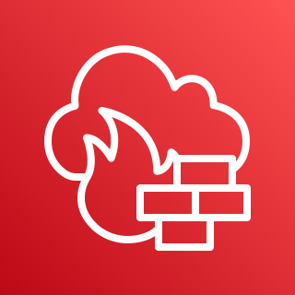




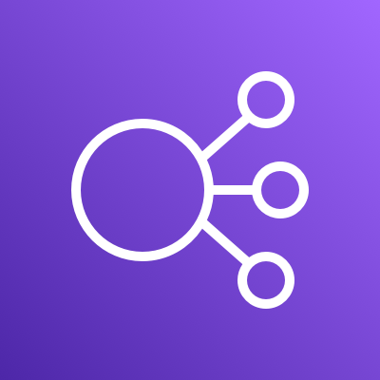


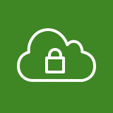








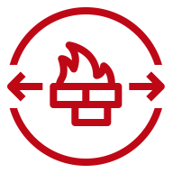










AWS Cloud
Region - 캘리포니아
VPC – bank-external-vpc
10.0.0.0/20
Availability Zone - us-west-1a
Private subnet
– external_web 10.0.20.0/23
Private subnet
– external_was 10.0.30.0/24
Availability Zone - us-west-1a
Availability Zone - us-west-1b
Public subnet
– external_edge01 10.0.0.0/24
Security group
Auto Scaling group
Auto Scaling group
Private subnet
– external_db01 10.0.40.0/24
Private subnet
– external_db02 10.0.50.0/24
Security group
Security group
Security group
Security group
Availability Zone - us-west-1b
Public subnet
– external_edge02 10.0.10.0/24
Security group
VPC – bank-internal-vpc
10.10.0.0/20
Availability Zone - us-west-1a
Private subnet
– internal_web 10.10.20.0/24
Private subnet
– internal_was 10.10.30.0/24
Availability Zone - us-west-1a
Availability Zone - us-west-1b
Public subnet
– internal_edge 10.10.0.0/24
Private subnet
– internal_db01 10.10.40.0/24
Private subnet
– internal_db02 10.10.50.0/24
Security group
Security group
Security group
Availability Zone - us-west-1b
Public subnet
– internal_edge 10.10.10.0/24
Security group
Corporate
data center

