Slide 1
Category Ranking
Sarvat Ali – 2018201009
Prabha Pandey – 2018201053
C.Sai Sukrutha – 2018201054
Shruthi Chandra - 2018202010
Team No – 23
Project No - 43

Slide 2

Category Ranking
Topic ranking
- Ordering of topics based on relevance for text documents
Supervised learning
Multi-label classification

Slide 3
Category Ranking
Expected Output
Perceptron Model
- Paper : Crammer and Singer

Slide 4
Dataset - Reuters 21578
No of Documents
Categories
5 category sets
- Exchanges : 39 categories
- Organizations : 56 categories
- People : 267 categories
- Places : 175 categories
- Topics : 135 categories
Training – Testing
SGML format

Slide 5
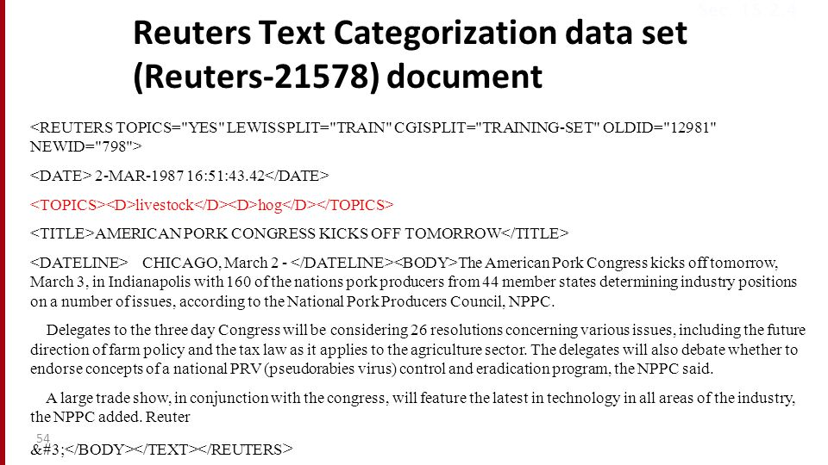

Slide 6
Documents Representation

Slide 7
Keras Neural Networks

Slide 8
Multinomial Naive Bayes

Slide 9
KNN

Slide 10
SVM

Slide 11
Decision Trees

Slide 12
Accuracy
Tablex

Slide 13
Thank you

