Slide 1
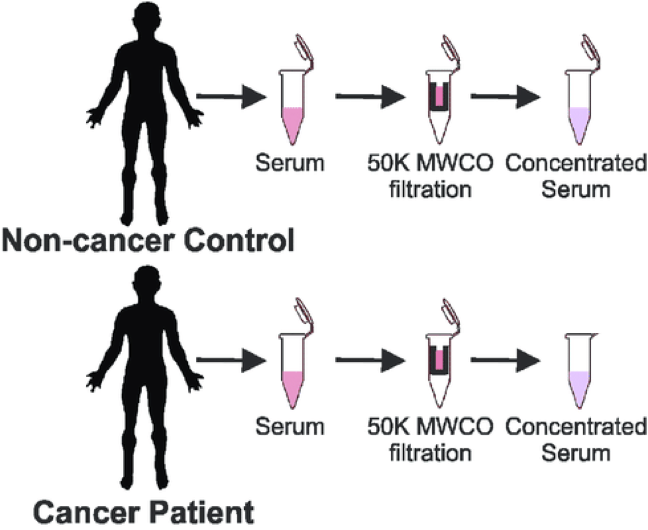
Data Files
Instrument files
Result files
Intermediate files
Plots
config files
Dataset general description
Sample
To
Data files

Slide 2
sample properties
data file properties
study variables
source name | characteristics[organism] | characteristics[disease] | characteristics[phenotype] | … | Assay name | comment[fraction identifier] | comment[label] | comment[data file] | factor value[phenotype]
sample 1 | homo sapiens | gastric carcinoma | control |  | Run 1 | 1 | label free | fileRAW_Control_F1.raw | control
sample 2 | homo sapiens | gastric carcinoma | primary tumor |  | Run 2 | 1 | label free | fileRAW_Tumor_F1.raw | primary tumor
….

