Slide 1
Advance Web Development Final Project
API Development
Created by: Imer Lopez

Slide 2
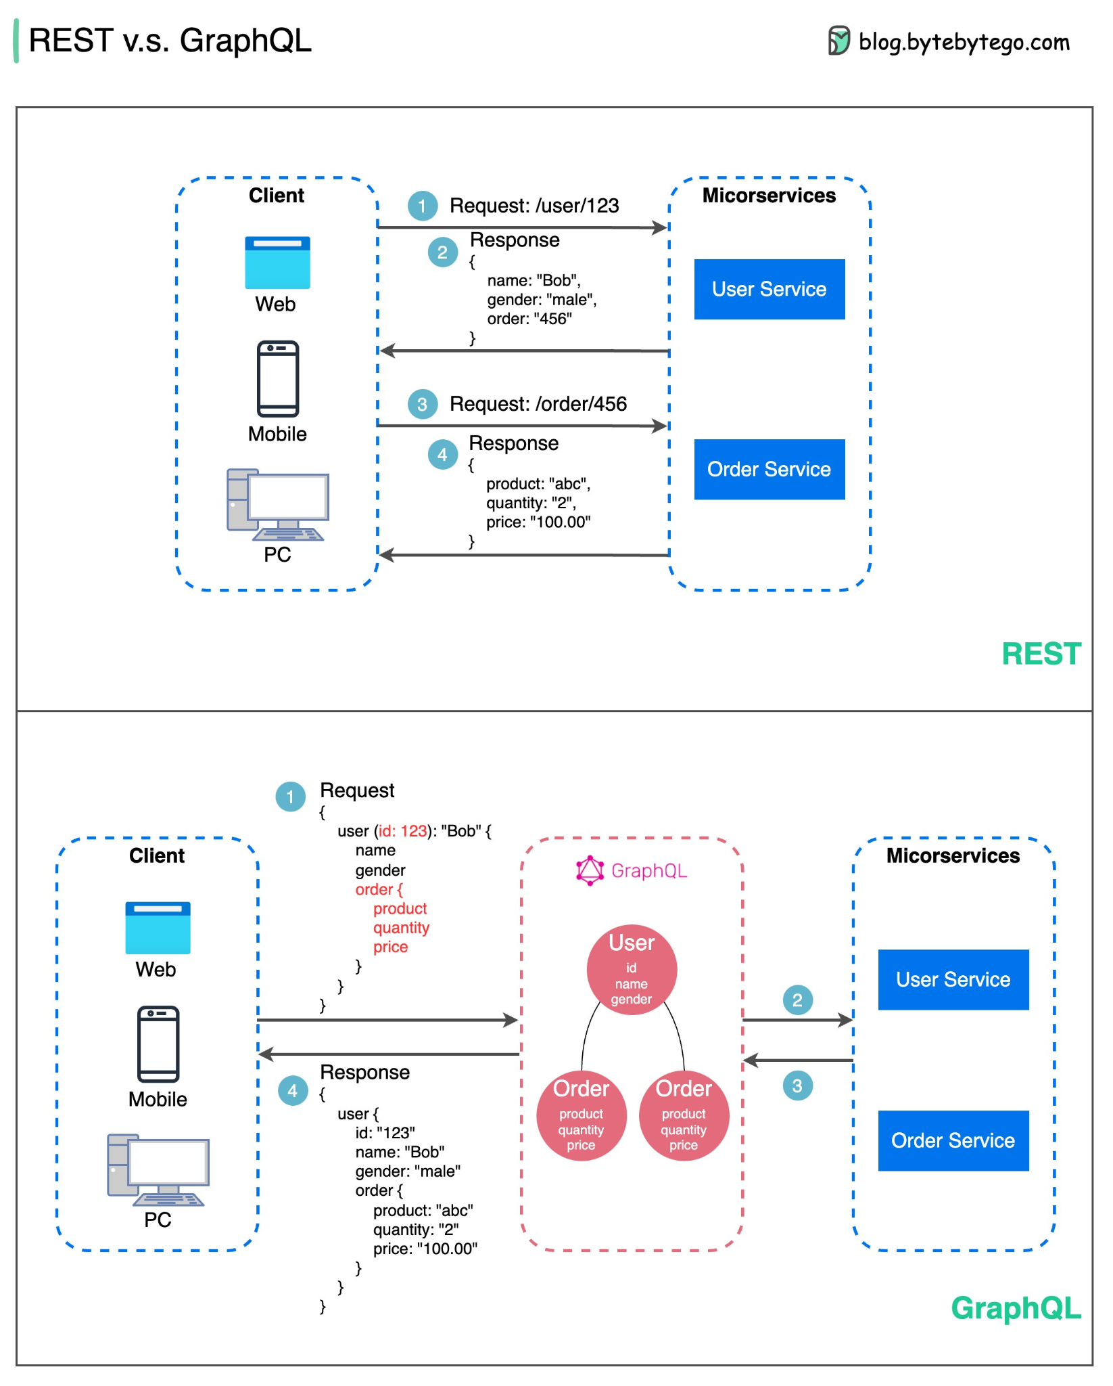
Agenda
What is an API
Difference between other types of software architectures
What components are needed to create an API
The technology stack choices for building an API
Security considerations
Choices for the front-end (mobile/web)
Deployment
Lessons learned about APIs after taking the course
Areas in API building that you would like to research further
Final Remarks

Slide 3
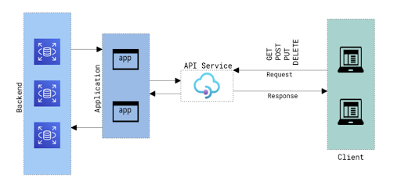
What is an API?
API stands for Application Programming Interface
APIs are mechanisms that enable two software components to communicate with each other using a set of definitions and protocols.
For example, the weather bureau’s software system contains daily weather data. The weather app on your phone “talks” to this system via APIs and shows you daily weather updates on your phone.

Slide 4
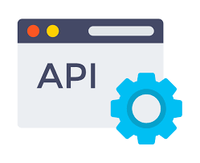
Examples of APIs
Pay with PayPal
Google Maps
Twilio
Slack
Facebook
GitHub

Slide 5
Difference between other Types of Software Architectures
Software architecture is the blueprint of building software. It shows the overall structure of the software, the collection of components in it, and how they interact with one another while hiding the implementation.
Different Software Architecture Patterns :
Layered Pattern
Client-Server Pattern - API
Event-Driven Pattern
Microkernel Pattern
Microservices Pattern

Slide 6
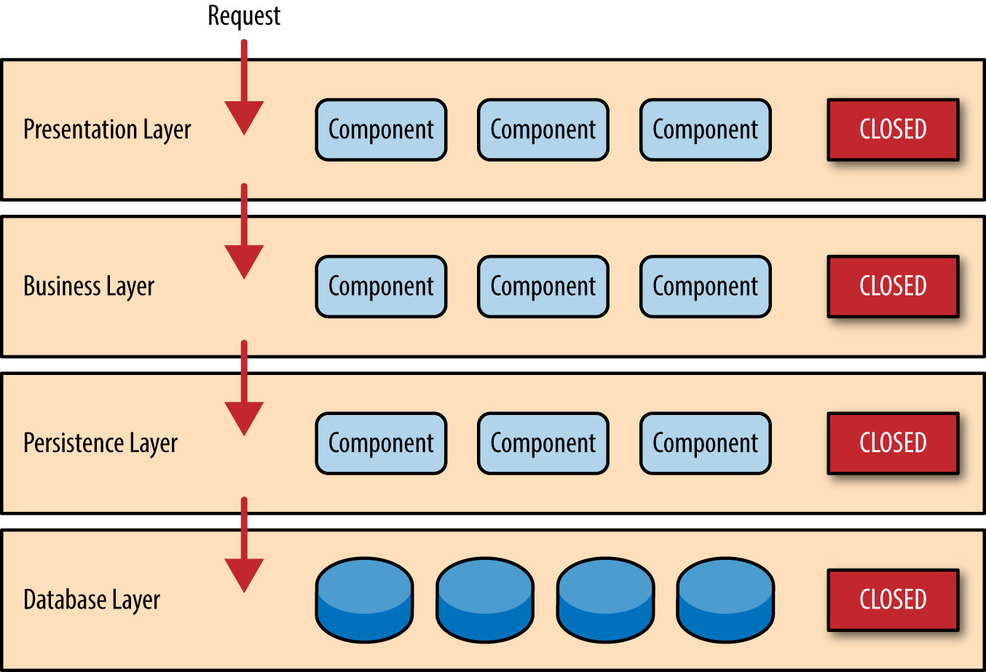
Layered Pattern
Presentation layer (The user interface layer where we see and enter data into an application.)
Business layer (this layer is responsible for executing business logic as per the request.)
Application layer (this layer acts as a medium for communication between the ‘presentation layer’ and ‘data layer’.
Data layer (this layer has a database for managing data.)
Example: E-commerce web applications development like Amazon.

Slide 7
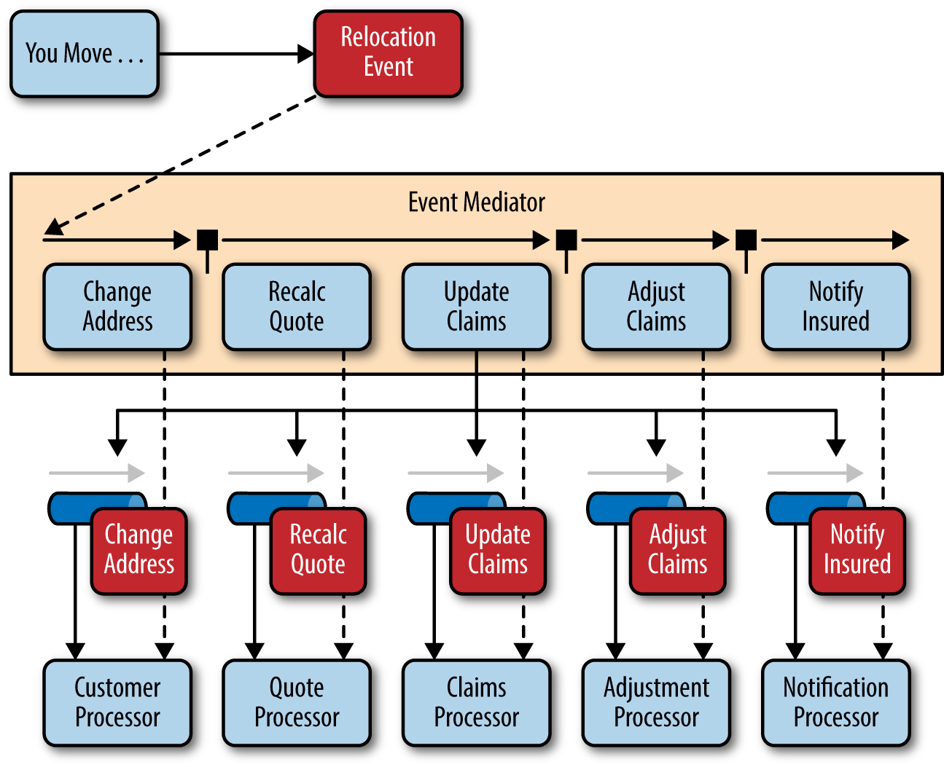
Event-Driven Pattern :
Event-Driven Architecture is an agile approach in which services (operations) of the software are triggered by events.
When a user takes action in the application built using the EDA approach
Example:
A new user fills the signup form and clicks the signup button on Facebook and then a FB account is created for him, which is an event.
JavaScript and e-commerce websites in general.

Slide 8
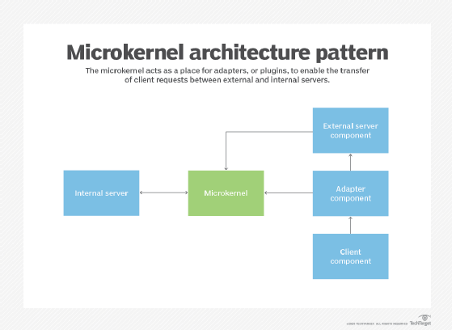
Microkernel Pattern:
The core system handles the fundamental and minimal operations of the application.
The plug-in modules handle the extended functionalities (like extra features) and customized processing.
Example:
Product-based applications and scheduling applications.

Slide 9
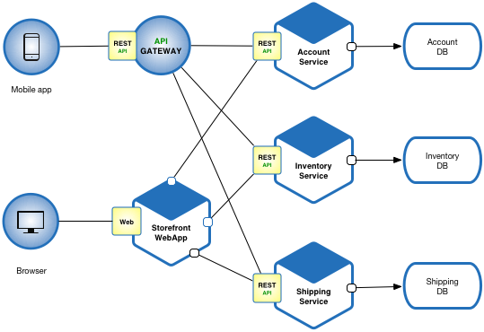
Microservices Pattern:
The collection of small services that are combined to form the actual application is the concept of microservices pattern.
Instead of building a bigger application, small programs are built for every service (function) of an application independently. And those small programs are bundled together to be a full-fledged application.
Example:
Netflix
This pattern is most suitable for websites and web apps having small components.

Slide 10

Client-Server Pattern :
The client-server pattern has two major entities. They are a server and multiple clients.
Here the server has resources(data, files or services) and a client requests the server for a particular resource. Then the server processes the request and responds back accordingly.
Examples:
Email.
WWW.
File sharing apps.
API’s

Slide 11
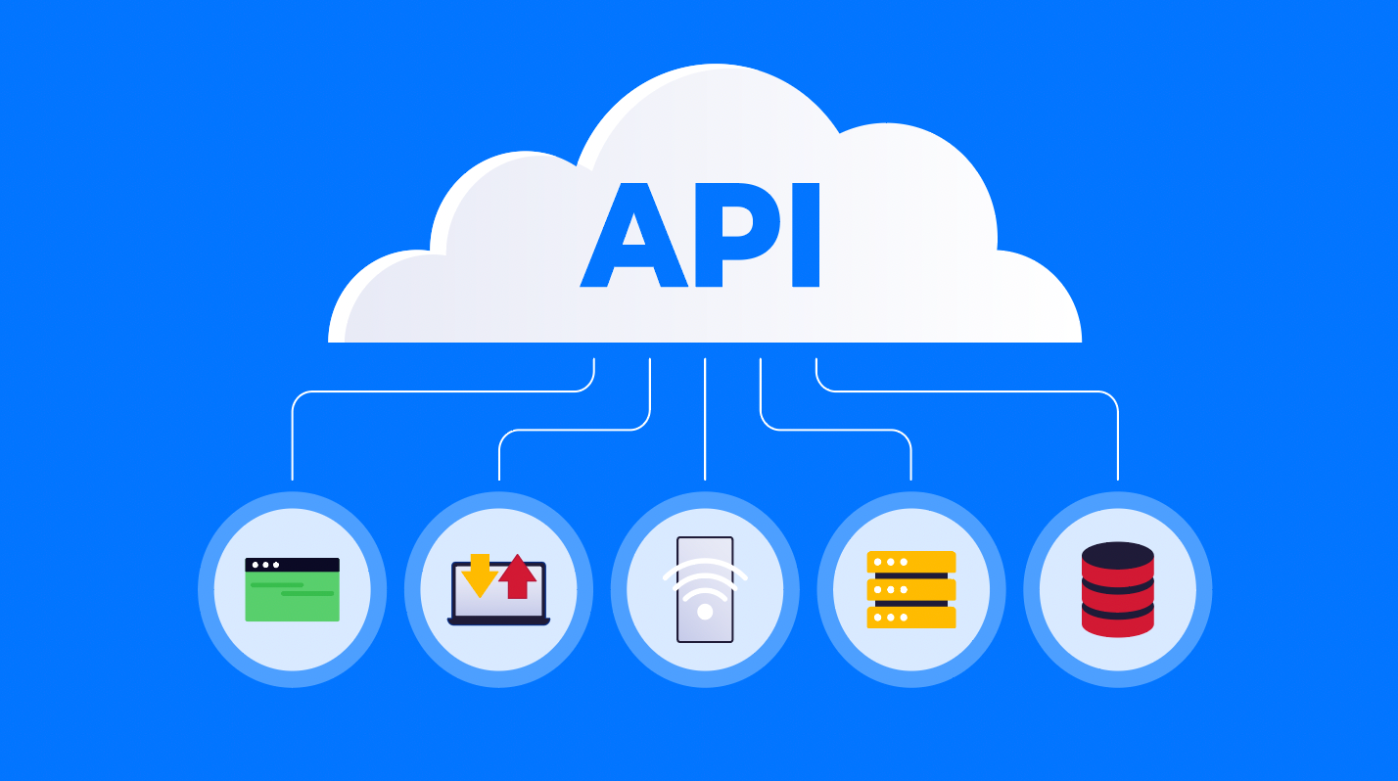
What components are needed to create an API
Server Hosting
Database Storage
Data Protection
Programming Language to develop the API

Slide 12
The Technology Stack Choices for Building an API
Choice 1
Programming Language - Golang
Frameworks - Scratch / Gin
Web Servers - Nginx
Databases - Postgresql
Choice 2
Programming Language - Javascript/Node Js
Frameworks - Express js
Web Servers - Nginx/Azure
Databases - Postgresql

Slide 13
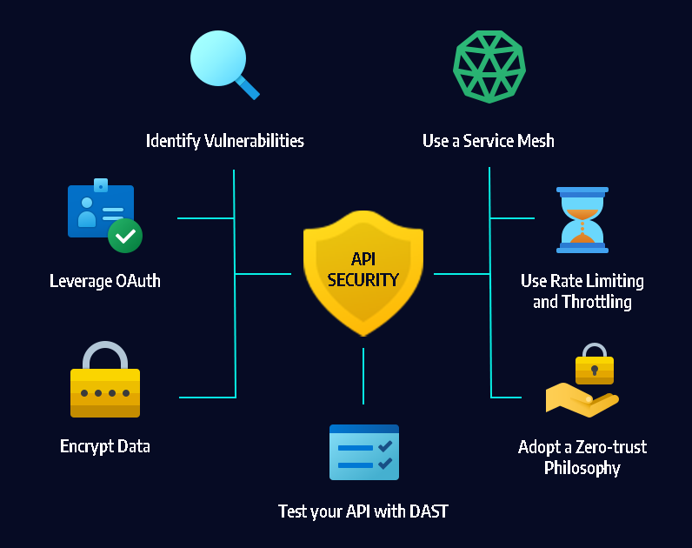
Security Considerations
Common API Attack Techniques
Man in the Middle Attack
API Injection Attacks
Account Takeover Fraud
Distributed Denial of Service (DDoS) Attack
Data Scraping

Slide 14
Security Implementation
Access Control
Confidentiality and Integrity of Data
Regularly Assess Vulnerabilities
Use Encryption
Validate Input Parameters
Monitor and Log Relevant Data
Implement API Throttling and Rate Limiting
Implement Access Control Measures
Basic authentication
API key-based authentication

Slide 15

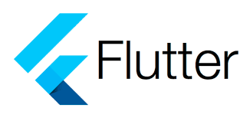
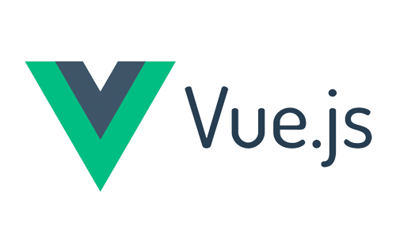
Choices for the Front-end (mobile/web)
Reactjs
Vuejs
React Native
Flutter

Slide 16
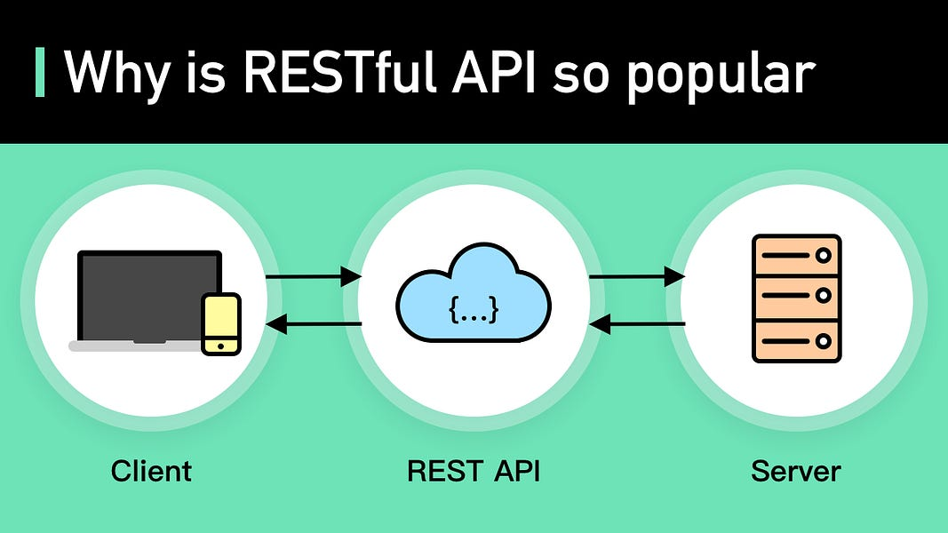
Deployment
Docker
Amazon API Gateway
Azure
Heroku
Digital Ocean

Slide 17
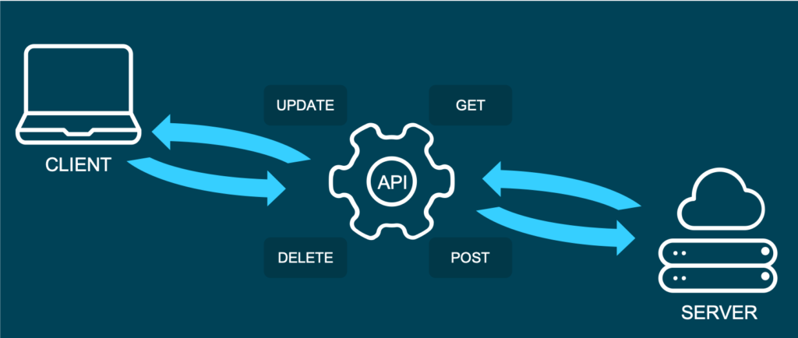
Lessons Learned about APIs after taking the Course
Proper API Development
Further Understanding on API Architecture
Golang
Learn how to Utilize the JSON format in web APIs
Learn how to Perform SQL migrations

Slide 18
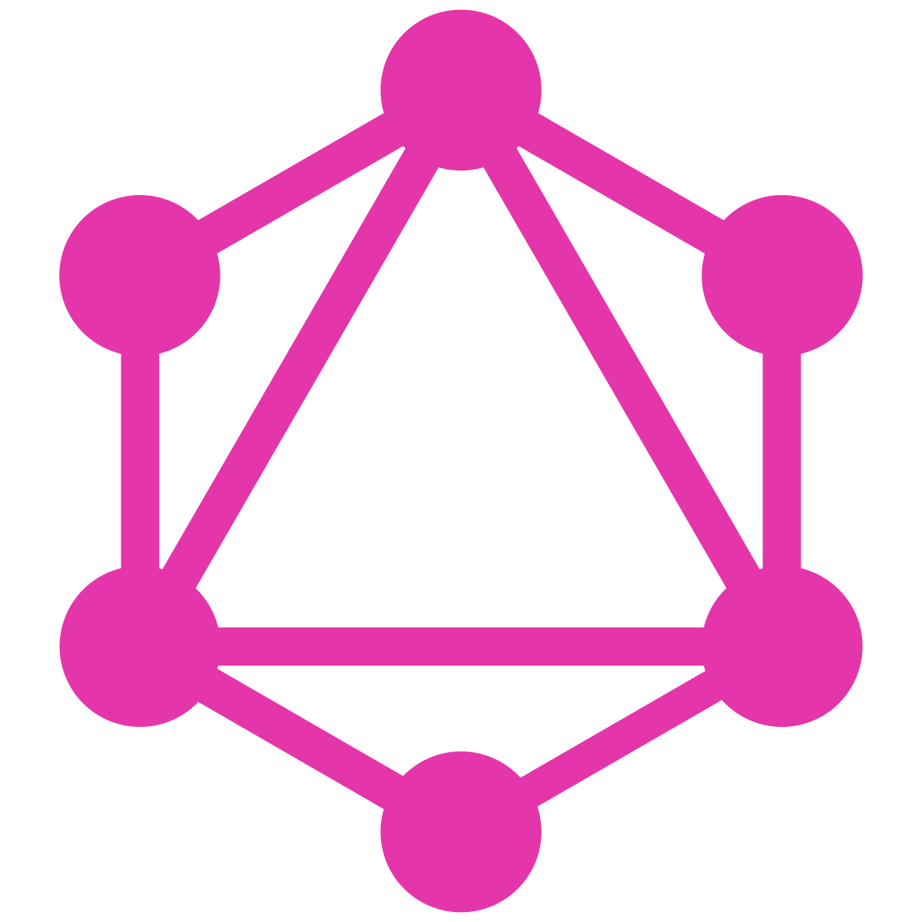
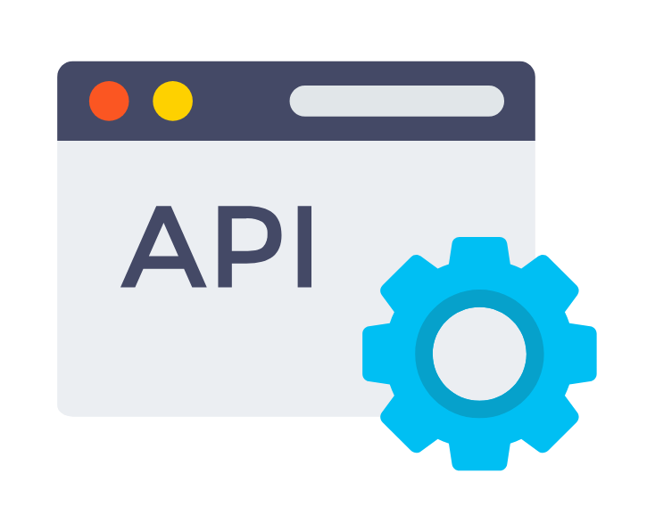
Areas in API building that you would like to Research Further
Golang API Development
Implementation of API key secret
API Integration
Graphql

Slide 19
THANKS!
CMPS4191 - Advanced Web Development

Slide 20
References
Amazon. (2022). What is ... Amazon. Retrieved December 4, 2022, from https://aws.amazon.com/what-is/api/#seo-faq-pairs#what-are-the-different-types-of-apis
Dorairajan, A. (2022, October 25). What is an API?: (API) application program interface definition. Axway Blog. Retrieved December 4, 2022, from https://blog.axway.com/learning-center/apis/basics/what-is-an-api
What is an API? Red Hat - We make open source technologies for the enterprise. (n.d.). Retrieved December 4, 2022, from https://www.redhat.com/en/topics/api/what-are-application-programming-interfaces
Hoffman, C., & Duino, J. (2021, August 13). What is an API, and how do developers use them? How. Retrieved December 4, 2022, from https://www.howtogeek.com/343877/what-is-an-api/
Jena, S. (2021, October 27). Types of software architecture patterns. GeeksforGeeks. Retrieved December 4, 2022, from https://www.geeksforgeeks.org/types-of-software-architecture-patterns/

