Slide 1
CommonEvidenceModel (CEM) Code Overview

Slide 2
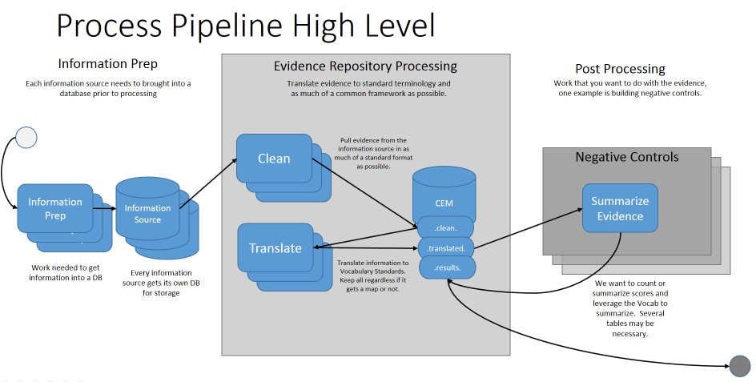
Processing High Level

Slide 3
Information Prep
Portion Lee manages to load “raw” data into “staging” with Pentaho Data Integration:
AEOLUS
EU_PL_ADR
MEDLINE
SemMedDB
UMLS
Vocabulary
https://github.com/OHDSI/CommonEvidenceModel/tree/master/informationPrep

Slide 4
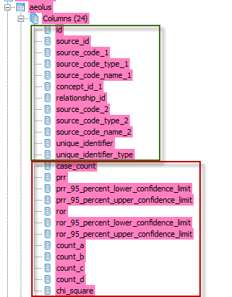
Clean
Pull information as is from raw data into much of a standardized table as possible
Standardized columns all clean tables have
AEOLUS specific columns

Slide 5
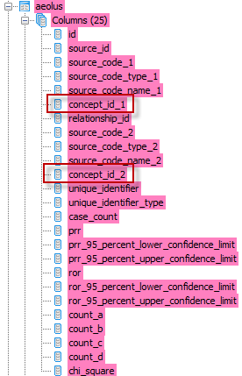
Translate
Take “Clean” data and translate source codes to standardized terminology
All translations happen off the SOURCE_TO_CONCEPT_MAP:
TRIFIRO_CONDITIONS
MEDDRA_TO_STANDARD
EUPLADR_TO_STANDARD
MESH_TO_STANDARD
SPL_TO_STANDARD_DRUG
STANDARD_TO_MEDDRA
CUI_TO_STANDARD

Slide 6
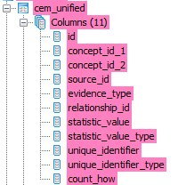
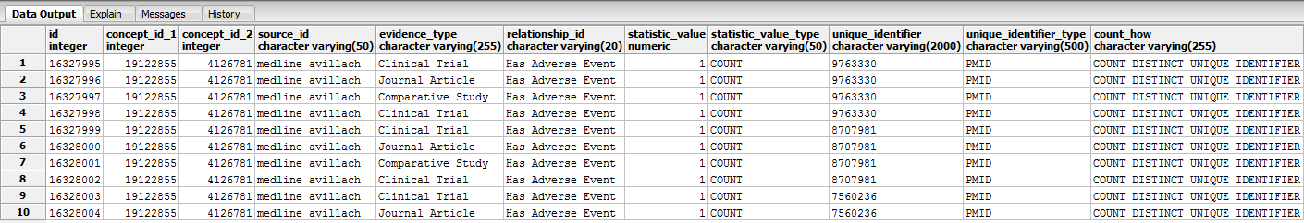
Evidence
CEM_UNIFIED
Negative Controls

Slide 7
Negative Controls
Prep
Find Universe by Utilizing Data (all pairs)
Define Broad Concepts
Drug Related Concepts
Pregnancy Concepts
User Input:
Concepts you want negative controls for
Concepts you already know you want to exclude (optional)
Concepts you already know you want to include (optional)
Processing
Based on concepts of interest, find universe
Pull evidence from sources based on universe
Summarize evidence into wide table
Optimize concepts left when all columns of evidence are 0
Export

Slide 8
Negative Controls Export
NEGATIVE_CONTROL
OUTCOME_OF_INTEREST_CONCEPT_ID
OUTCOME_OF_INTEREST_CONCEPT_NAME
PERSON_COUNT_RC
PERSON_COUNT_DC
DESCENDANT_PMID_COUNT
EXACT_PMID_COUNT
PARENT_PMID_COUNT
ANCESTOR_PMID_COUNT
INDICATION
TOO_BROAD
DRUG_INDUCED
PREGNANCY
DESCENDANT_SPLICER
EXACT_SPLICER
PARENT_SPLICER
ANCESTOR_SPLICER
DESCENDANT_FAERS
EXACT_FAERS
PARENT_FAERS
ANCESTOR_FAERS
USER_EXCLUDED
USER_INCLUDED
OPTIMIZED_OUT
NOT_PREVELANT

Slide 9
Next Steps
Issue 30 – Bug – Review Drug Fingolimod
Issue 33 – Fix Raw Data Counts
Issue 32 – EVIDENCE.EVIDENCE_UNIFIED
Issue 44 - postProcessingNegativeControlsExport
Issue 35 – Make code Release
Issue 26 – Re-envision Universe (concept exists across data sources)
Issue 16 – Redevelop Negative Controls Model
Issue 7 – Slow CoOccurrence Query
Issue 3 – MedDRA → Standard Condition Map
Web API Changes
Issue 29 – Mixed Domain Return
Issue 13 – WebAPI Support
Issue 56 & Issue 51 – getting in sync with R

