Slide 1
Common Evidence Model (CEM)
Core Development Team:
Erica A. Voss, Lee Evans, Anthony Sena, & Rich Boyce
Support:
Martijn Schuemie, Peter Rijnbeek, & Patrick Ryan

Slide 2
Topics
What is the Common Evidence Model?
Initial Use Case: Finding Negative Controls

Slide 3
What is the Common Evidence Model?

Slide 4
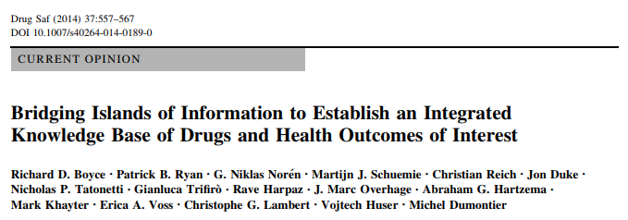

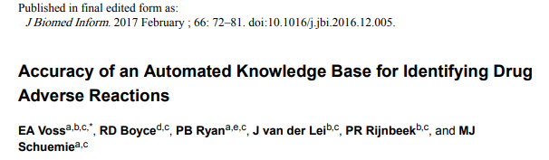
History

Slide 5
CommonEvidenceModel (CEM)
Database bridging islands of information together with goal of supporting research of existing evidence about drugs and outcomes of interest.
CEM replaces LAERTES
CEM pulls together and standardizes the following types of data:
Spontaneous Reports
Product Labels
Publications

Slide 6
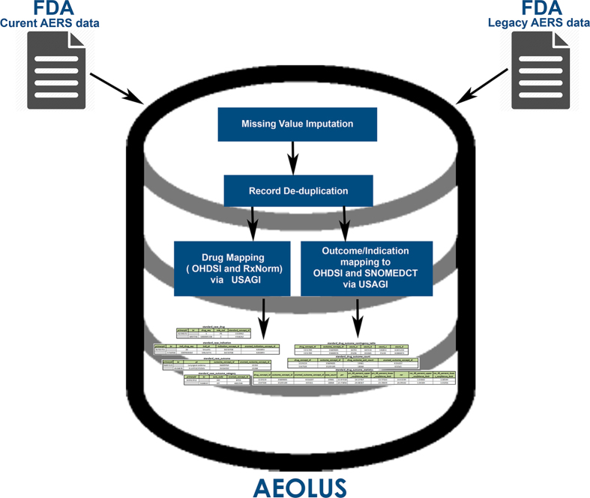
Spontaneous Reports
U.S. FDA's Adverse Event Reporting System (FAERS)
“Curated and standardized version of FAERS removing duplicate case records, applying standardized vocabularies with drug names mapped to RxNorm concepts and outcomes mapped to SNOMED-CT, and pre-computed summary statistics about drug-outcome relationships for general consumption.”
AEOLUS
Banda JM, Evans L, Vanguri RS, Tatonetti NP, Ryan PB, Shah NH. A curated and standardized adverse drug event resource to accelerate drug safety research. Sci Data. 2016 May 10;3:160026. doi: 10.1038/sdata.2016.26. PubMed PMID: 27193236; PubMed Central PMCID: PMC4872271.
6

Slide 7
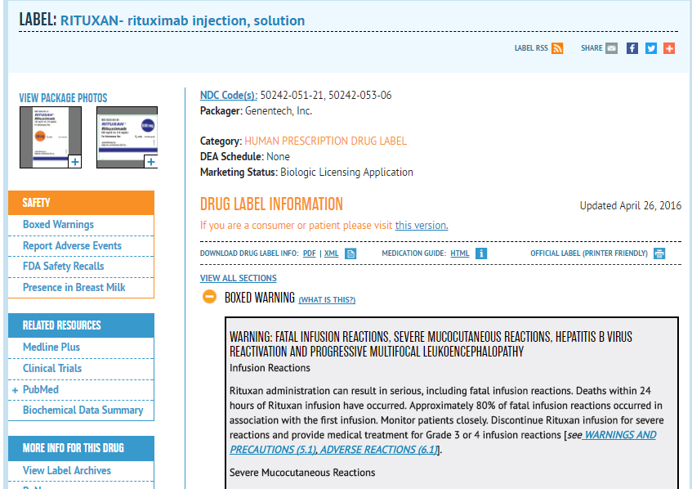
Product Labels
SPLICER, a tool that reads and parses United States Structured Product Labels (SPLs) for drugs and HOIs in the sections “Adverse Drug Reactions” or “Postmarketing”
SPLICER already utilizes the OMOP Vocabulary and maps drugs to RxNorm and HOIs to MedDRA terms.
Duke J, Friedlin J, Li X. Consistency in the safety labeling of bioequivalent medications. Pharmacoepidemiol Drug Saf. 2013 Mar;22(3):294-301. doi: 10.1002/pds.3351. Epub 2012 Oct 8. PubMed PMID: 23042584.
7

Slide 8
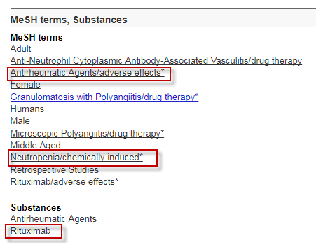
Published Literature
We have several methods that access data from published literature:
Using MeSH tagged publications from Medline looked for adverse drug reactions based on the co-occurrence of a drug and an adverse event on the same citation
Co-occurrence of a drug and condition MeSH tag or found in the Title of Abstract of a publication. Leverages PubMed API
Semantic Medline DB uses natural language processing to extract semantic predictions from titles and text. CEM pulls those in an “adverse event” relationship
Winnenburg R, Sorbello A, Ripple A, Harpaz R, Tonning J, Szarfman A, Francis H, Bodenreider O. Leveraging MEDLINE indexing for pharmacovigilance - Inherent limitations and mitigation strategies. J Biomed Inform. 2015 Oct;57:425-35. doi: 10.1016/j.jbi.2015.08.022. Epub 2015 Sep 2. PubMed PMID: 26342964; PubMed Central PMCID: PMC4775467.
Kilicoglu H, Rosemblat G, Fiszman M, Rindflesch TC. Constructing a semantic predication gold standard from the biomedical literature. BMC Bioinformatics. 2011 Dec 20;12:486. doi: 10.1186/1471-2105-12-486. PubMed PMID: 22185221; PubMed Central PMCID: PMC3281188
8

Slide 9
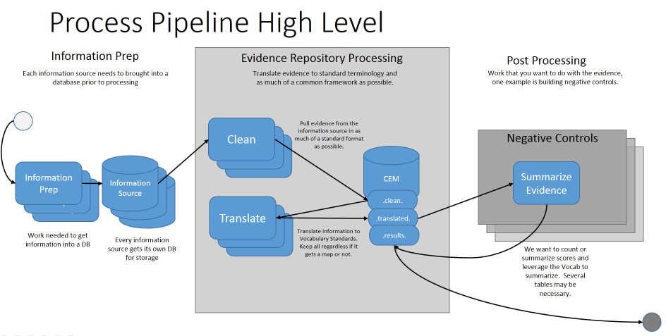
Process Pipeline

Slide 10
Can I Use CEM?
CEM is consumed similarly to the Vocabulary, nothing some to run yourself, just consume:
Export of summary table CEM_UNIFIED
WebAPI Calls
All code is shared: https://github.com/OHDSI/CommonEvidenceModel
Working Group: Pharmacovigilance Evidence Investigation Workgroup http://www.ohdsi.org/web/wiki/doku.php?id=projects:workgroups:kb-wg

Slide 11
CEM_UNIFIED
Column | Description
ID | Unique identifier for each row
CONCEPT_ID_1 | Each row represents a pair of concepts, this is the first of the pair represented by an OMOP Concept ID
SOURCE_CODE_1 | For CONCEPT_ID_1 what was the original code provided by the source
SOURCE_CODE_TYPE_1 | For SOURCE_CODE_1, what was the type of code given by the source (e.g. MeSH)
CONCEPT_ID_2 | Each row represents a pair of concepts, this is the second of the pair represented by an OMOP Concept ID
SOURCE_CODE_2 | For CONCEPT_ID_2 what was the original code provided by the source
SOURCE_CODE_TYPE_2 | For SOURCE_CODE_2, what was the type of code given by the source (e.g. MeSH)
SOURCE_ID | Identifier for the source where this row of evidence came from
EVIDENCE_TYPE | Sometimes the source will provide additional qualifiers of the evidence (e.g. a publication is of type "Clinical Trial" or the stat provided is a PRR score)
RELATIONSHIP_ID | Description of the type of relationship between the two concepts for the row
STATISTIC_VALUE | The evidence provided by the source
STATISTIC_VALUE_TYPE | Describes what the STATISTIC_VALUE is
UNIQUE_IDENTIFIER | Some rows of evidence have a unique identifier (e.g. PMID), that is listed here
UNIQUE_IDENTIFIER_TYPE | Description of what the UNIQUE_IDENTIFIER is
COUNT_HOW | Describes how to use the evidence in aggregate

Slide 12
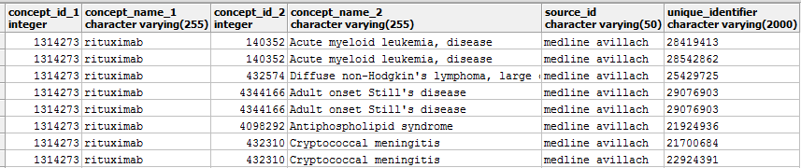
CEM_UNIFIED
Currently the evidence that is populated in the CEM_UNIFIED table includes:
Label data from SPLICER
Information from Medline using Winnenburg approach
Information from Medline using Avillach approach
Adverse event information from SemMedDB
European Product Label adverse event information
Spontaneous Report information from AEOLUS
Co-occurrence of terms found from PubMed
Subset of information found in CEM_UNIFIED

Slide 13
Initial Use Case: Finding Negative Controls

Slide 14
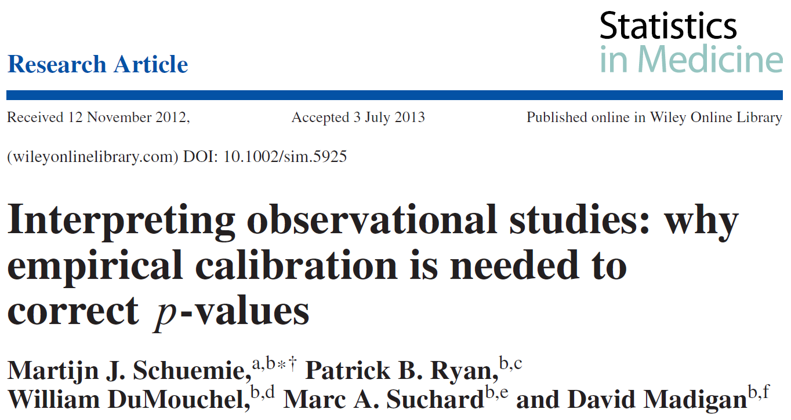
Motivation
Schuemie MJ, Ryan PB, DuMouchel W, Suchard MA, Madigan D. Interpreting observational studies: why empirical calibration is needed to correct p-values. Stat Med. 2014 Jan 30;33(2):209-18. doi: 10.1002/sim.5925. Epub 2013 Jul 30. PubMed PMID: 23900808; PubMed Central PMCID: PMC4285234.

Slide 15
Motivation
“observational studies are more vulnerable than RCTs to systematic error such as bias and confounding.”
“Although we believe that most researchers are aware of the fact that traditional p-value calculations do not adequately take systematic error into account, likely because of a lack of a better alternative, the notion of statistical significance based on the traditional p-value is widespread in the medical literature.”
“Using negative controls to empirically estimate the bias in a study provides a straightforward approach of interpreting the outcome of a study. The observed null distribution incorporates most forms of bias, including residual confounding, misclassification, and selection bias. The error distribution resulting from this bias (which does not depend on sample size) can be added to the random error distribution (which is based on sample size) to produce a single intuitive value: the calibrated p-value.”
“We recommend that observational studies always include negative controls to derive an empirical null distribution and use these to compute calibrated p-values.”
Schuemie MJ, Ryan PB, DuMouchel W, Suchard MA, Madigan D. Interpreting observational studies: why empirical calibration is needed to correct p-values. Stat Med. 2014 Jan 30;33(2):209-18. doi: 10.1002/sim.5925. Epub 2013 Jul 30. PubMed PMID: 23900808; PubMed Central PMCID: PMC4285234.
15

Slide 16
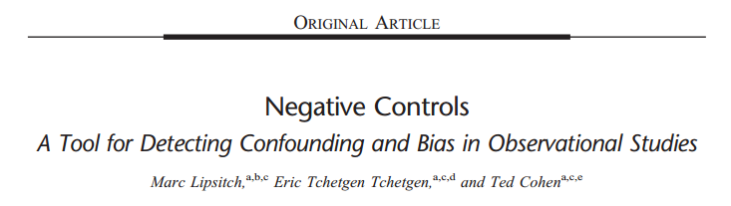
What are Negative Controls?
Biologists employ “negative controls” as a means of ruling out possible noncausal interpretations of their results
Negative controls are either exposures or outcomes that when used to “repeat the experiment under conditions which it is expected to produce a null result and verify that it does indeed produce a null result”
The essential purpose of a negative control is to reproduce a condition that cannot involve the hypothesized causal mechanism but is very likely to involve the same sources of bias that may have been present in the original association
Lipsitch M, Tchetgen Tchetgen E, Cohen T. Negative controls: a tool for detecting confounding and bias in observational studies. Epidemiology. 2010 May; 21(3): 383-8. doi: 10.1097/EDE.0b013e3181d61eeb. Erratum in: Epidemiology. 2010 Jul;21(4):589. PubMed PMID: 20335814; PubMed Central PMCID: PMC3053408.
Notes:
Negative controls should have the same/similar confounding structure but not cause the outcome.

Slide 17
Negative Controls in Calibration
“Our proposed approach instead derives an empirical null distribution from the actual effect estimates for the negative controls. These negative control estimates give us an indication of what can be expected when the null hypothesis is true, and we use them to estimate an empirical null distribution.”
Schuemie, M. J., Ryan, P. B., DuMouchel, W., Suchard, M. A., & Madigan, D. (2014). Interpreting observational studies: why empirical calibration is needed to correct p-values. Statistics in Medicine, 33(2), 209–218. http://doi.org/10.1002/sim.5925

Slide 18
Causal Diagrams
In order to select negative controls, we need to understand the relationship between the exposure and outcome of interest
Causal diagrams visually encode assumptions about causal relations
In today’s diagrams:
E = Exposure
O = Outcome
N = Negative Control
M = Measured/Unmeasured Variable
Smoking
Lung Cancer
Rothman, K. J., et al. (2008). "Modern epidemiology. 3rd." Philadephia: Lippincott Williams & Wilkins.

Slide 19
Good Negative Controls
Proper
Negative Control Outcome
Proper
Negative Control Exposure
Question of Interest
M
E
?
O
M
E
N
M
N
O
We are trying to understand the exposure of a drug on some outcome
When finding negative control outcomes, we want something that:
E does not cause
has the same causal associations to other variables either measured or not
When finding negative control exposures, we want something that:
does not cause O
has the same causal associations to other variables either measured or not
E = Exposure; 0 = Outcome; N = Negative Control, M = Measured/Unmeasured Variable
Notes:
Example:
Negative Control Outcome – Studying the effects of different diabetic medication exposures (e.g. insulin) on the outcome of diabetic ketoacidosis. Here we need negative control outcomes.
Negative Control Exposure –
No, almost always (as in I’ve never seen it otherwise), the question of interest is about ascertaining a causal effect from an exposure on an outcome. You can use negative control outcomes or negative control exposures to evaluate that purposed question of interest, but almost never (as in, I’ve never seen it) is the question of interest the effect of an outcome on an exsposure (and even if it were, you would reframe it as ‘exposure to the disease’ and the ‘outcome of being exposed’).

Slide 20
Good Negative Controls
Proper
Negative Control Exposure
Exposure Does Not Cause the Outcome
M
N
O
Ideally, Similar Confounding Relationships to Measured and Unmeasured Variables
Proper
Negative Control Outcome
M
E
N
Today’s examples will focus on Negative Control Outcomes

Slide 21
What Relationships Make a Bad Negative Control Outcomes?
Exposure Causes/Prevents the Outcome
M
E
N
Exposure Causes/Prevents a variable that causes the Outcome
M
E
N
No Confounding Relationships
M
E
N
M
E
N
M
E
N
M
E
N
M
E
N
M
E
N

Slide 22
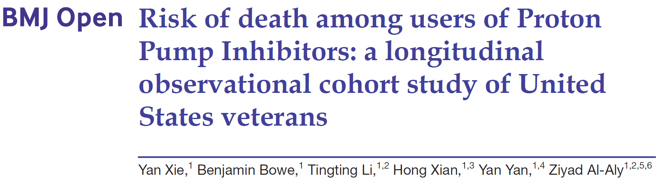
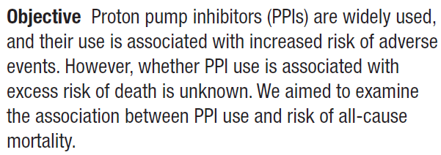
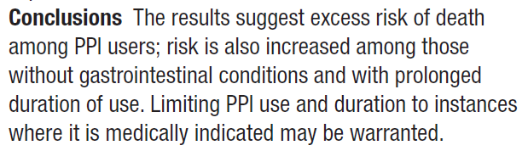
Example Study
Notes:
Published 8/27/2017

Slide 23
Study Set Up
Comparative Cohort Analysis
Inputs | Target Cohort (T) |  | New Users of a Proton Pump Inhibitor (PPI)
 | Comparator Cohort (C) |  | New Users of Histamine H2 Receptor Antagonist (H2 Blockers)
 | Outcome Cohort (O) |  | Death
 | Database |  | Dept. Of Veterans Affairs Database
 | Effect Estimate Parameters | Model Type | Cox
 |  | Time at Risk Start and End | Start: Index (exposure to drug) End: Until End of Observation Periods (Intend to Treat Analysis)
 |  | Washout Period | N/A
 |  | Minimum Days at Risk | N/A
 |  | Remove subjects with prior outcomes? | N/A
 |  | Methods to adjust for bias | 1:1 propensity score matching
While the authors discussed how they tried to control for bias, empirical calibration was not one of the methods
Let us find negative controls for this study . . .
Epi Analytics Menu - https://jnj.sharepoint.com/:w:/t/epi/EbG5P93KvrtCrBB8ry2_fNkBxIeQL82RvkILmhP47EdikQ

Slide 24
How to Find Negative Controls?
Finding negative controls manually:
FDA product labels does not associate the drug and outcome
There are now spontaneous reports signals in the U.S. FDA's Adverse Event Reporting System (FAERS)
Manual review in PubMed that there is no studies showing the drug causes the condition
However OHDSI has developed tools in ATLAS to make this easier . . .

Slide 25
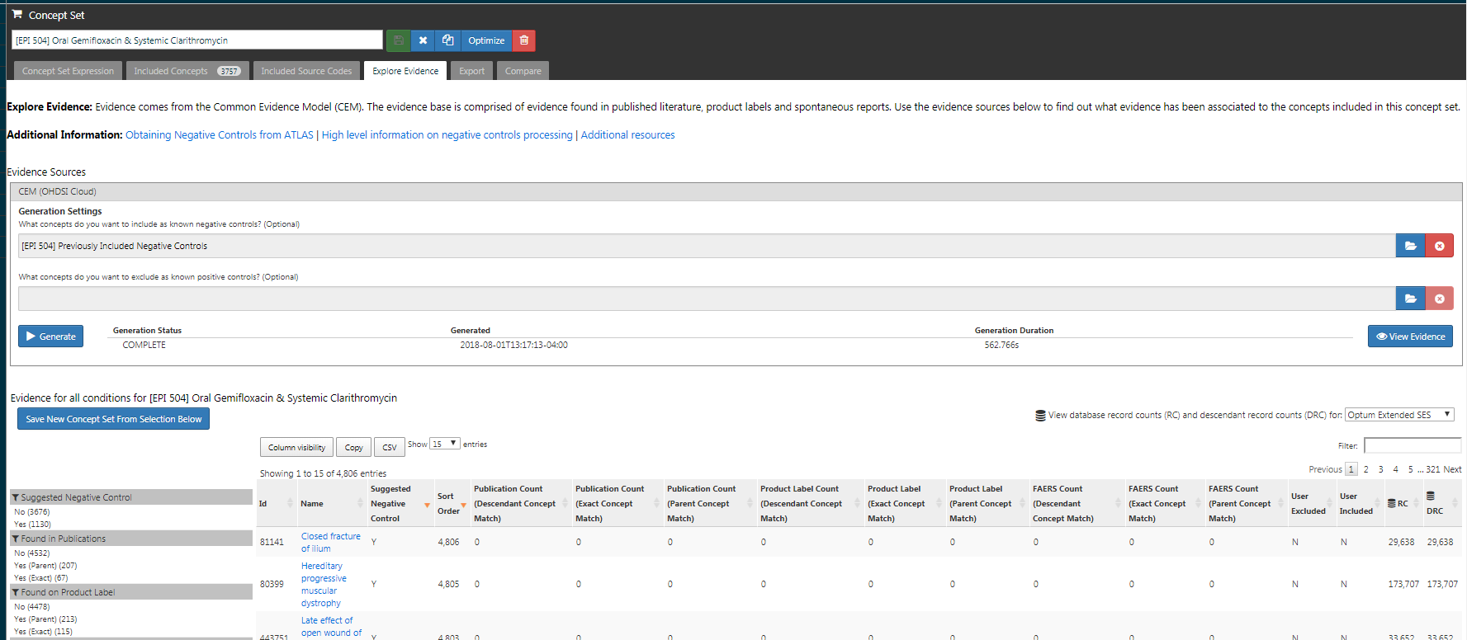
Use ATLAS to Build Negative Control Outcomes
Notes:
Show where you go to generate negative controls in ATLAS
Concept Set
Generate
Link outs
Export
Drug Label Evidence
Show how to export the list for review (making it more concrete where our next examples come from)
Show how to view evidence
Example = Omeprazole

Slide 26
Generating Negative Controls in ATLAS
ATLAS can be used to generate and suggest negative controls for a study.
Suggested negative controls:
have no published literature adverse event association
not existing on the product label
not considered a FAERS signal
have no indication or contraindication listed in the OMOP Vocabulary for the pair
are not considered a broad concepts
are not considered a drug induced concept
not considered a pregnancy related concept
was not suggested to be excluded by the user
was not optimized out, meaning another parent concept existed that was also considered a good negative, so the lower level concept was excluded
All information known about the drug-condition pair is provided so if the user wishes to loosen this criteria they can (i.e. ignore evidence from ancestor restrictions).
https://github.com/OHDSI/CommonEvidenceModel/wiki/Negative-Controls-In-ATLAS

Slide 27
Finding Good Negative Control Outcomes

Slide 28
Good Negative Control Outcome
Exposure Does Not Cause the Outcome
M
E
N
Ideally, Similar Confounding Relationships to Measured and Unmeasured Variables
E = PPI or H2 Blocker
N = Rosacea (CEM Suggested)
Notes:
Where people can get confused: A good negative control, they do not need to be the same magnitude of effect or same variables.
Exchangeability Assumption – if we are still finding things are = 1, then there is still some type of bias that we are not handling for

Slide 29
Good Negative Control Outcome
Exposure Does Not Cause the Outcome
E = PPI or H2 Blocker
N = Rosacea (CEM Suggested)
M
E
N
Do PPIs/H2 Blockers cause Rosacea?
What evidence do we find?
Spontaneous reports there is no disproportionality analysis signal (PRR <2) (Evans et al.)
Not existing on the US product label in the “Adverse Drug Reactions” or “Postmarketing” section
Found no publications suggested drug-outcome pair were in adverse event relationship (Winnenburg et al.)
There are some mention of rash and skin inflammation if you review the label however no mention of acne
Winnenburg R, Sorbello A, Ripple A, Harpaz R, Tonning J, Szarfman A, Francis H, Bodenreider O. Leveraging MEDLINE indexing for pharmacovigilance - Inherent limitations and mitigation strategies. J Biomed Inform. 2015 Oct;57:425-35. doi: 10.1016/j.jbi.2015.08.022. Epub 2015 Sep 2. PubMed PMID: 26342964; PubMed Central PMCID: PMC4775467.
Evans, S.J., P.C. Waller, and S. Davis, Use of proportional reporting ratios (PRRs) for signal generation from spontaneous adverse drug reaction reports. Pharmacoepidemiol Drug Saf, 2001. 10(6): p. 483-6.

Slide 30

Good Negative Control Outcome
Exposure Does Not Cause the Outcome
E = PPI or H2 Blocker
N = Rosacea (CEM Suggested)
M
E
N
CEM is helpful in finding these relationships!

Slide 31
Good Negative Control Outcome
Ideally, Similar Confounding Relationships to Measured and Unmeasured Variables
E = PPI or H2 Blocker
N = Rosacea (CEM Suggested)
M
E
N
Influences that both affect getting rosacea and death?
Age
Rosacea is most common in years 30 to 50
Risk of death increases with age
Gender
Menopause can cause Rosacea
Women on average live longer
Smoking Status
Smokers have an increased risk of developing rosacea
Smoking influences death
Notes:
By using rosacea as negative control we should get a result of 1 (true effect), we know rosacea has at least 3 confounders, these are also confounders for death – if we get the wrong answer for rosacea then we are susceptible to getting the wrong answer for death.
you want your negative control to have some confounding, meaning there are some covariates that impact exposure and outcome. If there is no confounding, then the negative control will be ‘an easy test’ for the method to produce an unbiased estimate. It is not necessary to ascertain or quantify all confounder variables, nor is it necessary that the confounders be the same as expected for the question of interest.

Slide 32

Good Negative Control Outcome
Ideally, Similar Confounding Relationships to Measured and Unmeasured Variables
E = PPI or H2 Blocker
N = Rosacea (CEM Suggested)
M
E
N
CEM cannot determine which concepts have similar confounding relationships.

Slide 33
Finding Bad Negative Control Outcomes

Slide 34


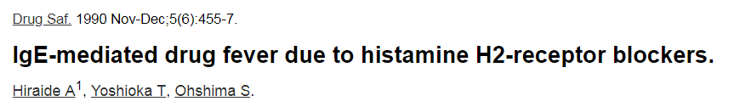
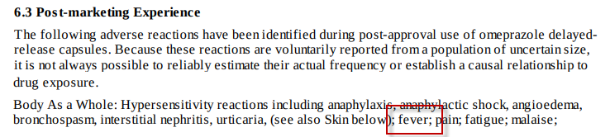
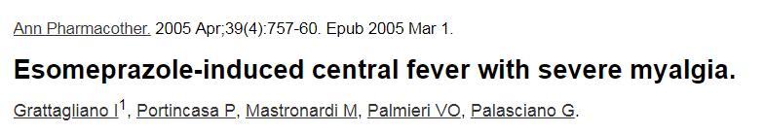
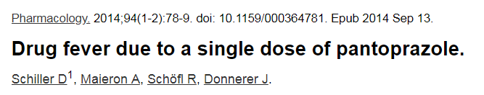
Bad: Exposure Causes Outcome
M
E
N
E = PPI or H2 Blocker
N = Fever
Dose exposure to PPI or H2 Blockers cause fever?

Slide 35
Bad: Exposure Causes Outcome
M
E
N
E = PPI or H2 Blocker
N = Fever
CEM is helpful in finding these relationships!

Slide 36

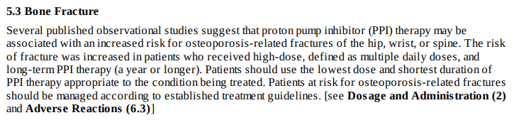
Bad: Exposure Causes a Variable that Cause Outcome
E = PPI or H2 Blocker
N = Falls (CEM Suggested)
M
E
N
Does exposure to PPIs/H2 Blockers cause an outcome that can lead to falls?
PPIs can cause fractures, which may lead to falls

Slide 37
Bad: Exposure Causes a Variable that Cause Outcome
E = PPI or H2 Blocker
N = Falls (CEM Suggested)
M
E
N
CEM cannot determine which concepts that lead to other concepts.

Slide 38

Bad: No Confounding Relationships
E = PPI or H2 Blocker
N = Effects of lightning (CEM Suggested)
M
E
N
Does the outcome effects of lightning have similar confounding relationships to other measured variables
Hard to imagine the confounding relationships

Slide 39
Bad: No Confounding Relationships
E = PPI or H2 Blocker
N = Effects of lightning (CEM Suggested)
M
E
N
CEM cannot determine which concepts lack similar confounding relationships.

Slide 40
Bad: Outcome not Prevalent
E = PPI or H2 Blocker
N = Absent nipple (CEM Suggested)
If an outcome is not prevalent does it make a good negative control?
CCAE only has 104 people with an absent nipple
Concepts that are so rare, you are unlikely to produce an effect estimate with enough precision to be informative

Slide 41

Bad: Outcome not Prevalent
E = PPI or H2 Blocker
N = Absent nipple (CEM Suggested)
CEM ATLAS tool orders results from most common to least common.

Slide 42
Reviewing Negative Controls in CEM
Exposure causes outcome
Drug indications
Orders concepts in prevalence order
Concepts have similar confounding?
Outcome causes another outcome or exposure
CEM is a huge improvement over manually finding negative controls, but still requires thoughtful review!
Notes:
Indication vocabularies were developed for a different use case than our analytical purposes, and as such, tend to either have terms that are too specific and don’t map to the place in SNOMED where we’d want, or too broad, meaning they are too high-level. It isn’t that the current vocabulary mappings are completely useless, it’s just that they aren’t reliable enough for our use cases to be applied broadly without adjudication.

Slide 43
CEM Next Steps
CEM is under development to help improve its use:
Working on a publication to describe what is a good negative control and comparing different negative control selection methods
Martijn, Rave Harpaz (Oracle), and I are working on another method for parsing of US Product Labels
Martijn, Anthony Sena, and I are working on an app for non-OHDSI members to go from source codes to source codes

