Slide 1
CommonEvidenceModel (CEM)

Slide 2
What are we trying to do?
Develop method that allows us to update and ingest new data sources to apply Voss et al. method of count/summarizing drug/condition evidence.
Part of the method is to develop an approach for automatically learning/building model and reporting out betas/predictors necessary to learn negative controls.

Slide 3
Process Pipeline High Level
Information Prep
Evidence Repository Processing
Post Processing
Each information source needs to brought into a database prior to processing
Translate evidence to standard terminology and as much of a common framework as possible.
Work that you want to do with the evidence, one example is building negative controls.
Clean
Pull evidence from the information source in as much of a standard format as possible.
Translate
Negative Controls
Translate
CEM
Information Prep
Information Source
Summarize Evidence
Evidence Prep
Evidence Source
Evidence Prep
Evidence Source
Translate
.clean.
Translate
.translated.
Translate
Work needed to get information into a DB
Translate information to Vocabulary Standards. Keep all regardless if it gets a map or not.
.evidence.
Every information source gets its own DB for storage
We want to count or summarize scores and leverage the Vocab to summarize. Several tables may be necessary.

Slide 4
Process Pipeline High Level
Information Prep
Post Processing
Evidence Repository Processing
MedlineXmlToDatabase
MEDLINE
.evidence.
Clean
Pull data into standardized format
Translated
Add mapping to standard terminologies
SemMedDB
SemMedDB
medlineAvillach()
medline
Vocabulary Processing
medline
medlinePubMed()
Medline_ pubtype
Medline_ pubtype
AEOLUS
AEOLUS
medlineTBD()
semMedDB()
semMedDB
semMedDB
SPLICER
US Product Labels
aeolus()
aeolus
aeolus
Negative Controls
EU Product Labels
EU Product Labels
Unifying Evidence
splicer()
splicer
splicer
VOCAB
UMLS
euPL()
euPL
euPL
.staging.
source
.clean.
.translated.

Slide 5
One Method: MedLine Avillach
Method for extracting MEDLINE Adverse Event information
Co-occurrence of a drug and condition MeSH tag on a publication with the qualifiers "adverse effects" and "chemically induced" respectively
Based on publication: Avillach P, Dufour JC, Diallo G, Salvo F, Joubert M, Thiessard F, Mougin F, Trifir? G, Fourrier-R?glat A, Pariente A, Fieschi M. Design and validation of an automated method to detect known adverse drug reactions in MEDLINE: a contribution from the EU-ADR project. J Am Med Inform Assoc. 2013 May 1;20(3):446-52. doi: 10.1136/amiajnl-2012-001083. Epub 2012 Nov 29. PubMed PMID: 23195749; PubMed Central PMCID: PMC3628051.

Slide 6
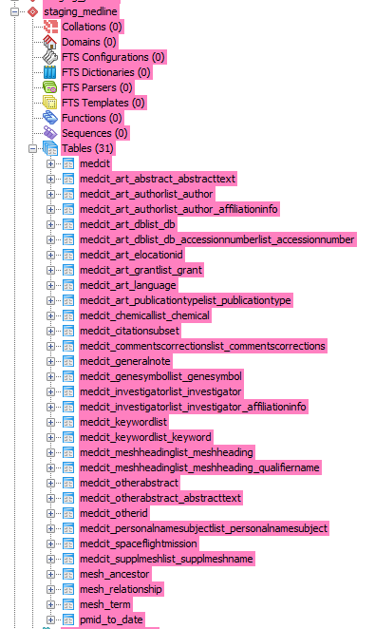
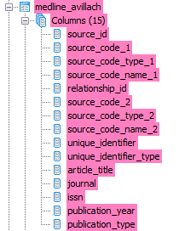
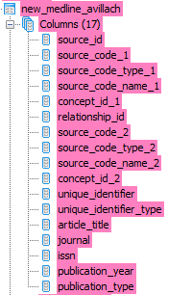
Example of Pipeline for MEDLINE_AVILLACH
Data Prep
Evidence Processing
Post Processing
Each evidence source will contribute 1 table to the translate and evidence database. Some may have more if information cannot be summarized to 1 table.
Avillach Clean
Avillach Translated
Each data source gets its own database.
The negative controls processing may just be one of many that are done after evidence is stored.
Information Prep
Negative Controls Process
.results.

