Slide 1
CommonEvidenceModel (CEM) Code Overview

Slide 2
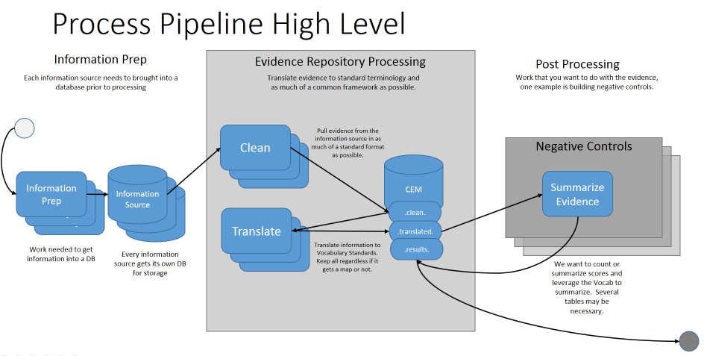
Processing High Level

Slide 3
Information Prep
Portion Lee manages to load “raw” data into “staging” with Pentaho Data Integration:
AEOLUS
EU_PL_ADR
MEDLINE
SemMedDB
UMLS
Vocabulary
https://github.com/OHDSI/CommonEvidenceModel/tree/master/informationPrep

Slide 4
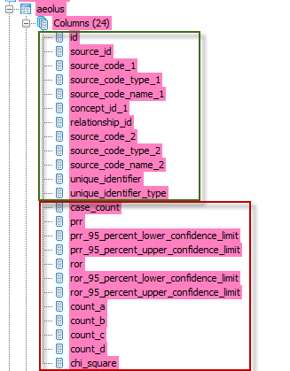
Clean
Pull information as is from raw data into much of a standardized table as possible
Standardized columns all clean tables have
AEOLUS specific columns

