Slide 1
FlipCard Project
A Simple Web-Based Flashcard Game
Presented by: Jamir Obando, Jaheim Lozano

Slide 2

Project Overview
FlipCard is a browser-based card matching memory game.
The objective: match pairs of cards by remembering their positions.
It’s designed using HTML, CSS, and JavaScript.
All code is hosted at: github.com/2019120162/FlipCard

Slide 3

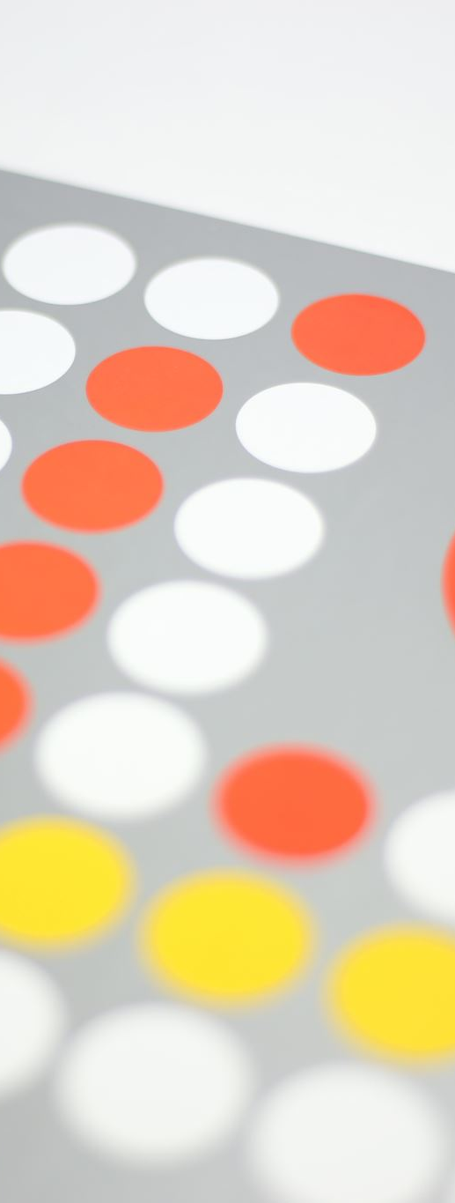
Features
Card flip animation with smooth transitions.
Timer to track how long the game takes.
Shuffle feature to randomize cards on reload.
Game win detection and reset mechanism.

Slide 4
Technologies Used
HTML5: Structure of the game layout.
CSS: Styling and flip animations.
JavaScript (Vanilla): Core game logic.
No frameworks or external libraries used.

Slide 5
Code Structure
index.html – Main page containing the card layout.
style.css – Styles for layout, cards, and animations.
script.js – Contains logic for flipping, matching, shuffling, timer.

Slide 6
Main Functionalities
Card Flipping: Adds 'flip' class on click.
Match Check: Compares 'data-framework' attributes.
Locking Mechanism: Prevents clicks during animations.
Game Completion: Alert on matching all pairs.
Timer: Starts on first card flip.

Slide 7
User Interface
Clean 4x4 grid layout of cards.
Hover and flip animations give feedback.
Matching pairs stay flipped.
Reset on page reload or match completion.

Slide 8
Challenges Faced
Timing bugs between clicks and animations.
Handling rapid clicks (solved with lockBoard flag).
Ensuring random card distribution after reload.

Slide 9
Conclusion
FlipCard is a fun and interactive game demonstrating core JavaScript DOM manipulation.
Great example of applying logic, UI design, and interactivity.
Can be extended with difficulty levels, scoreboards, or sound effects.

