Slide 1
TCP vs UDP Chat App in Go
Name: Gavin D. Juarez, Jamir Obando
Class: System Programming
Date: May 10th 2025

Slide 2

Goals and Purpose
Goal: Implement a chat app using TCP and UDP protocols in Go to explore
the differences in functionality, performance, and use cases.
Purpose:
Understand how TCP and UDP handle chat messaging.
Compare latency, throughput, and packet loss between both protocols.
Evaluate concurrency handling with Go’s goroutines.

Slide 3

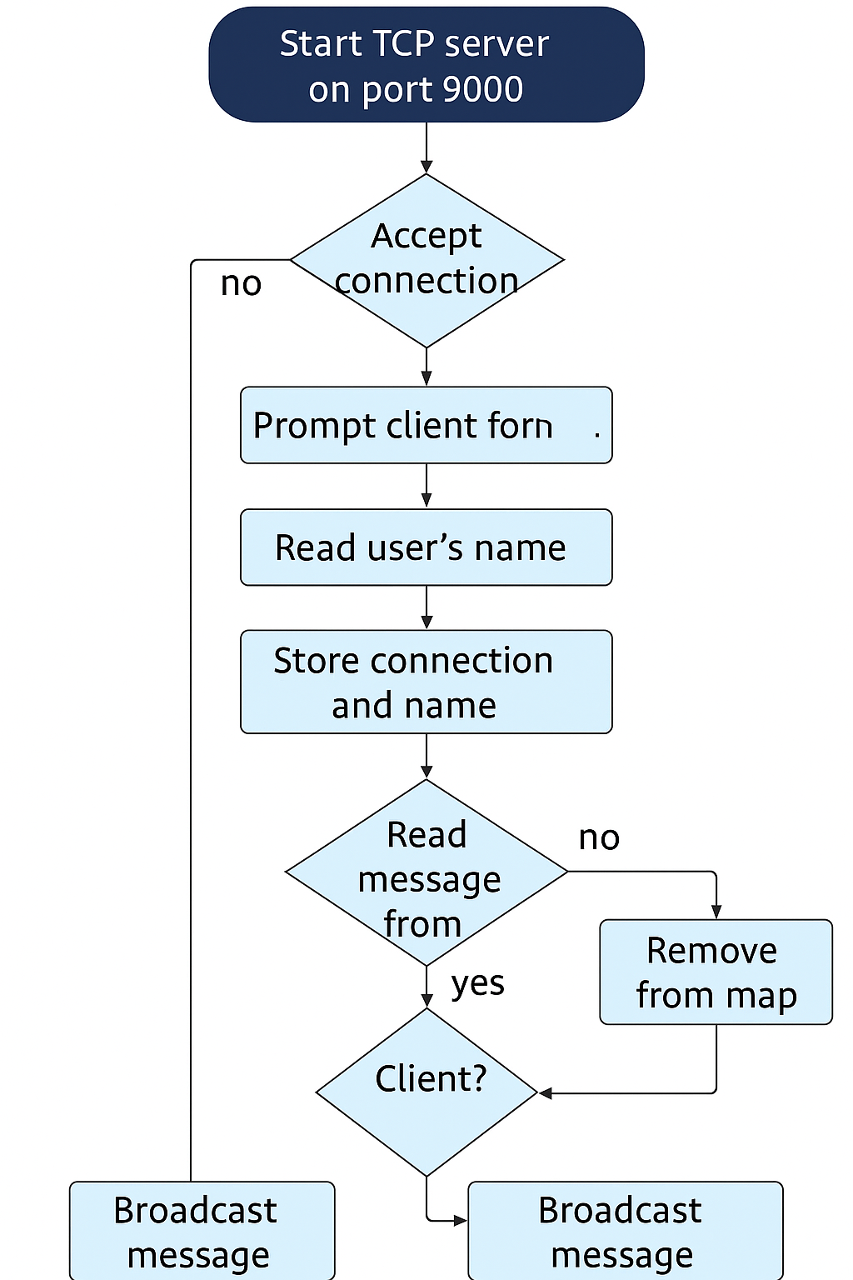
Architecture and Protocol Design
Protocol Design:
TCP: Connection-based, reliable, guarantees message order.
UDP: Connectionless, fast but no guarantee of order or reliability.

Slide 4
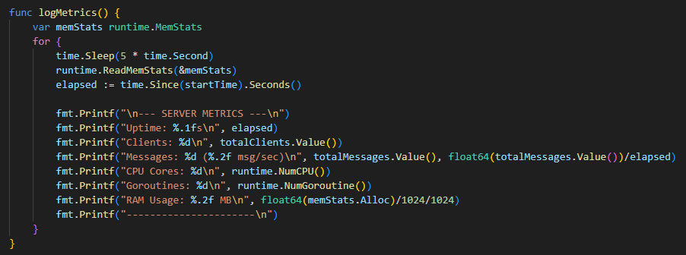
Code Highlight
Code snippets:
This is a critical section where all the servers usage and data is logged and shown for this project.
For example for TCP/UDP client and server:
We log the information such as Uptime, Num. of clients, messages being sent per sec. cpu cores in the server, Goroutines, and mainly RAM usage.

Slide 5
DESIGN CHOICE
Design Choices:
Chose UDP for its lower latency vs. TCP for reliable message delivery.
Handled concurrency using goroutines to ensure responsive behavior even with multiple clients.

Slide 6
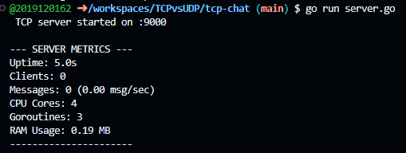
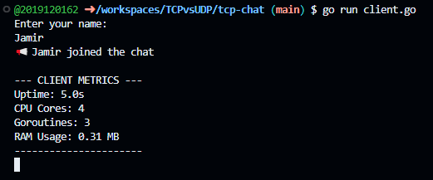

How it works and what is seen
For TCP Server the logs show on startup the Ram usage is already decently high
For the TCP client connection it shows it uses also a considerable amount of RAM as well.

Slide 7
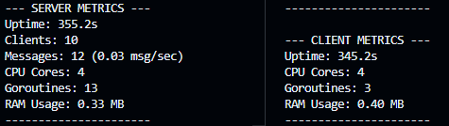
How it works and what is seen Cont.
After making 10 users connect and send constant messages we can see here that the RAM and GoRoutines go up considerably.
So with that being said in a real world scenario with thousands of users it will take up a lot of resources.

Slide 8
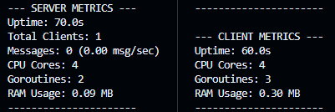
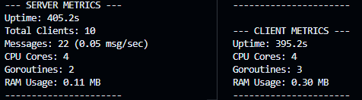
How it works and what is seen Cont.
Now for UDP Server and client we can see the main difference, the RAM usage.
We then made the same 10 users connect and send messages.
As you can see the ram usage is basically half of what the TCP server had.
As you can see the server RAM is hardly affected and the client sided ram stays consistent throughout all the clients.

Slide 9
Although the RAM may not seem like a problem, once in a real world
Situation the numbers really add up and can be detrimental to a service depending on what they want to focus on and provide.

Slide 10
Challenges and Insights
Challenges:
Handling UDP packet loss and the lack of guaranteed delivery.
Handling client disconnections in UDP since it's connectionless.
Balancing concurrency and message flow between many clients.
Insights:
UDP can offer lower latency but sacrifices reliability.
TCP guarantees message order but at a higher latency and overhead.

Slide 11
Summary and Recommendation
Both TCP and UDP have their strengths and weaknesses depending on the use case.
UDP is suited for real-time or low-latency applications like gaming or live chat.
TCP is better for reliable communication where message order matters.
Recommendation:
Use UDP for real-time systems where speed is critical.
Use TCP when data integrity and order are essential.

