Slide 1
DISMEC:
Distributed sparse machine for extreme
Multi-label classification
(using MPI )
BY:
VISHAL(2019201018)
VAIBHAV MANDIR(2019201060)
DIKSHA SINGH(2019201066)

Slide 2
DISMEC can easily scale upto hundreds of thousands labels, provides significant improvements over state-of-the-art prediction accuracies, learns compact models and performs real-time prediction.
APPROACH USED - One-vs-rest method, learns a weight vector for each label to distinguish that label from the rest.

Slide 3
ALGORITHM: (from research paper)
Input: Training data T = {(x1, y1
). . .(xn, yn)}, input dimensionality D, label set {1 . . . L}, B =
L/1000 + 1
and ∆
Output: Learnt matrix W(D*L) in sparse format
1: Load single copy of input vectors X = {x1 . . . xn} in the
main memory . Refactor data without replication
2: Load binary sign vectors sL = {+1, −1} for i=1:n separately
for each label in the main memory
3: for {b = 0; b < B; b + +} do
4: for {l = b × 1000; l ≤ (b + 1) × 1000; l + +} do
5: Using (X,sL), train weight vector wL on a single
core
6: Prune ambiguous weights in wL . (Model
Reduction)
7: end for
8: return W(D*1000). (Learnt matrix for a batch on one
Node)
9: end for
10: return W(D*L) . (Learnt matrix from all the nodes)
L2 regularization and square hinged loss is used
set ∆ = 0.01
The hyper-parameter ∆ > 0 in DiSMEC controls the trade-off between model size and prediction accuracy.

Slide 4
Dataset used:
EURLex-4K which has just ~4000 labels and ~15,000 training points
The dataset folder contains 3 files -
trn_ft_mat.txt - the training feature file
trn_lbl_mat.txt - the training label file
tst_ft_mat.txt - the test feature file
Train test split ratio:
Test size = 0.3
Train size = 0.7

Slide 5
Programming model used- MPI
MPI for Python package mpi4py
Message Passing Interface (MPI) is a standardized and portable message-passing standard designed by a group of researchers from academia and industry to function on a wide variety of parallel computing architectures.
MPI_Send(
void* data,
int count,
MPI_Datatype datatype,
int destination,
int tag,
MPI_Comm communicator)
MPI_Recv(
void* data,
int count,
--------------)
MPI_Bcast(
void* data,
int count,
MPI_Datatype datatype,
int root,
MPI_Comm communicator)
During a broadcast, one process sends the same data to all processes in a communicator.

Slide 6
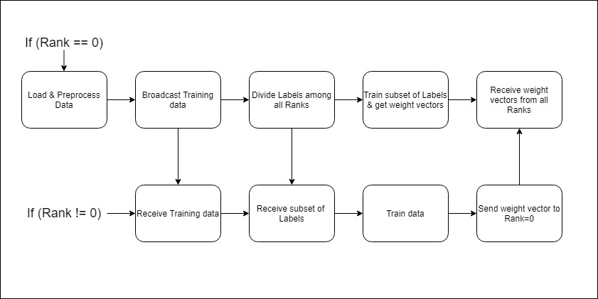
Flow chart :

Slide 7
SNIPPETS OF CODE -
1- Broadcast training data –
x_train = comm.bcast(x_train, root=0)
num_labels = comm.bcast(num_labels, root=0)
2- Sending subset of labels to other ranks –
for i in range(1,size):
comm.send(y_train_small[:,start[i]:end[i]+1],i)
3- Training on subset of labels and pruning weights –
for col in range(y_train_subset.shape[1]):
clf = LinearSVC()
if( np.unique(y_train_subset[:,col] ).shape[0]>1 ):
clf.fit(x_train,y_train_subset[:,col])
wvec = clf.coef_[0]
wvec = np.where(abs(wvec)>0.01,wvec,0)
else:
wvec = np.zeros(x_train.shape[1])
wvec = sparse.csr_matrix(wvec)
W[:,col] = wvec.T
4- Send weights to Rank = 0 :
comm.send(W,0)
5- Receiving weights from rank!=0 :
if(rank == 0):
for i in range(1,size):
returned_w = comm.recv(source=i)
W = hstack([W,returned_w])

Slide 8
Observations:
Sequential code result =
Time taken = 12min 24.509sec
= 744.509 sec
Parallel code result =
(Speed up = time taken by parallel / time taken by sequential)
No of processes |  | Time taken |  | Speedup
2 |  | 9m 41.292s | = 581.292sec | 0.7808
3 |  | 5m 58.150s | = 358.15sec | 0.4811
4 |  | 7m 26.538s | = 446.538sec | 0.5998
5 |  | 8m 6.216s | = 486.216sec | 0.6531

Slide 9
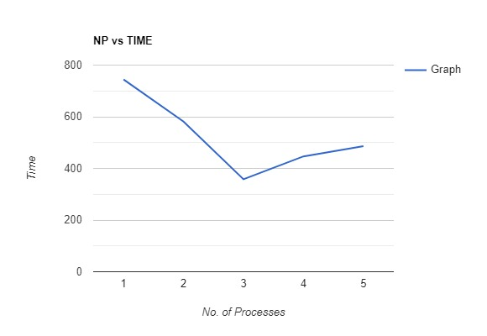
Graph -

Slide 10
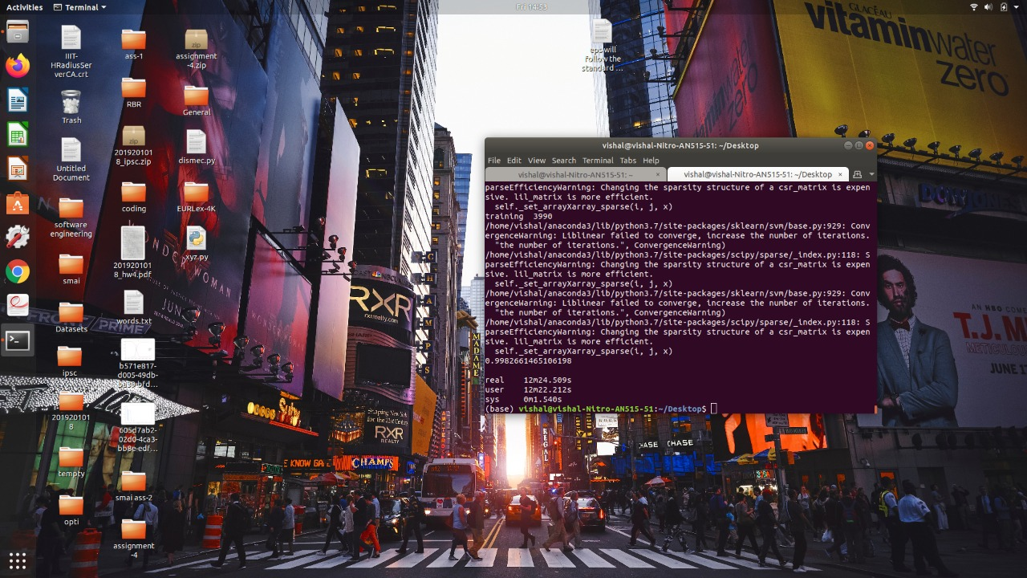
Screenshots :
Sequential -

Slide 11
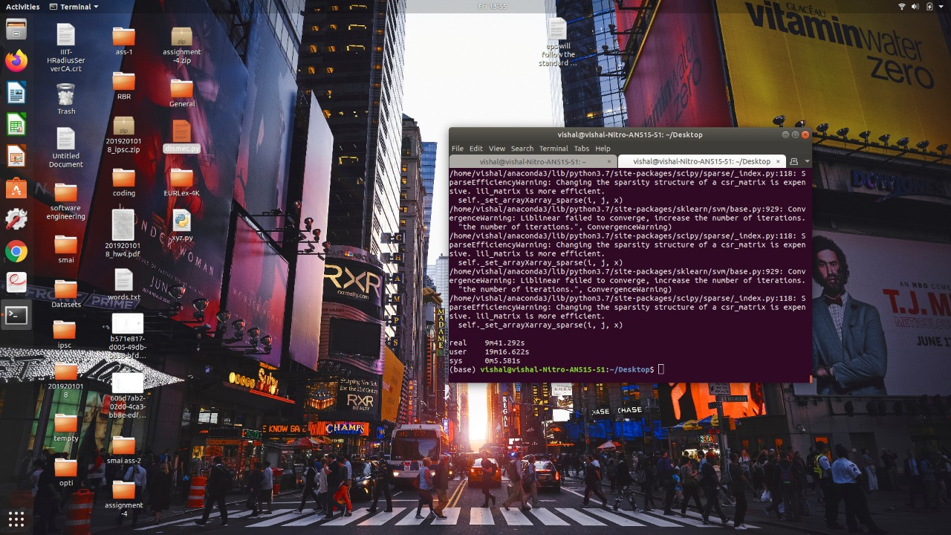

Parallel for n = 2 parallel for n = 3

Slide 12
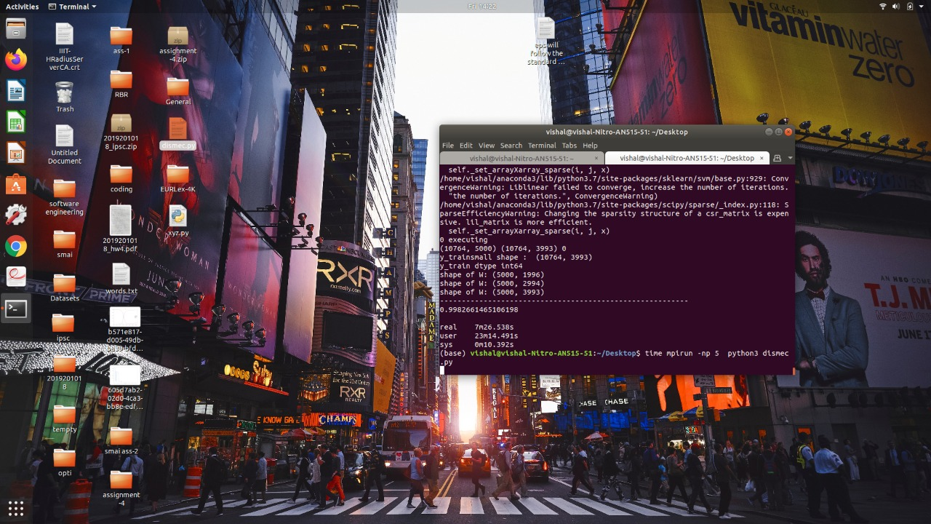
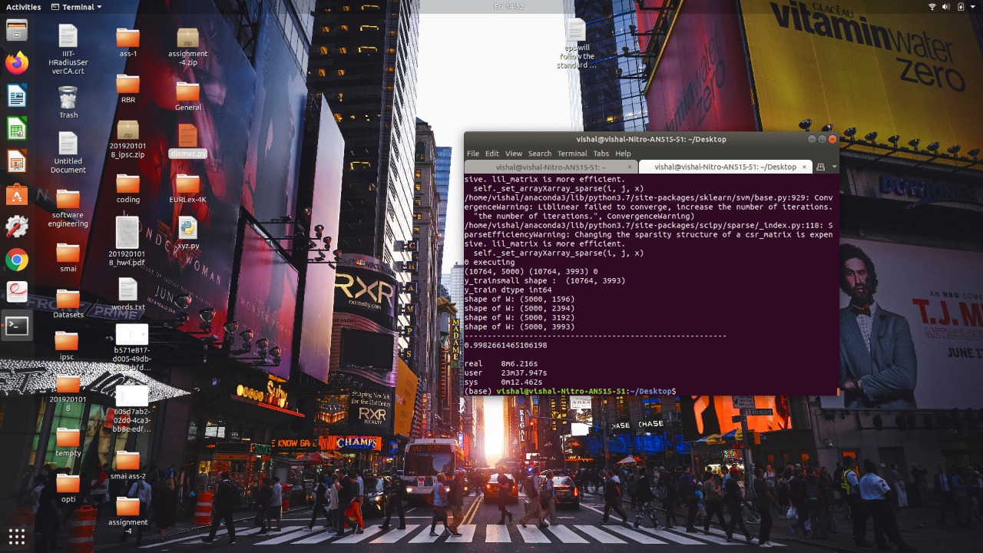
Parallel for n = 4 Parallel for n = 5

Slide 13
CONCLUSION:
In this work, we presented DiSMEC learning framework for extreme multi-label learning. By employing the doubly parallelized architecture and explicit model sparsity induction, we showed that a careful implementation of one-vs-rest mechanism can result in drastic improvements in prediction accuracies over state-of-the-art industrial machine learning systems

