Slide 1
Slide 7
Slide 6
Slide 5
Personal Info
Slide 4
Start
Slide 3
Slide 2
Slide 1

Slide 2

Slide 7
Slide 6
Slide 5
LUDOS
Slide 4
Start
Slide 3
Slide 2
Slide 1

Slide 3


Slide 7
Today’s Topics
Slide 6
What is biological Databases
Features
Slide 5
Here you need to add some brief about the service that your company is providing currently
Here you need to add some brief about the service that your company is providing currently
Slide 4
Our Databases choice
Choice 2
Here you need to add some brief about the service that your company is providing currently
Here you need to add some brief about the service that your company is providing currently
Slide 3
Slide 2
PubMed
Features
Here you need to add some brief about the service that your company is providing currently
Here you need to add some brief about the service that your company is providing currently
Slide 1

Slide 4
Slide 7
Slide 6
Slide 5
Slide 4
Slide 3
Slide 2
Slide 1

Slide 5
Slide 7
PubMed
Slide 6
Slide 5
Slide 4
Slide 3
Slide 2
Slide 1

Slide 6

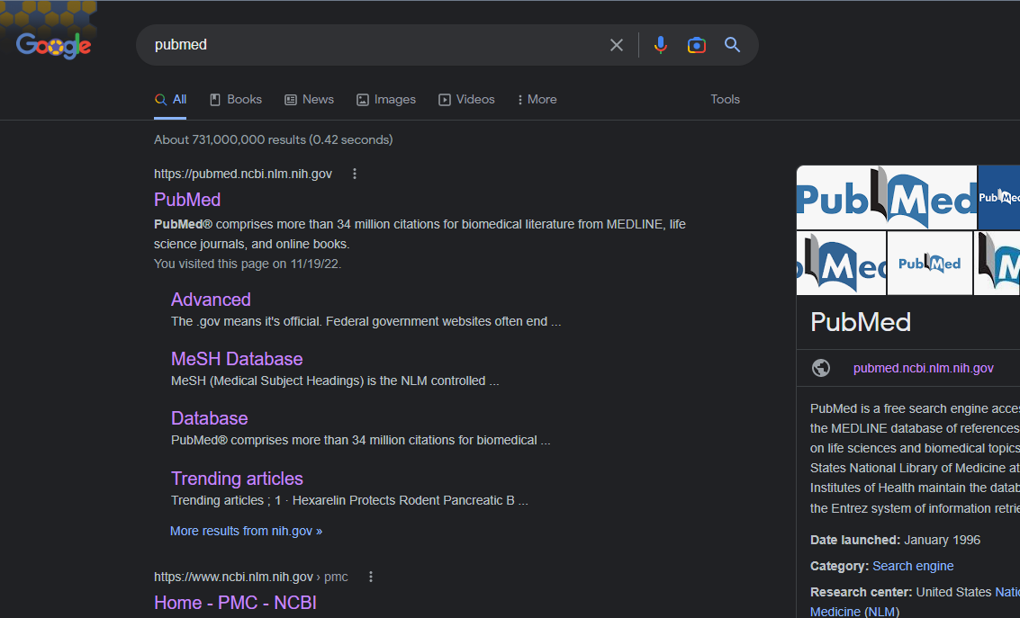
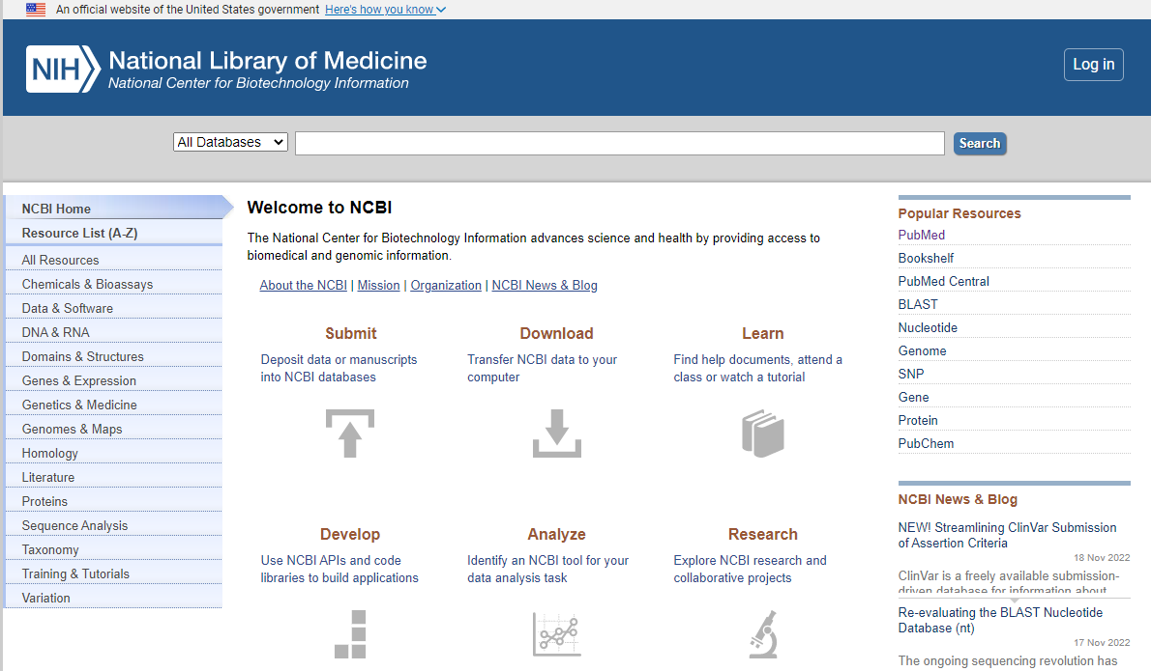
Slide 7
How To Access
Slide 6
01
02
Direct
Undirect
Slide 5
Directly search the website name or type its URL directly from any browser.
Access through NCBI website
Slide 4
Slide 3
Slide 2
Slide 1

Slide 7
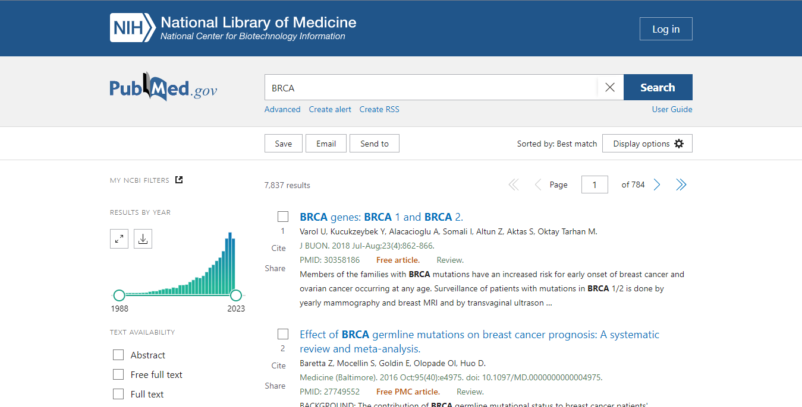
Slide 7
Features
How to search
Slide 6
Slide 5
Slide 4
Slide 3
Slide 2
Slide 1

Slide 8
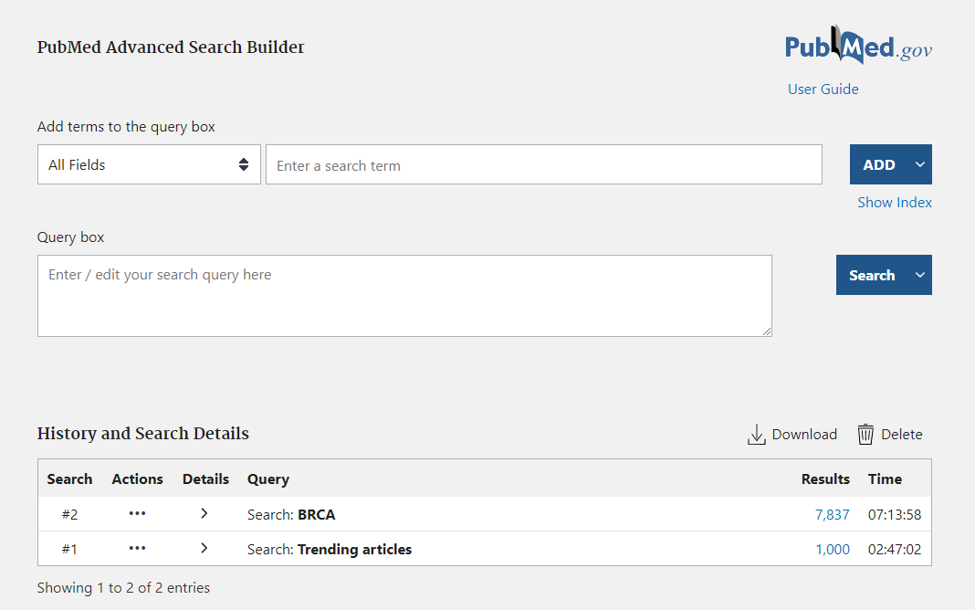
Slide 7
Features
Advanced search
Slide 6
Slide 5
Slide 4
Slide 3
Slide 2
Slide 1

Slide 9
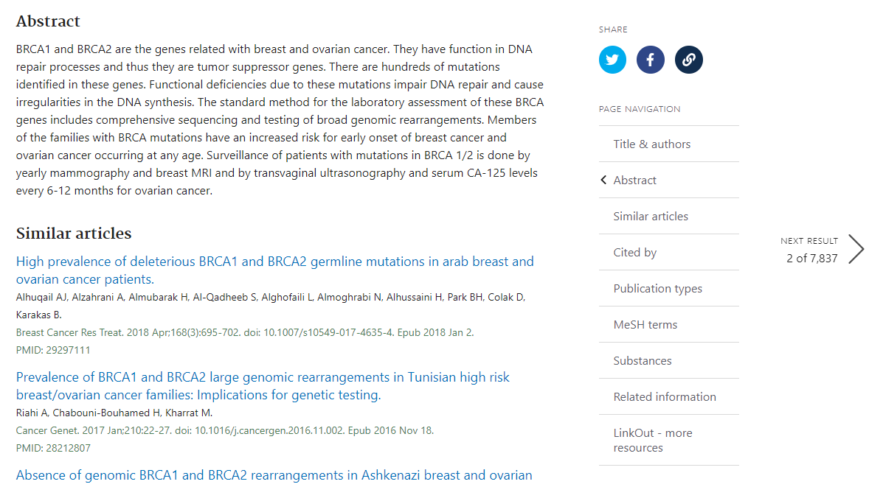
14
Slide 7
Features
Page navigation
13
Slide 6
12
Slide 5
11
Slide 4
10
Slide 3
Slide 9
Slide 2
Slide 8
Slide 1

Slide 10
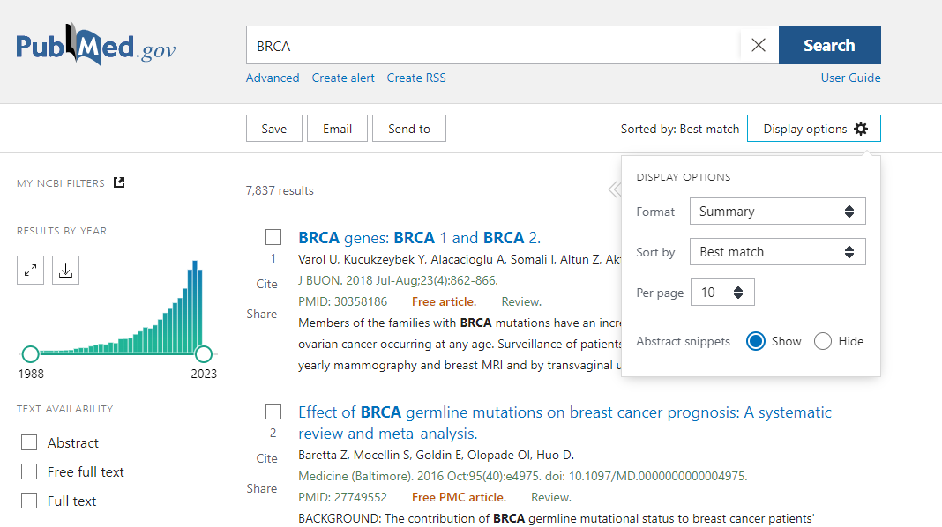
Features
14
Slide 7
Display options
13
Slide 6
12
Slide 5
11
Slide 4
10
Slide 3
Slide 9
Slide 2
Slide 8
Slide 1

Slide 11
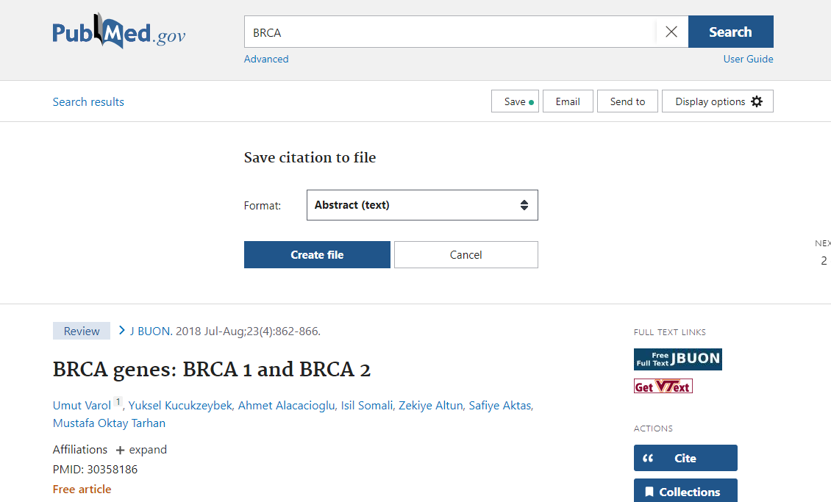
14
Features
How to Download
13
12
11
10
Slide 9
Slide 8

Slide 12
14
Choice 2
13
12
11
10
Slide 9
Slide 8

Slide 13
Thanks for Listening with great patience

Slide 14
Any Questions?

