Slide 1
Transistors

Slide 2
Bipolar Junction Transistors
The transistor is a three-layer semiconductor
device consisting of either two n- and one p type
layers of material or two p- and one n-type
layers of material.
The former is called an npn transistor, while
the latter is called a pnp transistor
So, there are two types of BJT
i) pnp transistor ii) npn transistor

Slide 3
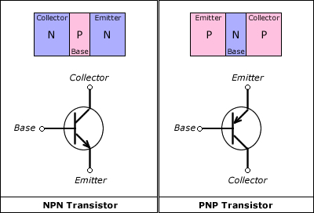
Representation of Transistor

Slide 4
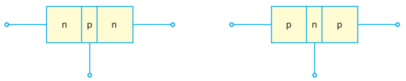
Every transistor has: i)two junctions, so transistor can be considered as two diode connected back to back. ii) three terminals. iii) middle section is thin than other.

Slide 5
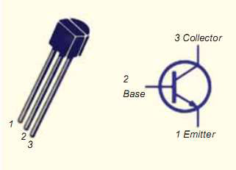
Emitter, Base & Collector of Transistor

Slide 6
1) Emitter
The section of one side that supplies carriers is called emitter.
Emitter is always forward biased w.r.t base so it can supply carrier.
For “npn transistor” emitter supply holes to its junction.
For “pnp transistor” emitter supply electrons to its junction.

Slide 7
2) Collector
The section on the other side that collects carrier is called collector.
The collector is always reversed biased w.r.t base.
For “npn transistor” collector receives holes to its junction.
For “pnp transistor” collector receives electrons to its junction.

Slide 8
3) Base
The middle section which forms two pn
junction between emitter and collector is called Base

Slide 9
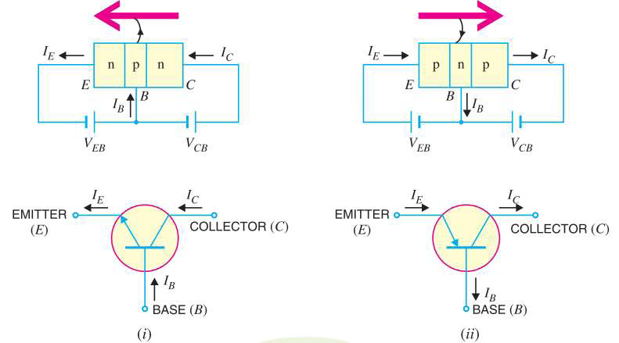
Transistor Symbol

Slide 10
Some important factors to be remembered
The transistor has three region named emitter, base and collector.
The Base is much thinner than other region.
Emitter is heavily doped so it can inject large amount of carriers into the base.
Base is lightly doped so it can pass most of the carrier to the collector.
Collector is moderately doped.

Slide 11
The junction between emitter and base is called emitter-base junction(emitter diode) and junction between base and collector is called collector-base junction(collector diode).
The emitter diode is always forward biased and collector diode is reverse biased.
The resistance of emitter diode is very small(forward) and resistance of collector diode is high(reverse).

Slide 12
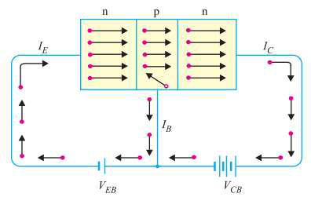
Transistor Operation
Working of npn transistor:
Forward bias is applied to emitter-base junction and reverse bias is applied to collector-base junction.
The forward bias in the emitter-base junction causes electrons to move toward base.
This constitute emitter current, IE

Slide 13

As this electrons flow toward p-type base, they try to recombine with holes.
As base is lightly doped only few electrons recombine with holes within the base.
These recombined electrons constitute small base current.
The remainder electrons crosses base and constitute collector current.

Slide 14
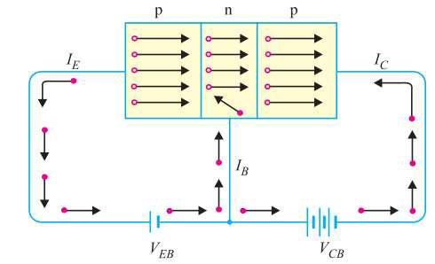
2) Working of pnp transistor:
Forward bias is applied to emitter-base junction and
reverse bias is applied to collector-base junction.
The forward bias in the emitter-base junction causes holes to move toward base.
This constitute emitter current, IE

Slide 15
As this holes flow toward n-type base, they try to recombine with electrons.
As base is lightly doped only few holes recombine with electrons within the base.
These recombined holes constitute small base current.
The remainder holes crosses base and constitute collector current.

Slide 16
Transistor Operating Modes
1. Active Mode
Base- Emitter junction is forward and Base-Collector junction is reverse biased.
2. Saturation Mode
Base- Emitter junction is forward and Base-Collector junction is forward biased.
3. Cut-off Mode
→ Both junctions are reverse biased

Slide 17
Transistor Connection
Transistor can be connected in a circuit in following three ways:
1) Common Base
2) Common Emitter
3) Common Collector

Slide 18
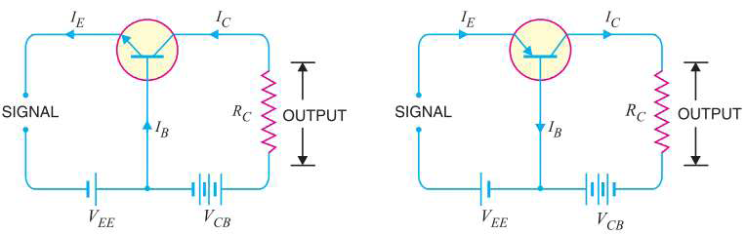
1. Common Base Configuration
The common-base terminology is derived from the fact that the base is common to both the input and output sides of the configuration.
First Figure shows common base npn configuration and second figure shows common base pnp configuration.

Slide 19
Current amplification factor ( α ) :
The ratio of change in collector current to the
change in emitter current at constant VCB is known as current amplification factor.
α = ∆IC/∆IE at constant VCB
Practical value of α is less than unity, but in the range of 0.9 to 0.99

Slide 20
Expression for Collector Current
Total emitter current does not reach the collector terminal, because a small portion of it constitute base current. So,
IE = IC+ IB
Also, collector diode is reverse biased, so very few minority carrier passes the collector-base junction which actually constitute leakage current, ICBO.

Slide 21
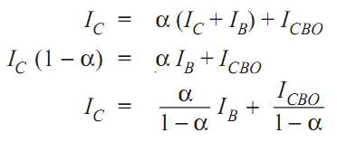
So, collector current constitute of portion of emitter current αIE and leakage current ICBO.
IC = αIE + ICBO

Slide 22
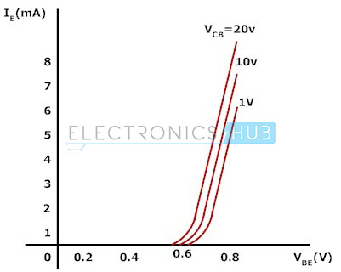
Characteristics of common base configuration
• Input Characteristics:
VBE vs IE characteristics is called input characteristics.
IE increases rapidly with VBE. It means input resistance is very small.
IE almost independent of VCB.

Slide 23
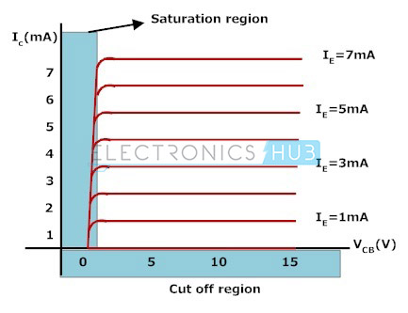
• Output Characteristics:
VBC vs Ic characteristics is called output characteristics.
IC varies linearly with VBC ,only when VBC is very small.
As, VBC increases, IC becomes constant.

Slide 24
Input and Output Resistance of common base configuration:
Input Resistance: The ratio of change in emitter-base voltage to the change in emitter current is called Input Resistance.
ri = ∆VBE / ∆IE
Output Resistance: The ratio of change in collector-base voltage to the change in collector current is called Output Resistance.
ro = ∆VBC / ∆IC

Slide 25
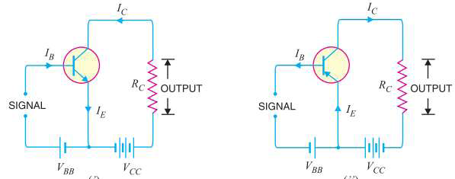
2. Common Emitter Connection
The common-emitter terminology is derived from the fact that the emitter is common to both the input and output sides of the configuration.
First Figure shows common emitter npn configuration and second figure shows common emitter pnp configuration.

Slide 26
Base Current amplification factor (β ) :
In common emitter connection input current is base current and output current is collector current.
The ratio of change in collector current to the change in base current is known as base current amplification factor, β.
β = ∆IC/∆IB
Normally only 5% of emitter current flows to base, so amplification factor is greater than 20. Usually this range varies from 20 to 500.

Slide 27
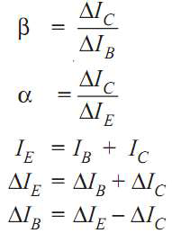
Relation Between α and β :

Slide 28

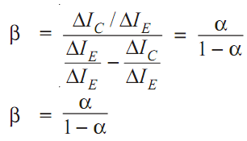

Slide 29
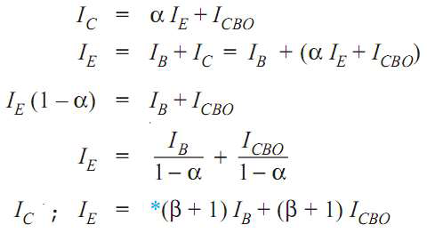
Expression for Collector Current

Slide 30
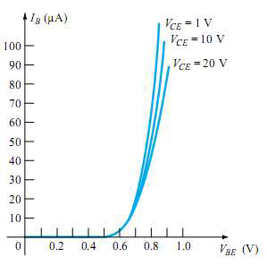
Characteristics of common emitter configuration:
Input Characteristics:
VBE vs IB characteristics is called input characteristics.
IB increases rapidly with VBE . It means input resistance is very small.
IE almost independent of VCE.
IB is of the range of micro amps.

Slide 31
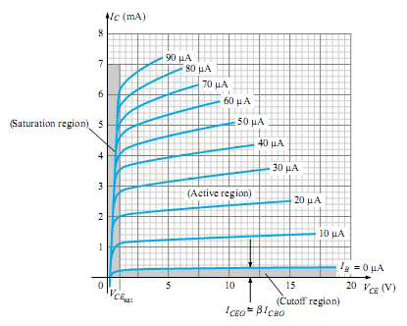
Output Characteristics:
VCE vs Ic characteristics is called output characteristics.
IC varies linearly with VCE ,only when VCE is very small.
As, VCE increases, IC becomes constant.

Slide 32
Input and Output Resistance of common emitter configuration:
Input Resistance: The ratio of change in emitter-base voltage to the change in base current is called Input Resistance.
ri = ∆VBE / ∆IB
Output Resistance: The ratio of change in collector-emitter voltage to the change in collector current is called Output Resistance.
ro = ∆VCE / ∆IC

Slide 33
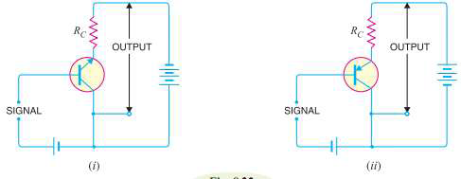
3. Common Collector Configuration
The common-collector terminology is derived from the fact that the collector is common to both the input and output sides of the configuration.
First Figure shows common collector npn configuration and second figure shows common collector pnp configuration.

Slide 34
Current amplification factor (γ ) :
In common emitter connection input current is base current and output current is emitter current.
The ratio of change in emitter current to the change in base current is known as current amplification factor in common collector configuration.
γ = ∆IE/∆IB
This circuit provides same gain as CE configuration as,
∆IE ≈ ∆IC

Slide 35
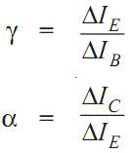
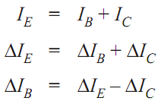
Relation Between γ and α :

Slide 36

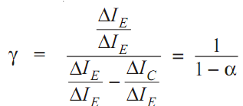

Slide 37
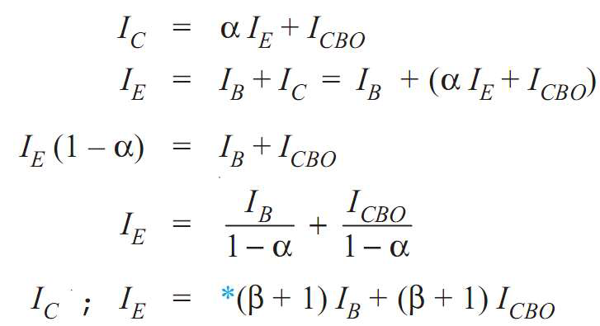

Expression for Collector Current:

Slide 38
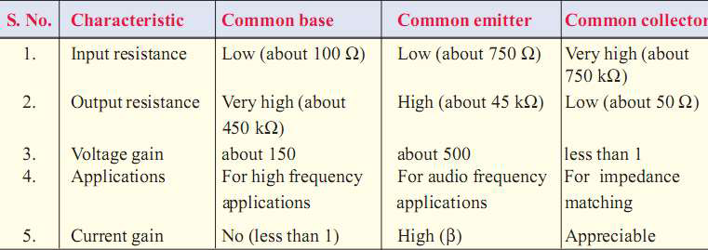
Comparison of Transistor Connections

Slide 39
THANK YOU

