Slide 1
Comparator

Slide 2
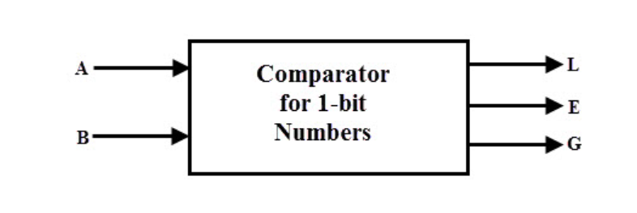
Single bit Comparator
A comparator used to compare two bits, i.e., two numbers each of single bit is called a single bit comparator.
It consists of two inputs for allowing two single bit numbers and three outputs to generate less than, equal and greater than comparison outputs.

Slide 3
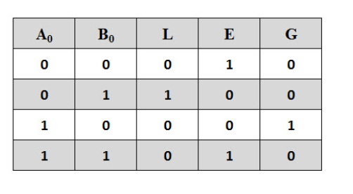
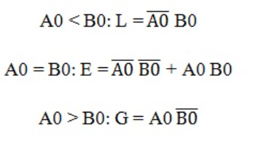
Truth Table
Logic Equation

Slide 4
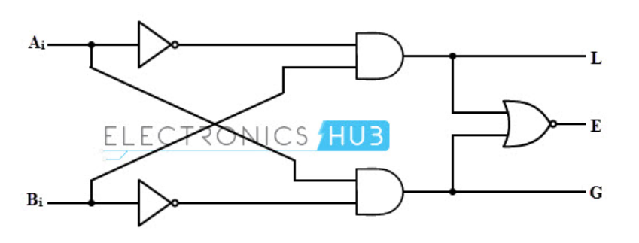
Logic Circuit Diagram

Slide 5
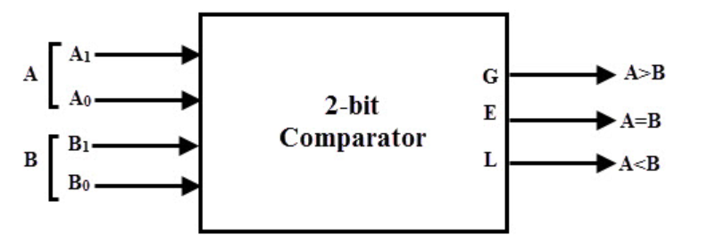
2-Bit Comparator
A 2-bit comparator compares two binary numbers, each of two bits and produces their relation such as one number is equal or greater than or less than the other.

Slide 6
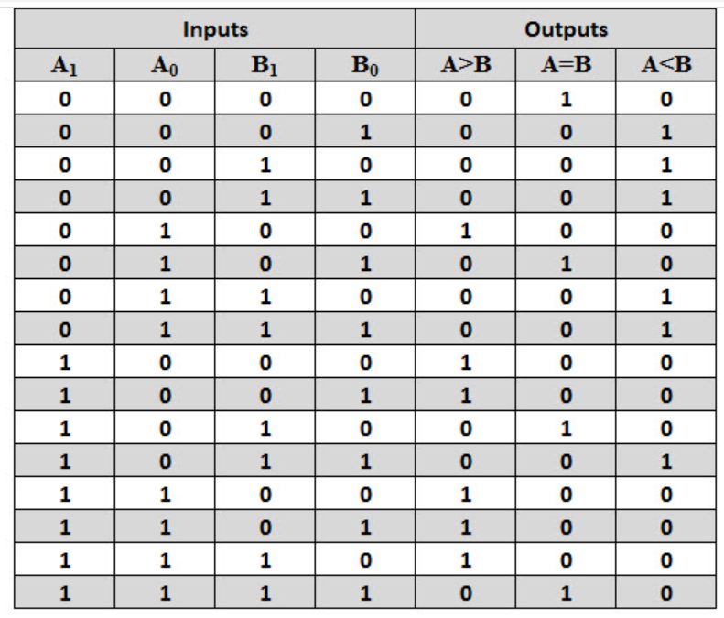

Slide 7
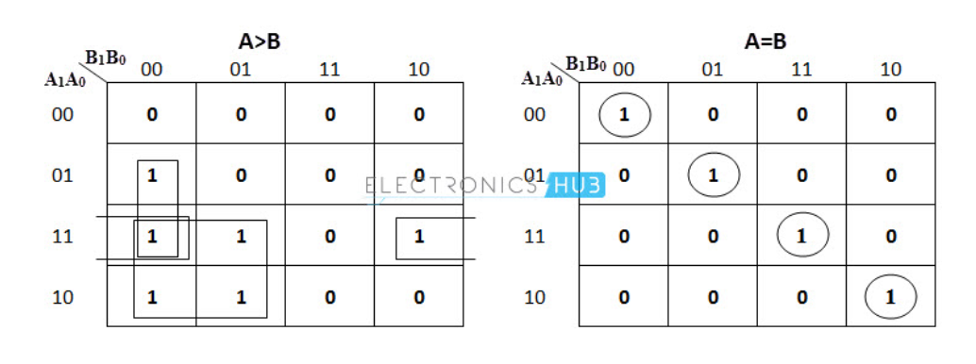

Slide 8
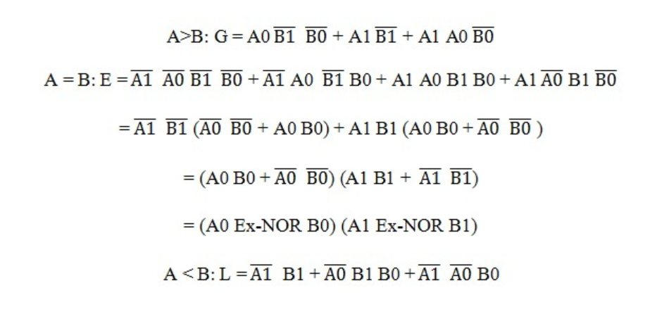

Slide 9
