Slide 1
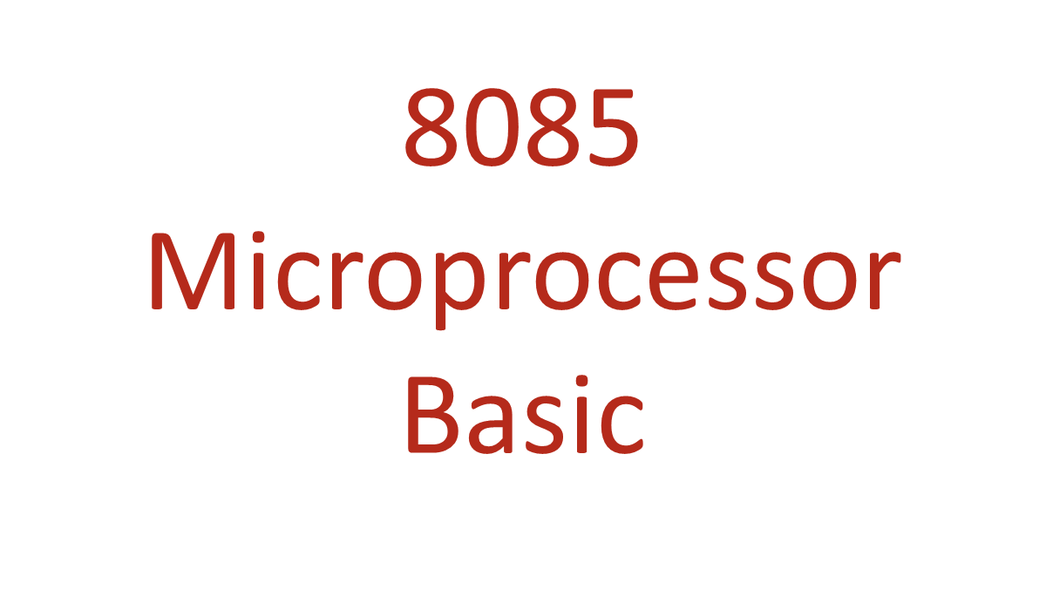

Slide 2
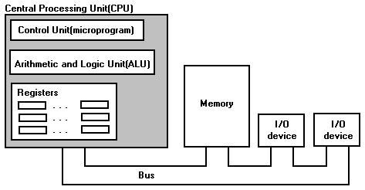
CPU Organization

Slide 3
Microprocessor
A microcontroller is a chip optimized to control electronic devices. It is stored in a single integrated circuit which is dedicated to performing a particular task and execute one specific application.
A microprocessor is a controlling unit of a micro-computer wrapped inside a small chip. It performs Arithmetic Logical Unit (ALU) operations and communicates with the other devices connected with it. It is a single Integrated Circuit in which several functions are combined.

Slide 4

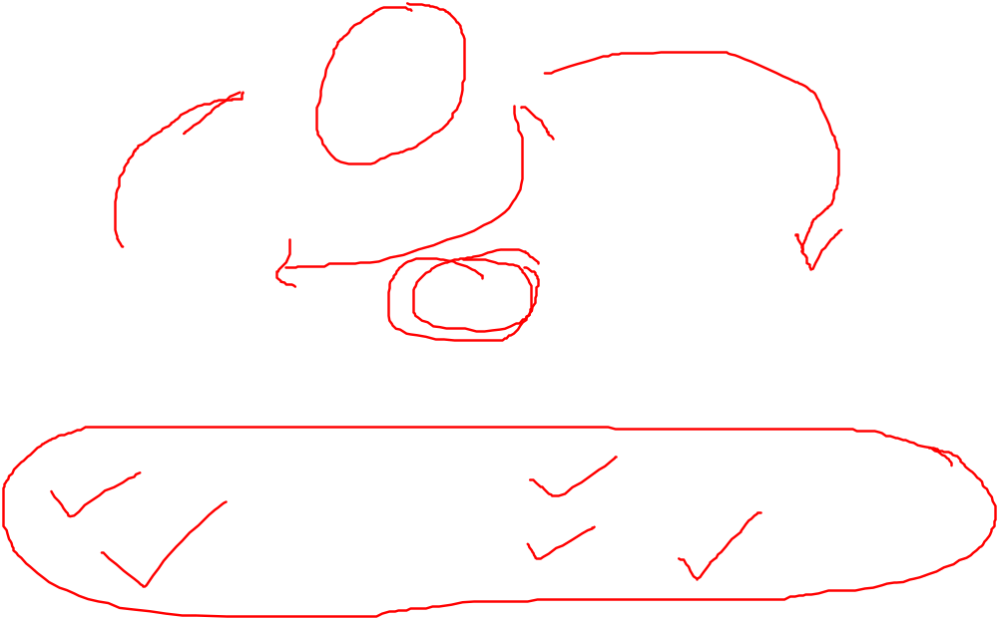
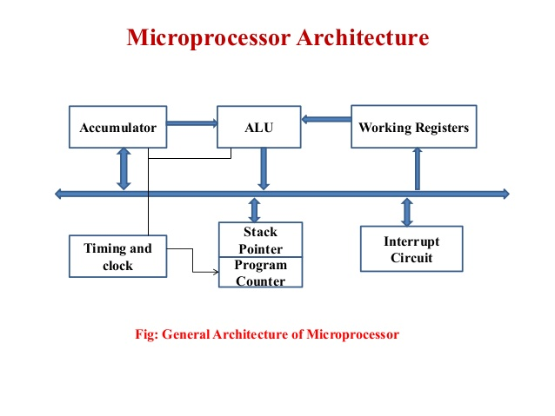

Slide 5
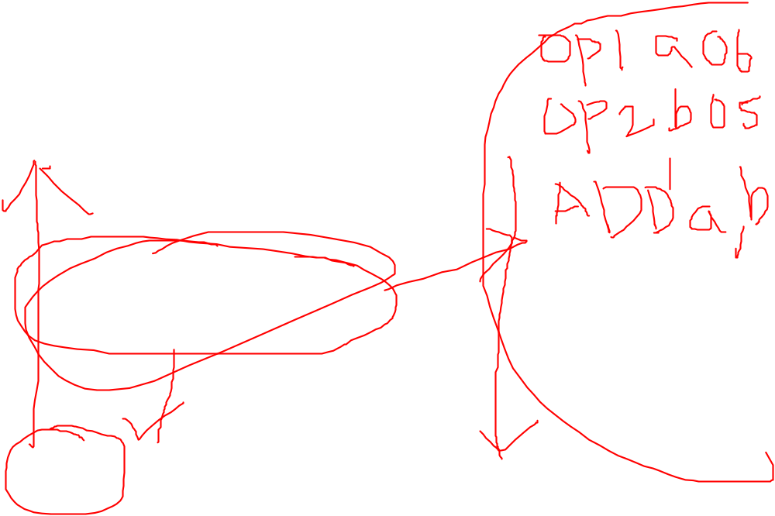
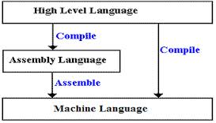
Language

Slide 6
Language
Machine language
The fundamental language of the computer’s processor, also called Low Level Language.
All programs are converted into machine language before they can be executed.
Consists of combination of 0’s and 1’s that represent high and low electrical voltage.
Machine language is a natural language of computer this language program are usually written in binary code.
All program are done in 8085 microprocessor
Advantages
This is suitable for small and simple programs.
Program execution is very fast and requires less computation time.
Generally, this language is suitable for prototype applications as final product.

Slide 7

Language
Assembly language
To overcome the limitations of machine language, assembly language was developed. A low level language that is similar to machine language.
Uses symbolic operation code to represent the machine operation code.
In this language machine level instruction are replaced by mnemonics.
For example, ADD represent addition, SUB represents subtraction. INC for increment, RAL for rotate left, and CMP for compare. This instruction are known as mnemonics.
a program written in mnemonics is called an assembly language program.
Advantages
It is easy to write.
It is easy to understand.
It produce faster results.

Slide 8
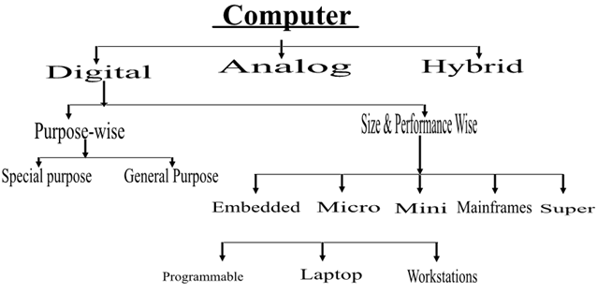

CLASSIFICATION OF COMPUTER

Slide 9

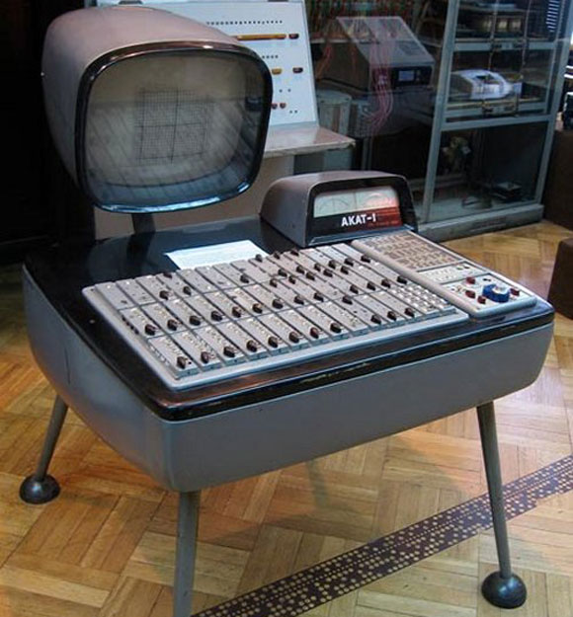
Classification of Computers
1. Analog Computers
Analog computers are used to process continuous data. Analog computers represent variables by physical quantities. Thus any computer which solve problem by translating physical conditions such as flow, temperature, pressure, angular position or voltage into related mechanical or electrical related circuits as an analog for the physical phenomenon being investigated in general it is a computer which uses an analog quantity and produces analog values as output. Thus an analog computer measures continuously. Analog computers are very much speedy. They produce their results very fast. But their results are approximately correct. All the analog computers are special purpose computers.

Slide 10

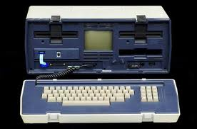
2. Digital Computers
Digital computer represents physical quantities with the help of digits or numbers. These numbers are used to perform Arithmetic calculations and also make logical decision to reach a conclusion, depending on, the data they receive from the user.

Slide 11
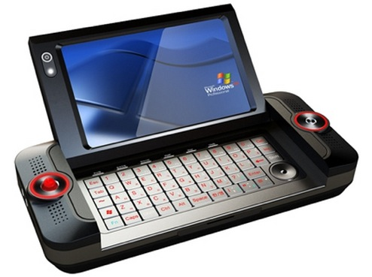
3. Hybrid Computers
Various specifically designed computers are with both digital and analog characteristics combining the advantages of analog and digital computers when working as a system. Hybrid computers are being used extensively in process control system where it is necessary to have a close representation with the physical world.
The hybrid system provides the good precision that can be attained with analog computers and the greater control that is possible with digital computers, plus the ability to accept the input data in either form.

Slide 12
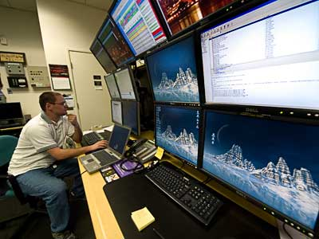
1. Super Computers
Large scientific and research laboratories as well as the government organizations have extra ordinary demand for processing data which required tremendous processing speed, memory and other services which may not be provided with any other category to meet their needs. Therefore very large computers used are called Super Computers. These computers are extremely expensive and the speed is measured in billions of instructions per seconds.

Slide 13
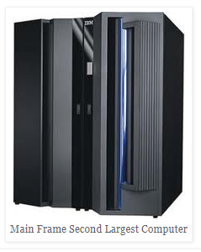
2. Mainframe Computers:-
It is a high speed computer. The data storage capacity of this computer is very large. The word length varies normally from 32 to 64 bits. It contains two or more central processing unit and each is implemented by using two or more chips. It is used for scientific calculations.

Slide 14

3. Mini Computers
Mini computers are smaller than mainframes, both in size and other facilities such as speed, storage capacity and other services. They are versatile that they can be fitted where ever they are needed. Their speeds are rated between one and fifty million instructions per second (MIPS). They have primary storage in hundred to three hundred megabytes range with direct access storage device.

Slide 15
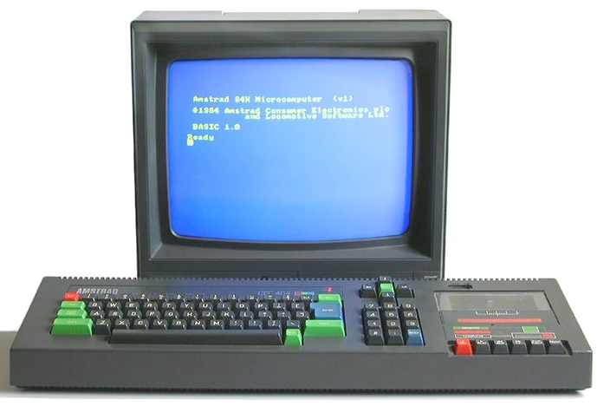
4. Micro Computers
These are the smallest range of computers. They were introduced in the early 70’s having less storing space and processing speed. Micro computers of todays are equivalent to the mini computers of yesterday in terms of performing and processing. They are also called “computer of a chip” because its entire circuitry is contained in one tiny chip. The micro computers have a wide range of applications including uses as portable computer that can be plugged into any wall.

Slide 16
Internal structure and basic operation of microprocessor
ALU
Register Section
Address bus
Data bus
Control and timing section
Control bus

Slide 17
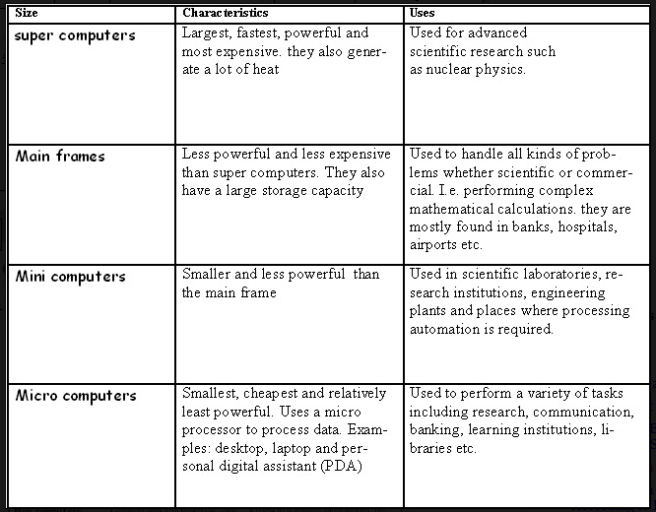

Slide 18
