Slide 1
AN INTRODUCTION TO MICROPROCESSOR ARCHITECTURE
USING INTEL 8085 AS A CLASSIC PROCESSOR

Slide 2
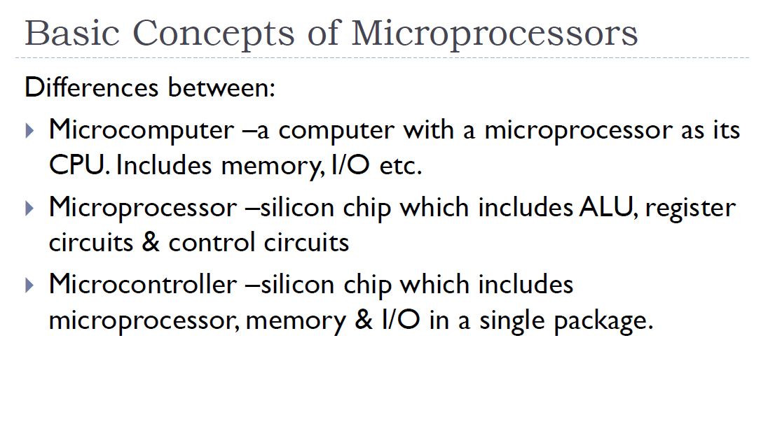


Slide 3
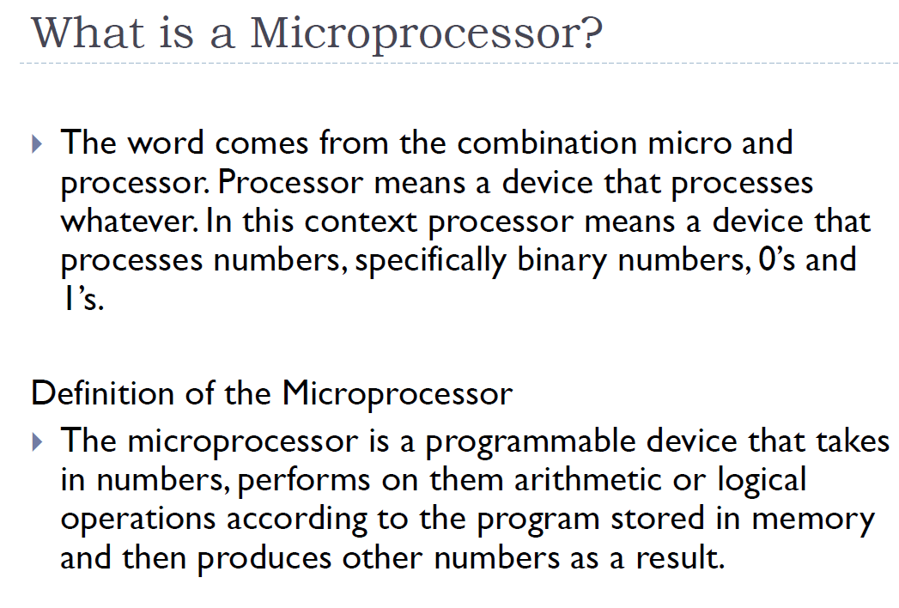


Slide 4
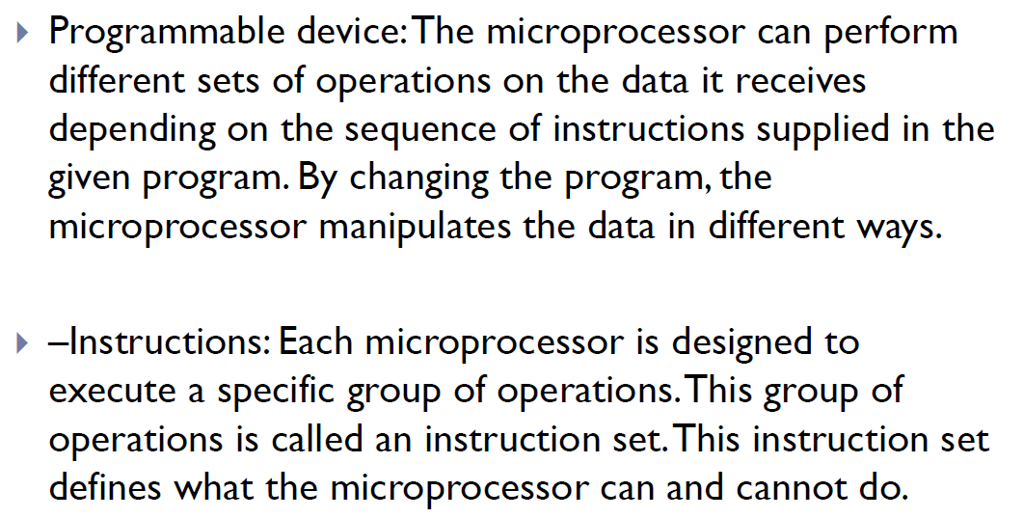

Slide 5
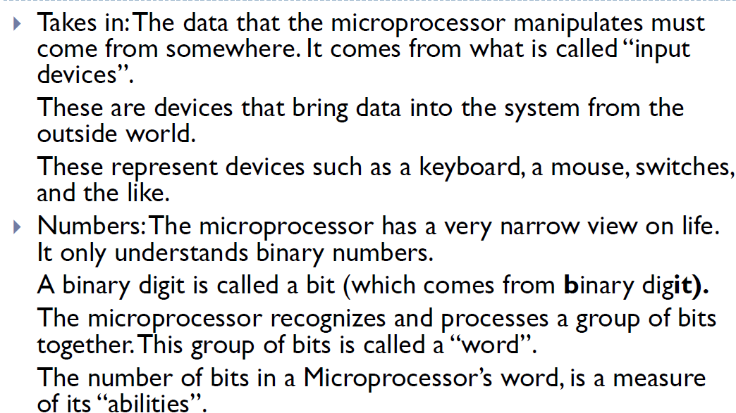


Slide 6
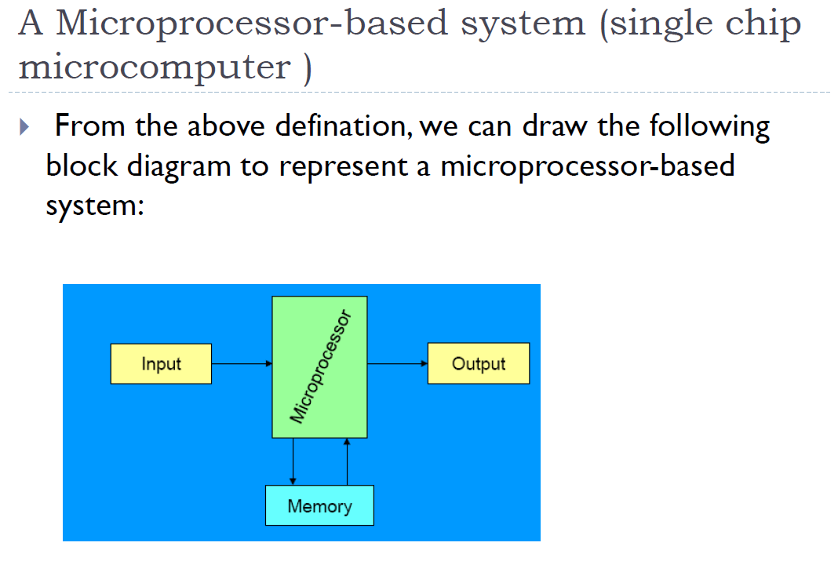


Slide 7
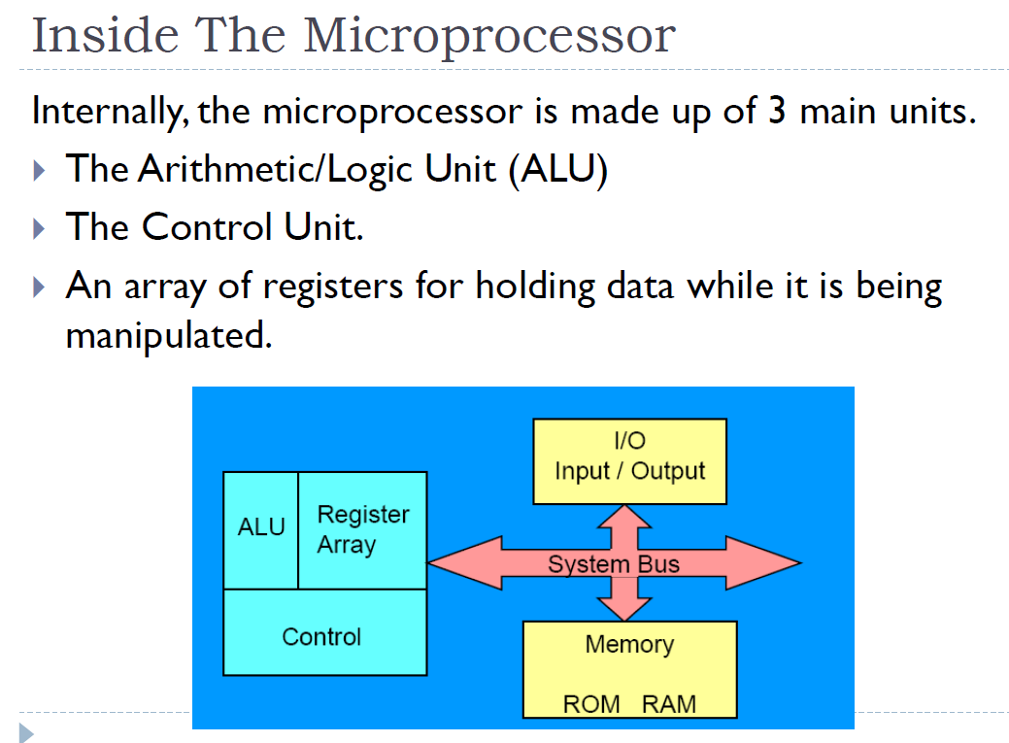


Slide 8
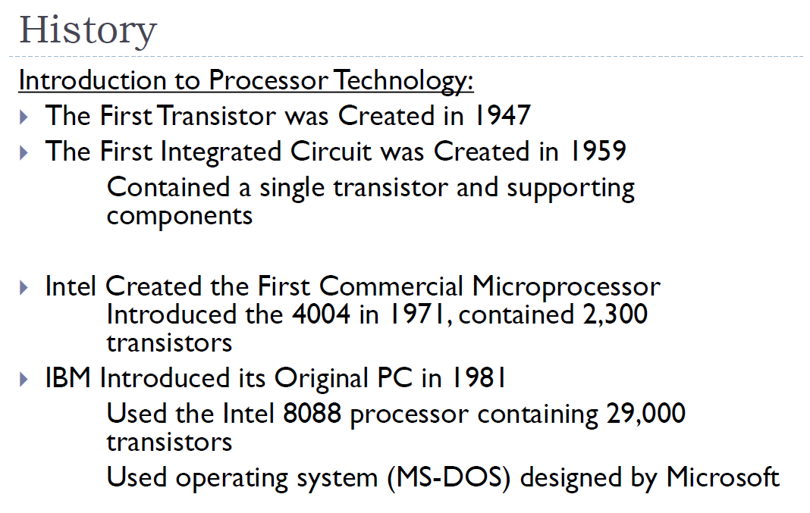


Slide 9
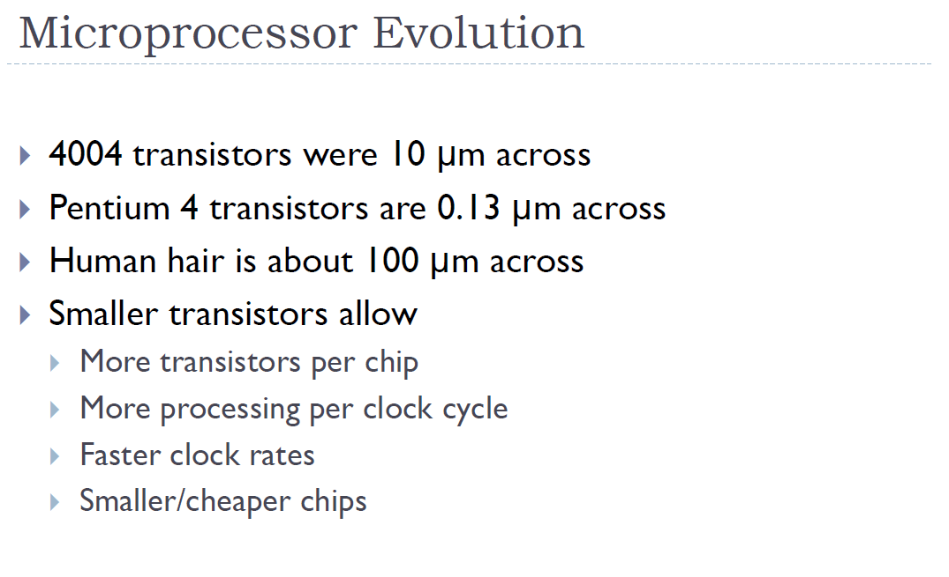


Slide 10
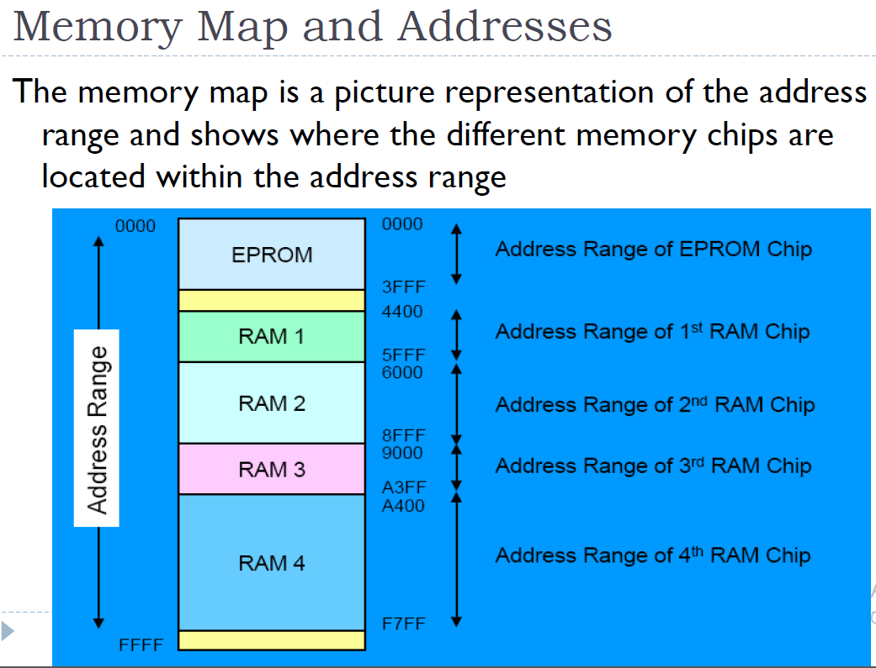


Slide 11
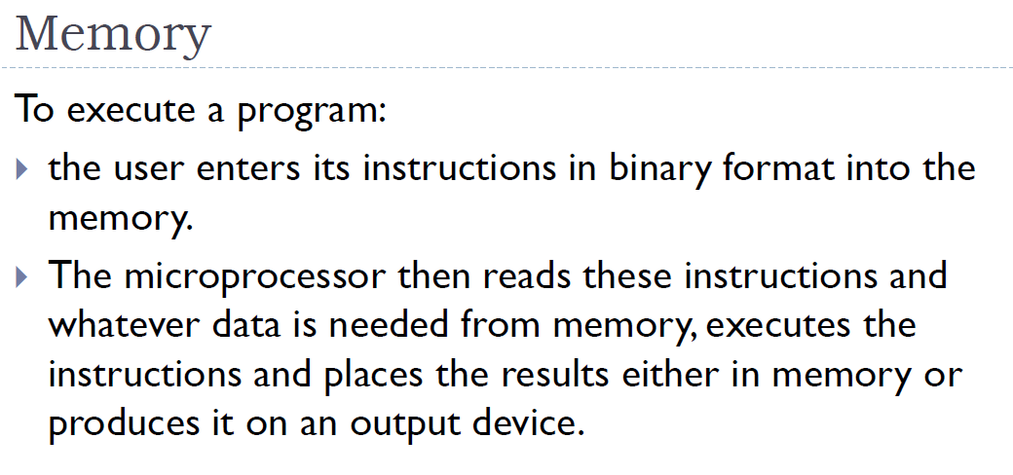

Slide 12
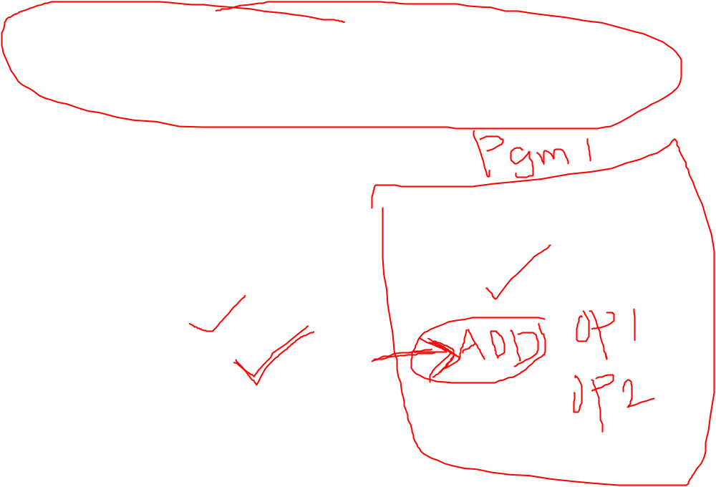
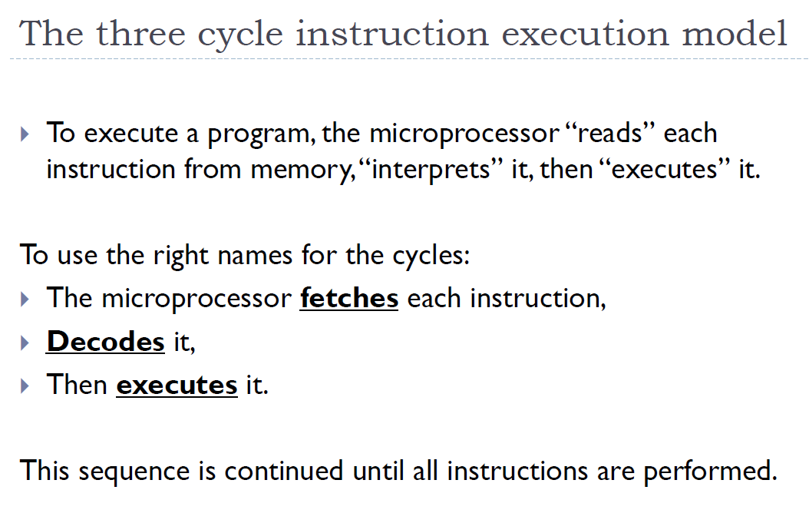

Slide 13
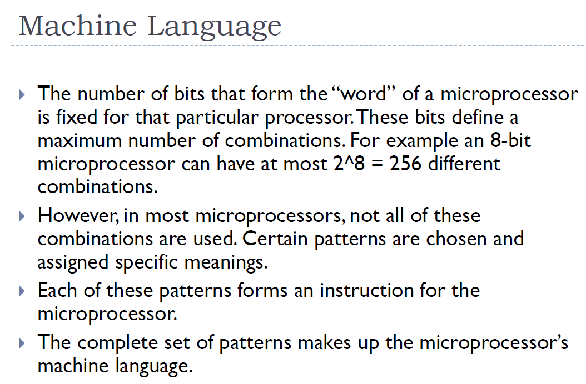


Slide 14
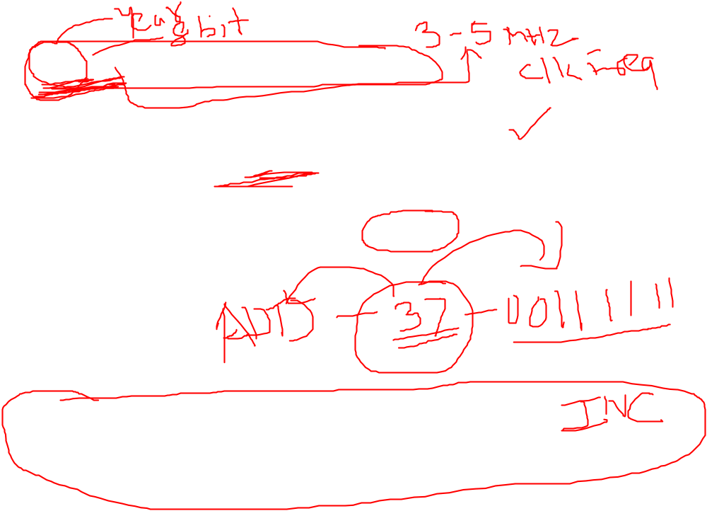
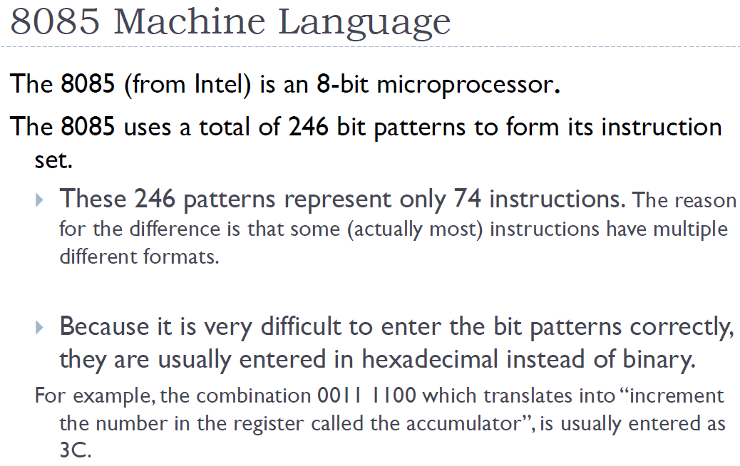

Slide 15
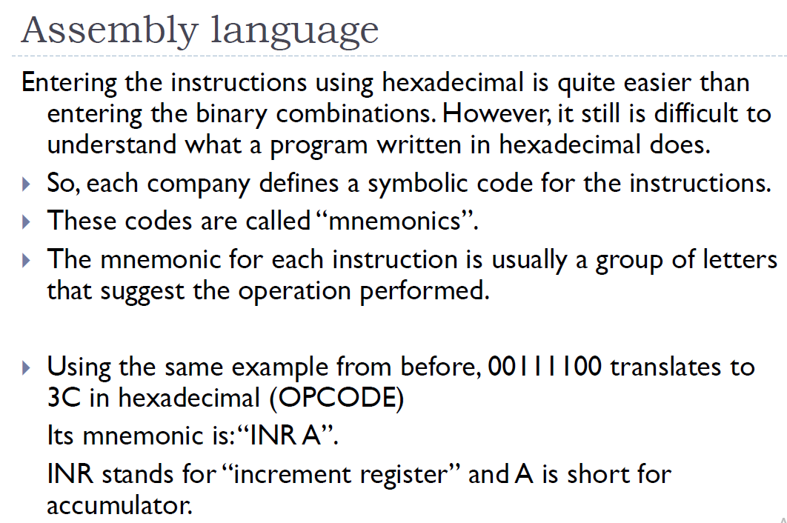


Slide 16
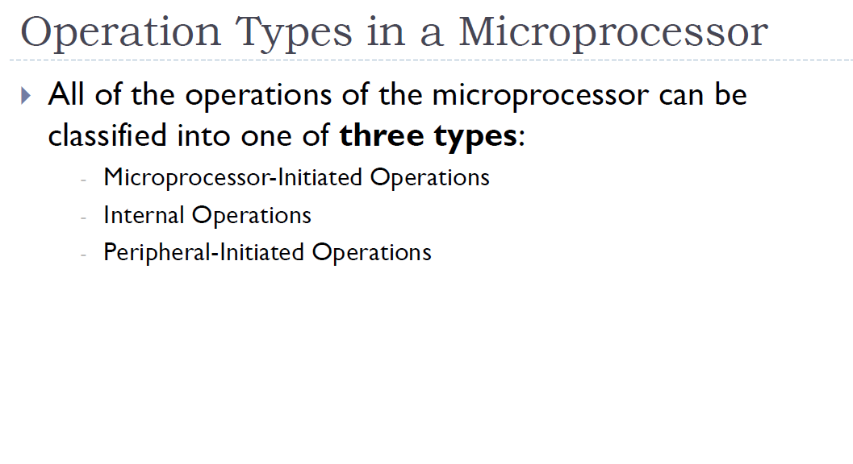

Slide 17
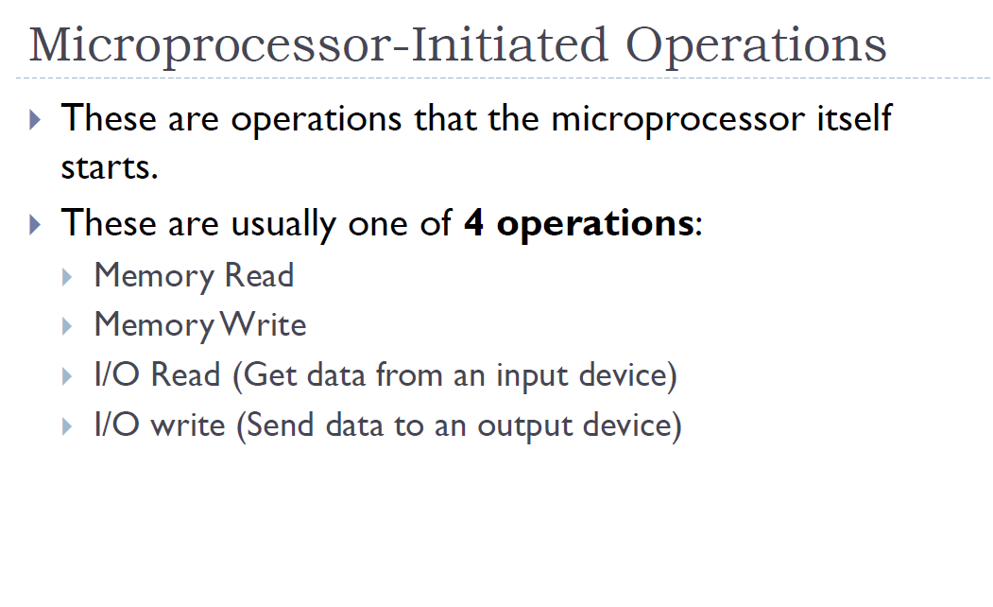

Slide 18
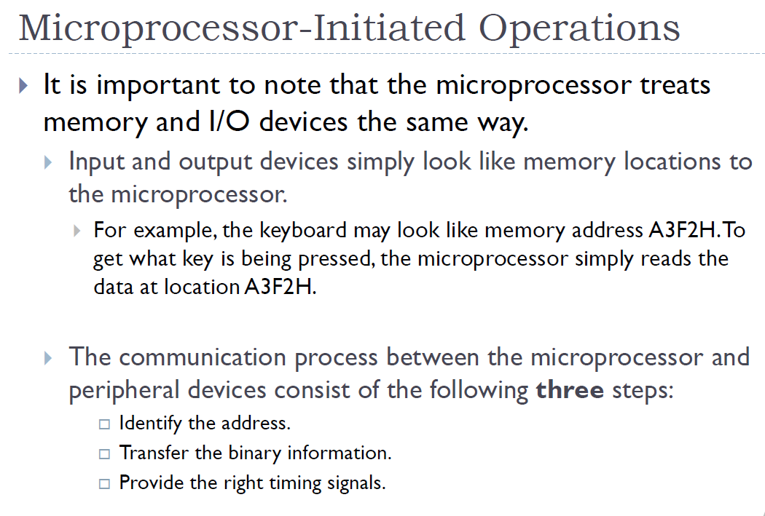


Slide 19
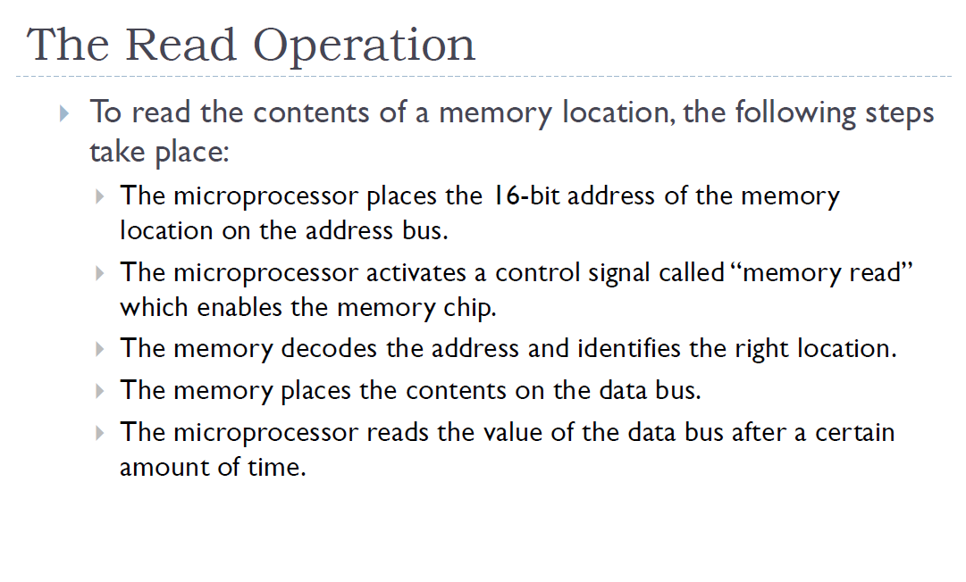


Slide 20
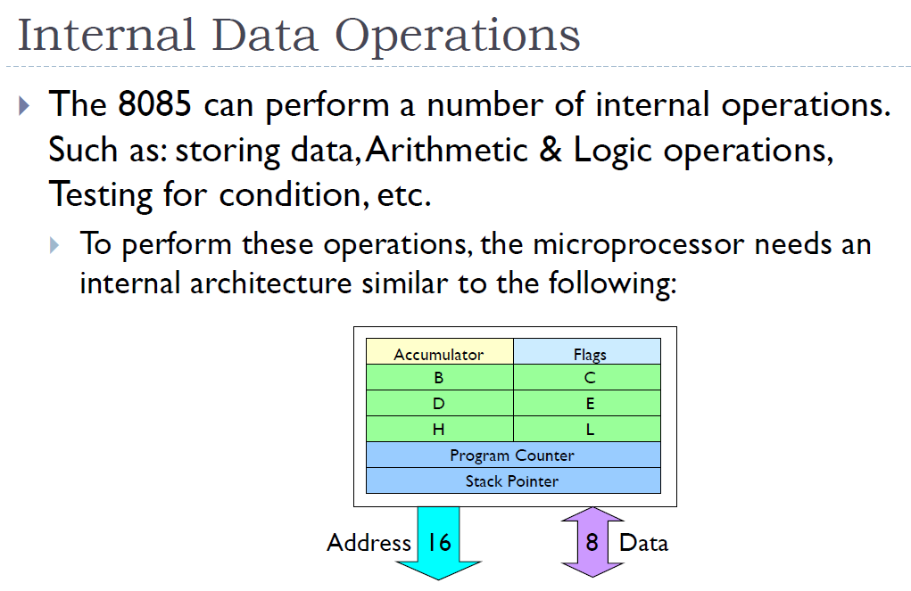
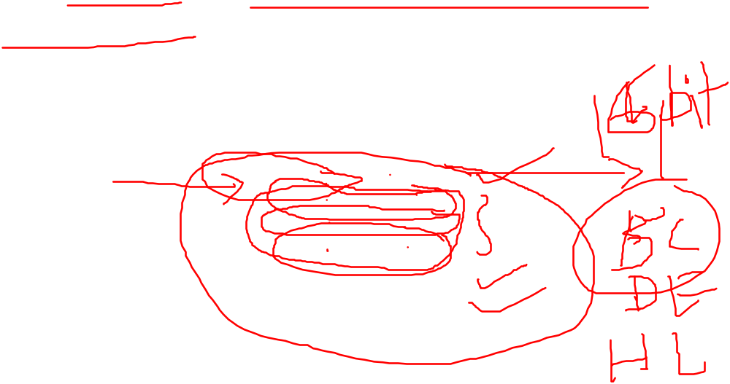

Slide 21
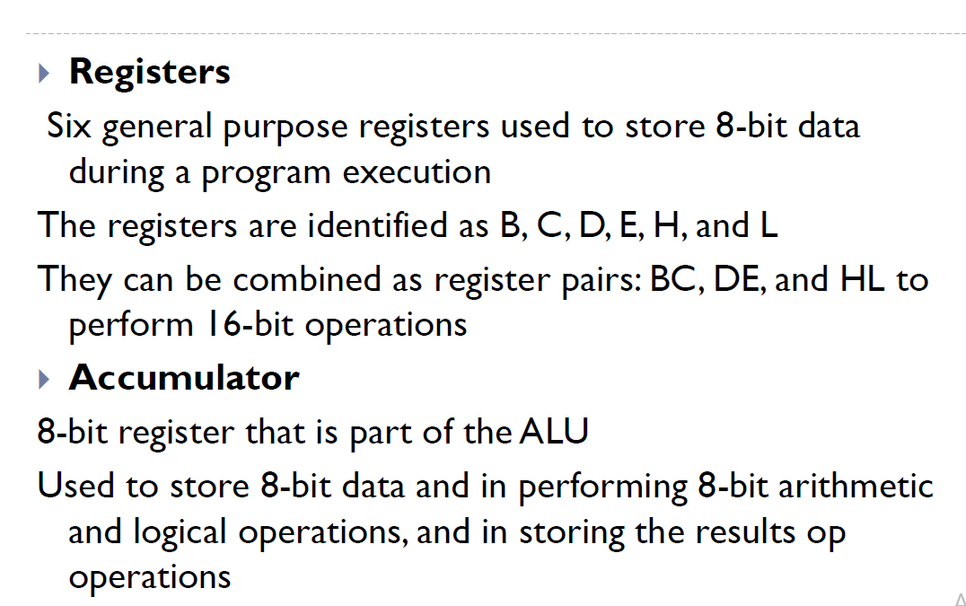

Slide 22
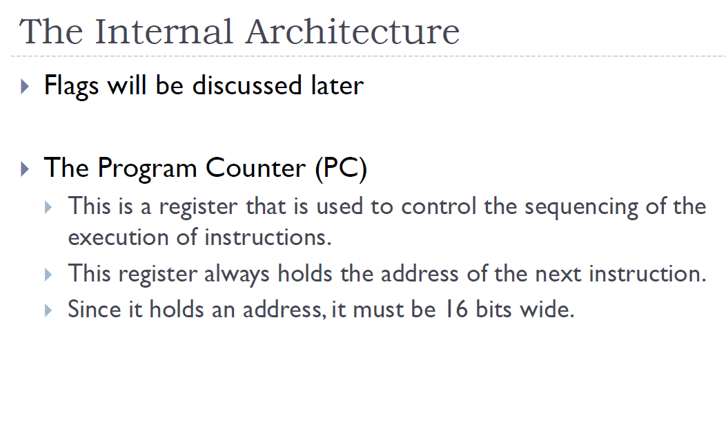


Slide 23
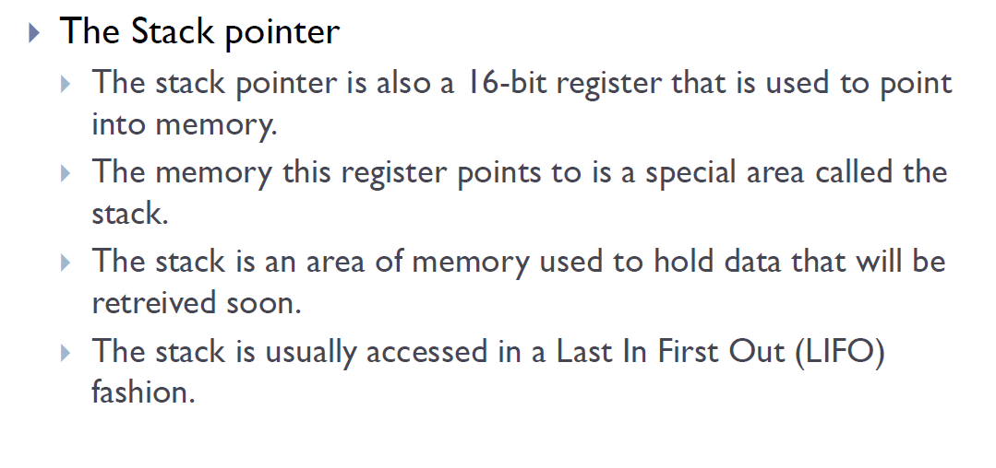


Slide 24
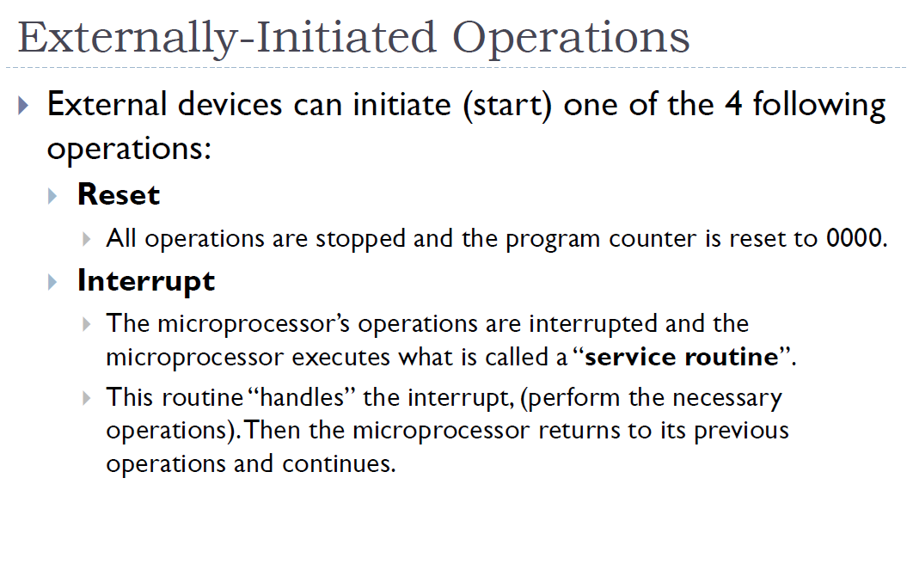


Slide 25

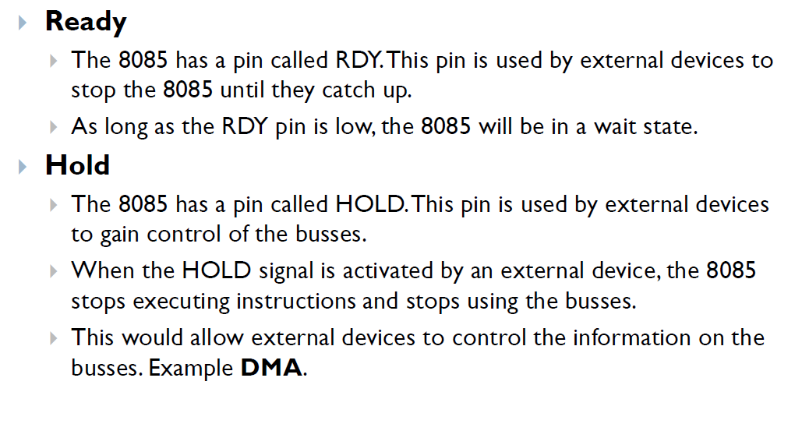

Slide 26
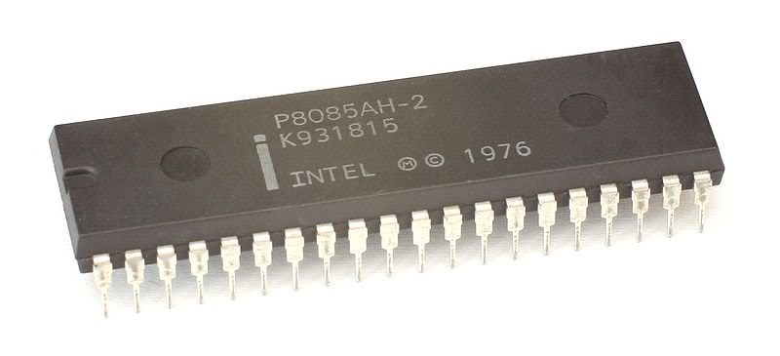

INTEL 8085

Slide 27
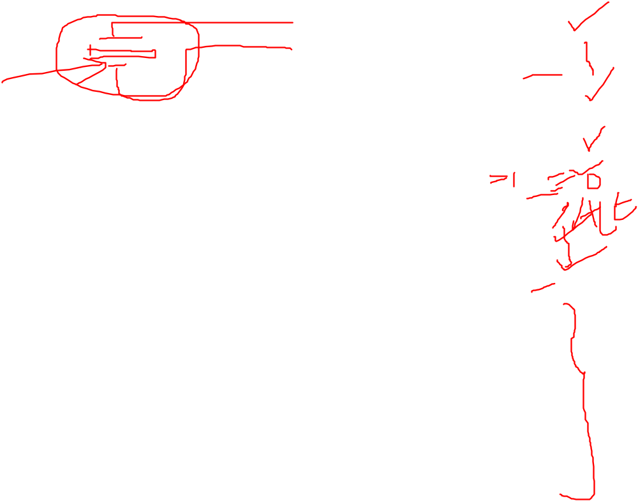
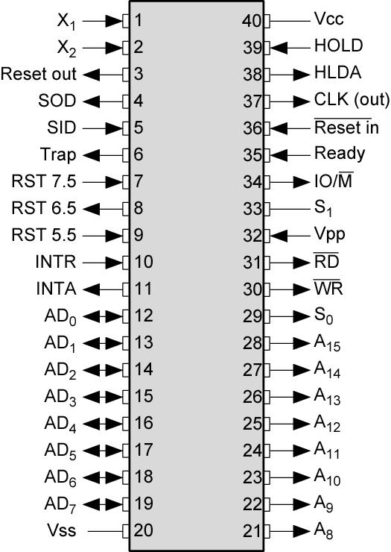

INTEL 8085 PIN
CONFIGURATION

Slide 28


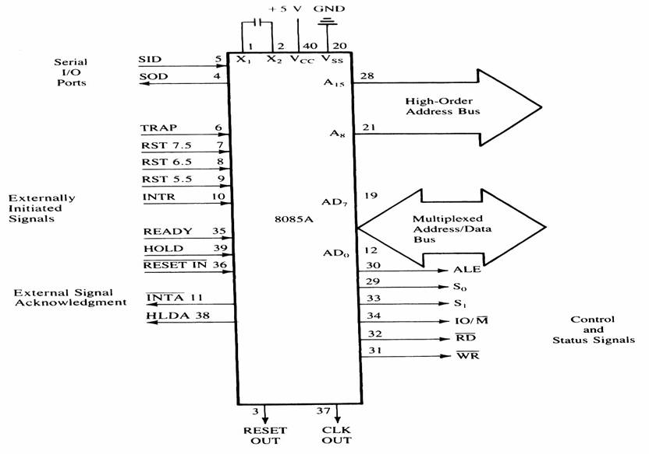





Signals and I/O Pins

Slide 29
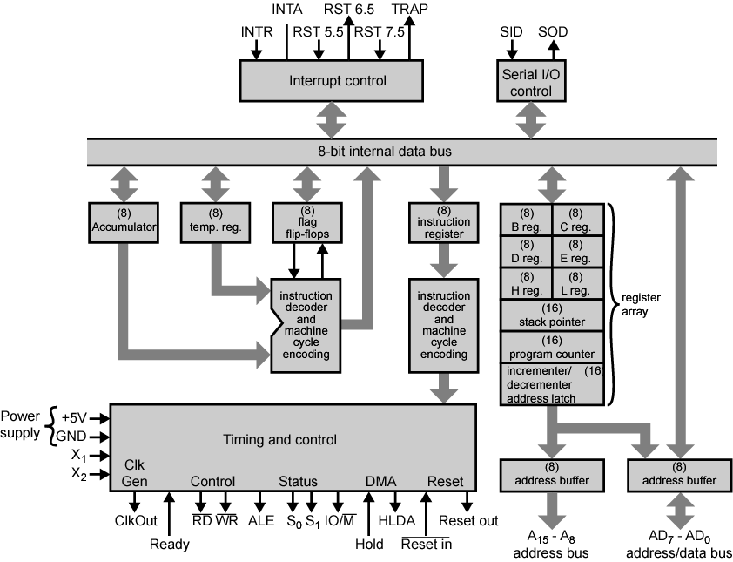









INTEL 8085 CPU BLOCK DIAGRAM

Slide 30

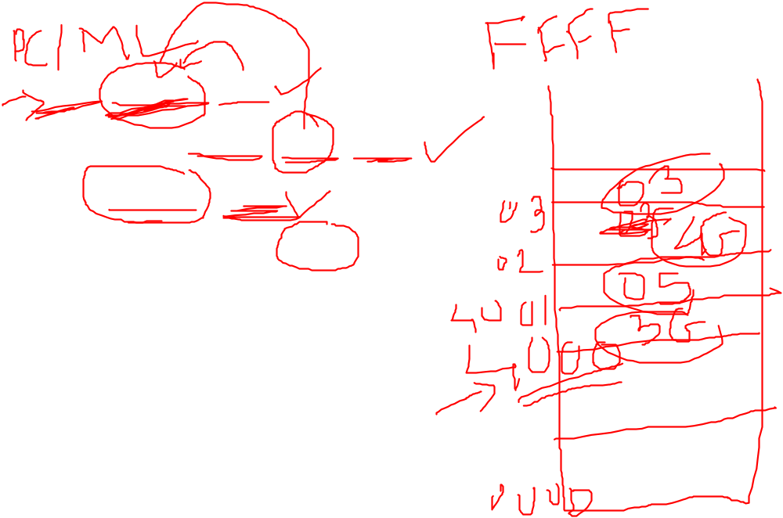



































MVI A , 05H
--------→ 4000 3G 05H
4002 MVI B , 03H
--------→ 4002 4G 03H
4004 ADD B
--------→ 4004 5G
4005 STORE C,A
--------→ 4005 6G
4007 STOP

Slide 31
THE 8085 AND ITS BUSES
The 8085 is an 8-bit general purpose microprocessor that can address 64K Byte of memory.
It has 40 pins and uses +5V for power. It can run at a maximum frequency of 3 MHz.
  The pins on the chip can be grouped into 6 groups:
    Address Bus.
    Data Bus.
    Control and Status Signals.
    Power supply and frequency.
    Externally Initiated Signals.
    Serial I/O ports.

Slide 32
THE ADDRESS AND DATA BUS SYSTEMS
The address bus has 8 signal lines A8 – A15 which are unidirectional.
The other 8 address bits are multiplexed (time shared) with the 8 data bits.
  So, the bits AD0 – AD7 are bi-directional and serve as A0 – A7 and D0 – D7 at the same time.
    During the execution of the instruction, these lines carry the address bits during the early part, then during the late parts of the execution, they carry the 8 data bits.
  In order to separate the address from the data, we can use a latch to save the value before the function of the bits changes.

Slide 33
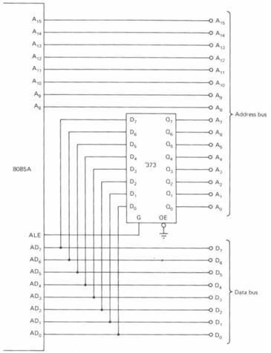
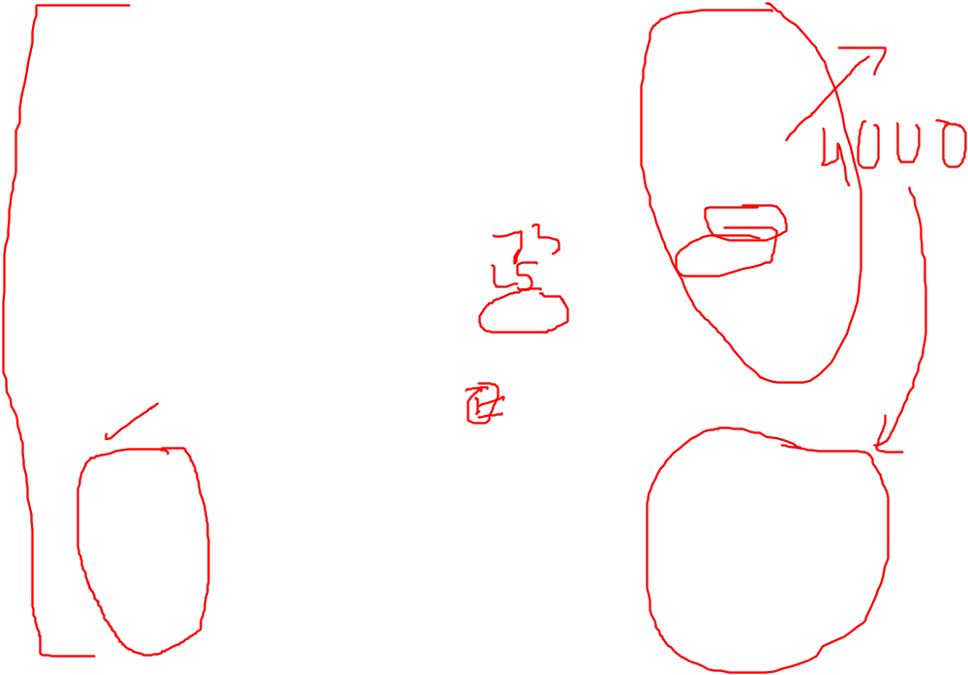
ALE USED TO DEMULTIPLEX ADDRESS/DATA BUS

Slide 34
THE CONTROL AND STATUS SIGNALS
There are 4 main control and status signals. These are:
    ALE: Address Latch Enable. This signal is a pulse that become 1 when the AD0 – AD7 lines have an address on them. It becomes 0 after that. This signal can be used to enable a latch to save the address bits from the AD lines.
    RD: Read. Active low.
    WR: Write. Active low.
    IO/M: This signal specifies whether the operation is a memory operation (IO/M=0) or an I/O operation (IO/M=1).
    S1 and S0 : Status signals to specify the kind of operation being performed. Usually not used in small systems.

Slide 35
FREQUENCY CONTROL SIGNALS
There are 3 important pins in the frequency control group.
  X0 and X1 are the inputs from the crystal or clock generating circuit.
    The frequency is internally divided by 2.
      So, to run the microprocessor at 3 MHz, a clock running at 6 MHz should be connected to the X0 and X1 pins.
  CLK (OUT): An output clock pin to drive the clock of the rest of the system.
We will discuss the rest of the control signals as we get to them.

Slide 36
THE ALU
In addition to the arithmetic & logic circuits, the ALU includes an accumulator, which is a part of every arithmetic & logic operation.
Also, the ALU includes a temporary register used for holding data temporarily during the execution of the operation. This temporary register is not accessible by the programmer.

Slide 37

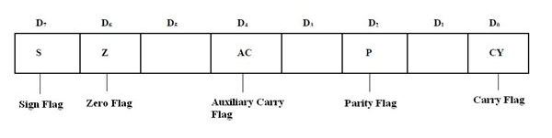
THE FLAGS REGISTER
  There is also a flag register whose bits are affected by the arithmetic & logic operations.
    S-sign flag
      The sign flag is set if bit D7 of the accumulator is set after an arithmetic or logic operation.
    Z-zero flag
      Set if the result of the ALU operation is 0. Otherwise is reset. This flag is affected by operations on the accumulator as well as other registers. (DCR B).

Slide 38

    AC-Auxiliary Carry
      This flag is set when a carry is generated from bit D3 and passed to D4 . This flag is used only internally for BCD operations.
    P-Parity flag
      After an ALU operation, if the result has an even # of 1s, the p-flag is set. Otherwise it is cleared. So, the flag can be used to indicate even parity.
    CY-carry flag
      This flag is set when a carry is generated from bit D7 after an unsigned operation.

Slide 39

Now, Let us see how the different units and bus systems stay connected:
A₁₅- A₁₀
Chip Selection
Circuit
8085
A15-A8
CS
ALE
AD7-AD0
A₉- A₀
1K Byte
Memory
Chip
Latch
A₇- A₀
WR
RD
IO/M
D₇- D₀
RD
WR

Slide 40
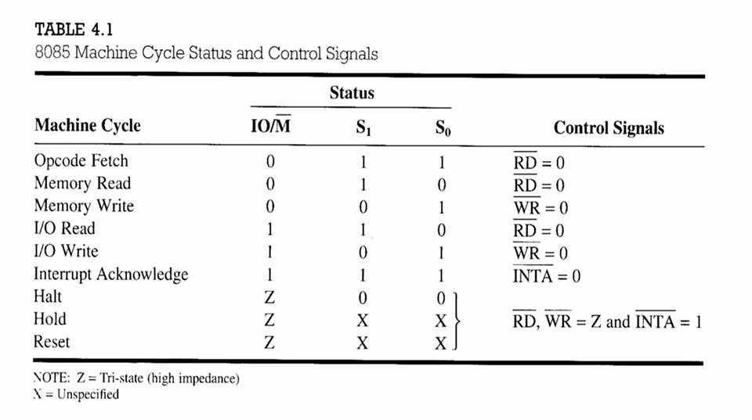

CONTROL AND STATUS SIGNALS.

Slide 41
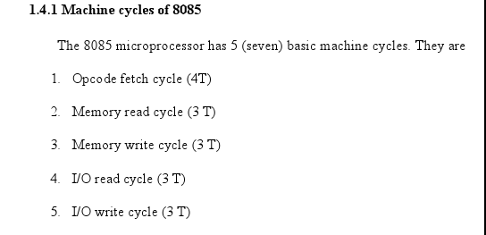

8085 MACHINE CYCLES

Slide 42
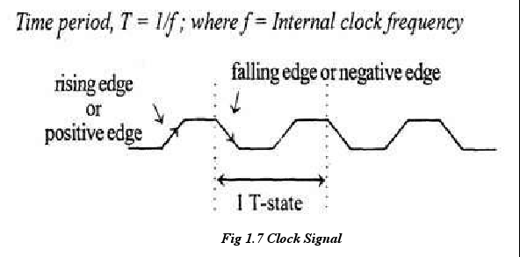
8085 MACHINE CYCLES

Slide 43
OPCODE FETCH MACHINE CYCLE
The first step of executing any instruction is the Opcode fetch cycle.
  In this cycle, the microprocessor brings in the instruction’s Opcode from memory.
    To differentiate this machine cycle from the very similar “memory read” cycle, the control & status signals are set as follows:
      IO/M=0, s0 and s1 are both 1.
  This machine cycle has four T-states.
    The 8085 uses the first 3 T-states to fetch the opcode.
    T4 is used to decode and execute it.
  It is also possible for an instruction to have 6 T-states in an opcode fetch machine cycle.

Slide 44
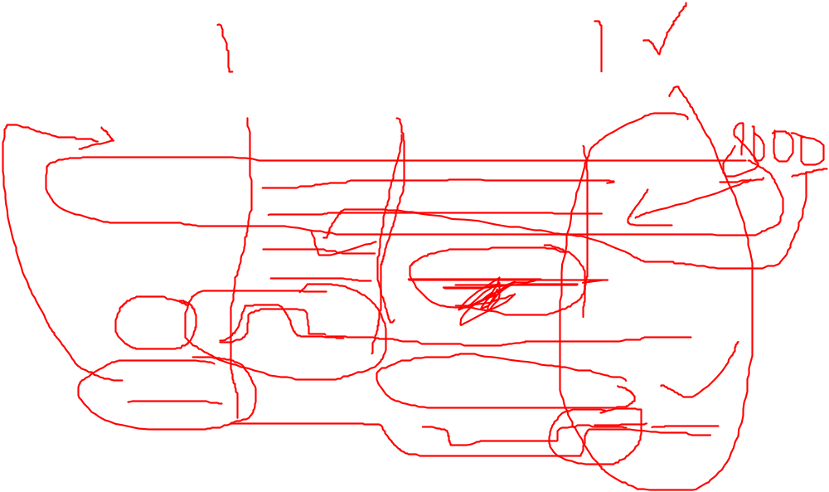
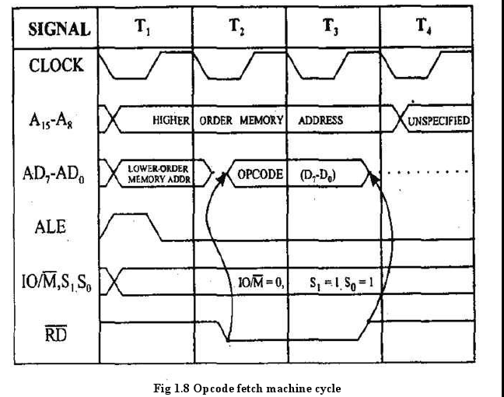
OPCODE FETCH MACHINE CYCLE

Slide 45
MEMORY READ MACHINE CYCLE
The memory read machine cycle is exactly the same as the opcode fetch except:
  It only has 3 T-states
  The s0 signal is set to 0 instead.

Slide 46

THE MEMORY READ MACHINE CYCLE
  To understand the memory read machine cycle,
  let’s study the execution of the following instruction:
    MVI A, 32
  In memory, this instruction looks like:
  The instructions which have more than one byte word size will use the machine cycle after the opcode fetch machine cycle.
    The first byte 3EH represents the opcode for loading a byte into the accumulator (MVI A), the second byte is the data to be loaded.
2000H
3E
2001H
32

Slide 47

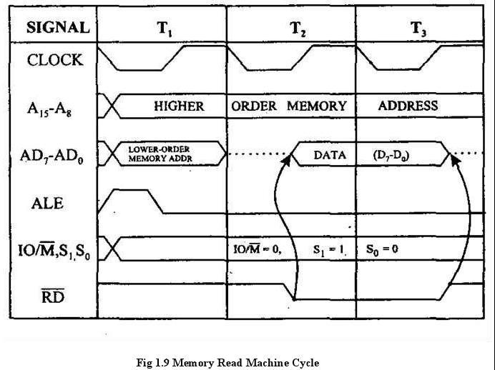
THE MEMORY READ MACHINE CYCLE

Slide 48
THE MEMORY WRITE MACHINE CYCLE
In a memory write operation:
  The 8085 places the address (2065H) on the address bus
  Identifies the operation as a ‘memory write’ (IO/M=0, s1=0, s0=1).
  Places the contents of the accumulator on the data bus and asserts the signal WR.
  During the last T-state, the contents of the data bus are saved into the memory location.

Slide 49
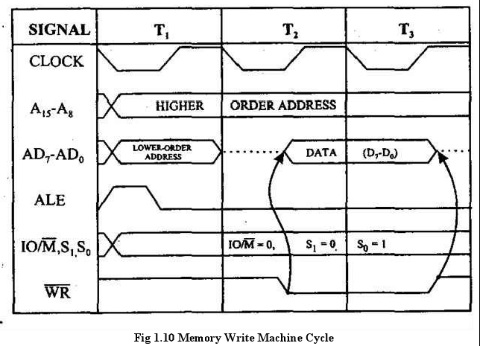

THE MEMORY WRITE MACHINE CYCLE

Slide 50
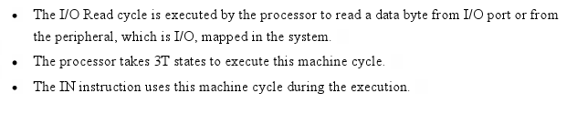
THE I/O READ MACHINE CYCLE

Slide 51
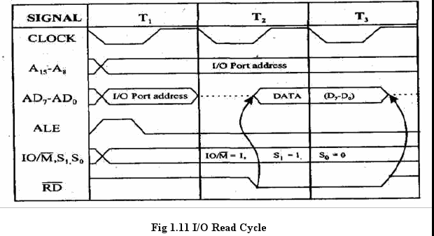

THE I/O READ MACHINE CYCLE

Slide 52
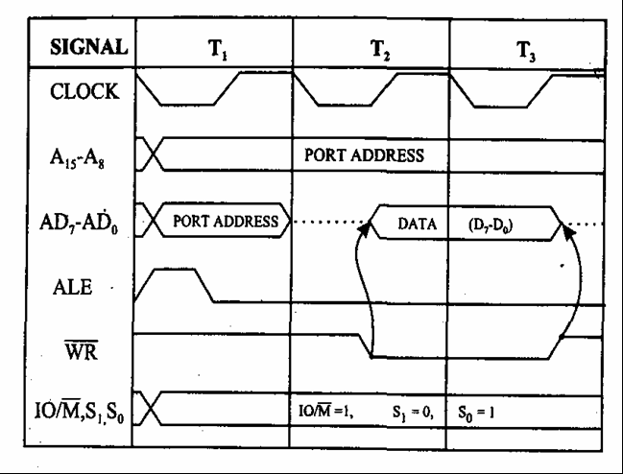

THE I/O WRITE OPERATION

Slide 53

MACHINE CYCLES VS. NUMBER OF BYTES
IN THE INSTRUCTION
Machine cycles and instruction length, do not have a direct relationship.
  To illustrate, let’s look at the machine cycles needed to execute the following instruction.
  STA 2065H
  This is a 3-byte instruction requiring 4 machine cycles and 13 T-states.
  The machine code will be stored in memory as shown to the right.
  This instruction requires the following 4 machine cycles:
  A ‘Opcode fetch’ to fetch the opcode (32H) from location
  2065H, ‘decode’ it and determine that 2 more bytes are needed (4 T-states).
  A ‘Memory read’ to read the low order byte of the address (65H) (3 T-states).
  A ‘Memory read’ to read the high order byte of the address (20H) (3 T-states).
  A ‘memory write’ to write the contents of the accumulator into the memory location.
32H
2010H
65H
2011H
20H
2012H

Slide 54
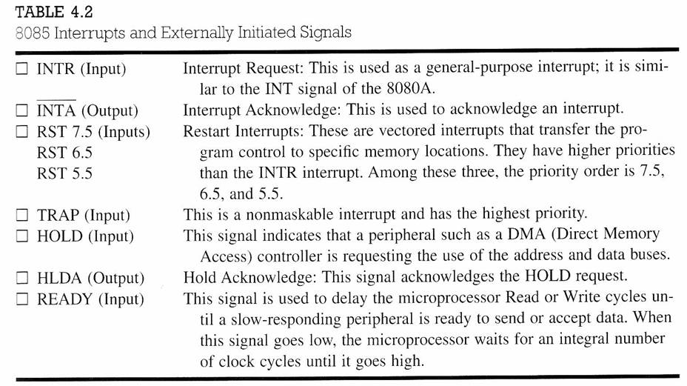
INTERRUPT SIGNALS
8085 μp has several interrupt signals as shown in the following table.

Slide 55

INTERRUPT SIGNALS
An interrupt is a hardware-initiated subroutine CALL.
When interrupt pin is activated, an ISR will be called, interrupting the program that is currently executing.
Pin | Subroutine Location
TRAP | 0024
RST 5.5 | 002C
RST 6.5 | 0034
RST 7.5 | 003C
INTR | *
Note: * the address of the ISR is determined by the external hardware.

Slide 56
INTERRUPT SIGNALS
INTR input is enabled when EI instruction is executed.
The status of the RST 7.5, RST 6.5 and RST 5.5 pins are determined by both EI instruction and the condition of the mask bits in the interrupt mask register.

Slide 57
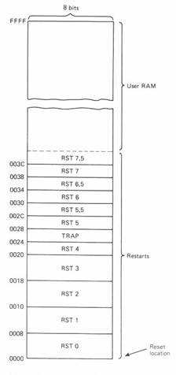

INTERRUPT VECTORS

Slide 58
RESET SIGNAL
Following are the two kind of RESET signals:
  RESET IN: an active low input signal, Program Counter (PC) will be set to 0 and thus MPU will reset.
  RESET OUT: an output reset signal to indicate that the μp was reset (i.e. RESET IN=0). It also used to reset external devices.

Slide 59
DIRECT MEMORY ACCESS (DMA)
DMA is an IO technique where external IO device requests the use of the MPU buses.
Allows external IO devices to gain high speed access to the memory.
  Example of IO devices that use DMA: disk memory system.
HOLD and HLDA are used for DMA.
If HOLD=1, 8085 will place it address, data and control pins at their high-impedance.
A DMA acknowledgement is signaled by HLDA=1.

Slide 60
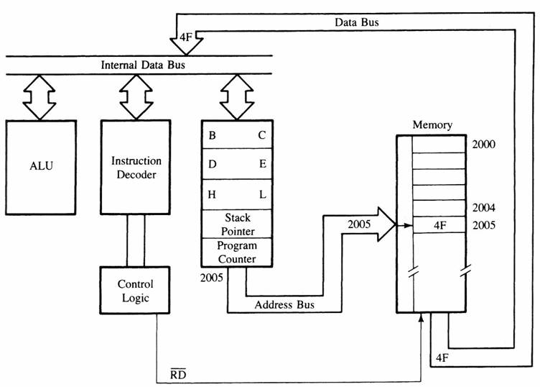
MPU COMMUNICATION AND BUS TIMING
Figure 3: Moving data form memory to MPU using instruction MOV C, A (code machine 4FH = 0100 1111)

Slide 61
MPU COMMUNICATION AND BUS TIMING
The Fetch Execute Sequence :
  The μp placed a 16 bit memory address from PC (program counter) to address bus.
    Figure 4: at T1
      The high order address, 20H, is placed at A15 – A8.
      the low order address, 05H, is placed at AD7 - AD0 and ALE is active high.
      Synchronously the IO/M is in active low condition to show it is a memory operation.
  At T2 the active low control signal, RD, is activated so as to activate read operation; it is to indicate that the MPU is in fetch mode operation.

Slide 62
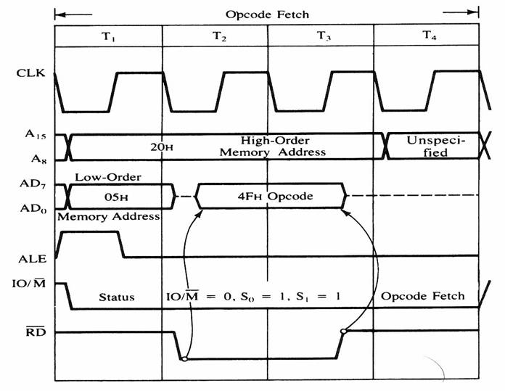
MPU COMMUNICATION AND BUS TIMING
Figure 4: 8085 timing diagram for Opcode fetch cycle for MOV C, A .

Slide 63
MPU COMMUNICATION AND BUS TIMING
  T3: The active low RD signal enabled the byte instruction, 4FH, to be placed on AD7 – AD0 and transferred to the MPU. While RD high, the data bus will be in high impedance mode.
  T4: The machine code, 4FH, will then be decoded in instruction decoder. The content of accumulator (A) will then copied into C register at time state, T4.

Slide 64


PROGRAMMING MODEL OF 8085

